Slide 1
Java 212:
Inheritance and Polymorphism

Slide 2
Chapter Objectives
Learn about inheritance
Learn about subclasses and superclasses
Explore how to override (not overload!) the methods of a superclass
Examine how constructors of superclasses and subclasses work

Slide 3
Chapter Objectives (continued)
Learn about polymorphism
Examine abstract classes
Become aware of interfaces and how to implement them
Define and make use of composition

Slide 4
Inheritance
One of the most important capabilities of OO programming.
Taking a previously existing class and adding on additional features and capabilities.
May also adjust (override) behaviors from a previously existing class.
The idea is to build new classes based on previously existing classes that have been well established, well tested and debugged
Important in software reuse – which is, as we have mentioned frequently, an important principle in software design.

Slide 5
Inheritance
We designate that a new class inherits all members and fields of a previously existing class.
Previously existing class is called the “superclass”
New class that inherits is called the “subclass”
“is-a” relationship
Subclass “is-a” Superclass
Do not conufse with the “has-a” relationship. The “has-a” relationship refers to something called composition.
“Single” inheritance - In Java, a class can only extend the definition of one class
Subclass can be derived from one and only one direct superclass.
The superclass may itself have been derived from another superclass.
A subclass can, in turn, be the superclass for future subclasses
“Multiple” inheritance
A subclass is derived from multiple superclasses
Not supported by Java
In some situations, Java programmers use inheritance to get around this limitation while avoiding some of the problems. We will not discuss these issues in this course.

Slide 6
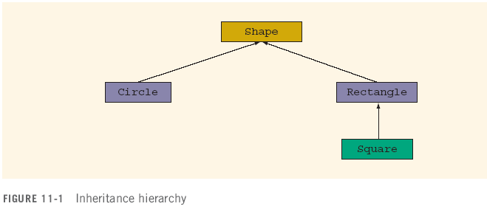
Inheritance - Overview
e.g. has a field: ‘color’
modifier(s) class ClassName extends ExistingClassName
modifier(s)
{
memberList
}

Slide 7
Subclass adds fields/methods
A subclass normally adds its own fields and/or methods. In other words, a subclass becomes a more specific or specialized group of objects.
Eg: Parent class: Shape
Child classes:
Circle (added field might include radius)
Triangle (added field(s) might include angles)

Slide 8
Direct v.s. Indirect Superclass
The direct superclass is the class from which your class explicitly inherits. The indirect superclass is any class above the direct superclass in the hierarchy.
The “top” level class in all of Java is a class called ‘Object’. All classes automatically inherit from Object. This means that any methods and fields from Object are available to all of your classes.
In this example, Rectangle is the direct superclass of Square. Shape is an indirect superclass of Square.
Can you name one additional indirect superclass of Square?
Answer: Object

Slide 9
Inheritance: class Circle is “derived” from class Shape
Terminology: The subclass is said to be derived from its superclass.
The syntax for deriving a subclass is: extends
public class Circle extends Shape
{
.
.
.
}

Slide 10
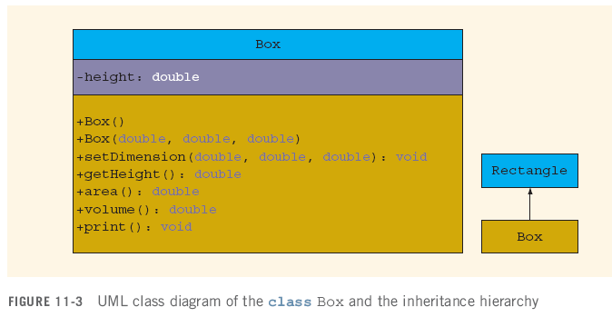
Inheritance - UML Class Diagram
A box (cube) is similar to a rectangle, but with the added dimension, ‘height’. So rather than create a whole separate class, we simply extend Rectangle and add our one additional field.
In UML, inheritance is demonstrated by an arrow that goes from the subclass to the superclass, with a solid arrowhead.

Slide 11
class Rectangle
private length;
private width;
public void print()
{
System.out.print("Length = " + length);
System.out.print("Width = " + width);
}
public void setDimension(double l, double w)
{
length = l;
width = w;
}
Other methods…
Part of a hypothetical Rectangle class

Slide 12
Methods in class Box
public void print()
{
super.print();
System.out.println("Height = " + height);
}
public void setDimension(double l, double w, double h)
{
super.setDimension(l, w);
height = h;
}
public double area()
{
return 2 * (getLength() * getWidth()
+ getLength() * height
+ getWidth() * height);
}
We overloaded the method setDimention() overrode the methods print() and area().

Slide 13
Another Example:
Consider a class used by a company called ‘Person’ which has fields for first and last name, street address, city, zip code. Suppose that at some later point your company wants a class to keep track of your employees. You would want to keep track of information such as first name, last name, address, pay rate, id number. Rather than creating a new class with redundant information, proper OO programming says you should simply extend the Person class.
public class Person
{
private String firstName;
private String lastName;
private String city;
//other fields, constructors, methods, etc
...
}
public class Employee extends Person
{
private double payRate;
private String idNumber;
//other fields, methods, etc
}

Slide 14
Inheritance Rules (important)
* The private members of the superclass are private to the superclass (i.e. even the subclass can not access them directly)
The subclass can still directly access the public members of the superclass
The subclass can include additional fields and methods
In fact, it typically has additional fields and/or methods. This is basically the whole point of extending a class.

Slide 15
Inheritance Rules (continued)
4. * The subclass can override, that is, redefine any public methods of any superclass
Ie: You can write a method with the exact same identifier, and number/types of parameters
However, this redefinition applies only to the objects of the subclass, not to the objects of the superclass
In other words, which version of the method gets invoked, depends on whether the calling object is of the subclass type or one of the superclasses
Do not confuse override with overload!
5. All data members of the superclass are also data members of the subclass (even if private)
Similarly, all methods of the superclass (unless overridden) are also available as methods of the subclass
Don’t forget the visibility rule (see rule #1 previously) when accessing a member of a superclass from inside a subclass

Slide 16
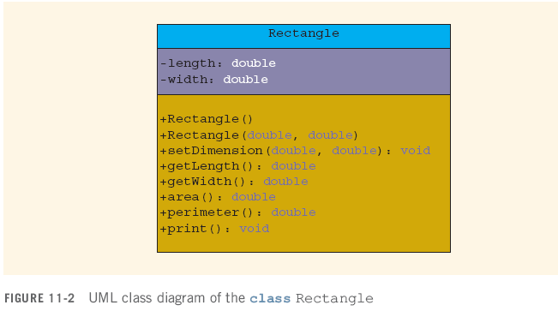
UML Class Diagram: class Rectangle

Slide 17
UML Class Diagram: class Box
* Note that the methods print() and area() have been overridden from the superclass.

Slide 18
Overriding Methods (important)
Recall the concept of overloading: This is when we have 2 or more methods with the same identifier but with different number/types of parameters.
Overriding is not the same thing…
Again, we know that it is not possible to have two methods in a class, both with the exact same signature. However, it is possible for a method of a subclass to have the identical signature as a method of the parent class. Why does this work?
Suppose you have a method called doStuff() in a parent class. If your object invokes that method, Java will first look for the method in the current class. If Java does not find it, it will look for that method in the immediate superclass, then the parent class, the grandparent class, all the way up to the class Object. If at any point it finds the method with the proper signature, that method will be invoked. If Java never finds the method, it will return an error.

Slide 19
Overriding Methods contd.
Consider the code below (files are on the class web page):
Employee e = new Employee();
e.anotherUselessMethod();
Java will first look for anotherUselessMethod() in the Employee class. It will not find the method there, so it will then look in the superclass. There it does find the method, so that method is invoked.
Now consider:
e.uselessMethod();
uselessMethod() exists in both the class Employee and in the superclass, Person. Notice also that they have the exact same signature. However, because Java begins by looking in the current class, the version of uselessMethod() that is invoked, will be the one from class Employee. In this case, the version of the method that was in the derived class (Employee) overrode the version of the method that was in the parent class.

Slide 20
* Invoking a superclass’ method using ‘super’
There will be many times where you will want to invoke an overridden method from your superclass. For example, consider the print() method in our Rectangle class:
public void print()
{
System.out.print("Length = " + length);
System.out.print("Width = " + width);
}
In our Box class, we want to output all of this information, and just tack on the height field. Remember, however, that we do not like to copy code. Instead, we always aim for ‘code reuse’. To do this, we invoke the superclass’ method from within our subclass by using the keyword ‘super’:
public void print()
{
super.print();
System.out.println("Height = " + height);
}
find the method, so that method is invoked.

Slide 21
Inheritance – Two more rules:
If a method of a class is declared final, it cannot be overridden with a new definition in a derived class
In a similar manner, you can also declare a class to be final using the final keyword
If a class is declared final, then no other class can be derived from this class

Slide 22
Defining Constructors of the Subclass – using “super()”
Because a derived class typically inherits one or more fields from parent class(es), we may want to have our derived class’ constructors initialize the inherited fields, as well as its own new/added fields. Now, you could go ahead and initialize all of the fields from parent classes explicitly in your derived class’ constructor, but it is usually better form to invoke the constructor or the parent class. Remember: Code Reuse! One of the reasons for this is that the parent class may, in turn, have invoked constructors of its own parent class, and so forth. The reserved word super() invokes the parent class’ constructor. You can also invoke any constructor that has parameters in this way. eg: from our Employee class:
super(“Frankie”, “Vallie”);
Calling the constructor of the superclass:
Must be first statement in the method
Specified by: super( parameter list )
public Box()
{
super();
height = 0;
}
public Box(double l, double w, double h)
{
super(l, w);
height = h;
}

Slide 23
Important:
Constructors of a subclass can and should (directly) initialize only the fields of the subclass.
Initialization of fields from the superclass should be carried out by invoking the constructor of the superclass.

Slide 24
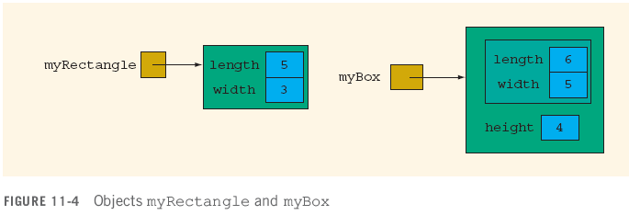
Objects myRectangle and myBox
Rectangle myRectangle = new Rectangle(5, 3);
Box myBox = new Box(6, 5, 4);

Slide 25
Explicitly invoking a method from the superclass:
There may be a time when you have overridden a method in your derived class, but find yourself, for whatever reason, wishing to invoke the version that was in your parent class. This time you can use the word super – but not as a method. Instead, super gives you a way to reference the superclass. Inside any method of your derived class, you can invoke a parent method by saying:
super.doStuff();
//invokes the version of doStuff() from the parent class
Example: See the method toString() from our Employee class and note how it references the same method from the superclass.

Slide 26
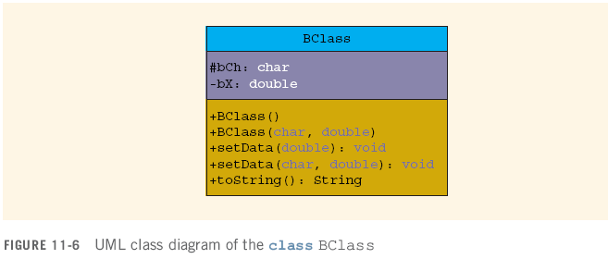
protected Visibility
Recall that subclasses can not access private data from a superclass.
Giving a field a visibility of ‘protected’ means that subclasses can directly access that field.
In UML diagrams, ‘protected’ is denoted by a # sign
public is denoted by a ‘+’
private is denoted by a ‘-’

Slide 27
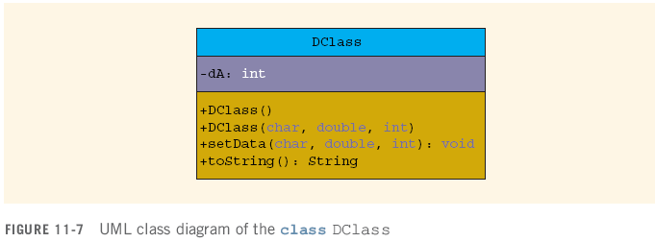
Protected Members of a Class (continued)
So, protected visiblity allows for the possibility of changing the state of an object to something invalid. Recall that this is precisely the issue we are trying to avoid by giving fields private visibility. For this reason, we do not use protected visibility very often.

Slide 28
No modifier = ‘package’visibility
If you do not specify a visiblity, then your field has “package” access
This means that any class within the same package can access the fields directly.
However, if a subclass is in a different package, it will not have direct access to a ‘packge’ visibility field.

Slide 29
class Object
class Object is directly or indirectly the superclass of every class in Java
public members of class Object can be overridden/invoked by object of any class type
We have already done this when we overrode toString and equals in our user-defined classes

Slide 30
The class Object contd
ALL classes extend Object. You do not need to specify it.
public class Clock
{
//Declare instance variables as given in Chapter 8
//Definition of instance methods as given in Chapter 8
//...
}
public class Clock extends Object //not necessary
{
//Declare instance variables as given in Chapter 8 //Definition of instance methods as given in Chapter 8
//...
}

Slide 31
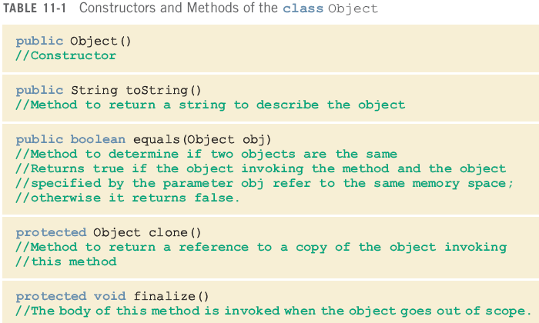
Some Constructors and Methods of the class Object
In other words, in our user-defined classes, we have been overriding toString() method all this time – we just didn’t realize it.

Slide 32
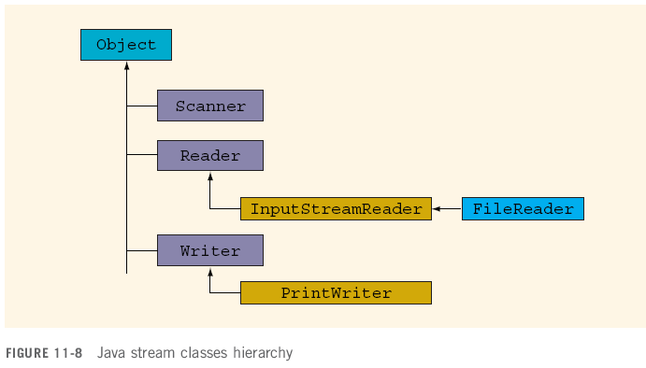
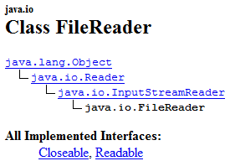
An Example: Hierarchy of Java Stream Classes
From the FileReader API:
Eg: see API for FileReader class

Slide 33
FileReader class’ Inherited Methods
Inherited from class Object (10):
clone(), equals(Object b), finalize(), getClass(), hashCode(), notify(), notifyAll(), toString(), wait(), wait(long timeout), wait(long timeout, int nanos)
Inherited from class Reader (6):
close(), mark(int readAheadLimit), markSupported(), read(), read(char[] cbuf), read(char[] cbuf, int offset, int len), read(CharBuffer target), ready(), reset(), skip(long n)
Inherited from class InputStreamReader (5):
close(), getEncoding(), read(), read(char[] cbuf, int offset, int length), ready()
Additional methods added by FileReader:
None
One field is added ( ‘lock’ )

Slide 34
Proof of Inerhitance from Object
As stated, all classes inherit from Object. This takes place automatically even though we don’t explicitly write ‘extends Object’.
Here is an example of our StudentRecord2 class invoking a method from the Object class.
StudentRecord2 s = new StudentRecord2();
System.out.println( s.hashCode() );

Slide 35
* Polymorphism
Java allows us to treat an object of a subclass as an object of its superclass
In other words, a reference variable of a superclass type can point to an object of its subclass
This is a case where you must clearly distinguish objects vs references
Draw them out on paper if need be…
Person person, personRef;
Employee employee, employeeRef;
person = new Person("John", "Blair");
employee = new Employee("Susan", "Johnson",
12.50, "453454“);
personRef = employee; //this is LEGAL
System.out.println(“personRef: " + nameRef);
//will use the toString() method of the Employee class
See next slide...

Slide 36
new Person()
person
This object is a Person (only)
firstName = John
lastName = Blair
new Employee()
emp
This object is both an Employee AND a Person
firstName = Susan
lastName = Johnson
payRate = 12.50
idNum = 453454
personRef
*** The second object was instantiated as an Employee. However, because every employee is also a (“IS-A”) person, the reference ‘personRef’ can validly refer to it.

Slide 37
“Polymorphic” References
The fact that reference variables can potentially point to different object types is why some references are described as being “polymorphic”.
A polymorphic reference is a reference that can be described as more than one type of object.
Eg: personRef can be described as either a Person object or as an Employee object. It is therefore, a polymorphic reference.
The reference variable person or personRef can point to any object of the class Person or the class Employee

Slide 38
Polymorphism – Late Binding
The term polymorphism means assigning multiple meanings to the same name
In Java, polymorphism is implemented using “late binding”
“Late Binding” or dynamic binding (run-time binding)
Which method gets executed, the superclass or derived class is determined when the program is executed, not when it is compiled.
There is also a corresponding ‘early’ or ‘compile-time’ binding

Slide 39
** Polymorphism (continued)
So: We know that an object (reference) of a superclass can always point to an object of its subclass. However the opposite does not hold true.
That is, a reference to a subclass can not always point to object of its superclass. If you wish to do so, you must cast the subclass reference.
Person p1, p2;
Employee e1, e2;
p1 = new Person();
e1 = new Employee();
p1 = e1; //Okay
e2 = p2; // Illegal!!

Slide 40
Polymorphism: Using “Is-A”
** Ask yourself:
1. What is the datatype of the reference? (e.g. The datatype of p1 is ‘Person’)
2. Is the object being pointed to the same as the reference (whether by its current class or by a parent class)? (e.g. p1 is pointing to an Employee object. However, since every Employee object IS-A Person, then p1 is indeed pointing to Person object).
However: The datatype of e2 is Employee. It is pointing to a reference/object of type Person. While it IS true that an Employee IS-A Person, it is NOT true that a Person IS-A Employee. So e2=p2 is illegal.
Person p1, p2;
Employee e1, e2;
p1 = new Person();
e1 = new Employee();
p1 = e1; //Okay
e2 = p2; // Illegal!!

Slide 41
Polymorphism (continued)
Suppose that p1 is a reference variable of a superclass type; moreover, suppose that p1 points to an object of its subclass
You can use an appropriate cast operator on p1 and make a reference variable of the subclass point to the object
Person p1;
p1 = new Employee();
Employee e1;
e1 = (Employee) p1;
//legal (though confusing!)
Again: This works because supRef (currently) points to an Employee object.
However, we do first have to cast supRef to en Employee.

Slide 42
Polymorphism (continued)
On the other hand, if p1 does not point to a subclass object and you try use a cast operator on p1, then Java will throw a ClassCastException—indicating that the class cast is not allowed
Person p1;
p1 = new Employee();
Employee e1;
e1 = (Employee) p1; //illegal!

Slide 43
Polymorphism - instanceof
The operator (not method) instanceof determines whether a reference variable that points to an object is of particular class type
p instanceof BoxShape
This expression evaluates to true if p points to an object of the class BoxShape; otherwise it evaluates to false
if ( e1 instanceof Employee) ...

Slide 44
Abstract Classes
Used in OO design, typically as part of an inheritance tree
The class that is declared with the reserved word abstract in its heading: eg public abstract class Shape { …
An abstract class can contain instance variables, constructors, finalizer, and non-abstract methods. (Compare with an interface in which all methods must be abstract and can not contain class member fields).
An abstract class often contains “abstract method(s)” (see next slide)
If a class contains even ONE abstract method, then the entire class must be declared abstract
You cannot instantiate an abstract class.
You can declare a reference variable to an abstract class type
What is typically seen is a subclass that derives from the abstract class. To do so, however, the subclass must provide definitions for all the abstract methods of the superclass (just like with inheritance).
This derived (i.e. sub) class can be instantiated.

Slide 45
Abstract Methods
Abstract method: method that has only the heading with no body
Must be declared abstract (though not within interfaces).
public void abstract print();
void abstract insert(int insertItem);

Slide 46
Abstract Class Example
public abstract class AbstractClassExample
{
protected int x;
public void abstract print();
// The presence of this one abstract method
// means that this class must be declared as
// an abstract class.
public void setX(int a)
{
x = a;
}
public AbstractClassExample()
{
x = 0;
}
}

Slide 47
Why have abstract classes?
Typically used as superclasses from which other subclasses can be derived
Serve as placeholders to store fields that you want to have common to various subclasses
Can be used to force subclasses to implement certain methods

Slide 48
** Composition
Another way of relating two classes
One or more members of a class are objects of another class type
“Has-A” relationship between classes
e.g. Every PersonalInfo HAS-A Date” (see next slide)
Do not confuse with Is-A relationship between classes!
“Is-A” - Useful when thinkng about inheritance
e.g. Every Employee IS-A Peron

Slide 49
Composition - Example
Suppose we wanted to record personal information about somebody. We might want to keep track of their id number, first name, last name and date of birth. For such a simple task, we might confine ourselves to a single class. However, suppose you already had a Person class with fields for first name and last name. You then wanted to add fields for birth date and id number.
Note: You would not want to go back and make changes to the Person class since people using the original version of your class would suddenly find all kinds of new fields and methods and their legacy code will no longer work as expected. Instead, we will create another class called ‘PersonalInfo’ which includes our additional desired fields.
Suppose we remember that we have already created a class we called ‘Date’ which encapsulates date information (ie: month, day, year).
Instead of rewriting all of this code into our PersonalInfo class, we will simply include a Date object as one of the fields.
Now we can create our ‘PersonalInfo’ class. We wish to record name information, birthdate information, id number. To do so, we will use these fields:
int personId: to record the id number
Person name: to encapsulate name information
Date bday: to encapsulate birthdate information

Slide 50
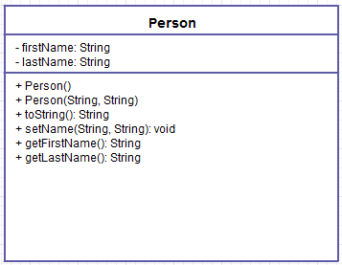
UML for Person class
This diagram was created online at http://creately.com/app/

Slide 51
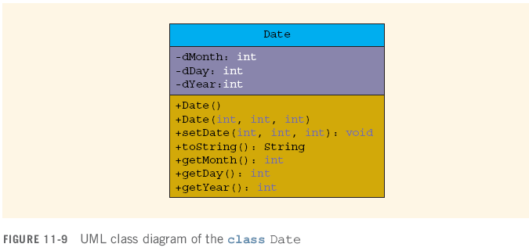
UML for Date class

Slide 52
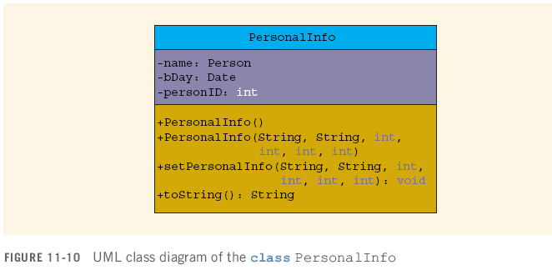
UML for PersonalInfo class

Slide 53
Now experiment
Open these classes in a text editor and examine them.
Then play around by instantiating PersonalInfo objects and modifying their data.
You may get stuck a couple of times, but as you experiment, you’ll begin to get the hang of things and improve your understanding of OO programming using composition.
This is a very important topic.

Slide 54
Chapter Summary
Inheritance
Single and multiple
Rules
Uses
Superclasses/subclasses (objects)
Overriding/overloading methods
Constructors
The class Object

Slide 55
Chapter Summary (continued)
Java Stream Classes
Polymorphism
Abstract methods
Abstract classes
Interfaces
Composition

