Slide 1
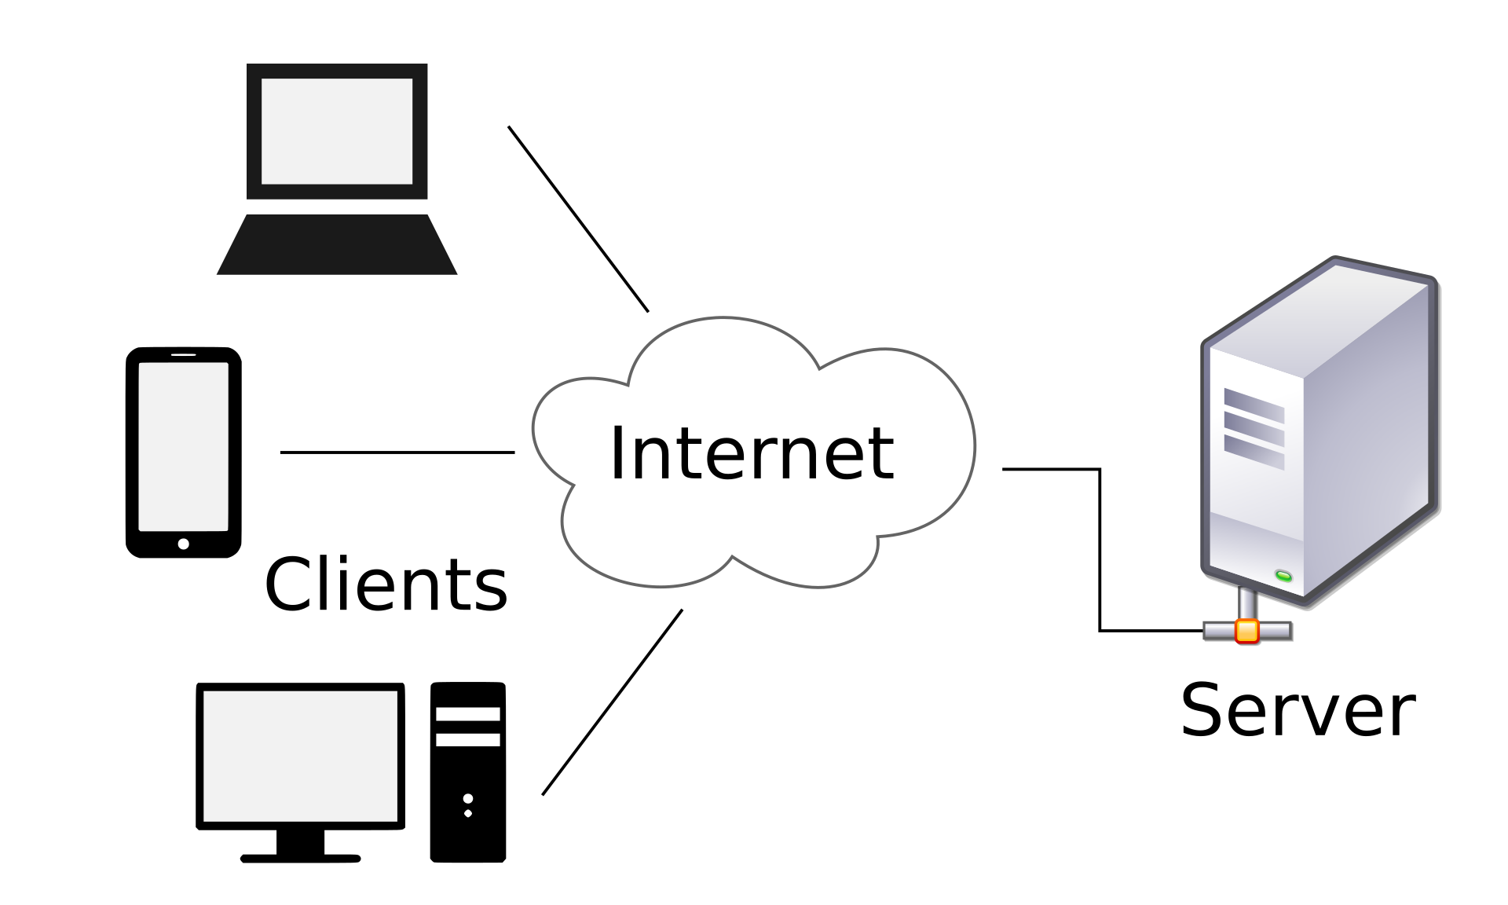
Web Clients & Servers
The HTTP Protocol
Notes:
Image from Wikipedia: https://en.wikipedia.org/wiki/Client%E2%80%93server_mode

Slide 2

Learning Objectives
Understand and be able to explain:
  The purpose of an HTTP (i.e. web) server and client.
  What is meant by a protocol in terms of the world wide web.
  Explain where HTTP requests and HTTP responses are generated, and list at least 2 important pieces of information that they contain.
  The basics of the process that occurs when a web client requests a resource from a web server.
  The breakdown of a URL (web address).

Slide 3
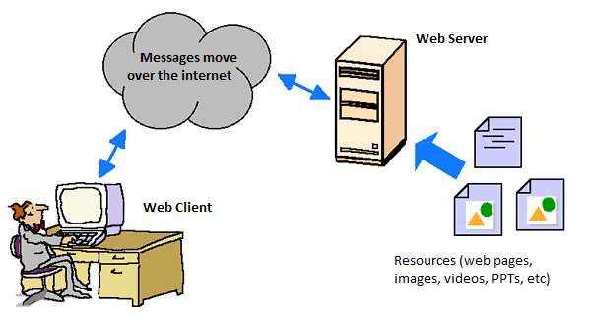
Requesting a page - Overview
A web client (usually in the form of a web browser) requests some kind of resource (e.g. a web document) from a specific web server.
The web server, a computer connected to the internet running web server software, receives the request and sends back the requested resource which is usually – though not always -- an HTML document (i.e. a web page).
The web client examines the returned object.
  If the resource is an HTML document, the client parses the file and renders (displays) it on the screen.
  If the resource is a file that the browser “understands” (jpeg images, gif images, mp4 videos, etc.), the client will play/display the resource.
  If the resource is a type of file that the client is unable to recognize (e.g. an Excel spreadsheet), the client will offer the option of saving it to your computer, or to open it in its native application (e.g. Microsoft Excel).

Slide 4
Requesting a Resource: Overview

Slide 5
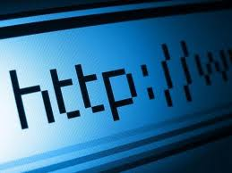
The Protocol: HTTP
Stands for “hypertext transfer protocol”
  (You don’t need to memorize this!)
A protocol is a series of rules and standards that are agreed to by a committee or organization.
For the web, HTTP is the protocol used that enables effective communication between web clients and web servers.

Slide 6
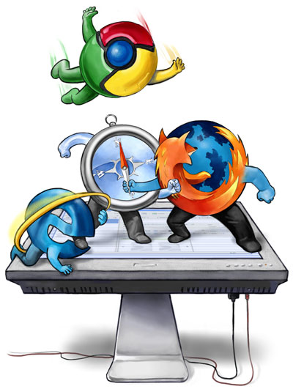
HTTP Client
Nearly always a web browser – but does not have to be!
Software that is used to:
  generate HTTP requests
  send those requests to an HTTP server
  interpret the HTTP response that is provided by the server
From Wikipedia:
  An HTTP client uses HTTP to connect to a web server over the Internet to transfer documents or other data. The most well known types of HTTP Clients include web browsers.
Examples: Firefox, Safari, Chrome, etc.

Slide 7
HTTP Server
This is software (a program). It is not a computer.
  However, you do need a computer to run the http server software!
  That being said, because the computer running the server software is typically dedicated exclusively to that task, we frequently call the computer the server, even though it is not strictly accurate.
  HTTP server software is entirely different software than HTTP client software.
The web server software:
  “listens” for incoming requests from HTTP clients
  “parses” (reads & interprets) that request
  sends out an http response
  Typically, this response includes sending a document or other resource back to the web client (aka ‘http client’)
Examples of http server software include Apache HTTP Server, Oracle HTTP Server, Microsoft Internet Information Services.

Slide 8
Overview: How to set up a web server
Have a computer to act as a web server with a large enough hard-drive to store all the resources (HTML documents, images, videos, PDF files, etc, etc) that you wish to make available on the web.
Ensure your computer is connected to the internet.
Install web server software (e.g. Apache HTTP Server).
Configure the web server (takes a little bit of know-how)
Upload all of the resources you wish to make available to the web server.
  This requires use of a file transfer protocol which we will learn about a little bit later.

Slide 9
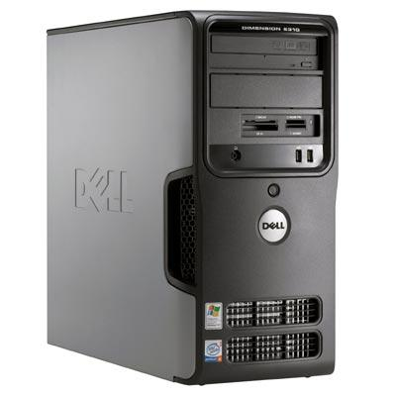
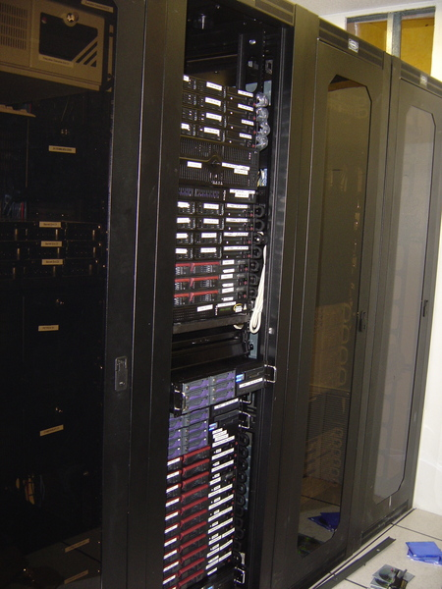
The Server Computer
Have a computer that will act as your web server. I.e. A computer that is running web server software and that has all of the resources you wish to make available stored on a connected hard drive or database.
The busier the site, the more powerful the computer(s).
A server can be as simple as your desktop/laptop – again, provided that you have installed web server software on to it.
Very large, and busy sites (e.g. Google, Microsoft) will have multiple redundant computers running server software all over the world.

Slide 10
The Server Software
Software that is constantly running (24x7) and patiently listening for incoming HTTP requests.
Once a request from a web client comes in, the server interprets ("parses") the request, and responds by sending back an HTTP response along with the requested resource (if available).
  The resource might be a web page (html document), video, PDF, Amazon product search, etc, etc.
Several software companies publish web server software
  Some of the better known server software programs include:
    Apache HTTP Server
    Microsoft IIS (Internet Information Services)

Slide 11
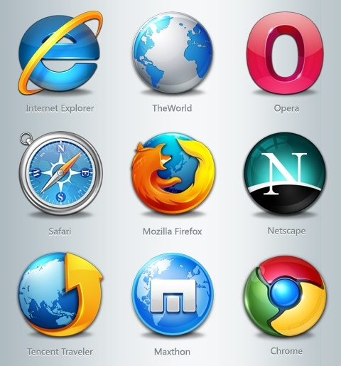
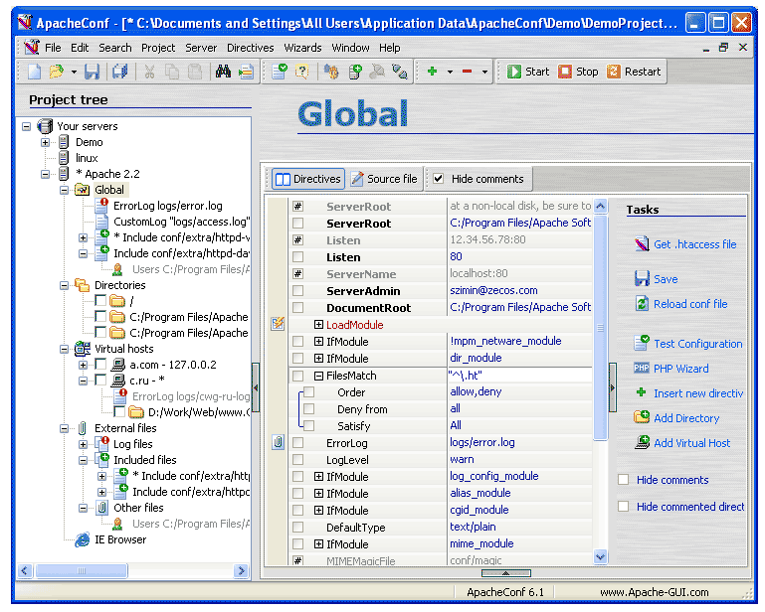
Client sends a request to the server.
Server sends a response back to the client.

Slide 12
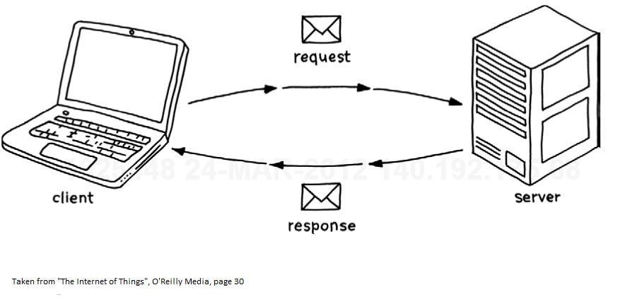
The Request/Response Process

Slide 13
The HTTP Request object
When you type a URL, say, for the syllabus of this course, your HTTP client (browser) creates something called an ‘HTTP request object’.
This request from the web client sitting in front of you is then routed (via a process we will not discuss here) over the internet to the appropriate HTTP server that was specified in your request.
  For the class web page, this server lives somewhere in downtown Chicago
The HTTP request contains all kinds of information that the server may need to know:
  The name of the resource being requested
  The time the request was made
  The “return address” (the internet address of the http client)
  The type/name of the http client (e.g. Pocket Safari for iPhone)
  etc.

Slide 14
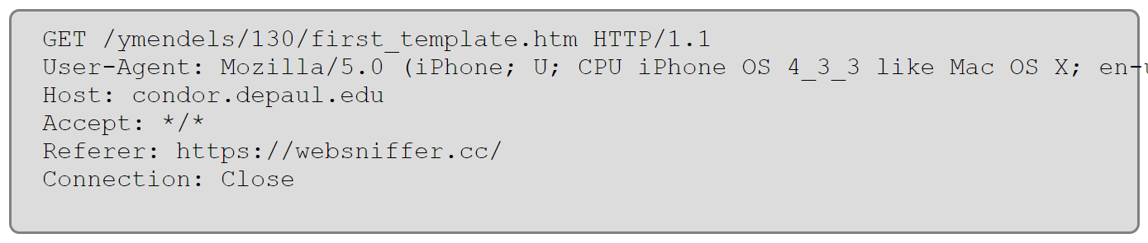
Example of an http request header
I would like to retrieve the file first_template.html from the course web page. The URL to this file is:
  http://condor.depaul.edu/ymendels/130/first_template.html
  The name of this web server is condor
  The web server lives in a domain called depaul.edu
  The resource is stored in a folder called ymendels and is inside a subfolder called 130
  The requested resource is called first_template.html
When I type the URL into my client, the client generates an HTTP request object. Part of this object is shown here:

Slide 15
The HTTP Response object
Once the server has received and parsed the http request, it answers by generating an http response. This response includes:
  A status line: e.g. ‘OK’ or ‘ERROR-404’
  A header with information such as the type of document being returned (JPG, MPG, HTML, etc.)
  The response object is packaged with the resource that was requested.
    This resource is commonly, but by no means always an ‘html’ document
    It can be other things such as an image, a request for a video on You Tube, etc.

Slide 16
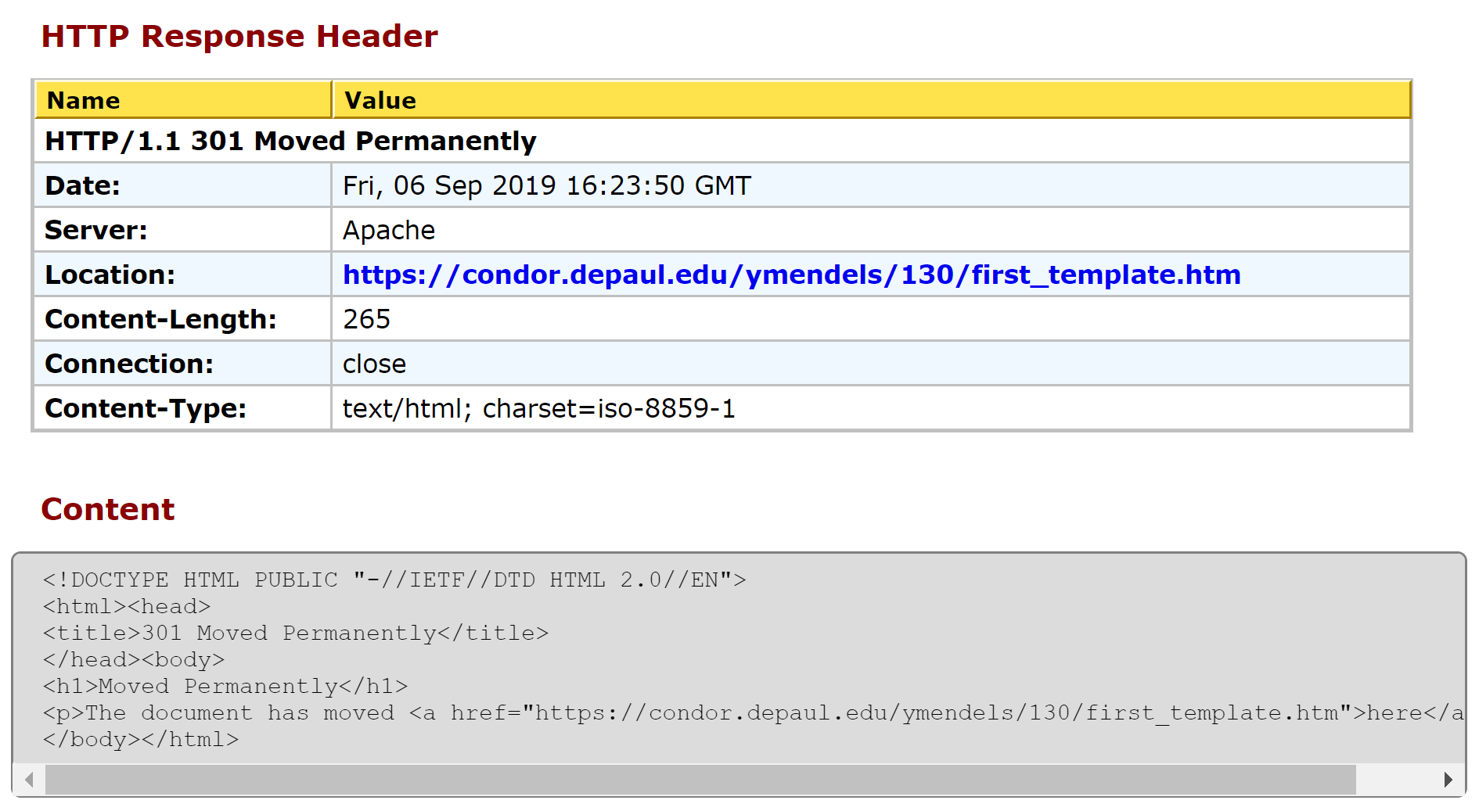
The HTTP Response Object and Resource
This is what is sent from the server back to the client:

Slide 17
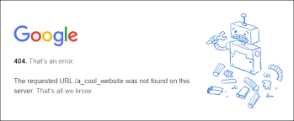

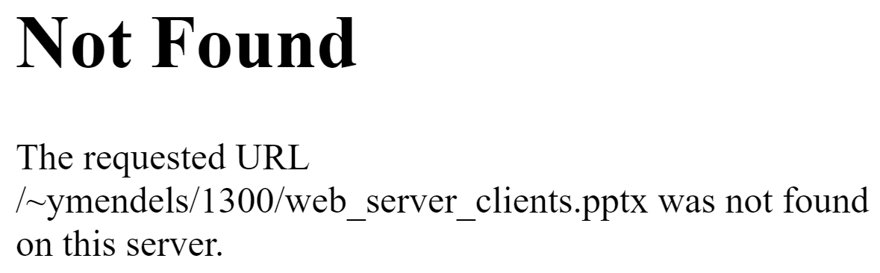
404 Error
If the web server is unable to find the requested resource, it will generate a message with the error code 404 indicating that there was an error and that the request could not be fulfilled.
The error may say something like “HTTP 404” or “Error 404” or something similar.
  The exact message printed when a 404 error is generated can be set by configuring the web server software.
A common way to encounter a 404 error is when there is a typo in the URL:
https://condor.depaul.edu/ymendels/1300/web_server_clients.pptx
Note the extra ‘0’ in '1300'

Slide 18
Anatomy of a URL
http://condor.depaul.edu/ymendels/202/intro_to_html1.pptx
The request finds its way to the depaul.edu domain
Within the domain, the request is navigated to a specific server named condor
On the condor server, look for a folder called ymendels
Within the folder ymendels, look for a subfolder called 202
Within that folder, look for a file called intro_to_html1.pptx

