Slide 1
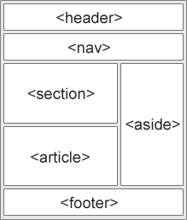
HTML Document Structure
Organizing your HTML Document using Semantic Tags

Slide 2

Learning Objectives
By the end of this lecture, you should be able to:
  Explain what is meant by a "semantic tag"
  Provide (when asked) at least 2 reasons for why semantic tags are important
  Use semantic markup to organize your HTML documents

Slide 3

Organizing the content of your HTML document
It is important to organize the content of your HTML document into appropriate sections.
  By "content" here, we are referring to the information that is displayed to the end-user when they visit your page.
  Typically, then, "content" refers to the information contained inside the <body> tag.
  In contrast, much (though not all) of the information inside <head> is usually referred to as "meta" information. That is, information about the page.
  That being said, information inside <head> can also include things like CSS scripts and JavaScript.
HTML: To this point, we have only used some very general tags to organize our page including <h> tags to set up headings and subheadings, <p> to delineate paragraphs, <ul> or <ol> to delineate lists, and a few others.
One of the most important concepts introduced by HTML5 was the idea of "semantic tags". The idea is that every HTML tag should have some kind of meaning that, hopefully, gives some general idea of what content is contained inside that tag.
<body> is a good example: Web designers, web clients (i.e. browsers), search engines, screen readers, etc. all understand that the information inside the <body> tag makes up the essential content of that HTML document.
In this lecture, we will introduce several other important semantic tags.
  You may be asked to apply semantic tags to many of the remaining web pages you create in this course!

Slide 4

Semantic Tags
A semantic tag gives some idea of the type of content contained inside of it.
HTML5 introduced several tags that are intended to be purely semantic in nature. These include:
  <header>
  <footer>
  <nav>
  <section>
  <article>
  <aside>
  and many others…
By "purely semantic" we mean that the tag itself does nothing! The only thing that a semantic tag does is describe what is contained inside.
  Compare a purely semantic tag with, say, a <p> tag that delineates a paragraph. In addition to wrapping the paragraph of content, the <p> tag also places a blank line on the web page after the paragraph.
  Similarly, compare a purely semantic tag with the <li> tag used in bulleted lists. Not only does the <li> tag indicate that we are creating a list item, but the tag also draws a bullet icon (e.g. a filled circle) before the text.
However, while a semantic tag doesn’t "do" anything, this does not prevent us from styling the tag as much as we like! In fact, one of the key benefits to consistent use of semantic tags is that it allows us to do CSS styling and scripting of semantic sections.

Slide 5

Commonly Used Semantic Tags
<header>
  Typically used for the header information at the top of a web document.
  Typically includes things like the title of a page (or name of a company), a logo or image of some kind, and sometimes a navigation section to navigate around that particular website.
  IMPORTANT: Do NOT confuse this <header> tag with the <head> tag!!!
<footer>
  Typically found at the bottom of a web page.
  Includes things like copyright notices, legal notices, citations.
  May include its own navigation section with various links to "Contact Us".
<main>
  Typically used to enclose the main section of your document (i.e. not including things like the header, and footer sections).
<nav>
  Typically used for a collection of links around that particular webpage or website.
  It is not typically used for, say, a collection of web links to "Other sites or interest" or things like that. As the name of the tag indicates, tags inside a <nav> are intended to help navigate that particular website.
<section>
  Often, the <main> section will be divided into at least a few different subsections using this <section> tag.
  Most sections will have at least one heading tag inside.
<article>
  Used when there is some stand-alone content on a web page. For example, if your page has a series of mini-topics that are relatively self-contained, you might put them inside this tag.
  Web programmers sometimes interchange their usage of the <article> tag and <section> tag.
<aside>
  For some content on the page that the programmer thinks may be of interest to the visitor, but that does not necessarily fit in directly with the other content on the page.

Slide 6

Reasonable People Can Disagree…
The "rules" for organizing your HTML code into semantic sections are still somewhat fluid. Even experienced and competent web designers may create essentially identical web pages, yet display numerous differences in how they use their semantic tags.
For example, it is not worth spending hours debating whether a given block should be enclosed in a <section> tag as opposed to an <article> tag.
However, there are certain fundamentals that should be respected.
We will learn about semantic markup by looking at some hypothetical examples.

Slide 7

Semantic Tags: Why bother?
Accessibility
  Many, many people use screen readers to surf the web. Web readers rely on semantic tags to assist in this process.
  Many corporate sites, government sites, popular sites require that their web designers create pages that follow proper accessibility guidelines.
  In some cases, sites are legally required to follow accessibility guidelines for web design.
Search Engine Optimization
  Search engines use the tags on your page as one of the main ways of determining what your page is about.
  Having properly labeled semantic tags can go a long way to help boost your page's rankings.
Clarity / Efficiency
  It makes your code much easier to interpret and follow.
  Makes it much easier to have a consistent look and flow to your web pages and even entire websites.
  Allows you to manage your CSS scripting and JavaScript code more effectively by giving you more control over the layout and behavior of your websites.
It's considered "Best Practice"
  In programming, it's always a great idea to adhere to "best practices" guidelines. We have been encouraging these throughout the course, and will continue to do so.
  Use of semantic tags is unquestionably among the "best practices" guidelines for creating web pages.

Slide 8
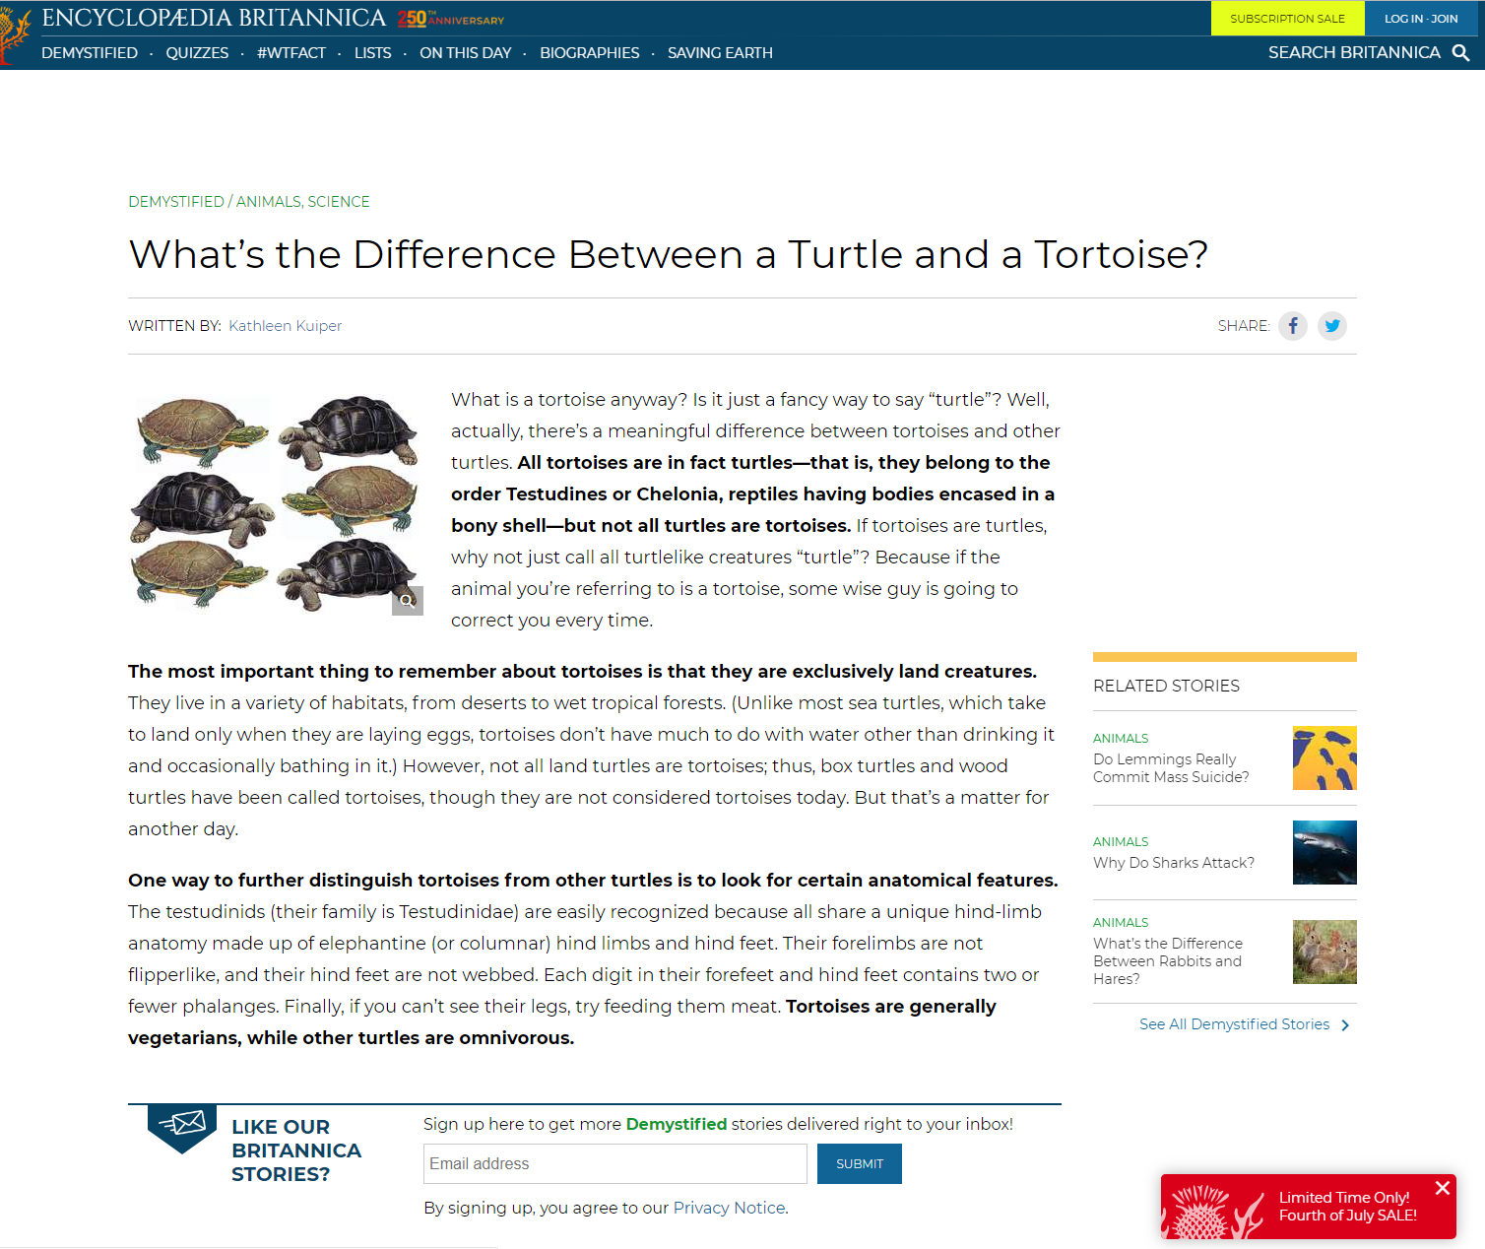
Example Page #1
<nav>
<header>
<main>
To begin with, assume that all of the following discussion about semantic tags refers to content that is contained inside the <body> tag.
The bar at the top containing the key identifying information about the company and/or web page would be placed in the <header> section.
  The <header> section may also contain things like a navigation section, a subheading, and other "titular" information.
  Note: Do not confuse the <header> section with the <head> section!
Within this <header> section, the links shown here should be grouped inside of a <nav> section.
The bulk of the page, i.e. the essential content, is typically placed inside a tag called <main>.
This information at the bottom, would probably make sense inside the <footer> tag.
These "related stories" are not directly related to the purpose of this page. This section would probably be placed inside an <aside> tag.
<aside>
<footer>

Slide 9
Example Page #1 continued
<h1>
That's not to say that our usual tags no longer apply – they certainly do!
We would still have things like our main headline inside an <h1>.
Similarly, individual paragraphs would go inside <p> tags.
<p>
<p>
<p>

Slide 10
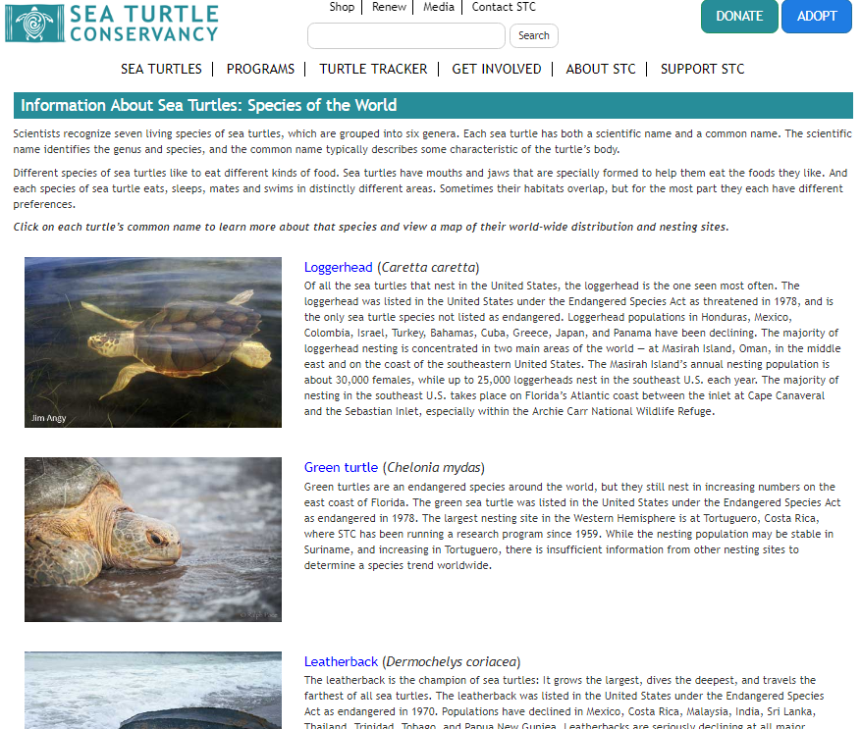
Example Page #2
<header>
Let's look at another page, where we can also make use of the <section> tag. We will stick with our turtle theme. (I'm a fan)
All of the code to create this section should probably go inside a <header> semantic tag.
These links should probably be inside a <nav> tag. Note: This <nav> section may or may not be included in the <header> section. As indicated previously, this is not an exact science! Sometimes, it's more a matter of personal preference.
Everything that follows would be contained inside a <main> tag.
This is probably an <h1> tag (and again, we are inside the <main> tag here).
Each of these topics would probably be inside an <article> tag.
  One could fairly ask whether or not they should be inside <section> tags. In this particular case, since each item is very much self-contained, it probably makes more sense to consider them articles.
<nav>
<h1>
<article>
<main>
<article>
<article>

Slide 11
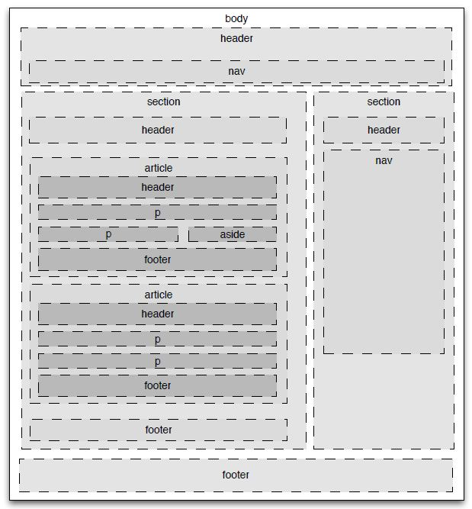
Thematic Outline
Here is a sketch outline that gives yet another idea of how you might organize your HTML code into semantic tags.
Spend a few minutes studying how various elements may contain other elements.
Things to note:
All of the content is inside a <body> tag.
There is a <header> section at the top.
There is a <nav> section that this particular designer felt should be part of the <header> section.
There are two <article> tags. Each has its own <header> and <footer> section. This is perfectly acceptable, though not strictly necessary.
The two articles themselves are contained inside their own <section> tag. That <section> also has its own <header> and <footer>.
There is another <section> to the right that has a separate <nav> section. It too has its own <header>.
Personally, I don't typically use so many <header> sections on my own pages. Again, quite a bit of this is a matter of personal preference.

Slide 12

Don't overthink it.
Sometimes when people tell me "I am overthinking it", I tend to suspect that what it really means is that that they haven't quite learned the concepts yet.
  Admittedly, this is just my opinion – I may be wrong here.
However, it is certainly possible to get carried away overthinking semantic tags.
Focus on the essential / basic organization of your page. Think about the <header> and <main> tags first. Those will pretty much be present in every single page that you create.
Then decide if you need others such as <footer> or any <section> or <article> tags.
It's not an exact science – and reasonable people can disagree on how to properly use semantic tags to organize their HTML document.

Slide 13
Content on a page does not have to be inside a semantic tag
(other than <body>)
All of the main content on your page after the <head> tag, will be placed inside the <body> tag.
Beyond that, however, not every piece of content present needs to be inside a semantic tag.
For example, if you have an image that is there for decorative or illustrative purposes, it does not necessarily need to be inside one of your semantic tags.
If, however, the image is, say, a logo for your company, and is at the top of your page, it should probably go inside the <header> section.

Slide 14

Which semantic tags are required?
For the reasons described earlier, there should always be some semantic tags present on every page.
At the very least, every web document we create should probably include:
  A <header> tag
  A <main> tag
  It would be pretty unusual to encounter a web page where those two tags would not be warranted.
  Moving forward in this course, those two tags should be present on every page you create!
In addition, the majority of pages that are in real-world use typically include:
  One or more <section> and/or <article> tags
  A <nav> tag
  A <footer> tag

Slide 15
Working Example
Outline of Our Turtle Page
Title: The World of Turtles
Subtitle: A Highly Abbreviated Primer
Image: Picture of a box turtle goes here
Introduction
Turtles are diapsids of the order Testudines. The earliest known members of this group date from the Middle Jurassic,[1] making turtles one of the oldest reptile groups and a more ancient group than snakes or crocodilians.
Turtles are ectotherms—animals commonly called cold-blooded—meaning that their internal temperature varies according to the ambient environment. However, because of their high metabolic rate, leatherback sea turtles have a body temperature that is noticeably higher than that of the surrounding water.
Anatomy
The largest living chelonian is the leatherback sea turtle (Dermochelys coriacea), which reaches a shell length of 200 cm (6.6 ft) and can reach a weight of over 900 kg (2,000 lb).
  Neck Retraction
  Turtles are divided into two groups, according to how they retract their necks into their shells (something the ancestral Proganochelys could not do).
  Shell
  The upper shell of the turtle is called the carapace. The lower shell that encases the belly is called the plastron. The carapace and plastron are joined together on the turtle's sides by bony structures called bridges.
Diet
A turtle's diet varies greatly depending on the environment in which it lives.
The text for this page taken from Wikipedia.
Links to Other Turtle Pages
Encyclopedia Britannica
10 Awesome Facts About Turtles
Turtle Conservancy
Let's go through an example together. To the right is a hypothetical hand-written mockup of a web page we plan to create.
  Note: The actual content of this page including the image was taken from Wikipedia's page on turtles.
All we have at the moment is our content. The purpose of making a mockup is to allow us to examine the content page and try to come up with an organizational structure of our HTML document.
After some examination, we note that our page has:
  A title
  A subtitle
  An image
  Three main topics (Intro, Anatomy, Diet)
  One of the main topics, "Anatomy" has two subtopics (Neck retraction, and Shell)
  A citation
  A group of links to other turtle-related pages

Slide 16
Working Example
Outline of Our Turtle Page
Title: The World of Turtles
Subtitle: A Highly Abbreviated Primer
Image: Picture of a box turtle goes here
Introduction
Turtles are diapsids of the order Testudines. The earliest known members of this group date from the Middle Jurassic,[1] making turtles one of the oldest reptile groups and a more ancient group than snakes or crocodilians.
Turtles are ectotherms—animals commonly called cold-blooded—meaning that their internal temperature varies according to the ambient environment. However, because of their high metabolic rate, leatherback sea turtles have a body temperature that is noticeably higher than that of the surrounding water.
Anatomy
The largest living chelonian is the leatherback sea turtle (Dermochelys coriacea), which reaches a shell length of 200 cm (6.6 ft) and can reach a weight of over 900 kg (2,000 lb).
  Neck Retraction
  Turtles are divided into two groups, according to how they retract their necks into their shells (something the ancestral Proganochelys could not do).
  Shell
  The upper shell of the turtle is called the carapace. The lower shell that encases the belly is called the plastron. The carapace and plastron are joined together on the turtle's sides by bony structures called bridges.
Diet
A turtle's diet varies greatly depending on the environment in which it lives.
The text for this page taken from Wikipedia.
Links to Other Turtle Pages
Encyclopedia Britannica
10 Awesome Facts About Turtles
Turtle Conservancy
<h1>
<h2>
<img>
We can already come up with a basic HTML outline for our page:
The title
  The title of a page should almost always be <h1>
A subtitle
  This one is a bit less clear. Perhaps <h2> ? Perhaps a <div> section? Something else?
    Let's go with for <h2> now.
An image
  That's easy: <img>
Three main topics (Introduction, Anatomy, Diet)
  We've already used <h1> for our title. So every major topic inside the page should use <h2> tags.
One of the main topics, "Anatomy" has two subtopics (Neck retraction, and Shell)
  Because these are subtopics of Anatomy for which we used <h2>, we should now use <h3> tags
A citation
  Perhaps <footer>? We'll decide momentarily.
A group of links to other turtle-related pages
  Perhaps <aside> ? We'll decide momentarily.
  The heading for this section should probably be <h2>
<h2>
<h2>
<h3>
<h3>
<h2>
<h2>

Slide 17
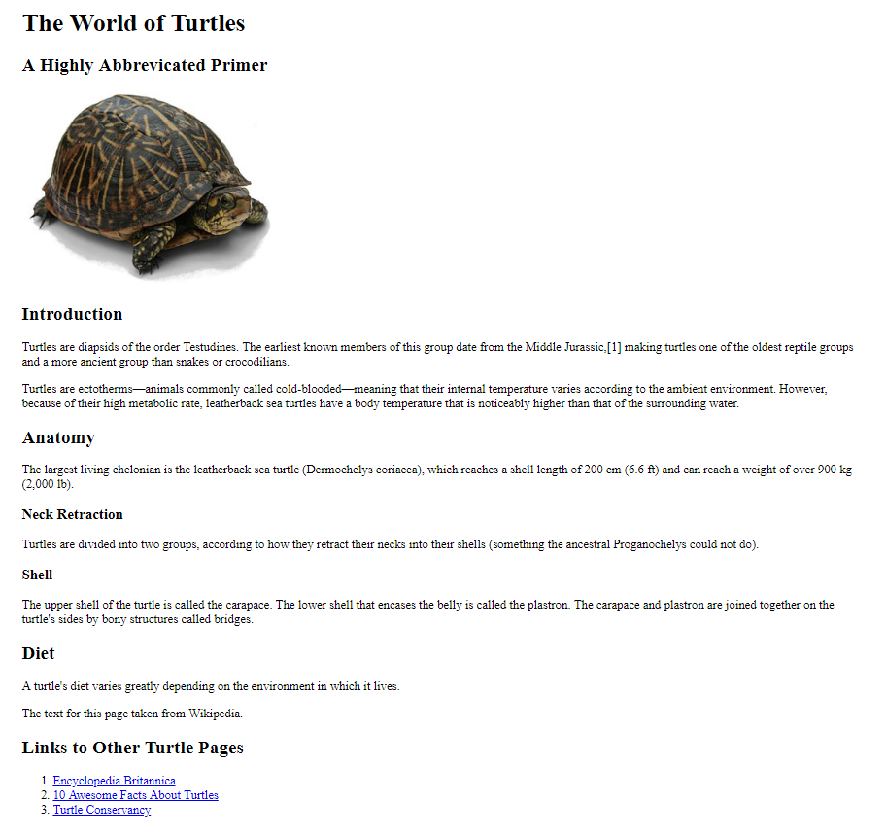
Working Example
- The HTML Code -
<!DOCTYPE html>
<html lang="en">
<head>
<title>All About Turtles</title>
<meta charset="utf-8">
</head>
<body>
<h1>The World of Turtles</h1>
<h2>A Highly Abbreviated Primer</h2>
<img src="box_turtle_wikipedia.jpg" alt="Picture of a box turtle">
<h2>Introduction</h2>
<p>Turtles are diapsids of the order Testudines. The earliest known members of this group date from the Middle Jurassic,[1] making turtles one of the oldest reptile groups and a more ancient group than snakes or crocodilians.</p>
<p>Turtles are ectotherms—animals commonly called cold-blooded—meaning that their internal temperature varies according to the ambient environment. However, because of their high metabolic rate, leatherback sea turtles have a body temperature that is noticeably higher than that of the surrounding water.</p>
<h2>Anatomy</h2>
<p>The largest living chelonian is the leatherback sea turtle (Dermochelys coriacea), which reaches a shell length of 200 cm (6.6 ft) and can reach a weight of over 900 kg (2,000 lb).</p>
<h3>Neck Retraction</h3>
<p>Turtles are divided into two groups, according to how they retract their necks into their shells (something the ancestral Proganochelys could not do).</p>
<h3>Shell</h3>
<p>The upper shell of the turtle is called the carapace. The lower shell that encases the belly is called the plastron. The carapace and plastron are joined together on the turtle's sides by bony structures called bridges.</p>
<h2>Diet</h2>
<p>A turtle's diet varies greatly depending on the environment in which it lives. </p>
<p>The text for this page taken from Wikipedia.</p>
<h2>Links to Other Turtle Pages</h2>
<ol>
<li><a href="https://www.britannica.com/animal/turtle-reptile">Encyclopedia Britannica</a></li>
<li><a href="https://www.natgeokids.com/nz/discover/animals/sea-life/turtle-facts/">
10 Awesome Facts About Turtles</a></li>
<li><a href="https://www.turtleconservancy.org/">Turtle Conservancy</a></li>
</ol>
</body>
</html>
File: turtles_no_semantics.html
Let's look at the basic HTML code first, without worrying about the semantic markup yet.
Starting with the basic HTML code is a good approach. Once we have the basic HTML markup, specifically involving headings and subheadings, we'll tack on our semantic structure.
The title - <h1>
A subtitle - <h2>
An image - <img>
Three main topics (Intro, Anatomy, Diet) - <h2>
Subtopics under "Anatomy" - <h3>
A citation: I'm undecided as to the appropriate tag for this. Perhaps we will choose <footer> when we add our semantic markup.
  Again, this is not a hard science.
  There is nothing wrong with deferring decisions.
A group of links to other turtle-related pages. I think this will be in an <aside> tag, but let's make that decision momentarily when we add our semantic markup. However, the heading for this section should probably be <h2>
Starting with a simple outline of headings and subheadings before getting into the semantic markup is a often a good idea.

Slide 18
Working Example
- Semantic Markup Added -
<!DOCTYPE html>
<html lang="en">
<head>
<title>All About Turtles</title>
<meta charset="utf-8">
</head>
<body>
<header>
<h1>The World of Turtles</h1>
<h2>A Highly Abbreviated Primer</h2>
<img src="box_turtle_wikipedia.jpg" alt="Picture of a box turtle">
</header>
<main>
<section>
<h2>Introduction</h2>
<p>Turtles are diapsids of the order Testudines. </p>
<p>Turtles are ectotherms—animals commonly called cold-blooded—meaning that...</p>
</section>
<section>
<h2>Anatomy</h2>
<p>The largest living chelonian is the leatherback sea turtle....</p>
<h3>Neck Retraction</h3>
<p>Turtles are divided into two groups, according to ...</p>
<h3>Shell</h3>
<p>The upper shell of the turtle is called the carapace...</p>
</section>
<section>
<h2>Diet</h2>
<p>A turtle's diet varies greatly depending on the environment in which it lives. </p>
</section>
</main>
<footer>
<p>The text for this page taken from Wikipedia.</p>
</footer>
<aside>
<h2>Links to Other Turtle Pages</h2>
<ol>
<li><a href="https://www.britannica.com/animal/turtle-reptile">Encyclopedia
<li><a href="https://www.natgeokids.com/nz/...">10 Awesome Facts About Turtles</a></li>
<li><a href="https://www.turtleconservancy.org/">Turtle Conservancy</a></li>
</ol>
</aside>
</body>
</html>
File: turtles_semantics.html
We will now add the semantic tags around our current outline.
NOTE: I have removed much of the text inside the paragraphs to enable us to fit the more relevant HTML code onto the screen.
We have added:
A <header> tag around the main title, subtitle, and image.
A <main> tag around all of the paragraphs that follow relating to our discussion of turtles.
  Note: This <main> tag does not enclose the <footer> (which contains the citation), and the <aside> which contains the links.
Inside our <main> section, I divided each major topic into its own <section> tag.
The citation went inside a <footer> tag. (Reasonable people can disagree on whether or not this was the right choice). Again, not an exact science…
The section containing related links went inside an <aside> tag.
  Note that we would not use a <nav> section here. <nav> sections are typically reserved for links to take the user around your web site.

Slide 19
Final Version!
Let's now compare the "before" and "after" versions….
Version without semantic markup
Version with semantic markup
File: turtles_no_semantics.html
File: turtles_semantics.html

Slide 20

Well… that was… anticlimactic.
All that work… and there is absolutely no visual difference.
This is a good time to remind you of a very important fact: When creating HTML documents, we want to separate markup from presentation (i.e. visual appearance). HTML tags are there for structural and organizational purposes. Any visual "flair" you wish to include in a page must be done via CSS.
Don't get discouraged. We have, in fact, accomplished a lot!
  Best practices have been adhered to.
  The document is very easy to follow for other programmers.
  Accessibility is vastly improved.
  The effective use of semantic tags in this document makes it ready for advanced styling including positioning and layout.
    For those of you progress to more advanced CSS techniques, these tags will increase your options tremendously.

