Slide 1

JavaScript
Working with ‘checked’ items
Checkboxes and Radio buttons

Slide 2

Learning Objectives
By the end of this lecture, you should be able to:
  Determine in your JavaScript code whether or not a checkbox was checked.
  Determine in your JS code which button in a group of radio buttons was checked.
  Retrieve a value from a checkbox or radio button.

Slide 3
Retreiving info from form elements that contain ‘text’
Recall the
document.getElementById('elementName').value
code that we’ve used for textboxes, textareas, and, select boxes.
Example: Suppose you have a select box called selNationality
To retreive the value you could type:
var country = document.getElementById('selNationality').value;
The value that gets retrieved will be the one you encoded inside the <option> tag. Similarly, for text boxes and textareas, the value retrieved is the information that was typed in by the user.

Slide 4
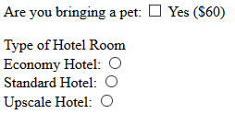
Determining if a checkbox or radio buton is checked
But what if there is no text? For example, what if you are simply working with a checkbox or a radio button and simply wish to know if the button was checked or not?
Answer:
We use
document.getElementById('element_name').checked

Slide 5
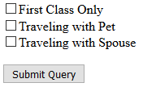
<input type="checkbox" id="chkFirst">First Class Only
<input type="checkbox" id="chkPet">Traveling with Pet
<input type="checkbox" id="chkSpouse">Traveling with Spouse
<button type="button" onclick="doStuff()">Submit Query</button>
<script>
function doStuff()
{
if (document.getElementById('chkFirst').checked)
alert("Going in style!");
if (document.getElementById('chkPet').checked)
alert("Taking your pet!");
if (document.getElementById('chkSpouse').checked)
alert("Taking your spouse");
}
</script>

Slide 6
Retrieving the value of a radio button
With things like text fields and select boxes, we must ultimately retrieve a 'value'. After all, that is the whole point of those particular types of form elements.
However, with checkboxes and radio buttons, this is not necessarily the case. That is, with things like checkboxes / radio buttons, we often only need to know if the box/button was checked.
However, while your radio buttons and checkboxes do not necessarily have to have a value, it is often very useful to do so. If your radio button (or checkbox) does contain a value attribute, you can retrieve it using the familiar ‘.value’ syntax. Again, though, whether or not you choose to include a value is a matter of context in terms of how you set up your page.
For example, in the following radio buttons, we have include a 'value' attribute:
What is your favorite color?
RED <input type="radio" name="favColor" id="radFavRed" value="red">
BLUE <input type="radio" name="favColor" id="radFavBlue" value="blue">
You could retrieve the value of the 'value' attribute of any of the buttons as follows:
  var favoriteColor = document.getElementById("radFavRed").value;
//favoriteColor will hold the value "red"

Slide 7
Retrieving the value of a radio button
What is your favorite color?
RED <input type="radio" name="favColor" id="radFavRed" value="red">
BLUE <input type="radio" name="favColor" id="radFavBlue" value="blue">
You could check to see which button was selected,
and then retrieve the value of its 'value' attribute as follows:
if (document.getElementById("radFavRed").checked)
{
favoriteColor = document.getElementById("radFavRed").value;
}
else if (document.getElementById("radFavBlue").checked)
{
favoriteColor = document.getElementById("radFavBlue").value;
}
alert("Your favorite color is " + favColor);

Slide 8
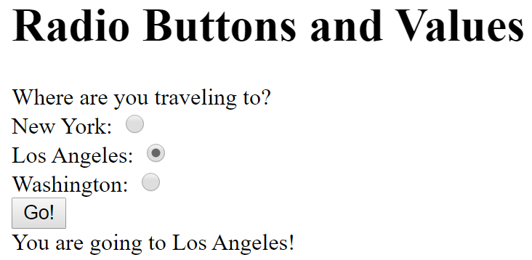
Example: radio_buttons_with_values.html
Where are you traveling to?
New York: <input type="radio" name="city" id="radNy" value="New York">
Los Angeles: <input type="radio" name="city" id="radLa" value="Los Angeles">
Washington: <input type="radio" name="city" id="radWash" value="Washington">
<button type="button" onclick="checkCity()">Go!</button>
<div id="output">
</div><!-- end of output div -->
<script>
function checkCity()
{
var cityChoice;
var outputMessage = "You are going to ";
if (document.getElementById('radNy').checked)
{
cityChoice = document.getElementById('radNy').value;
}
else if (document.getElementById('radLa').checked )
{
cityChoice = document.getElementById('radLa').value;
}
else if (document.getElementById('radWash').checked )
{
cityChoice = document.getElementById('radWash').value;
}
outputMessage = outputMessage + cityChoice + "!";
document.getElementById("output").innerHTML = outputMessage;
} //end of checkCity function

Slide 9
Exercise:
Prompt the user for their income over the past year. Then have radio buttons for the 4 options shown below. Then have a button that says “Calculate my taxes”. Calculate their tax based on the following criteria:
  If the user has an income less than $30K (i.e. $30,000), their tax rate should be 0%.
  If their income is between $30K and below $50K their rate should be 25%.
  If their income is between $50K and below $100K, use 35%.
  $100,000 and more use 40%.
  Round the result to 0 decimal places.
Output a result that says something like:
For an income of $64000, you must pay $22400 in taxes.

