Slide 1

JavaScript:
Event Listeners

Slide 2

Learning Objectives
By the end of this lecture, you should be able to:
Understand and explain the basic idea of “event-driven programming”
Understand / explain the basic makeup of the addEventListener() function, specifically the two important arguments that are needed
Write code that connects the addEventListener() function to the getElementById() function to make a web page element (such as a button or image) listen for some behavior
Apply the click, mouseover, and mouseleave events to elements on a web page
Be able to explore a reference to examine other possible events you can listen for

Slide 3
Event-Driven Programming
It is common for web applications to work by reacting to various “events”. These events can be automated (e.g. time-related), but often, the idea of “events” refers to some behavior generated by the person who visits our web page.
We have already worked with one type of event: When the user clicks their mouse on some web page element such as a button. This is known as a “click event”.
Clicking on something is just one of many possible events. Other events that we can write code to react to include the following. The item in parentheses refers to JavaScript’s name for the event.
  Moving the mouse over something (“mouseover” event)
  Moving the mouse off of something (“mouseleave” event)
  Holding the mouse down – but not releasing it – while over a web element (“mousedown” event)
  Pressing a key on the keyboard (“keydown” event)
    Only applies to certain form elements such as text fields, textareas, and certain others.
    This demonstrates that many aspects of what can and can not be done in web application programming is highly dependent on context.
  Moving to one form element from a different one such as when completing a form (“focus” event)
    For example, when moving from the “first name” to the “last name” text field when completing a form.
    Again, an event that only applies in certain contexts
It is almost impossible to simply memorize every possible event– especially given that they tend to change as the standards evolve. This is why it is important to always use a good web reference such as MDN.

Slide 4
Event Listeners
Event listeners are functions that “listen” for certain actions.
Event-listener functions typically accept two arguments:
The type of event we want our web page to listen for (e.g. mouse click, key press, moving the cursor, etc, etc)
A function (usually one that we write ourselves) that we wish to invoke when that event occurs.
Here is what the addEventListener function looks like:
addEventListener("event_type", functionToExecute);
Note:
The event that we wish to listen for must be in quotes
The function we wish to execute is not in quotes, and does NOT include parentheses
Example:
addEventListener("click", greetUser);
But we’re not quite done….

Slide 5
Connecting the Listener to an HTML Element
As discussed, the listener code shown here says that whenever the user “clicks”, to invoke a function called greetUser.
addEventListener("click", greetUser);
But…. when the user clicks WHAT?? There are many, many elements on a web page!
Which element are we referring to?
A button?
One of the images on the page?
A hyperlink?
The answer is that we must specify which element we are referring to.
For example, suppose we have a button that has an ID of “btnGreeting” like so:
<input type="button" id="btnGreeting" value="Greet Me!">
We first need to access this element with our familiar getElementById function:
document.getElementById("btnGreeting")
…and then connect it to the listener command:
document.getElementById("btnGreeting").addEventListener("click", greetUser);
This may seem like a lot, but the good news is that we will be using this command many times. We only have to modify the elements, event types, and function to invoke. With practice, I promise that you will get used to it!

Slide 6

Putting It Together
<!DOCTYPE html>
<html lang="en">
<head>
<meta charset="utf-8">
<title>Event Listeners 101</title>
</head>
<body>
<h1>Working With Events</h1>
<input type="button" id="btnGreet" value="Greet Me!">
<div id="output" style="font-size:200%;">Greeting will go in here….</div>
<script>
function greetUser()
{
var greeting = "Hello, how are you today???";
document.getElementById("output").innerHTML = greeting;
}
document.getElementById("btnGreet").addEventListener("click", greetUser);
</script>
</body>
</html>
We are going to be referencing this button inside our script. So we have to give it an id.
We need a place to output our message. A <div> section is often a great choice.
Let’s write the function we wish to invoke when the button is clicked.
Outputting to the <div> section.
We select the element that we want to do the “listening”. In this case, the element named ‘btnGreet’.
… and we “attach” that element to the addEventListener() function.
The first argument to the addEventListener() function says we are listening for a “click” event.
The second argument to the addEventListener() function says to invoke the greetUser function when the event happens.

Slide 7
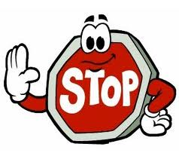
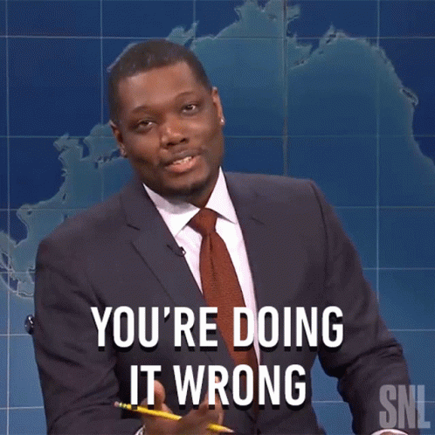
Stop!
You DID type out the last example for yourself right????
If not….
(Yes, I know he’s not really saying it).
You certainly don’t have to type out the entire page.
Just any code / concepts that are new or still unfarmiiliar to you.
Also: It’s okay if you first want to go through the entire lecture to get an overview. But once you are ready to “learn it”, it is imperative to always be typing out the code for yourself.

Slide 8
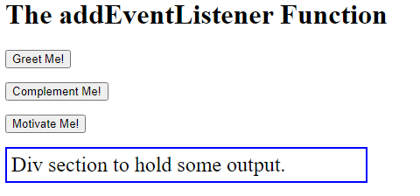
File: listener_three_buttons.html
<!DOCTYPE html>
<html>
<head>
<meta charset="UTF-8">
<title>Simple Listener</title>
<style>
.output-highlight {border:2px solid blue;
padding:5px; font-size:150%; width:400px;}
</style>
</head>
<body>
<h1>The addEventListener Function</h1>
<p><input type="button" value="Greet Me!" id="btnGreet">
<p><input type="button" value="Complement Me!" id="btnComplement">
<p><input type="button" value="Motivate Me!" id="btnMotivate">
<p><div id="output" class="output-highlight">Div section to hold some output.</div>
<script>
function greetUser() {
var greeting="Hi there!";
document.getElementById("output").innerHTML = greeting;
}
function complementUser() {
var complement="You have a lovely smile!";
document.getElementById("output").innerHTML = complement;
}
function motivateUser() {
var statement="Practice makes perfect!";
document.getElementById("output").innerHTML = statement;
}
document.getElementById("btnGreet").addEventListener("click",greetUser);
document.getElementById("btnComplement").addEventListener("click",complementUser);
document.getElementById("btnMotivate").addEventListener("click",motivateUser);
</script>
</body>
</html>

Slide 9
“onclick” attribute v.s. event listener
You may be wondering why we don’t simply use the familiar HTML attribute “onclick”.
<input type="button" value="Greet Me!" onclick="greetUser()">
For a very simple and straight forward function call from a button, this can indeed be a perfectly valid choice. However, the event-driven programming model has many more options, and far more power than can be achieved using simple HTML attributes.
In addition, in the example shown here, the button can only listen for one event, in this case, a click. But sometimes we want the ability to have an element listen for multiple different events.
In fact, we will now look at one such example now where we have one element on a page, an image, listen for two different events.
Not only that, neither of those two events we will listen for is a “click”! (That’s boring stuff)

Slide 10
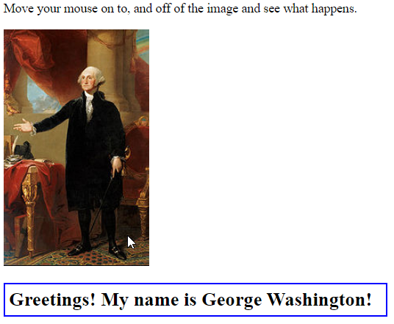
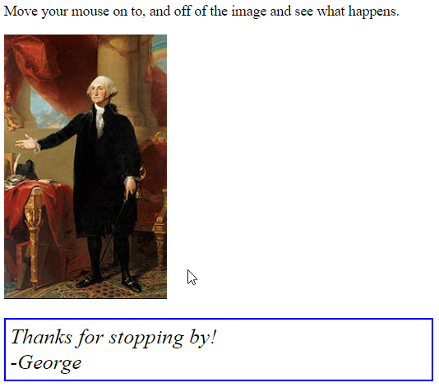
Listening for mouseover and mouseleave events
As mentioned earlier, “click” events are just one of many, many types of events we can listen for.
Another type of event commonly used in web applications involves listening for when the user moves their mouse on to (over) some element on the web page, and/or moving their cursor off of an element.
The JavaSript code for these events are mouseover and mouseleave.
Here are two screen captures showing this behavior in action:
In the first example, note that the mouse is directly over the image (lower right). The web page reacted by printing a greeting.
In the second example, note that the mouse is off the image (just to the right near the bottom). The web page reacted by printing a different message.
Just for fun and demonstration purposes, I also changed the appearance of the font that was output for the two different events. We will examine the code to achieve all of this behavior now.

Slide 11
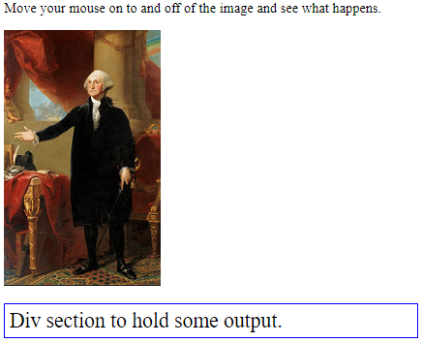
Listening for mouseover and mouseleave events
<body>
Move your mouse on to, and off of the image and see what happens.
<p><img src="washington.jpg" alt="Image of Washington" id="imgWashington">
<!-- Because we intend to refer to this image in our script,
we need to give it an id -->
<p><div id="output" class="output-highlight">
Div section to hold some output.</div>
<script>
function helloFromWashington() {
var message="<strong>Greetings! My name is George Washington!</strong>";
//Note the use of HTML code inside the string. This is an important technique to know about!
document.getElementById("output").innerHTML = message;
}
function goodbyeFromWashington() {
var message="<em>Thanks for stopping by!<br>-George</em>";
//Again, demonstrating the inclusion of HTML code inside the string.
document.getElementById("output").innerHTML = message;
}
document.getElementById("imgWashington").addEventListener("mouseover",helloFromWashington);
<!-- When the "mouseover" event occurs, the function "helloFromWashington" is invoked -->
document.getElementById("imgWashington").addEventListener("mouseleave",goodbyeFromWashington);
<!-- When the "mouseleave" event occurs, the function "goodbyeFromWashington" is invoked -->
</script>
</body>
File: listener_mouseover.html

Slide 12
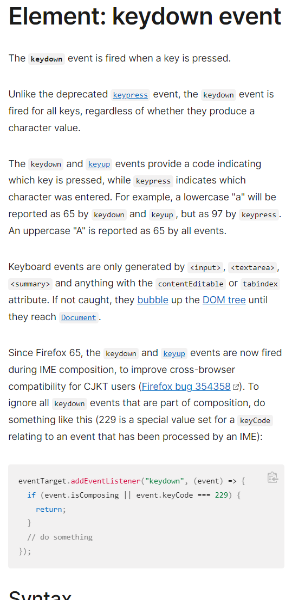
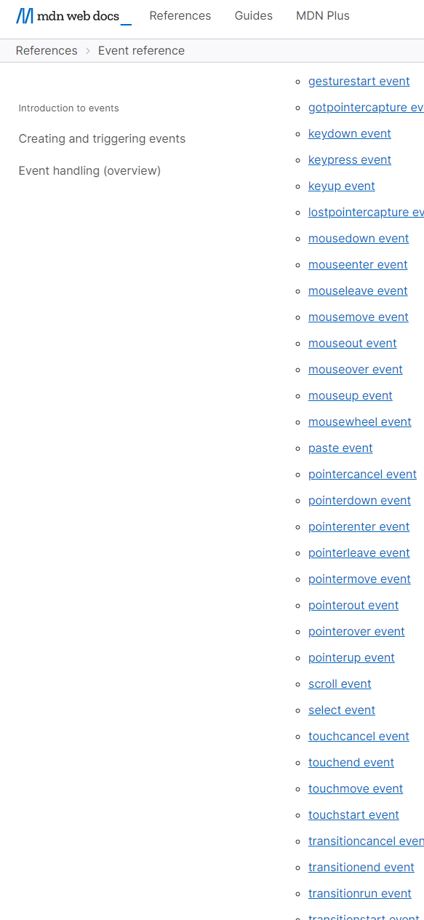
The MDN Reference for Events
Here is the URL. Please note that this will likely change over time. But it is very easy to find. https://developer.mozilla.org/en-US/docs/Web/Events
Only a small part of the page is shown here. Note the many different events that can be listened for.
Important: Not all events can be listened for in all situations. For example, the “keydown” event requires a web element where the user has the ability to type such as a text field or textarea.
Let’s click on this link and see what happens…
Here is where the reference tells us that this keydown event only works for specific types of web elements.
Note: Don’t get discouraged if you find that much of the documentation is hard to interpret. As you gain experience, you will find that more and more of it starts making sense.

Slide 13
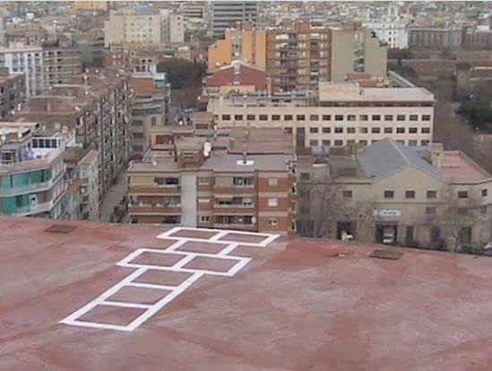
One final, not very subtle reminder…
Don’t be “doing it wrong”

