Slide 1

JavaScript:
Events and Video

Slide 2

Learning Objectives
By the end of this lecture, you should be able to:
Use the <video> tag to embed videos in your web pages
Continue to explore using online references to apply HTML, CSS, and JavaScript techniques
Apply functions (a.k.a. “methods”) and properties of media elements such as play(), pause(), duration, currentTime, playbackRate

Slide 3
Some Useful References
HTMLMediaElement:
https://developer.mozilla.org/en-US/docs/Web/API/HTMLMediaElement
The <video> tag:
https://developer.mozilla.org/en-US/docs/Web/HTML/Element/video
HTMLVideo Element:
https://developer.mozilla.org/en-US/docs/Web/API/HTMLVideoElement
Supported Media Formats:
https://developer.mozilla.org/en-US/docs/Web/Media/Formats
Event Types (e.g. click event, focus event, mouseover event, etc)
https://developer.mozilla.org/en-US/docs/Web/Events
- See “Event Listing” section for a list of events

Slide 4
Embedding Videos in a Web Page
Embedding a video is quite simple, we use the <video> tag.
Hopefully you are starting to see that is can be quite useful to do a little bit of research into the HTML elements you are employing in your web pages. So let’s take a quick look at the reference page for this <video> element.
At the time of this writing, the URL is: https://developer.mozilla.org/en-US/docs/Web/HTML/Element/video
It can, of course, change at any time. But a quick online search will bring up the correct link.
When you look at a reference, don’t be intimidated by all of the information you see there. It’s quite normal for much of it to sound very confusing at this point. With time and experience, more and more of it will come to make sense to you.
Also, be aware that this is an HTML reference – NOT a JavaScript reference! So this page will not provide much information about the JavaScript that we can and will be using with videos.
For now, take a look at some of the attributes for the <video> tag such as:
src: the reference to the video you wish to embed
controls: whether or not you wish to have playback controls shown on the video window
autoplay: in particular, note how the reference indicates that usage of this attribute is discouraged

Slide 5
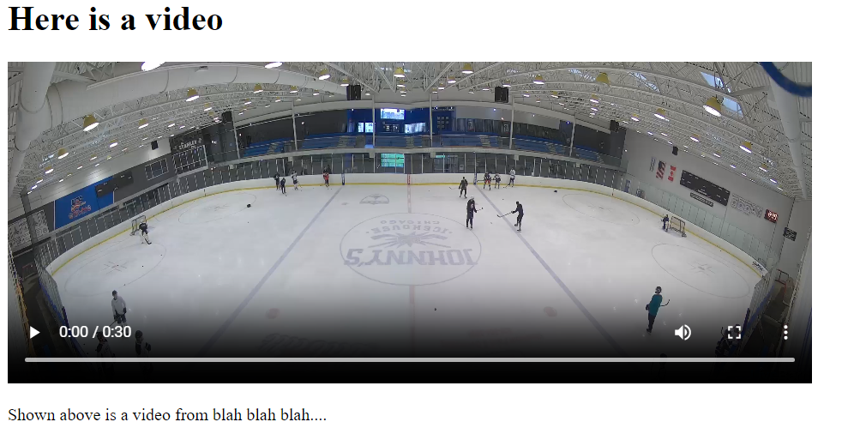
Embedding a Video
<body>
<h1>Here is a video</h1>
<video src="fordo.mp4" height="256" width="640" controls >
</video>
<p>Shown above is a video from blah blah blah....</p>
</body>
File: embedding_a_video.html

Slide 6
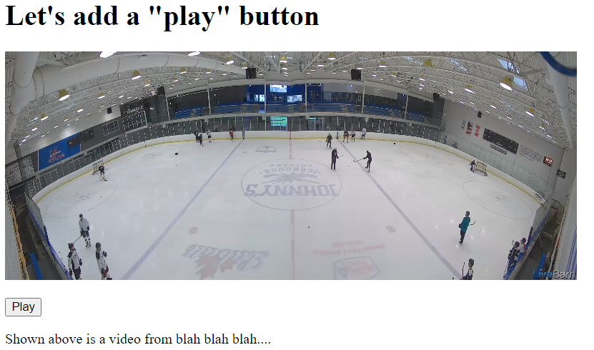
Let’s Add Our Own “Play” Button
<body>
<h1>Let's add a "play" button</h1>
<video src="fordo.mp4" height="256" width="640" id="vidFordo">
</video><p>
<input type="button" id="btnPlay" value="Play">
<p>Shown above is a video from blah blah blah....</p>
<script>
document.getElementById("btnPlay").addEventListener("click",playVideo);
function playVideo() {
alert('playing video'); //USED DURING TESTING!
document.getElementById("vidFordo").play();
}
</script>
File: working_with_video_1.html
Note that I have removed the controls attribute from the <video> tag.
We are going to be referencing this video in our scripts, so we need to add in an “id” attribute.
The play function is available to media elements of the video and audio type.
? ? ? ?

Slide 7
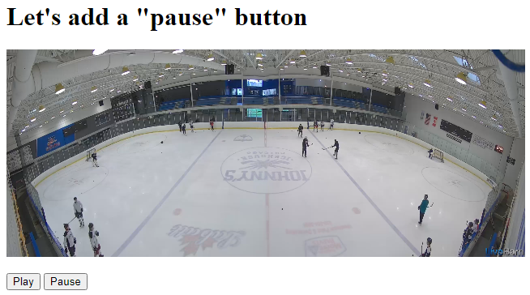
Let’s Add Our Own “Pause” Button
<h1>Let's add a "pause" button</h1>
<video src="fordo.mp4" height="256" width="640" id="vidFordo">
</video><p>
<input type="button" id="btnPlay" value="Play">
<input type="button" id="btnPause" value="Pause">
<p>Shown above is a video from blah blah blah....</p>
<script>
document.getElementById("btnPlay").addEventListener("click",playVideo);
document.getElementById("btnPause").addEventListener("click",pauseVideo);
function pauseVideo() {
document.getElementById("vidFordo").pause();
}
function playVideo() {
document.getElementById("vidFordo").play();
}
</script>
File: working_with_video_2.html
The pause function is available to media elements of the video and audio type.

Slide 8
Working With Time in Media
When working with media, it is often useful to be able to work with time. For example, you may want to let the user know how much time is left in the video they are playing. Or perhaps you may want to allow them to jump to specific times in the video.
Aside: As a quick reminder, by media in this context, we are referring to audio and video.
Let’s take a look at two properties of media elements in JavaScript that we can refer to:
currentTime → tells you the current time that you are at in the media clip
duration → tells you the duration of the media clip
Note: These are “properties” are not functions. When we refer to the “properties” of something, we are referring to characteristics of the object. This might mean the height of an image, the resolution of a video, the playback speed of an audio clip, the duration of a video, the color of an HTML button, etc. etc. etc.
Determining the Duration: If you had a video with an id of “videoDune”, you could output its length with the JavaScript property called “duration” :
var clipLength = document.getElementById('videoDune').duration;
alert(clipLength);
Determining the Current Time of Playback: Similarly, you could output the current time that the player is at with a JavaScript property called “currentTime” :
var time = document.getElementById('videoDune').currentTime;
alert(time);
Again: Note that these properties only apply to media elements. They would not make sense in the context of most other elements. For example, what would it mean to refer to the “duration” of an image?!

Slide 9
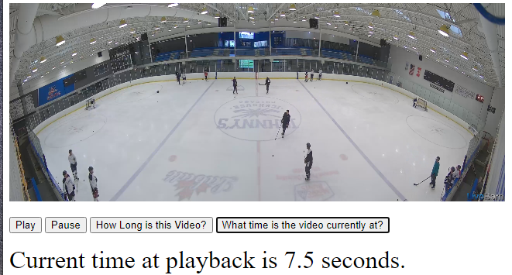
Working With Time in Media
File: working_with_video_time.html
Note: To save space, I have removed most of the unrelated code from the example below. For example, you won’t see the code for the “Play” and “Pause” buttons, etc. You can, of course, see the complete code by downloading this file from the course web page.
<video src="fordo.mp4" height="256" width="640" id="vidFordo"></video>
<input type="button" id="btnLengthVideo" value="How Long is this Video?">
<input type="button" id="btnCurrentTime" value="What time is the video currently at?">
<div id="output" style="font-size:200%;">Placeholder for Time Info</div>
<script>
document.getElementById('btnLengthVideo').addEventListener('click',outputLength);
document.getElementById('btnCurrentTime').addEventListener('click',outputCurrentTime);
function outputLength() {
var lengthVid = document.getElementById('vidFordo').duration;
lengthVid = lengthVid.toFixed(0); //set this number to 0 decimal places
var lengthString = "Length: " + lengthVid + " seconds";
document.getElementById('output').innerHTML = lengthString;
}
function outputCurrentTime() {
var timeNow = document.getElementById('vidFordo').currentTime;
timeNow = timeNow.toFixed(1); //set to 1 decimal place
var timeString = "Current time at playback is " + timeNow + " seconds.";
document.getElementById('output').innerHTML = timeString;
}
This‘ duration ‘ property will work with media elements such as audio and video clips. That is, as long as the “id” matches up with a media element, this property will return the excpted value.
You are not required to know how to use the toFixed() function at this time. We will discuss it later. But it’s nice to know about since it helps us control the number of decimal spaces that get output.
As with the ‘ duration ‘ property , the ‘ currentTime ‘ property will work with media elements such as audio and video clips. That is, as long as the “id” matches up with a media element, this property will return the excpted value.

Slide 10
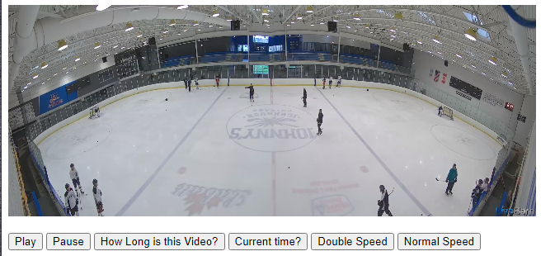
Working With Speed
We may also want to control the speed. This is less common, but the point here is to demonstrate that there are many tools that allow us to control the behavior of media that we are embedding in our web pages.
In this case, we make use of a property of media elements called playbackRate.
<video src="fordo.mp4" height="256" width="640" id="vidFordo"></video>
<input type="button" id="btnDoubleSpeed" value="Double Speed">
<script>
document.getElementById("btnDoubleSpeed").addEventListener("click",doubleTheSpeed);
function doubleTheSpeed() {
document.getElementById("vidFordo").playbackRate=2;
}
</script>
File: working_with_video_speed.html
YOUR TURN!
Write code to implmenet the button and functionality for “Normal Speed”. That is, this button should change the playback rate to the normal speed (i.e. a value of 1).
In other words, the user should be able to click back and forth between the “Double Speed” and “Normal Speed” buttons and have the video play back at those rates.
Then when you’re done, implement yet another button for “Half Speed” with a playback rate of 0.5.
You can find the solutions on the file from the course web page.
The playbackRate property is available to media elements of the video and audio type.

Slide 11

How Did I Learn All of This?
Hopefully you see where I’m going with this question.
We can, of course, always look to books, teachers, colleagues, etc to help us learn new techniques. However, at the end of the day, the most complete resource for information is a reference site such as MDN.
As has been said a few times, don’t be intimidated. Much of it will not make sense – and even things that seemingly do make sense, may not work for reasons that aren’t clear to you. This is normal and will get easier with time and experience.
Often, even finding the exact reference page you are looking for can be confusing. Again, just stick with it – it will come, I promise!

