Slide 1

JavaScript
Concatenation of Strings
JavaScript Comments

Slide 2

Learning Objectives
By the end of this lecture, you should be able to:
  Concatenation:
  Describe the two different operations carried out by the ‘+’ operator.
  Describe the circumstances under which the + operator does addition, and when it does concatenation.
  Join variables, text, and numbers into a single string using concatenation.
  Comments:
  Be comfortable inserting comments into your JavaScript code.
  Demonstrate how comments can be used to temporarily remove code for debugging and testing purposes.

Slide 3


Reminder:
  Only move on from a concept after you can apply the concept in your code with few if any peeks at the notes.

Slide 4
The lowly ‘+’ operator
We are all familiar with this operator… we use it for addition all the time.
    alert(5+2); → the + operator does addition, to give: 7
    alert(5+5); → the + operator does addition, to give: 10
However, this '+' operator is unusual in that it has two different uses. In addition to doing addition, the + operator, if used with strings, can “concatenate” (join) those strings together.
  alert("H" + "e" + "l" + "l" + "o" + "."); →ouputs: Hello.
  alert("Hello, " + "How are you?"); → outputs: Hello, How are you?
  alert("5" + "5"); → what do you think??
  → Answer: outputs the string "55"

Slide 5
Can’t we all just get along?
Consider:
    alert("5" + "5"); → two strings, so concatenation: outputs 55
    alert(5+5); → two integers, so addition: outputs 10
What if there is a disagreement?
    alert("5" + 5);
  Notice that we have a string and a number. So… which version of the ‘+’ operator will the JS interpreter use?
  Answer: When it comes to the ‘+’ operator, the string always “wins”. That is, if there is a string on EITHER side of the ‘+’ operator, you will get concatenation.
    Note: This is how things work JavaScript. In other languages, things may behave differently.
  Therefore, in this example, because there is a string on the left side, and a number on the right side, the presence of the string “wins out”, and thus, the operator will concatenate as opposed to add.
  So in this case, the output of: alert("5" + 5); will be 55

Slide 6
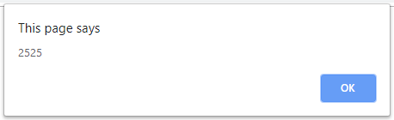
Form values are retrieved as strings
This will turn out to be a very important point!
Any time you retrieve a value from a form, that value comes back as a string.
Even if the value looks exactly like a number, that "number" is in fact, a string!
Concept check: Can you predict what will be output by the alert box here?
    var age;
    age = document.getElementById('txtAge').value;
    //Let's suppose that the user entered 25 for their age
    alert(age+age);
Because age is holding a string (not a number), the ‘+’ operator will do concatenation as opposed to addition.
This type of thing comes up a lot! And if we don't learn how to "fix" it, all kinds of errors and bugs in your code will result.
Be absolutely certain that you understand this concept. It will be vital in many, many situations over the remainder of the course. Also, I can guarantee exam questions relating to it!

Slide 7
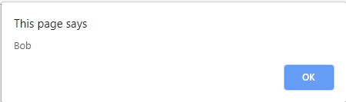
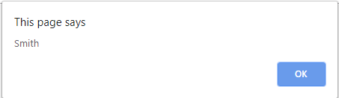
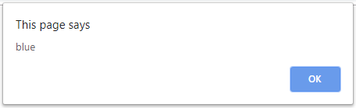
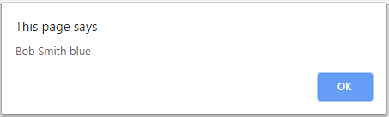
Concatenation Example
Concatenation is also extremely useful when we want to output the value of different strings and variables together. Consider this situation:
      var firstName = "Bob";
      var lastName = "Smith";
      var favColor = "blue";
      alert(firstName);
      alert(lastName);
      alert(favColor);
Hopefully you will agree that it is hardly good scripting!
Now let’s improve on this by first concatenating the strings together:
      alert(firstName + " " + lastName + " " + favColor);
By concatenating the five strings together, this line of code will output all three variables as just one single string.
Note the need to put spaces between each string. If we did not, we would end up with one long bunch of text with no spaces between the words.

Slide 8
Concatenation example
Study this example to ensure that you understand it.
    var firstName, lastName, age;
    firstName = document.getElementById('txtFirstName').value;
    lastName = document.getElementById('txtLastName').value;
    age = document.getElementById('txtAge').value;
    alert("Dear " + firstName + " " + lastName + ",");
    alert("You are " + age + " years old.");
As always, be sure to type out the example yourself and to experiment with it.
Incidentally, note how I typed a space before and after certain strings in our alert statements. If I neglected those spaces, I hope you can see that the words would all be scrunched up against each other.
Next, experiment by placing the entire string in just one alert() window instead of two.

Slide 9
Concatenation example
var firstName = "Wolfgang";
var middleName = "Amadeus";
var lastName = "Mozart";
var fullName;
fullName = lastName + ", " + firstName + " " + middleName + "!";
alert(fullName);
In this case, I concatenated the variables firstName, middleName, and lastName, and placed the resulting longer string inside the variable fullName.
In this example, I hope you can see that our alert box would output the string:
Mozart, Wolfgang Amadeus!

Slide 10
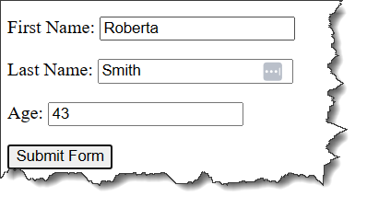
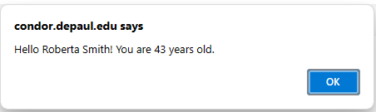
File: concat_ex1.html
<!DOCTYPE html>
<html lang="en">
<head>
<meta charset="utf-8">
<title>Concatenation Example</title>
</head>
<body>
<h1>It Takes Practice...</h1>
<form id="userInfo">
<p>First Name: <input type="text" id="txtFirstName">
<p>Last Name: <input type="text" id="txtLastName">
<p>Age: <input type="text" id="txtAge">
<p><button onclick="testConcatenation()">Submit Form</button>
</form>
<script>
function testConcatenation()
{
var firstName, lastName, age;
firstName = document.getElementById("txtFirstName").value;
lastName = document.getElementById("txtLastName").value;
age = document.getElementById("txtAge").value;
alert("Hello " + firstName + " " + lastName + "! " +
"You are " + age + " years old.");
}
</script>
</body>
</html>

Slide 11
When Form Elements Go Rogue
File: age_next_year_no_parse.html
Be sure to study this example so that you can appreciate the problem.
(Explanation on the next slide)
<!DOCTYPE html>
<html lang="en">
<head>
<meta charset="utf-8">
<title>Form Elements are Strings</title>
</head>
<body>
<h1>How old???!!</h1>
<p>How old are you now? <input type="text" id="txtAge">
<p><button onclick="calcNextYear()" >How old will I be next year?</button>
<script>
function calcNextYear()
{
var ageThisYear, ageNextYear;
ageThisYear = document.getElementById('txtAge').value;
ageNextYear = ageThisYear + 1;
alert("Next year, you will be: " + ageNextYear + " years old!");
}
</script>
</body>
</html>

Slide 12
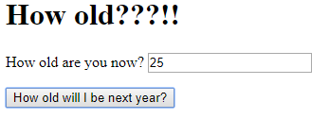
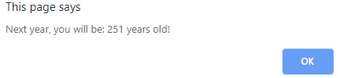
Remember: Form values are retrieved as strings
<!DOCTYPE html>
<html lang="en">
<head>
<meta charset="utf-8">
<title>Form Elements are Strings</title>
</head>
<body>
<h1>How old???!!</h1>
<p>How old are you now? <input type="text" id="txtAge">
<p><button onclick="calcNextYear()">How old will I be next year?</button>
<script>
function calcNextYear()
{
var ageThisYear, ageNextYear;
ageThisYear = document.getElementById('txtAge').value; //ageThisYear is a STRING
ageNextYear = ageThisYear + 1; //We are effectively saying: "25" + 1
alert("Next year, you will be: " + ageNextYear + " years old!");
}
</script>
</body>
</html>
ageThisYear is holding the string "25"
Recall: Adding a string to a number results in concatenation.
Therefore, the expression "25" + 1 produces concatenation (not addition)!
Therefore, the variable ageNextYear will hold the string "251".
We are going to learn how to fix this in our lectures on “parsing”.

Slide 13
New Topic: “Comments”
Recall that comments are very important in programming. As your code becomes increasingly complex, you will find that including comments in your code makes life far, far more pleasant for other programmers working with you on your code.
We have already discussed how to comment in HTML. Recall that placing text inside <!-- and --> will cause that text to be ignored by the web browser. That is, the text will be ignored by the interpreter as it is displaying content on the web browser.
Similarly, JavaScript also has a syntax for including comments. However, the syntax for creating comments in JavaScript is, not surprisingly (as they are different languages), quite different from the syntax for creating comments in HTML.
In JavaScript, there are two ways of creating comments:
Placing two forward slashes // anywhere on a line of JS code tells the interpreter that anything that follows on that SAME LINE OF CODE is a comment and should be ignored.
  If you have multiple lines you wish to “comment out”, then you must put the // characters before each and every one of those lines.
If you wish to write several consecutive lines of comments (a common occurrence), it might be tedious to type double slashes at the beginning of each line. In this situation, we can use "multi-line comments". To do so, type /* Everything that follows until you type a closing */ will be treated as a comment.

Slide 14
Why we comment – part 1
    alert("Hello " + "How are you?");
    //greets the user
    alert( Today is: + Date());
    //prints the date
In this example, only the 1st and 3rd lines will be interpreted. The 2nd and 4th lines will be not be executed by the JavaScript interpreter. Those lines will be ignored because they were “commented out”.
Over time, you will see that programming code – especially when it was written by other people -- can become very confusing to look at and interpret. For this reason, including comments in your code can make life much, much easier for other programmers who may need to work with or modify your code down the road.
Therefore, good programmers use comments quite a lot as a means of communicating their thought process to other programmers, especially for more involved / complicated segments of code.
Note: In the example above, the comments are not really needed since the code is very simple. However, you will come to see that, sometimes, code that makes "perfect sense" when you are writing it, can, in fact, be very confusing when you look at it out of context at a later point in time.

Slide 15
Examples of Commenting
    alert("Hello " + "How are you?");
    /* The above exceptionally brilliant
    example of JavaScript code was written by
    a tragically under-appreciated prodigy. */
    alert("My talents have been wasted.");
    alert("But I'll keep trying"); //Feeling optimistic
A multi-line comment
A single-line comment.
Recall that everything from the // and forward is a comment.

Slide 16
Comments as a debugging tool
Another very common use of comments is as a debugging tool. This is VERY useful. I use it constantly.
var number, name, age;
age = document.getElementById('txtAge').value;
name = document.getElementById('txtName').value;
number = Math.Sqrt(33);
alert(name);
alert(age);
alert(number);
Let’s say that we suspect that our page is failing to work properly due to an error in the line that is calculating the square root.
The easiest way to debug, is to temporarily delete this line (along with its corresponding alert statement). However, in addition to being time-consuming, if we forget to copy the line somewhere, we will probably lose it. This may not seem like a big deal, but imagine if the line of code was very detailed and/or complicated. If we delete it and forget to save it somewhere else, we will end up extremely frustrated!
One VERY convenient tool, therefore, is to simply “comment out” (this is a term programmers use a lot) the lines of code that we think may be causing the problem. We can then reload the page in your browser, and if the file now works, we will have isolated the approximate location of the bug!

Slide 17
The ‘suspicious’ lines commented out:
var number, name, age;
age = document.getElementById('txtAge').value;
name = document.getElementById('txtName').value;
//number = Math.Sqrt(33);
alert(name);
alert(age);
//alert(number);
Because we suspect that the error is in the square root line somewhere, it is commented out. (We also had to comment out the related alert() statement).
When we go back and reload our page, we see that things are working fine. As a result, we know that we do appear to have isolated the error. We can now focus in on that particular line in order to find the bug.
Incidentally, have you spotted the bug?
  Recall that JS is case-sensitive – the function is called sqrt() NOT Sqrt()!

Slide 18
File: debug_practice.html
<!DOCTYPE html>
<html lang="en">
<head>
<meta charset="utf-8">
<title>Practice Makes Perfect</title>
</head>
<body>
<h1>Debugging Example</h1>
Go ahead and comment out the lines you think are causing the problem.
<form id="formName">
<p>Name: <input type="text" id="txtName">
<p>Age: <input type="text" id="txtAge">
<p><button onclick="testComments()" >Submit</button>
</form>
<script>
function testComments()
{
var number, name, age;
age = document.getElementById("txtAge").value;
name = document.getElementById("txtName").value;
number = Math.Sqrt(33);
alert(name);
alert(age);
alert(number);
}
</script>
</body>
</html>
Try it! Go ahead and run this page in your browser. You will see that when you run this page, even though there is a bug on only ONE line of code, the entire script fails!
In other words, a SINGLE line of mistyped code can often cause the ENTIRE script to fail!
Now ‘comment out’ the sqrt() line and see what happens…
Of course, it still won't work because of the alert(number) statement. So comment that one out as well…

Slide 19

Summary
Comments are extremely helpful for explaining your code to other programmers (including your future self!).
They are perhaps even more widely as a debugging tool. Whenever you are stuck in the middle of a block of code somewhere, try "commenting out" one or more lines of code that you think as causing problems. After doing this a few times, you will come to see commenting out as an invaluable tool to help you isolate and fix bugs in your code.

