Slide 1

JavaScript Part 1
Introduction to scripting

Slide 2

Learning Objectives
By the end of this lecture, you should be able to:
  Understand the basics of what a scripting language is and does
  List the three locations where you can place your JavaScripts
  Describe what is meant by “case sensitive”
  Demonstrate familiarity with the various ways the alert() function can be used including when and when not to use quotes
  Describe what a string is
  Open and make use of Chrome’s programming “console”
  FROM MEMORY, be able to type out a short, but complete web document that includes some simple line(s) of JavaScript code

Slide 3

About Scripting Languages
A scripting language provides a set of instructions for the computer to follow.
    Do a calculation
    Change an image
    Store some information
JavaScript is by far the most widely-used client-side scripting language on the web.
  We'll explain "client-side” later
There are several other languages commonly used for web scripting. Some of the best known are PHP, Node, and others.
Full-fledged programming languages including Python, C#, Java and others are also used.

Slide 4

JavaScript is not Java
This is not a particularly important point – I only bring it up here to avoid potential confusion.
One is a scripting language, the other is a full programming language.
  The distinction between a scripting vs a programming language is also not particularly important at this point.
They do share quite a lot of syntax, however.
Java is not easily embedded inside web pages. JavaScript is very easy to embed inside a web page.

Slide 5
Where do you put your scripts?
In an HTML document, any script code must be placed inside a <script> tag
You can place your scripting code anywhere inside the HTML document as long as it is inside the <script> tag.
However, most scripting code is grouped together at the very end of the <body> section.
Scripts may be placed in an entirely separate file (e.g. my_favorite_scripts.js). That file is then referenced from inside the <script> tag.
  This is analogous to referencing external CSS files. (See the discussion on External CSS Stylesheets)
  Many web programmers consider it good form to use external JavaScript documents.

Slide 6
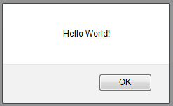
Your first JS function: alert()
This is the tool we will use early on in this course to output information back to the user.
  We will soon learn a far better way of outputting information to a web document.
The alert()function can accept all kinds of information inside the parentheses.
The alert()function displays information inside a dialog box that has an ‘OK’ button. When the user clicks this 'OK' button, the box goes away.

Slide 7
Your first page using JavaScript
<!DOCTYPE html>
<html lang="en">
<head>
<meta charset="utf-8">
<title>JS Practice</title>
</head>
<body>
<h1>Welcome to my first JS Page!</h1>
Let me greet you:
<script>
alert( "Hello World!" );
</script>
</body>
</html>
Note the ; → Semicolons are required at the end of nearly ALL lines of JS code.
Your code will often work without the semicolons, but it is good practice to include them. In this course, they are required.

Slide 8
Case Sensitivity
Many programming languages – including JavaScript— are “case sensitive”.
This means that upper case and lower case letters can not be interchanged – they are considered to be completely different letters!
E.g.:
  alert("Hello World"); → no problem
  Alert("Hello World"); → will not display!
For this reason, whenever you look up code in a reference, be sure to pay attention to case!

Slide 9

Case Sensitivity
Here is an example from the MDN reference page showing a function that returns the square root of a number.
Note that the 'M' (in Math) is capitalized, while the 's' (in sqrt) is not.
  In other words, when typing out this command, be sure to respect these distinctions. Your code will end up with errors if you do not!

Slide 10
Only script code should be present in the <script> tag
(i.e. no HTML or CSS code should be present)
<html>
<head>
<title>First JS</title>
</head>
<body>
<script>
<h1>My First JavaScript</h1>
alert("Hello World");
</script>
</body>
</html>
Bad!

Slide 11
Fun & Games with the alert() function
We can place a variety of information inside the alert() function’s parentheses. Here are some examples.
  alert("Hello"); → Will output the string: Hello
  alert( 5+5 ); → will output: 10 (discussed shortly)
  alert( "5+5" ); → will output the string: 5+5
  alert( Date() ); → will output the date and time
  alert( Math.sqrt(25.0) ); → will output the square root of 25
  alert("5+5 equals " + (5+5) + ".");
    → Uses a technique called ‘concatenation’. We will discuss this later.
Note: The alert box is a JavaScript window, it is NOT a miniature web browser. For this reason, you can not place HTML code inside an alert function.

Slide 12

STOP!
Are you practicing???
Did you type out the examples from the previous slide for yourself?? Did you experiment with those examples by making slight variations in the code?
Learning programming is not a passive process. The only way to learn programming is to program!
The one exception to this is if you are doing a “first pass” through the lecture by simply listening. But the moment you are reviewing the topic, the ONLY way to “get” the material, is to try the examples out for yourself.

Slide 13
Strings
If you put information inside quotation marks, we call that text a ‘String’.
  You should know this term.
A String gets output literally on the screen:
  alert("Hello World"); → Will output “Hello World”
  alert("5+5"); → will output “5+5”
Now notice what happens when we remove the quotes:
  alert(5+5); → Will output 10
  Because it is no longer a String, the literal text will NOT be output to the screen. Instead, the JS engine will attempt to treat that text as a JS command. In this case, JS recognizes the ‘+’ symbol as an addition character and will respond accordingly. This will be discussed in more detail later.
Another example:
  alert("Date()"); --> Can you figure out what will appear?
    → Answer: The alert() function will output the string “Date()”
  alert(Date());
    → JS will attempt to execute the JS function called Date()

Slide 14
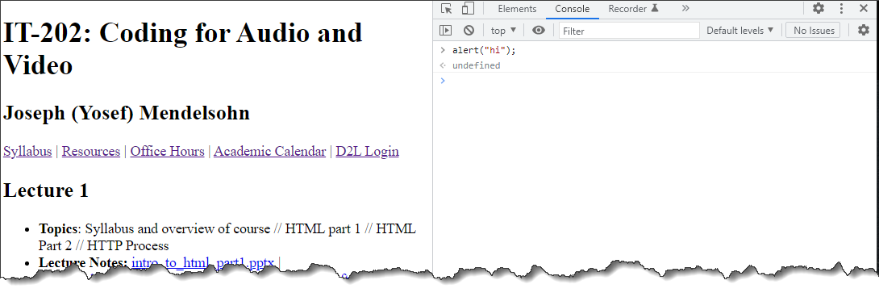
Using Your Browser’s “Console” Tool
We will make much use of a tool called the “Console”. We access this resource through the browser’s “Developer Tools”. This console is an extremely useful resource that will save you a tremendous amount of time when you are developing – especially in JavaScript.
Pretty much every major browser has some form of developer tools. You may have to do a search to figure out how to open it up on your particular browser.
When a bug or error occurs in your page, it will almost always be flagged in this space.
Interpreting the errors can be confusing at times. This becomes much easier with experience.

Slide 15
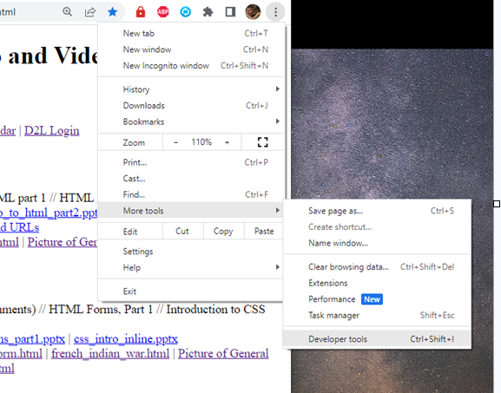
Opening the Console
This will be different from one browser to the next. On Chrome it is currently -- this may, of course change -- accessible by:
Clicking the ellipsis
Clicking on “More Tools”
Then on “Developer Tools”.
Keyboard Shortcut: The current keyboard shortcut is: Control-Shift-I on Windows
Cmd-Alt-I on Mac.
Use It! You will definitely want to make use of this tool when working on your JavaScript.

Slide 16
Be sure to click on “Console”
It’s easy to forget this step. Make sure that the tool your are using in the Developer window is the “Console” tool.
  As of this writing, Chrome defaults to the “Elements” tool.

Slide 17

Scary Warning: Fluency
It's not enough to be vaguely / barely able to execute this code. You must be comfortable with it.
We will be building on these skills quite a bit over the next few weeks. If you don’t get the ‘basics’ down, life is going to be stressful and rough moving forward.
It’s not easy to catch up with JavaScript, so be sure and stay on top of it!
Look at the code in the file specified here. Type it out for yourself a few times, until you can type it out without looking at your notes.
Example: first_javascript.html
If you are not able to create a page with some simple alert statements from memory, than you have not practiced enough!

Slide 18


Your Turn!
Remember: It takes practice!!!
In programming there is a HUGE difference between “understanding” and actually being able to “do it”.
  Trust me on this one… ya gotta practice.
  Go back through every (and I mean every) JavaScript example in this lecture and try them out for yourself.
  Simply feeling like you “got it” isn’t enough. It is very different when you start typing things out on your own.
  Do it… You do not want to fall behind in JavaScript – trust me. ☺

