Slide 1
Intro to HTML – Part III
Creating lists
Creating hyperlinks
Inserting Images
Inserting Video
Understanding HTML Attributes
HTML Comments

Slide 2

Learning Objectives
By the end of this lecture, you should be able to:
  Apply a few additional tags such as li, ol, ul, img
  Be comfortable with certain terminology including "content", "attribute", and "attribute value"
  Be comfortable learning about various HTML attributes through the use of a reference
  Know the difference between the three most common image formats used on web pages
  Know how to insert video into a web page
  Understand what an HTML “comment” is and how to include them

Slide 3
HTML Terminology
Content
  the parts of the HTML file that the user reads and sees (text, images, videos, etc)
  Nearly all of a page’s content is placed inside the ‘body’ section
Tags
  Codes used to create HTML elements
  e.g.
    <p> - tag used to create a paragraph
    <ol> - tag used to create an unordered list
    <img src="picture.jpg"> - tag used to display an image
Attributes
  properties within a tag that specify additional information
  In the tag below, img is the tag, while src, width, and height are all attributes
    <img src="picture.jpg" width="100" height="50">

Slide 4
Some Basic Tag Syntax
Most (though not all) tags must be “closed”. For this reason, tags typically come in pairs
  <title> </title>
Tags usually enclose document content
  <p> … some text ... </p>
Some tags do not enclose content, and therefore do not have to be closed. We sometimes call them "empty tags".
  <br>
  <img>
Sometimes empty tags will be closed with a ‘/’ at the end:
    <br />
    <img />
    This technique is not used in HTML5 and is mostly a relic of older pages.

Slide 5
Nesting Tags
Tags must be nested properly:
LEGAL:
  <p> <em> some text... </em> </p>
  Note how the inner tag, <em> is closed before we close the outer tag, </p>.
ILLEGAL:
  <p> <em> some text... </p> </em> illegal
  Note how the outer tag, </p> is closed before the inner tag, </em> was closed. This is illegal.

Slide 6
HTML Lists
There are two types of lists:
Unordered lists which use bullets
Ordered lists which use some kind of numbering
  1, 2, 3,
  A, B, C,
  i, ii, iii, iv,
  etc.
As you might imagine, we can control the type of bullet using CSS.
Chicago Sports Teams
Hawks
Cubs/Sox (or Sox/Cubs)
Bears
Bulls
Fire
NL Central Standings
Cubs
Brewers
Cardinals
Reds
Pirates
Unordered List
Ordered List

Slide 7
Unordered lists
An unordered list (a.k.a. a bullet list) is created with the tag pair <ul> … </ul>.
  Note that the above code only indicates that we wish to create a list.
Each item in a list is created with the tag pair <li> … </li>.
  This produces an indented list with a default character (usually a small dot) in front of each item.
One optional "attribute" is called 'type'. This attribute dictates the type of bullet to be used:
  <ul type="square">
  Wait: Doesn't use of the type attribute violate the rule that says we should never use HTML to modify the appearance of something?
  You would certainly be forgiven for thinking so. However, over time, there has been considerable discussion about whether or not changing the style of a bullet is semantic (describing the presentation) or stylistic (describing the appearance). Eventually, the case was made that changing the style of the list could be considered semantic, and therefore, the type attribute was allowed to be used with lists.
  If you are ever not sure, always to go an HTML5 reference to see if a certain attribute is allowed. In general, however, we should use CSS whenever possible.

Slide 8
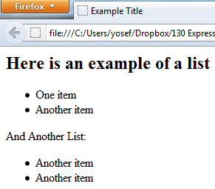
Unordered List Example
<h1>Here is an example of a list</h1>
<ul>
<li>One item</li>
<li>Another item</li>
</ul>
And Another List:
<ul>
<li>Another item</li>
<li>Another item</li>
</ul>
Note the use of whitespace in the HTML code for our list!

Slide 9
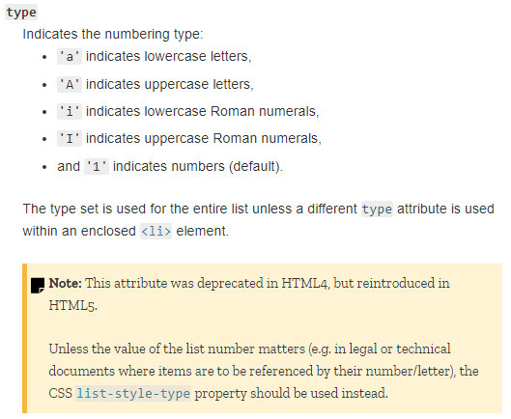
Ordered lists
Standings
Cubs
Brewers
Cardinals
Reds
Pirates
An ordered list is created with the tag pair <ol> … </ol>.
As with unordered lists, each list item is created with the tag pair <li> … </li>.
  This produces an indented list with a default character of 1, 2, 3 in front of each item.
One optional attribute is 'start' which, you guessed it, dictates the starting number.
  <ol start="4">
Another optional attribute is 'type' which, specifies what type of list (1,2,3 vs. A,B,C, vs. I, II, III, IV, etc)
  <ol type="A">
  Note that the MDN reference tells us that we MAY use the HTML “type” and “start” attributes to modify the appearance of the bullets using HTML code. However, the reference also tells us that we should be using CSS to do this. Therefore, once we learn how to do CSS, however, you should modify your list style types using CSS only!
From MDN Reference

Slide 10
Terminology: Tag, Attribute, Value
  <ol type="A">
    ol is the tag
    type is the attribute
    A is the attribute value
      Note how the attribute value is placed in quotes. The value of an attribute is always placed inside quotes.
    Be comfortable with these terms!

Slide 11
Terminology - Another Example
  <img src="picture.jpg" width="50" height="75">
    img is the tag
    width, height and src are attributes
    picture.jpg, 50, and 75 are the attribute values
Again: Attribute values should always be placed in quotation marks
  Though not strictly required by the HTML5 standard, it is sometimes necessary for various reasons (that we won't go into now).
  For this reason, it is a good habit to get into and it used by many web developers.
  Because we want to get into good habits of writing robust, quality code, in this course, placing attribute values inside quotation marks is required!

Slide 12
Using an HTML reference
  <ol type="A">
    Let’s check out the ol tag to see what other options besides A may be used…
      Navigate to a reference such as www.w3schools.com
      Find the link to the HTML Reference page
      Search for the ol tag
      Look for the information on the type attribute
    In spite of the fact that this reference indicates that the type attribute is acceptable, I would like all of you to recognize that its use in this context is "iffy" given that we are adhering to the principle that HTML should never be used to change the appearance of something.
    That being said, until we learn how to do this properly using CSS, we will experiment with this attribute. Go ahead and read up on the type attribute. Note other values that can be assigned to the attribute.
    Experiment with a few of these. (You are trying these out for yourself as you review these lectures, right? RIGHT??) Don’t forget to save your page on your text editor, and refresh the browser after each change.

Slide 13
RIGHT????
There are no shortcuts, I’m afraid. (If there were, I would tell them to you!)
The only, only, only way to “get” this stuff, is to type out code for yourself and experiment with it.

Slide 14
Nested lists
Both ordered and unordered lists can be nested, i.e., a list can go inside a list. This is done by starting a new list before the current list has ended.
There is no limit to the number of levels of nesting.
It’s good practice to use indenting in the source code to distinguish between each level of nesting.

Slide 15
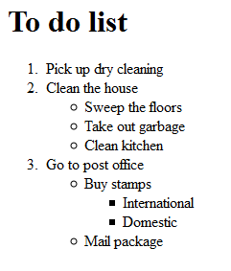
<h1>To do list</h1>
<ol>
<li>Pick up dry cleaning </li>
<li>Clean the house</li>
<ul>
<li>Sweep the floors </li>
<li>Take out garbage </li>
<li>Clean kitchen </li>
</ul>
<li>Go to post office</li>
<ul>
<li>Buy stamps</li>
<ul>
<li>International</li>
<li>Domestic </li>
</ul>
<li>Mail package</li>
</ul>
</ol>
Note the use of indentation in the code.

Slide 16
The Anchor Tag
Creating hyperlinks
One of the most important tags in HTML.
<a> … </a> tags are used to create hyperlinks
We can hyperlink to:
  external web sites
  other documents / resources in the same web site
  different locations in the current document
The required attribute href indicates the destination of the link:
<a href="address/location">clickable text</a>

Slide 17
Some anchor tag examples
Let's create a link to the New York Times web page. The URL (i.e. web address) is www.nytimes.com.
<a href="http://www.nytimes.com">
New York Times
</a>
Now let's create a link to Gmail (mail.google.com):
<a href="http://mail.google.com">Check Gmail</a>
Now let's create a hyperlink to the Chicago Cubs baseball team web site (chicagocubs.com). However, instead of making the hyperlink be text, let's hyperlink an image. (Yep, you can do that!)
<a href="http://chicagocubs.com">
<img src="cubs_logo.jpg">
</a>
Note: Don’t forget to close the hyperlink tag!
Pop-Quiz: What would happen if you forget?

Slide 18
Opening pages in a new window or tab
To open a page in a new window or tab, use the attribute named target:
  <a href="http://www.cdm.depaul.edu" target="_blank">
  (Note the underscore)
  Recall that the value of an attribute should be placed inside quotes

Slide 19
Hyperlink to a non-http protocol:
The anchor tag and the href attribute can be used to reference the protocols other than http. A relatively common one is to link to the e-mail protocol:
<a href="mailto:xyz@depaul.edu">name</a>
Example:
  To make an appointment contact
  <a href="mailto:JosephMendelsohn@gmail.com">Yosef Mendelsohn</a>.
Note how the href attribute is not telling the browser to use the http (i.e. web) protocol. Instead, the attribute is telling the browser to use a mail protocol. Most browser’s have a setting that connects this protocol to your e-mail program (e.g. Outlook, Exchange, etc)
In general, I’m not a big fan of using ‘mailto’, as many visitors use web-based e-mail sites. This link frequently opens up a local e-mail utility such as Outlook other. Better to simply write out your e-mail address.

Slide 20
Inserting images: the <img> tag
An image is inserted using the img tag:
<img src="kittens.jpg">
Note that any image file you wish to display must be uploaded to the server along with your HTML documents!
To reduce clutter within our directories, it is good form to put images in a separate folder.
  In fact, you should organize your website just as you would organize folders on your personal computer. While we won’t do this right away, we will talk about organizing your site later.
Help! My image isn’t displaying:
Be sure that you have spelled the file name correctly (including case!)
Be sure your image has also been uploaded to the server
Check your path (more on this later)

Slide 21
Image Types
Three image file types are supported by pretty much all of today's browsers.
  GIF (a.k.a. Compuserve GIF) - Graphic Interchange Format (filename.gif)
  JPEG - Joint Photographic Experts Group (filename.jpg or filename.jpeg)
  PNG - Portable Network Graphics (filename.png)
Notes:
http://en.wikipedia.org/wiki/Raster_graphics shows an example of raster graphics made of pixels. Vector graphics are another type of graphics that are handled differently.

Slide 22

GIF
GIF files are best used for images that have broad areas of flat color and are highly defined. Things like line art, or very simple drawings.
GIF also supports transparency and animation.
GIF allows a maximum of 256 colors.
Guidelines to keep GIF files small:
  Reduce the number of colors
  Crop out extra space if possible
The file extension for GIF files is .gif
GIFs are not very high-quality images. Developers are using them less frequently in favor of PNGs.

Slide 23

PNG
PNG is another image format for drawings that web developers are encouraged to use over GIF.
They compress well and support transparency.
Most graphics programs provide the option to save drawings in png format.

Slide 24

JPEG
JPEG files are best for images that use many colors and shading, such as photographs.
JPEG has a higher compression ratio but it is a “lossy” compression. This means the compression sacrifices some image data to reduce the file size. This is usually ideal for the web as it allows our pages to load faster.

Slide 25
Images: the alt attribute
The alt attribute allows you to provide a text description of the image.
This attribute should always be included with your images. There are several reasons for this including:
  Accessibility: Many people such as sight-impaired have screen reading software that reads the page out loud. When an <img> tag is encountered, these readers will automatically read the textual description of the image.
    In fact, in some situations, such as many governmental web sites, programmers are required to include the alt attribute.
  Some users intentionally disable the display images such as those currently in areas with extremely slow internet connectivity.
The code:
<img src="lisa_bob.jpg" alt="Lisa and Bob at Eiffel Tower">
For this course, you must always include the alt attribute with your images.
  I remind you of this (and other things) on the assignment checklist page. Be sure to refer to that page before submitting your assignments. It will probably save you from a few lost points along the way.

Slide 26
Inserting Media: the <video> tag
A video can be inserted using the video tag:
<video src="skiing.mp4">
  Note: Some consider it better practice to place it as a separate <source> tag between the opening and closing <video> tags. This is so that browsers that can’t display video have other options.
    <video>
    <source src="skiing.mp4">
    </video>
  For this course, we will typically just use the one <video> tag.
As with images, any file you wish to display must be uploaded to the server along with your HTML file!

Slide 27
Some Considerations for the <video> tag
Resizing: Because you are displaying inside a web browser, always consider resizing the video. However, be sure to keep the aspect ratio consistent. Because the original skiing video was 1920x1080, I resized it to one third of its original size: 640x360.
<video src="skiing.mp4" height="360" width="640">
Downgrade: If the video is large, consider downsizing using video editing software. The original skiing video is about 6 MB in size. This is larger than is probably needed. We may not want visitors to our page to wait for a file of this size to download.
Controls: A useful attribute to include is called controls. This provides play/pause and other controls for the video. Incidentally, note how this particular attribute does not have any associated value.
<video src="skiing.mp4" height="360" width="640" controls>
Upload the Media! As with images, any video (or other media) file you wish to display must be uploaded to the server along with your HTML documents!
Some References for the <video> tag:
https://developer.mozilla.org/en-US/docs/Web/HTML/Element/video
https://www.w3schools.com/tags/tag_video.asp
Be sure to experiment with some of these. Note that not all browsers support all attributes. It can also depend on context.

Slide 28
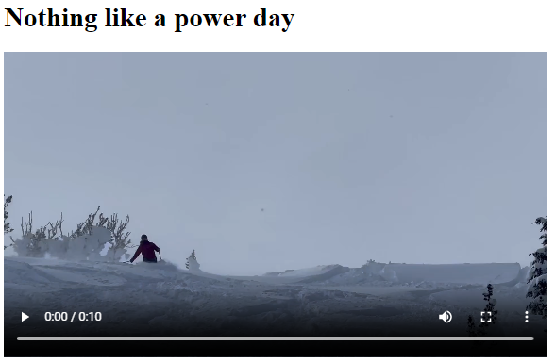
love_to_ski.html
<!DOCTYPE html>
<html lang="en">
<head>
<meta charset="utf-8">
<title>Skiing is Life</title>
</head>
<body>
<h1>Nothing like a power day</h1>
<p>
<video src="skiing.mp4" height="360" width="640" controls>
</body>
</html>

Slide 29
HTML “Comments”
Commenting: Very often when coding, we wish to include some text that should not be considered as part of the code. For example, we may wish to include some side notes to ourselves or to other (or future) members of our programming team. This is called “commenting”.
Every programming language has techniques for commenting. In HTML, we can comment by placing the text between a <!-- Tag and a corresponding --> Tag.
Any content between these two tags will be ignored by the web client when it parses your HTML document.

Slide 30
HTML “Comments” contd.
Here is an example using our skiing video page from before:
When you view this page in your browser, the text between the <!-- and --> will not be displayed.
Both of these comments will be ignored by the browser when parsing your HTML document. They are there purely for informational purposes.
<!DOCTYPE html>
<html lang="en">
<head>
<meta charset="utf-8" />
<title>Skiing is Life</title>
</head>
<body>
<h1>Nothing like a power day</h1>
<p>
<!-– The following code inserts a video into the web page. -->
<video height="360" width="640" controls>
<source src="skiing.mp4">
</video>
<!-– Comments are very important in code. As your code gets
more complex, or if you work in teams, you will start to
appreciate the importance of comments. -->
</body>
</html>

Slide 31
Pop Quiz:
Note the comment tags on this page. Can you predict what will happen when this page is loaded?
Answer: The video will not be displayed. The reason is that the content between the opening <!-- and closing --> will not be parsed by the browser since it is “commented code”.
Note: I will be using HTML comments periodically throughout this course to discuss code in the example files.
<!DOCTYPE html>
<html lang="en">
<head>
<meta charset="utf-8" />
<title>Skiing is Life</title>
</head>
<body>
<h1>Nothing like a power day</h1>
<p>
<!--
<video height="360" width="640" controls>
<source src="skiing.mp4">
</video>
-->
</body>
</html>

Slide 32



