Slide 1
Intro to HTML – Part II
More HTML Tags
Deprecated Tags
Use of Reference Sites
Use of an HTML Validator

Slide 2

Learning Objectives
By the end of this lecture, you should be able to:
  Apply additional tags such as headings and paragraph tags
  Demonstrate effective use of “whitespace” in your code
  Appreciate that visual ‘styling’ is done using only CSS (not HTML)
  Understand the term ‘deprecated’ and how this applies to you as a web developer
  Be able to make use of a reference such as MDN or W3 Schools
  Understand how to use an HTML Markup Checker (a.k.a. Validator)

Slide 3
HTML: The Language of the Web
HTML documents are text files written in HTML.
Basic HTML is very easy to write and even non-programmers can learn it.
When written properly, a given HTML document will appear nearly identical on every browser, regardless of which computer / operating-system is viewing the document
  Think of how a PDF file looks the same no matter what computer or PDF viewer you use to view the document. HTML has the same objective.
HTML describes the organization of a web page through the use of tags.
  Web browsers parse (read) the HTML file, interpret the HTML tags, and render (display) the web page accordingly.
  Ideally, all browsers should display pages exactly the same way. While this is generally true, there are still numerous issues that need to be taken into account.
    Handheld browsers such as those used on a smart phone.
    Browsers that implement unique features.
  Sometimes the differences are subtle, other times, they are obvious. This can be a significant issue in web development, and one that we will refer to periodically throughout the course.

Slide 4
Uses of HTML
Tell the web client (browser) how the text is organized.
  Main heading of a web page
  Subheadings on a page
  Footer of a web page
  Navigation section
  Main section
  Lists
  Paragraphs
  Etc.
Tell the client (i.e. browser) when we are ‘switching languages’ such as when you want to start “speaking” CSS or JavaScript.
The HTML code is used to provide the essential "content" of the page,
  i.e. the information seen by people when they visit your page
Give additional information about the current document, such as:
  the language of the document (English, Spanish, etc)
  the character set being used
  etc.

Slide 5
Anatomy of an HTML tag
Example – the ‘title’ tag:
  <title>IT-202 My First Page</title>
Tags are encased in ‘<‘ and ‘> brackets
  I usually call them “angled brackets”
Most, though not all tags must be “closed”
  A closing tag has a forward slash ‘/’
  In the example above, the </title> is the closing tag

Slide 6
The “Heading” tag
An example of a ‘structure’ tag. I.e. A tag that is used to describe the structure / organization of the document.
Headings: <h1> … </h1> → main topic
  <h2> … </h2> → a subtopic within the <h1>
  <h3> … </h3> → a subtopic within the <h2>
  <h4> … </h4>
  <h5> … </h5>
  <h6> …. </h6>
Note that while these tags print text from very large to very small, they are NEVER to be used as a way to size text or to make it appear in bold.
Heading tags are intended to be used exclusively as a way to divide our page into sections. See the next slide for an example.
In the ‘real world’ we rarely use the whole range of h1 through h6.

Slide 7
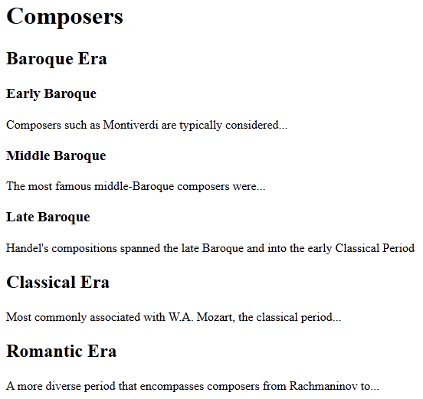
h1
h2
h3
h3
h3
h2
h2

Slide 8
More tags: p, br, img
Paragraph: <p> … </p>
  Every paragraph of content should be enclosed inside the ‘p’ tags.
  Down the road, we will learn that p tags can be used to style and position individual paragraphs.
  The ‘p’ tag also provides an additional blank line of space at the end of each paragraph when displayed inside the browser.
Line Break: <br>
  Creates a new line.
  Without a ‘br’ tag, simply pressing ‘enter’ on your keyboard will only start a new line in your editor. It will not generate a new line when your file is displayed by the browser. Try it!
  Note: Some people feel that <br> is not "pure" HTML. We won't go into tremendous detail for now, however, note that the current W3C HTML validator has no problem with it!
    That being said, you'll find that you won't use this tag very often. If you are creating a list of things, you would use, a list (discussed later). Or if you wanted to create a new paragraph, you would use the aforementioned <p>, etc.
    Examples of places where it might apply include separating lines in an address, or perhaps to write a poem.
Images: <img>
  Used to instruct the browser to display an image.
  We will examine this tag in more detail shortly.

Slide 9
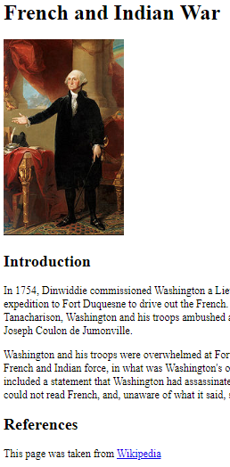
Sample Page – french_indian_war.html
<!DOCTYPE html>
<html lang="en">
<head>
<meta charset="utf-8">
<title>French and Indian War</title>
</head>
<body>
<h1>French and Indian War</h1>
<img src="washington.jpg" alt="Picture of George Washington">
<h2>Introduction</h2>
<p>In 1754, Dinwiddie commissioned Washington a Lieutenant Colonel and ordered him to lead an expedition to Fort Duquesne to drive out the French. With his American Indian allies led by Tanacharison, Washington and his troops ambushed a French scouting party of some 30 men, led by Joseph Coulon de Jumonville.</p>
<p>Washington and his troops were overwhelmed at Fort Necessity by a larger and better positioned French and Indian force, in what was Washington's only military surrender. The terms of surrender included a statement that Washington had assassinated Jumonville after the ambush. Washington could not read French, and, unaware of what it said, signed his name.</p>
<h2>References</h2>
<p>This page was taken from <a href="www.wikipedia.org">Wikipedia</a></p>
</body>
</html>

Slide 10
Whitespace
Note some characteristics of how the document was typed that makes it very easy to follow:
  Independent statements are placed on their own lines (e.g. h tags, meta tags, title tag, etc)
  Indentation of the meta tag and title tag
  Empty lines added between paragraphs
<!DOCTYPE html>
<html lang="en">
<head>
<meta charset="utf-8">
<title>French and Indian War</title>
</head>
<body>
<h1>French and Indian War</h1>
<img src="washington.jpg" alt="Picture of George Washington">
<h2>Introduction</h2>
<p>In 1754, Dinwiddie commissioned Washington a Lieutenant Colonel and ordered him to lead an expedition to Fort Duquesne to drive out the French. With his American Indian allies led by Tanacharison, Washington and his troops ambushed a French scouting party of some 30 men, led by Joseph Coulon de Jumonville.</p>
<p>Washington and his troops were overwhelmed at Fort Necessity by a larger and better positioned French and Indian force, in what was Washington's only military surrender. The terms of surrender included a statement that Washington had assassinated Jumonville after the ambush. Washington could not read French, and, unaware of what it said, signed his name.</p>
<h2>References</h2>
<p>This page was taken from <a href="www.wikipedia.org">Wikipedia</a></p>
</body>
</html>

Slide 11
Whitespace
However, you could type nearly the entire document on a single line - and it would display just fine inside the browser as seen below. But would you want to?!
Clearly, this version of the document is not at all easy to follow. We must ALWAYS remember that other programmers (or even we ourselves) will be looking at our code down the road. As a result, good programmers always try to make their code as clean, and easy to follow as possible.
<html lang="en"><head><meta charset="utf-8"><title>French and Indian War</title></head><body><h1>French and Indian War</h1><img src="washington.jpg" alt="Picture of George Washington"><h2>Introduction</h2><p>In 1754, Dinwiddie commissioned Washington a Lieutenant Colonel and ordered him to lead an expedition to Fort Duquesne to drive out the French. With his American Indian allies led by Tanacharison, Washington and his troops ambushed a French scouting party of some 30 men, led by Joseph Coulon de Jumonville.</p><p>Washington and his troops were overwhelmed at Fort Necessity by a larger and better positioned French and Indian force, in what was Washington's only military surrender. The terms of surrender included a statement that Washington had assassinated Jumonville after the ambush. Washington could not read French, and, unaware of what it said, signed his name.</p><h2>References</h2><p>This page was taken from <a href="www.wikipedia.org">Wikipedia</a></p></body></html>

Slide 12
Whitespace contd
The main way to make your code very clear and easy to follow is through the appropriate use of whitespace. In writing HTML, we try make effective use of whitespace by doing things like:
  Trying to make our HTML document resemble the finished version as it would appear in the browser. In other words, each paragraph separated by a line; each ‘h’ tag on its own line, etc
  Indenting small commands within a section (e.g. The ‘meta’ and ‘title’ tags within the head section).
Clarity is King!! Always use whitespace to ensure that your code is relatively easy to follow.
<!DOCTYPE html>
<html lang="en">
<head>
<meta charset="utf-8">
<title>French and Indian War</title>
</head>
<body>
<h1>French and Indian War</h1>
<p>In 1754, Dinwiddie commissioned Washington a Lieutenant Colonel and ordered him to lead an expedition to Fort Duquesne to drive out the French. With his American Indian allies led by Tanacharison, Washington and his troops ambushed a French scouting party of some 30 men, led by Joseph Coulon de Jumonville.</p>
<p>Washington and his troops were overwhelmed at Fort Necessity by a larger and better positioned French and Indian force, in what was Washington's only military surrender. The terms of surrender included a statement that Washington had assassinated Jumonville after the ambush. Washington could not read French, and, unaware of what it said, signed his name.</p>
<p>This page was taken from <a href="www.wikipedia.org">Wikipedia</a></p>
</body>
</html>
Tags inside the ‘head’ section are typically indented
Section tags (head, body, html, etc) and h tags placed on their own line
Add a blank line between paragraphs

Slide 13
Whitespace: More is NOT better!
Do not overdo whitespace! Too much of a good thing is no longer a good thing. For example, you should rarely (if ever) have more than one blank line on a page.
  Important: Whitespace is NOT a hard-and-fast rule. You will not be graded on how ‘perfect’ your whitespace is. Simply make sure that your code is easy to follow, and don’t overdo it.
<!DOCTYPE html>
<html lang="en">
<head>
<meta charset="utf-8">
<title>French and Indian War</title>
</head>
<body>
<h1>French and Indian War</h1>
<img src="washington.jpg" alt="Picture of George Washington">
<h2>Introduction</h2>
<p>In 1754, Dinwiddie commissioned Washington a Lieutenant Colonel and ordered him to lead an expedition to Fort Duquesne to drive out the French. With his American Indian allies led by Tanacharison, Washington and his troops ambushed a French scouting party of some 30 men, led by Joseph Coulon de Jumonville.</p>
<p>Washington and his troops were overwhelmed at Fort Necessity by a larger and better positioned French and Indian force, in what was Washington's only military surrender. The terms of surrender included a statement that Washington had assassinated Jumonville after the ambush. Washington could not read French, and, unaware of what it said, signed his name.</p>
<h2>References</h2>
<p>This page was taken from <a href="www.wikipedia.org">Wikipedia</a></p>
</body>
</html>

Slide 14
Styling your content: What NOT to do
Any type of visual syling such as changing colors, fonts, text size, underlining, etc must NEVER be done using HTML. This includes positioning things on a page (e.g. centering text).
  Instead, all styling must be done using something called Cascading Style Sheets, or, CSS.
While there are HTML tags that allow you style, these tags are being deprecated (i.e. phased out) and therefore should not be used by a competent programmer. Some examples of deprecated tags:
      <font> </font> Formerly used to modify the font
      <center> </center> Formerly used to center text on the page
To reiterate: Just because a certain tag works, does NOT mean that it’s okay to use it. If a tag has been deprecated, this means it is being phased out of the HTML standard.

Slide 15
Just because it works, doesn't mean it's right!
This is a very important point and must be kept in mind throughout the entire course.
Many things will "work". But that does not mean that they are correct.
Many things that seem to “work” may:
  be generating errors "under the hood"
  not work in the future
  not work on certain browsers
  not be accessible to users with disabilities
It is very important to make sure that you adhere to all of the various rules and conventions as we introduce them throughout the course.
  There will be quite a few, but we will add them incrementally.
  Be sure to stay on top of your practice. Things that seem easy early on, can easily be forgotten as we add more and more rules throughout the course!

Slide 16
Deprecated Tags
An HTML tag is said to be deprecated if it is currently accepted by the current version of HTML but will eventually be eliminated from future versions of HTML.
  This was a very common scenario as HTML4 was being replaced by HTML5.
In the early years of HTML5, there were numerous deprecated tags and attributes out there. So while they were (and often are) still rendered by modern browsers, their use is highly discouraged.
  Deprecated tags and attributes are officially illegal in this course!
The BEST way to find out if a tag or attribute is deprecated is to seek out a reliable reference.
  A great reference to start with the W3 Schools page at: http://www.w3schools.com
  Another, perhaps more “official” reference, is MDN: https://developer.mozilla.org/en-US/docs/Web/HTML
  Bookmark these pages on your computer.

Slide 17
W3 Schools
http://www.w3schools.com
Reference for HTML,CSS, Javascript, etc
Tells you how to use HTML tags, CSS styles, etc
Tells you if tags and attributes are deprecated
Many examples
Tools for experimenting with HTML, JavaScript and CSS
Bookmark It!
Example:
Navigate to the W3Schools page and look for the HTML Reference link.
Note that certain tags such as ‘u’ and ‘center’ are listed as deprecated.
    In fact, if you click on the HTML-5 reference, you will see that these tags are shown as not even being supported by the official HTML5 standard.

Slide 18
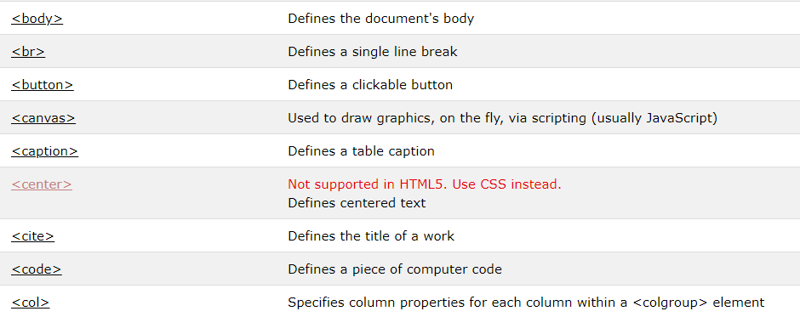
Snippet from W3Schools' HTML5 Reference Page

Slide 19
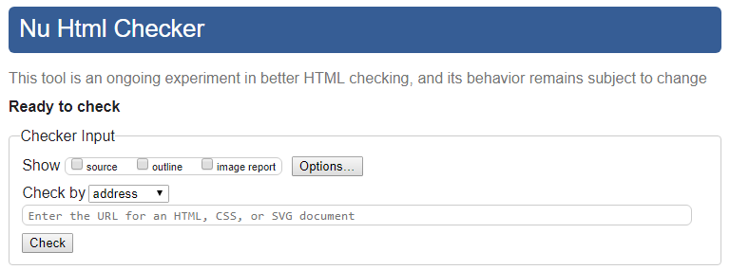
An HTML5 Markup Checker
One very useful tool that can be used to help ensure (though not guarantee) that your code is fully compliant with the official W3 standard for HTML code is through the use of a "markup checker"
  You will often hear this referred to as a "validator"
https://validator.w3.org/nu/

Slide 20
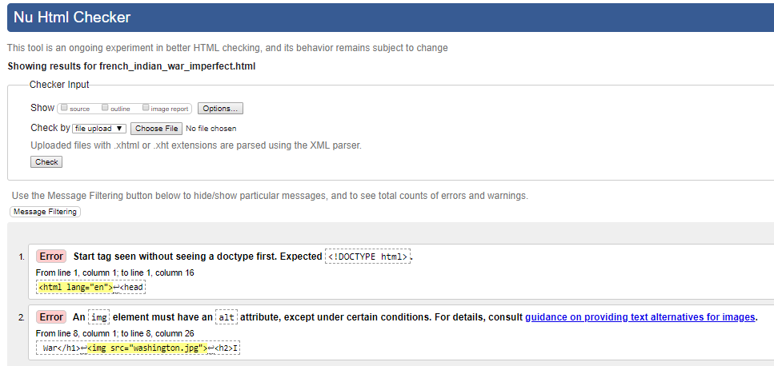
HTML5 Validator
The validator is a very useful tool. However, it is not meant as a foolproof means of catching errors.
Try it with french_indian_war.html and with french_indian_war_imperfect.html
  The imperfect document is missing
    DOCTYPE declaration
    The ‘alt’ attribute inside the <img> tag
    The closing </body> tag
  The validator will pick up on some but not all of these.

