Slide 1

Cascading Style Sheets: Part 1

Slide 2

Learning Objectives
After reading/watching/practicing this topic, you should be able to:
Appreciate the motivation behind the development of CSS
Appreciate the fact that HTML tags and attributes should never be used to change how something appears
Name the three components that make up an inline CSS style
Be able to create an inline style
Be able to assign a color to a style using hexadecimal code

Slide 3
HTML code defines the organization of a document
Recall that HTML is intended for tags to indicate only the content and organization of a document (headings, lists, titles, etc.).
HTML was never originally intended as a tool for formatting the content (e.g. bolding, italics, colors, etc.).
This was fine when web pages were mostly read by scientists doing research work. Nobody was thinking about web pages being used in the elaborate ways that we see today.

Slide 4
…but developers began to want more…
As the web became more ubiquitous and went beyond the realm of scientific research, web page developers, especially those developing commercial websites, wanted to add more visual flair to their pages.
For this reason, several new tags and attributes were introduced in subsequent versions HTML that allowed designers some control over the appearance of the content on the page.
Even so, many designers were still unsatisfied with the options available to them. There were many reasons for this, including limitations on what could actually be done, as well as inconsistency in how HTML documents were being displayed among the many different web clients in use.

Slide 5
…and then it started getting out of hand…
Developers soon started getting carried away though. They started inventing their own HTML formatting tags and attributes.
Yet most of these tags had never been standardized by the W3C which meant that some browsers supported them, and others did not. In addition, because there was no uniformity, even when a tag was “popular” different browsers frequently displayed those tags differently.
All of this went completely against the main objective of HTML which is that a web document should look the same on any browser, on any computer, running any operating system!
At one point then, the W3C basically decided to start over. They decreed that HTML was no longer to be used for formatting. However, they did come up with a standardized—and quite powerful—way of formatting documents which they called Cascading Style Sheets (CSS).

Slide 6
Enter: Cascading Style Sheets (CSS)
The W3 Consortium (www.w3c.org), the same organization that develops the standards for HTML and related standards, introduced Cascading Style Sheets in the mid-1990s.
CSS was intended as a way of formatting web pages.
CSS was designed to augment HTML by allowing web designers a powerful and consistent way of controlling the visual appearance of web pages.

Slide 7
Separating Content and Style
The fundamental difference between CSS and HTML, is the distinction between the outline and content of a web page (achieved via HTML) and the formatting (e.g. appearance, positioning, etc.) of that content (achieved via CSS).
As we learn about CSS you will see that it provides us with:
  Consistent design (e.g. changing a style definition in a single “style sheet” can change every single page on an entire website!)
  More flexibility
  Less work to maintain large websites – some very cool features possible here…
Like HTML, style sheets are written in a language with its own rules and syntax.

Slide 8
An example of a CSS Style
Here is a CSS style that changes the appearance of a particular h1 tag. In this example, we use CSS to instruct the browser to double the size of the h1 content, and to turn it green. We will explain this in detail in the upcoming slides.
<h1 style="font-size:200%; color:green;">

Slide 9
Components of a CSS Style
There are three parts to a CSS style: selector, property, and value.
The selector is the HTML tag you are formatting (e.g. h1),
The property is the characteristic you want to change (e.g. font, color, font size, borders, etc).
You can then assign a value to your property.
Every property and its value are separated by a colon ( : ).
    Recall that in HTML, we assign an attribute to its value by using the equals sign. However in CSS, we separate a property from its value by a colon.
If you include multiple of property/value pairs, each pair must be separated from the next pair by semicolons ( ; ).
  Even if there is only one property-value pair being used, I typically put a semicolon in there anyways in case I decide to add another one later. Many programmers do this.

Slide 10
An example of a CSS Style
HTML attribute to create an "inline" CSS style
“value”
“value”
<h1 style="font-size:200%; color:green;">
“selector”
“property”
“property”
Note: The CSS style shown here is an example of an "inline" style. We will soon learn that there are two additional– and in fact preferable – ways of applying CSS styles called internal, and external styling.

Slide 11
Property / Value Pairs
Comparison of how you assign an attribute/property with its value in HTML vs. CSS:
  HTML syntax: attribute="value"
  CSS syntax: property:value;
    We separate the property from its value by a colon
    We separate each property:value pair from the next property:value pair with a semicolon.
    Even if there is only one property:value pair, I usually place a semicolon after it anyways.

Slide 12
Another Example of an Inline Style
This example applies several styles to a single h1 tag.
    <p style="font-family:Arial;
    font-style:italic;
    font-weight:bold;
    color:blue;">
    Blah blah, de blah blah blah...
    </p>
Note how each property is separated from its value by a colon.
Note how each property:value pair is separated from the next pair by a semicolon (including the last one).
The particular paragraph on this page will be in Arial font, in bold, in italics, and blue text.

Slide 13
Whitespace redux
As discussed earlier, note how we spread the code over more than one line to make it a little easier to read. It is not always necessary to do this. It all comes down to preference. However, you should always do your best to ensure that your code is relatively easy to follow.
For example, compare our code:
  <h1 style="font-family:Arial;
  font-style:italic;
  font-weight:bold;
  color:blue;">
  It Takes Practice...
  </h1>
With this:
  <h1 style="font-family:Arial;font-style:italic;font-weight:bold; color:blue;">It Takes Practice... </h1>
Both will work just fine. However, the second version strikes me as a bit dense. At the very least, I'd probably do something like this:
  <h1 style="font-family:Arial;font-style:italic;font-weight:bold; color:blue;">
  It Takes Practice...
  </h1>
Again, it must be emphasized that proper use of whitespace is fairly subjective. However, you should always make some effort to ensure that your code is easy to read.

Slide 14
Three ways of creating a style
There are 3 different ways that you can apply a CSS style.
  Inline style
  Internal style (a.k.a. "Embedded style")
  External style
Each has various advantages and disadvantages.

Slide 15
Three ways of creating a style:
Inline, Internal, External
Inline style
  An inline style is applied to a single tag inside an HTML document.
  Inline style declarations are placed inside the tag.
  The HTML attribute "style" is used to notify the browser that we are about to apply a CSS style.
  <h1 style="font-size:200%; font-style:italic">
Internal style sheet (also called embedded style sheet) → discussed later
  An internal style is applied to the entire current HTML file but is not applied to other files on the website.
  Internal style declarations are frequently placed in the <head> section of the HTML document.
External style sheet (also called linked style sheet) → discussed later
  An external style is applied to the entire HTML file and may be applied to any or all pages on the website.
  External style declarations are written in a separate text file which is then linked to the HTML file.
  External style sheets make it easy to give a consistent look to any number of web pages.

Slide 16
Inline Style
Again: To create an inline style, the style is declared inside the tag:
<h1 style="font-size:200%; font-style:italic;">

Slide 17
Inline Style Examples
Identify the selector, property, and value
<body style="color:blue;">
body is the selector, color is the property, and blue is the value.
This style would set the text of the entire <body> section to blue.
<p style="background-color:silver;">
p is the selector, background-color is the property, and silver is the value.
This style would set the background color of the particular paragraph (but not any other paragraphs) to silver.

Slide 18
Inline Style Examples
In the style
<p style="font-family:Arial; font-weight:bold">
p is the selector, font-family and font-weight are the properties, and Arial and bold are the values.
In the style
<p style="font-size:300%; color:red">
p is the selector, font-size and color are the properties, and 300% and red are the values.

Slide 19
Pop Quiz:
Can you predict what this page will look like?
<body>
<h3>This is plain h3</h3>
<h3 style="font-family:Arial;font-style:italic; color:green">
This is an example of h3 in Arial, italic, green.
</h3>
</body>
This is plain h3
This is h3 in Arial, italic, and green

Slide 20
Aside: How to specify colors
There are a few different ways to specify a color. However, there is one in particular that is preferred.
All of the examples below specify the color ‘teal’ but in different ways:
Name code: <body style= "color:teal">
RGB color values: <body style= "color:rgb(0,128,128)">
RGB color percentages: <body style= "color:rgb(0%,50%,50%)">
Hexadecimal form: <body style= "color:#008080">
  We will try to use this form throughout our course
  Note the pound sign (#) – this HAS to be there.
Most people use hexadecimal, and that is what we will use in this course.
Sometimes during testing, I will use the ‘name code’, (e.g. ‘blue’) since it's quick and easy – great when just experimenting and "playing around". However, when making a “professional” page, I use hex codes. You should generally try to use hex codes for your assignments, but I won’t be militant about this.

Slide 21
Again: Ideal is to use hex codes for your colors
When playing around on your own during testing, experimenting and so on, feel free to use "name form" (i.e. specifying the color by its name).
  e.g. <h1 style="color:red;">
However, some feel that using hex codes is “best practice”. So it’s not a bad idea to get in the habit of doing so.
  e.g. <h1 style="color:#ff0000;">

Slide 22
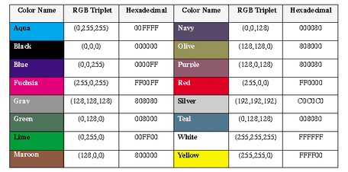
Colors: Names, RGB, and Hex values
This is only a very small sampling of the colors available to you. Google “html color swatch” and you’ll see a vast number of pages with similar tables/swatches.
Notes:
One example: http://websitetips.com/colorcharts/visibone/hex/

Slide 23
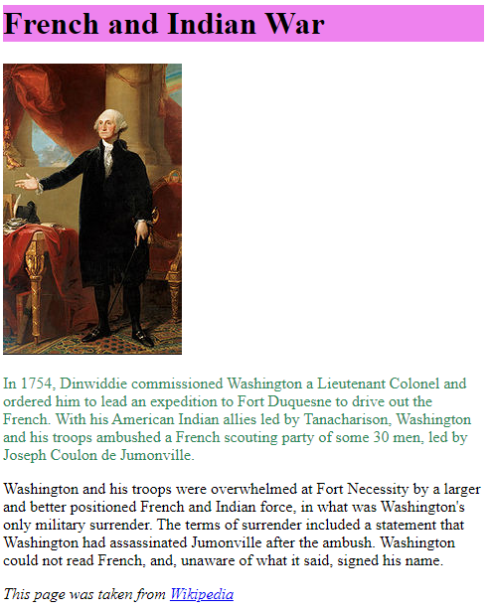
french_indian_war_with_styles.html
<!DOCTYPE html>
<html lang="en">
<head>
<meta charset="utf-8">
<title>French and Indian War</title>
</head>
<body>
<h1 style="background-color:#ee82ee;"> <!-- purple -->
French and Indian War
</h1>
<img src="washington.jpg" alt="Picture of Washington">
<p style="color:#2e8b57;"> <!-- greenish -->
In 1754, Dinwiddie commissioned Washington etc. etc
</p>
<p>Washington and his troops were overwhelmed at Fort Necessity by etc. etc
</p>
<p style="font-style:italic;">
This page was taken from
<a href="www.wikipedia.org">Wikipedia</a>
</p>
</body>
</html>

