Slide 1
CSS
Internal Style Sheets
External Style Sheets

Slide 2

Learning Objectives
By the end of this lecture, you should be able to:
  Distinguish between inline, internal, and external styling.
  Apply the three types of styles.
  Recognize who “wins” when there is a disagreement between the three styles.

Slide 3
Review:
Selectors, Properties, Values
Recall that every style has three components:
Selector:
  i.e. the element the style should apply to. I.e. Elements such as: body, p, h2, img, etc.
Properties:
  e.g. color, background-color, font-family, text-align, width, height
Values:
  #ff0000 (the color red), italic, center, 200px

Slide 4
Inline Style
The style is placed inside the element’s tag.
The style is applied to that element - and ONLy that element! Any subsequent elements – even of the same selector will not have those styles applied, unless you rewrite out the inline style each time.
<body>
<p style="font-style:italic; color:#ff0000;">
This paragraph will be in red and italics. </p>
<p>The styles in the paragraph above will NOT apply to this paragraph. </p>
</body>

Slide 5
Three ways of creating a style:
Inline, Internal, External
Inline style
  An inline style is applied to a single element of the current HTML document.
  Inline style declarations are placed inside the tag.
  <h1 style="font-size: 200%; font-style: italic;">
Internal style sheet (also called “embedded” style sheet)
  An internal style applies the style to every element in the entire current HTML file. However, the styles are not applied to other files on the website.
  Embedded style declarations are frequently placed in the head section of the HTML file. Sometimes they are placed near the end for performance reasons.
    We will place them in the <head> section for this course.
External style sheet
  An external style is applied to the entire HTML file and may be applied to any or all pages on the website.
  External style declarations are written in a separate text file which is then linked to the HTML file.
  External style sheets make it easy to give a consistent look to any number of web pages.

Slide 6
Internal Style Sheets
Styles that apply to every instance of a tag within the current HTML document.
    i.e. They will not apply to other pages on your website.
The styles are placed not inside the tag as with inline styles, but rather, between <style> and </style> tags .
This section is typically placed inside the <head> section.
The selector is identified, and then inside curly braces, we place all of the property:value pairs.
<head>
<title>Internal Styles</title>
<meta charset="utf-8">
<style>
h1 {font-size: 200%; font-style: italic}
h2 { color:#ff0000; }
</style>
</head>
This line says that every h1 tag in the current document will use this style.

Slide 7
Example: internal_style.html
<head>
<title>Internal Styles</title>
<meta charset="utf-8">
<style type="text/css">
body { border:10px solid #335bff; width:300px; }
h2 { font-family:Verdana; text-size:140%; }
h3 { font-family:Arial; font-style:italic; color:#ff0000;}
</style>
</head>
<body>
<h3>This is some h3 content.</h3>
<h4>This is some h4 content.</h4>
<p>Notice how the entire body has a border around it.</p>
</body>
Note the inclusion of the ‘type’ attribute in the <style> tag. This attribute is not strictly necessary in HTML5, but some programmers like to include it, typically for backwards compatibility. You are not required to use it for this course.

Slide 8
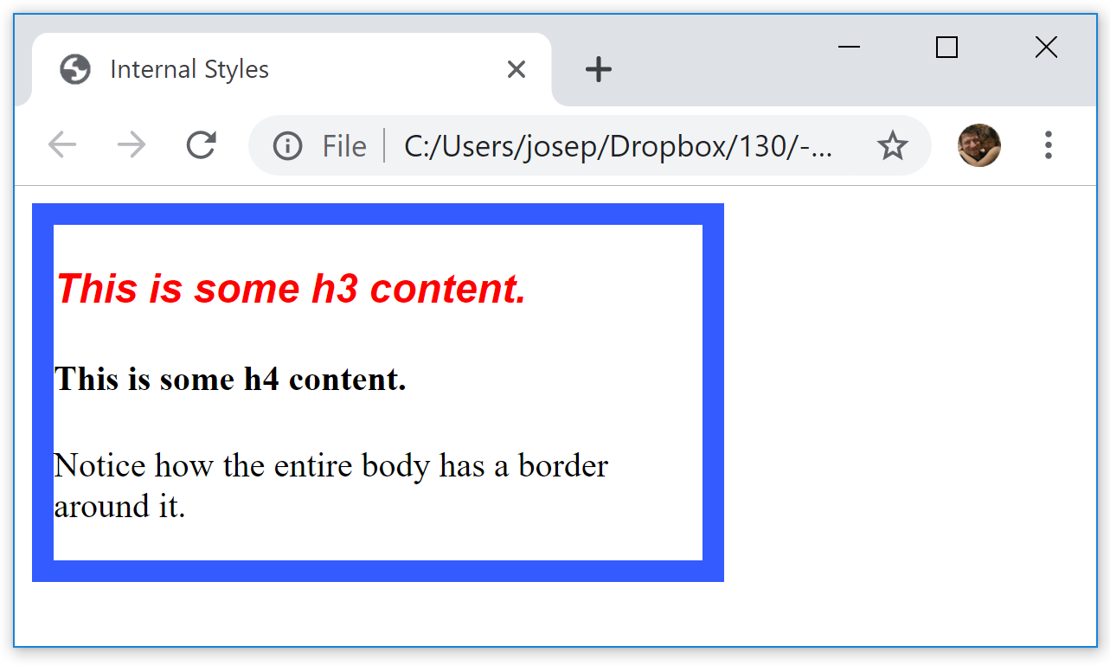
<style type="text/css">
body { border:10px solid #335bff; width:300px; }
h2 { font-family:Verdana; text-size:140%; }
h3 { font-family:Arial; font-style:italic; color:#ff0000;}
</style>
</head>
<body>
<h3>This is some h3 content.</h3>
<h4>This is some h4 content.</h4>
<p>Notice how the entire body has a border around it.</p>
</body>

Slide 9
Shortcut: Applying the same style to multiple tags
<style type="text/css">
h1, h2, h3, h4, h5, h6 { color:#ff0000; font-family:Arial}
</style>
This shows that you can apply styles to several selectors (e.g. tags) at the same time. In this case, all of your h tags would be in red and Arial.
Simply separate the selectors with commas.

Slide 10
External Style Sheets
You can create an entirely separate document containing all of the styles you wish to apply. Then you can link any HTML page you ever create to this one document.
To create an external style sheet, place all of your styles in a separate text file and give that file the extension .css (e.g. my_styles.css )

Slide 11
Example of an external style sheet
An external style sheet lives in its own separate document.
This document should not have any HTML tags: An external style sheet should contain only CSS styles.
  When we say "no HTML tags", this includes the <style> tag! Remember that the <style> tag is an HTML tag, not a CSS style.
favorite_styles.css
body {
background-color:#ccffff;
color : blue;
}
h1 {
color:#000090;
font-size:150%;
}
h2 {
color:#000090;
font-size:150%;
}
h3 {
color:#000090;
font-size:115%;
}
form {
color:#000090;
font-size:115%;
}

Slide 12
Linking to a web document to an external style sheet
Once you have created an external style sheet, you can now link any HTML document to this sheet. By linking a web document to the style sheet, all of the styles in that sheet will be applied to the web document.
To link an external style sheet to an HTML document, include the following <link> tag inside the <head> section of your HTML document:
<link rel="stylesheet" href="favorite_styles.css">
This <link> tag’s attributes tell the browser to
  apply an external style sheet
  and that the name of that style sheet is favorite_styles.css
Reminder: An external style sheet must NOT contain any HTML or JavaScript code.

Slide 13
Some benefits of external style sheets
An external style sheet lets you maintain a consistent look and feel throughout all of the pages on a website.
For example, you can link every page on your company’s website to the same style sheet. At that point, all of the styles created in your external sheet will be applied to every page on your site.
In addition, if you wish to make a change throughout your entire site, you only need to change it once within your external sheet. Your change will then be reflected throughout your entire website!

Slide 14
Recap of external style sheets
As with other programming code (HTML, JavaScript), the .css file is a text file and can be created using any text editor.
This CSS file should have no other code in it besides CSS styles.
  For example, there should NOT be any HTML code in your external sheet.
  This even includes the <style> tag – which, of course, is an HTML tag – not CSS!
The <link> tag which tells the current HTML document to use this external style sheet is placed inside the <head> section.

Slide 15
Summary of the syntax for the three style types
With inline styles:
  styles are written directly inside the tag
  style= attribute is used
  the property / value pairs are in quotes
  styles apply only to the current tag
With internal styles
  the styles are placed in the <head> section
  <style> </style> tags are used
  the property / value pairs are placed inside curly braces
  styles apply to all instances of the tag (selector) in the current web page
With external style sheets
  styles are written out in a separate (external) document – a text file with a CSS extension
  <style> </style> tags are NOT used -- in fact, no HTML should be present
  the property / value pairs are in curly braces
  styles apply to all instances of the tag (selector) on all web pages that are linked to the style sheet

Slide 16
All three formats can be in use at the same time
Suppose an external style sheet has:
h3 { color:red; text-align:left; }
… and the internal style sheet has:
h3 { font-size: 20pt }
…and one particular h3 on your page, adds one (or more) additional style(s):
<h3 style="font-family:Verdana;>
Then the h3 style for that particular tag will end up as:
color:red; text-align:left; font-size: 20pt; font-family:Verdana
* Note that I did not use a hex name for the color 'red' in the above example. As indicated in an earlier talk, when practicing / experimenting, it is perfectly okay to use color names. However, for "finished" products, you should use hex names.

Slide 17
When styles collide…
It is not uncommon to find yourself in a situation where you are using an external style sheet for several web pages, only to decide you’d like to change a style on one particular page.
Suppose the external style sheet has:
h3 { color: red; text-align: left; font-size:30pt; }
… and for a particular page, you decide you want to make the font a little smaller. In this case, you can include the following internal style:
h3 { font-size:20pt; }
Then the h3 style for that particular page will end up as:
color:red; text-align:left; font-size: 20pt
Note how the internal style “beat out” or “overrode” the external style.

Slide 18
Who’s the boss?
The style with higher priority overrides/overrules/replaces the style with lower priority. This explains the name “Cascading Style Sheets”.
So, all styles from the different locations will be applied. However, when there is a disagreement:
  Inline styles take precedence over internal styles
  Internal styles takes precedence over external styles
  Inline > (wins over) Internal > External
One way to remember: The “nearer” a style is to its HTML tag, the higher the priority.

Slide 19
Multiple Styles On One Page
body {
background-color:#ccffff;
color : blue;
}
h1 {
color:#000090;
font-size:150%;
}
h2 {
color:blue;
font-size:150%;
}
h3 {
color:#000090;
font-size:115%;
}
form {
color:#000090;
font-size:115%;
}
Within a single web page, you can have all three kinds of styles present!
  Your page is linked to an external style sheet
  You have added some additional styles via an internal style that were not used in the external sheet
    E.g. You decide to apply an additional style to <h2> that was not provided in the external sheet.
  You used a couple of inline styles for some small individual sections
<head>
<meta charset="utf-8">
<title>Practice Makes Perfect</title>
<link rel="stylesheet" href="favorite_styles.css">
<style>
h2 { font-family:Arial; }
</style>
</head>
<body>
<h2 style="color:red;">Some H2 text...</h2>
Rest of page here...
</body>
favorite_styles.css
The net effect is that the h2 will be at size 150% (from the external sheet), in Arial font (internal style), and in red (changed from blue via the inline style).

Slide 20
Example
Suppose the external style sheet has:
body {font-family:Arial; text-align:left; font-size:16pt; }
…and the internal style sheet has:
body { text-align:right; }
…and within the body tag, you add the inline style:
<body style="font-weight:bold;">
What will the body’s properties be?
font-family:Arial; text-align:right; font-size:16pt; font-weight:bold;
Again, recall that the inline style has a priority over internal style, which, in turn, has priority over external styles.
And, of course, the non-conflicting styles will continue to be applied.
20

Slide 21
File: css_int_ext.html
An example of a page that makes use of inline, internal, and external styles.
  Links to the external style sheet: favorite_styles.css
  I am not using hex-codes for the colors here, in order to make the discussion easier.
<!DOCTYPE html>
<html lang="en">
<head>
<meta charset="utf-8">
<title>Demonstration of Internal and External Styles</title>
<link rel="stylesheet" href="favorite_styles.css">
<style>
body { background-color:peachpuff; }
h2 { color:green; font-family:Arial; }
h3 { color:red; }
</style>
</head>
<body>
<p>Please note that I am NOT using hex codes here. I am doing this to make it easier for purposes of this discussion.</p>
<p>The first thing you may notice is that the background color for this page is 'peachpuff'. This is an example where the external style says one thing (silver) and the internal says another (peachpuff). Remember that inline "beats" internal, and internal "beats" external. </p>
<h1>Note that there is no reference to an h1 color here on this document. The color you see here is generated by the external style sheet.</h1>
<h3>Note that the h3 color here is generated by the internal style sheet. </h3>
<h3>Note that this h3 color is still the same color... This is an advantage of internal/external styles over inline styles. EVERY instance of the tag on the page displays using the styles indicated.</h3>
<h2 style="font-size:150%; font-family:Verdana;">And yet, if we want to apply inline styles, we can. We can either add additional styles inline, and/or we can override styles from the internal/external style sheets. In this case, we override the font from the internal style in favor of the one written in the inline style.</h2>
</body>
</html>

