Slide 1
JavaScript:
Limiting Free Text Entry

Slide 2

Learning Objectives
By the end of this lecture, you should be able to:
  Understand and describe why it’s a good idea to limit free-text entry by users
  Apply various techniques for limiting free-text entry

Slide 3
Limiting / Avoiding Free-text Entry by Users
When visitors to your web page are allowed to type in data on their own, there is tremendous opportunity for bugs – and even hacking. For example, hackers have successfully entered JavaScript code into text fields and used that code to gain entry to “secure” systems and do tremendous damage.
On a more benign level, imagine you want the user to tell you the day of the week (recall our parking meter example). Will they enter Sunday, sunday, SUNDAY? What about typos? Ssunday, Sunda, etc, etc.
This is why web designers will, whenever possible take the option for entering text out of the user’s hands. There are many techniques for doing so including the use of
  Select boxes (e.g. for day of the week)
  Check boxes (I agree/Disagree)
  Radio Buttons (rate from 1 to 10)
  Calendar widgets (for dates)
  Etc.
Generally speaking, you should only allow the user to enter text where it is absolutely required. Some examples:
  Name
  Email Address
  Address
  Phone number

Slide 4
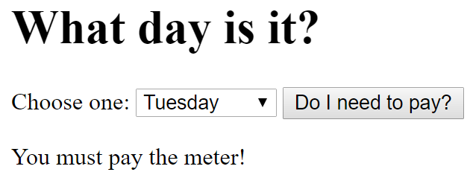
Eliminating free-text entry
Recall our parking meter example in which we asked the user what day or the week it was. We then had them type the day of the week into a text box.
Now that we know that this is something to avoid, let’s redo the example but instead of using a text field, we will use a select box.
Here is the code for the web page itself. Before looking at my solution, try to convert this into a working program in which if the day is Sunday, you tell the user to pay the meter. If it is not Sunday, you tell them that they do not have to.
My version of the solution (which may well differ from yours) is on the next slide. But DO work it out on your own before looking at my answer.
<!DOCTYPE html>
<html lang="en">
<head>
<meta charset="utf-8">
<title>Parking Meter</title>
</head>
<body>
<header>
<h1>What day is it?</h1>
</header>
<main>
Choose one:
<select id="selDayOfWeek">
<option value="su">Sunday</option>
<option value="mo">Monday</option>
<option value="tu">Tuesday</option>
<option value="we">Wednesday</option>
<option value="th">Thursday</option>
<option value="fr">Friday</option>
<option value="sa">Saturday</option>
</select>
<button type="button" onclick="determinePayment()">
Do I need to pay?</button>
<p>
<div id="output_area">
</div> <!-- end of output_area div -->
</main>
<script>
WRITE YOUR FUNCTION HERE
</script>
</body>
</html>

Slide 5
File: parking_meter_select.html
<!DOCTYPE html>
<html lang="en">
<head>
<meta charset="utf-8">
<title>Parking Meter</title>
</head>
<body>
<header>
<h1>What day is it?</h1>
</header>
<main>
Choose one:
<select id="selDayOfWeek">
<option value="su">Sunday</option>
<option value="mo">Monday</option>
<option value="tu">Tuesday</option>
<option value="we">Wednesday</option>
<option value="th">Thursday</option>
<option value="fr">Friday</option>
<option value="sa">Saturday</option>
</select>
<button type="button" onclick="determinePayment()">
Do I need to pay?</button>
<p>
<div id="output_area">
</div> <!-- end of output_area div -->
</main>
<script>
function determinePayment() {
var outputString;
var dayOfWeek = document.getElementById("selDayOfWeek").value;
if ( dayOfWeek != "su" )
outputString = "You must pay the meter!";
else
outputString = "You do not have to pay the meter!";
document.getElementById("output_area").innerHTML = outputString;
}
</script>
</body>
</html>
Where are the braces?
Recall that if the block of an if or else or else if statement is only one statement long, then the braces are optional.

Slide 6
Eliminating free-text entry
Suppose you wanted to ask the user their favorite Chicago sports team. Will they enter: Cubs, cubs, Chicago cubs, Sox, White Sox, White-Sox, CWS, Hawks, Blackhawks, BLACKHAWKS!, etc, etc, etc. In other words, we have absolutely no idea what the user may type!
Depending on the team they choose, we output “You are a fan of the Chicago Blackhawks“ (or whichever team they selected).
Again, our solution to this problem is to take away the user’s ability to enter any free text at all. Instead, we use form elements such as radio buttons, or, in this case, a select box.

Slide 7

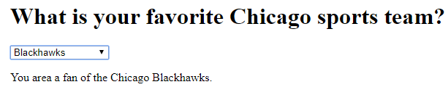
File: favorite_sports_team.html
<h1>What is your favorite Chicago sports team?</h1>
<select id="selTeam" onclick="checkTeam()">
<option value="choose">Choose One</option>
<option value="cubs">Cubs</option>
<option value="sox">Sox</option>
<option value="bears">Bears</option>
<option value="hawks">Blackhawks</option>
<option value="other">None of the Above</option>
</select>
<div id="output_area">
</div> <!-- end of output_area div -->
<script>
function checkTeam()
{
var outputString = "You are a fan of the Chicago ";
//We will concatenate onto this string the team that they choose.
var team = document.getElementById("selTeam").value;
if ( team=="cubs" )
{
outputString = outputString + "Cubs."; //Concatenate “Cubs.” onto the variable ‘outputString’
}
else if (team=="sox")
{
outputString = outputString + "White Sox.";
}
else if (team=="bears")
{
outputString = outputString + "Bears.";
}
else if (team=="hawks")
{
outputString = outputString + "Blackhawks.";
}
else if (team=="other")
{
outputString = "Not a sports fan?";
}
if (team!="choose") //We output ONLY if they chose one of the options from the select box
{
document.getElementById("output_area").innerHTML = outputString;
}
}
</script>

Slide 8
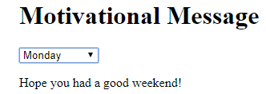
Exercise:
Prompt the user for the day of the week again by using a select box.
  If they choose Saturday or Sunday (you MUST use the logical or “||” to do this) output: “Have a great weekend!”
  If they choose Monday output: “Hope you had a good weekend”
  If they choose Tuesday OR Wednesday OR Thursday output: “Mid-week Blahs”. (Note: Use your OR operators for these three).
  Friday, alert: “TGIF!”
  For this program, place the onclick attribute inside the <select> tag.
  You can see my version in: day_of_the_week.html

