Slide 1
Intro to HTML – Part IV
The W3C
More on images
Entity codes
Remote vs Local Computers

Slide 2

Learning Objectives
By the end of this lecture, you should be able to:
  Identify the organization responsible for creating the “rules” of the web
  Understand a little more about images
  Use entity codes to display non-standard characters
  Explain what is meant by ‘uploading your file to the server’ and the name of the protocol used to accomplish this task.
  Explain what is meant by a "local" vs. "remote" computer

Slide 3
The World Wide Web Consortium (W3C)
The WWW Consortium (W3C) is the group that establishes the “rules” of HTML and related standards.
It is a collection of organizations and experienced individuals tasked with agreeing upon and documenting the standards for use with the world wide web.
Long, long ago (i.e. the 90s and 00s!) there were numerous issues involving inconsistency in how different browsers displayed the same HTML code. In addition, many browsers implemented their own "specialized" tags and functionality. This quickly became a nightmare, and was one of the reasons that the W3C has taken a major role in HTML and related web standards.
As an example, if a new tag or attribute is to be approved (or an old one to be deprecated), it is the W3C that will investigate and discuss the reasons for doing so.

Slide 4
Reminder: “URL” = Web Address
URL: Uniform Resource Locator. It is an address that specifies the location of a file on the Internet.
That is if someone says to you: “What is the URL of that page?”, they are asking you for the web address.
    E.g. http://www.nytimes.com

Slide 5
Images: Bandwidth limitations
Image files consume more bandwidth than text files since they are usually considerably larger.
Users who access the Internet via slower connections will have to wait (sometimes for quite a while).
Therefore, for purposes of usability, try to avoid/minimize use of large images.

Slide 6
Images: Using thumbnails
If you do want to make very large images available, one option is to use thumbnails, which are reduced versions of your images. Those thumbnails can then be hyperlinked to the larger versions.
  <a href="high_resolution_photo.jpg">
  <img src="low_resolution_photo.jpg">
  </a>
* Note: To save space, I've left out the alt attribute from this example.
In this example, the photo called: low_resolution_photo.jpg is initially displayed However, it is hyperlinked to the image high_resolution_photo.jpg. If the user clicks on the initial image, the larger one will then display.
Several freeware and shareware graphic programs can create thumbnails
Guess What: This particular example is not meant to teach you about the use of thumbnails! Rather, it is about "usability". Always bear in mind that there are many, many users out there using different devices, different browsers, and at different bandwidths. This fact must always be kept in mind by web developers.

Slide 7
Images: Rescaling images
It is possible to rescale an image by changing its WIDTH and HEIGHT attributes:
<img src="mozart.jpg"
height="100" width="100"
alt="Picture of Mozart" >
Important: If you wish to rescale an image, be sure to preserve the aspect ratio (height-to-width ratio) otherwise the image gets distorted. Divide or multiple the dimensions by the same factor. In the example above, the original image of Mozart was 300x300 pixels. So in this example, while we have reduced the display on the screen to 1/3 its original size, we have also preserved the original dimensions.
Important: Scaling down an image DOES NOT reduce its file size (bandwidth requirements). To reduce the file size, you need to compress the image.
This should really be done using CSS!!!

Slide 8
Special Characters aka “Entities”
Suppose you wanted to insert the copyright symbol – how would you do it?
Suppose you wanted display the < symbol on a web page – how would you do it?
  Recall that this symbol will make some browsers think you are about to create a tag.
Answer: There are special codes we can use to display special characters. I.e. Characters that are either not available on conventional keyboards, or are reserved because they are used as HTML syntax.
  HTML provides us with special codes to display such characters.
  Look up “HTML Entities” in an HTML reference to find a detailed list.
  A few examples are provided on the next slide.

Slide 9
A Few Entity Codes
Code name | Code | Symbol
&nbsp; | &#160; | non-breaking space
&lt; | &#60; | <
&gt; | &#62; | >
&amp; | &#38; | &
&copy; | &#169; | ©
&reg; | &#174; | ®
 | &#64; | @
For some entities, in addition to the numeric entity codes, the W3C has given us “friendlier” versions that can also be used.
Chicago Cubs&#169;
Chicago Cubs&copy;

Slide 10
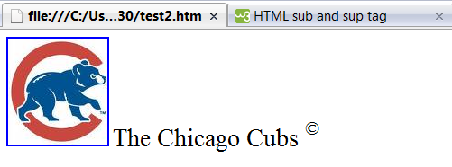
Using an entity code to display a symbol:
The Chicago Cubs<sup>&copy;</sup>
(Can you guess the purpose of the <sup> tag?)

Slide 11
Practice Time
Practice the following until you get to the point where you can type the HTML code from memory:
Inserting images
Creating hyperlinks
Hyperlinking images
Your goal is to be able to create the following page without referring to your notes:
Download an image from the web on a favorite musician, sports team, hobby, etc.
Then create a very short HTML document in which you talk about it. (For practice purposes, just make it just a single sentence or so).
Have the image link to the Wikipedia web page about the topic.
NOTE: This exercise is absolutely NOT about memory per se! Rather, by typing things out by memory, it will mean that you are getting many of these details under your "mental fingertips". Believe me – it helps. A lot.

Slide 12
The next step in creating web pages, contd:
Secure File Transfer Protocol (SFTP)
Type up the HTML document
  text file (i.e. do not write in Word)
  View on a browser on your local machine (File → Open)
However, the document is not yet available to the world. It currently exists only on the "local" computer – i.e. the computer in front of you. In order to make this document available on the web, it must be uploaded to a web server.
New Step: Upload your file(s) to the server
  There is a protocol used to copy the file(s) from the local computer (i.e. the computer in front of you) to another computer (e.g. a web server) located elsewhere on the internet, the "remote computer". This protocol is called “Secure File Transfer Protocol” or “SFTP”.
    Often, for short, we simply say: “FTP”. You will sometimes hear people say “SSH” which is a similar protocol used to accomplish the same task.
  Don't forget that in addition to the HTML documents that you create, you must also upload any additional files you wish to make available on the web. For example, if your page has images, you must also upload those images to the web server.

Slide 13
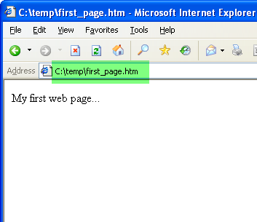
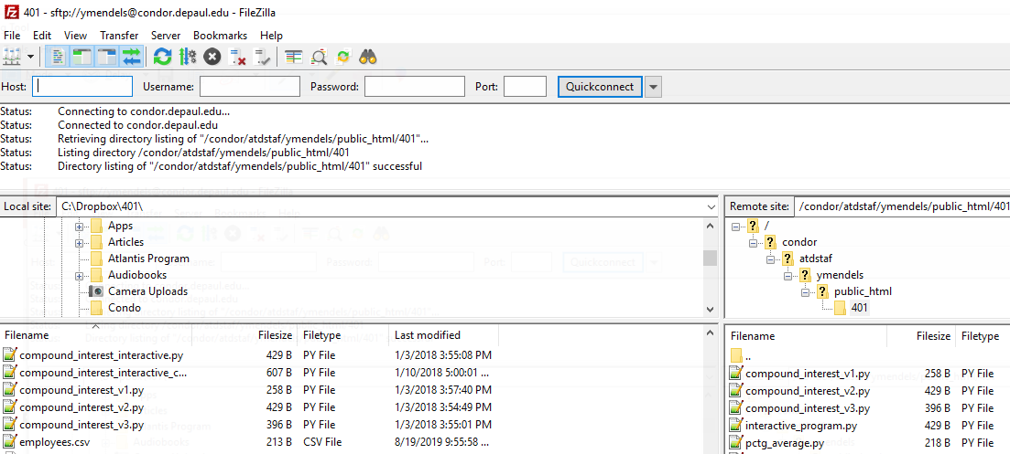
Review of the process
Create your HTML document and test/edit/modify as needed on the computer in front of you.
  We typically refer to the computer in front of you as the “local” computer.
Click on File → Open and navigate to your file. Or, simply type the name of the file in the URL box.
Once you are happy with the version on your computer and are ready to make go live on the web, you must upload it to the server using a protocol such as SFTP.
  We typically refer to the computer you are moving your file(s) to as the “remote” computer.
We will discuss how to do this in an upcoming lecture.

