Slide 1
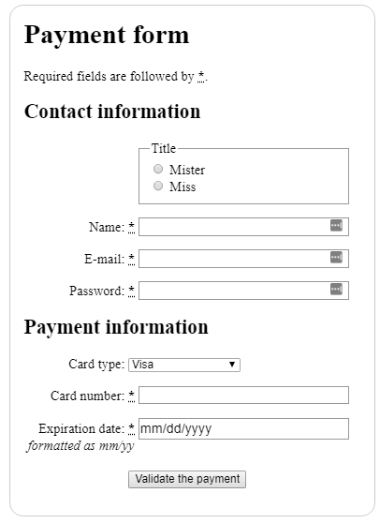
HTML Forms, Part 1
Image taken from "How to structure an HTML form" from Mozilla Developer Network.

Slide 2

Learning Objectives
By the end of this lecture, you should be able to:
  Create a basic form with text fields, text areas, and buttons
  Understand the need for the <label> tag, and the for attribute
  Describe what is meant by “programming conventions”
  Apply programming conventions when creating a web form
  Describe the next step that must occur in order for an HTML form to be able to “do something”

Slide 3
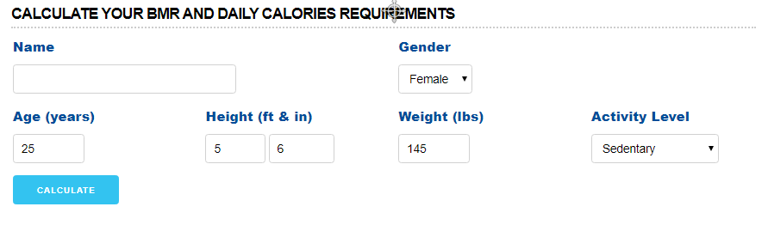
Example: The BMR Calculator
A form
Allows the user to enter some information about themselves and estimates the their basal metabolic rate (the number of calories their body consumes at rest in a day).
Dynamic HTML being used:
    A form to enter data
    A client-side JavaScript that parses the form and uses the data to come up with a calculated value
    http://www.drgily.com/basal-metabolic-rate-calculator.php
      Note: This URL may change.
      FYI: Calculating BMR is a debated topic in medical/nutrition circles. Be careful of which formula you use.

Slide 4

Another example – CDM Tutor Search
  Form: The user selects a subject from the select box. In response to this choice, the form queries a database and returns a list of tutors who can help with that particular subject.

Slide 5
FORMS
Our first venture into creating interactive/dynamic web pages.
Web page takes input from the user and processes it in some way:
    Calculator (e.g. BMR, Mortgage, etc)
    Stores information in a database (registering a purchased product, signing up for a mailing list)
    Submits information (e-mail customer support)

Slide 6
Overview of Forms
Forms are made up of a group of HTML elements that allow the person viewing the page to supply information.
Form elements include things like buttons, text-boxes, drop-down boxes (also known as "select boxes“), check-boxes, radio buttons, etc.
  The HTML code to place these elements on a page is pretty straight-forward.
Creating HTML forms is not difficult. However, doing something with the information that has been entered into a form requires writing instructions in the form of a scripting or a programming language such as JavaScript or PHP.
For now we’ll focus on learning the elements to create and layout a form on your web page.
  Once we begin JavaScript you will learn how to make your web pages respond to input from a form.

Slide 7
Basic Form (incomplete)
<form>
<input type="text" >
<input type="button" >
<!-- other elements here…-->
</form>
The ‘form’ tag groups the all of the elements of a form together.

Slide 8

Form Element: Text Boxes
<input type="text" id="txtFirstName">
We must be sure to include a prompt before the text box, e.g. “Name:”.
This prompt must be placed inside a <label> tag (discussed shortly).
Optional attributes include
  maxlength: sets the maximum value of characters
      It’s a good idea to include this attribute as the default value for this attribute is unlimited!
  size: sets the length of the box

Slide 9

Form Element: Buttons
<input type="button"
id="btnSubmit"
value="Submit My Application">
We will pretty much always want to include the ‘value’ attribute. This value becomes the text that is displayed inside the button.

Slide 10
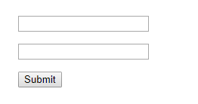
Basic form, better
(but still incomplete…)
<form id="userInformation">
<input type="text" id="txtFirstName">
<input type="text" id="txtLastName">
<input type="button" id="btnSubmit">
</form>
Note how each element has an ‘id’ attribute
  Note that our form elements include an id attribute. We will use this ID value when we want to pass information entered into the form to a script (which is almost always the case).
  For this reason, nearly every single form element (with perhaps an occasional exception) should have an id attribute.
Important: Also note the conventions we use when naming our form elements:
  Button names begin with btn
  Text names begin with txt
  First word must begin with a lower-case letter
  Subsequent words are separated by capital letters
  More on naming conventions for form elements later….

Slide 11
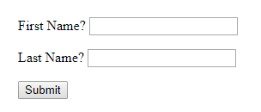
Basic Form
(pretty good)
<form id="userInformation">
<label for="txtFirstName">
First Name?
</label>
<input type="text" id="txtFirstName">
<label for="txtLastName">
Last Name?
</label>
<input type="text" id="txtLastName">
<input type="button" id="btnSubmit" value="Submit">
</form>
Our prompts (e.g. First Name, Last Name, etc) will display just fine without the <label> element. However, this element is required for this course (as well as by many web design firms) for purposes of adhering to accessibility requirements, better code validation, and simply "good practices".
Note that the value of the for attribute from the <label> tag must match up with the id value used in the corresponding form element.

Slide 12
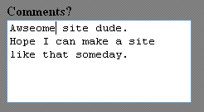
Form Element: Text Areas
Similar to text boxes, but allows the user to type in multiple lines of information.
Instead of <input> tag, uses <textarea> tag.
Optional attributes include cols and rows to specify the initial size of the box. (Not always precise).
<textarea id="txtarComments" cols="25" rows="5">
</textarea>
Note: The textarea tag requires a closing tag. That is, even though there is no content present inside the open <textarea> and closing </textarea>, we still need to include this closing tag.

Slide 13
Getting your button to actually do something
Placing a button on the HTML page simply displays the button.
To make the button actually do something we need to:
  Create a script
  Connect the button to our script
The purpose of a form is to take the information entered by the user and do something with it.
Reading (a.k.a. “parsing”) the form and then actually “doing” something with that information is usually the job of a script.
In this course, we will typically connect our form to a JavaScript via our buttons. Here is a sneak preview:
<input type= " button"
value="Submit Form" id= " btnSubmit "
onclick= "runSomeScript()" >
More on this in JavaScript Part 1

Slide 14
Programming Conventions
In programming it is a very good idea to come up with a consistent style of doing things.
A convention means that it is considered desirable – even necessary – to consistently do things a certain way.
However, a convention means that it is a choice. That is, the code will work even without adhering to these conventions. However, when a company, or team leader, etc asks a programmer to adhere to a convention, then it is considered very poor form to deviate.
Programmers who are careful and consistent with adhering to designated conventions are noticed by hiring managers, colleagues, and others.
We will require certain conventions in this course.
  In fact, you have already encountered one of them: Our naming conventions for file names in which we require that all file names are lower case, and that spaces between words should use an underscore character. e.g. my_first_page.html
  We will now add an additional naming convention, one that is to be used whenever naming form elements.
Sometimes a project manager will dictate these kinds of conventions. Other times it is up to you to decide on one. However, it is an excellent idea to have one as it will help clarify your coding.
In this course, you MUST follow programming conventions once they are introduced. In the “real” world, it looks sloppy/careless/unprofessional when programmers fail to follow conventions.
Many will thank you:
    Project collaborators
    Later debuggers
    You! (down the road)

Slide 15
This course's required programming convention for naming form elements
For this course you are required to use the following convention when naming form elements:
  Buttons: btnName
  Text boxes: txtName
  Text areas: txtarName
  Checkboxes: chkName
  Radio buttons: radName
  Select menu: selName
  Form elements not specified here: You may choose your own prefix.
Note: These conventions are my own (although others may use something similar).
  If, in the "real world" you encounter a different convention used by whichever team you are working with, you should, of course, adhere to theirs.

Slide 16
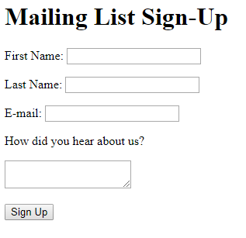
File: simple_form.html
<h1>Mailing List Sign-Up</h1>
<form id="mailingList">
<p>
<label for="txtFirstName">First Name:</label>
<input type="text" id="txtFirstName">
</p>
<p><label for="txtLastName">Last Name:</label>
<input type="text" id="txtLastName"></p>
<p><label for="txtEmail">E-mail:</label>
<input type="text" id="txtEmail"></p>
<p><label for="txtarReferral">
How did you hear about us?</label></p>
<p><textarea id="txtarReferral">
</textarea></p>
<p>
<input type="button"
value="Sign Up" id="btnSignUp">
</p>
</form>
Some Notes
I have used a couple of different examples of whitespace here. As long as your code is clear and easy to follow, any technique you choose is fine! (Just don’t overdo it with too much whitespace!)
Separating form elements with a <p> tag can be useful.
Every form element should have a prompt (e.g. Name, Email, etc)
Prompts should be inside a <label> tag.
Every label tag should include the for attribute that is matched with the id attribute of the corresponding form element.
The fact that the form elements do not neatly line up on the page may bother you – and that’s a good thing! Doing so requires a certain degree of CSS skill.

