Slide 1
SE 433/333 Software Testing
& Quality Assurance
Dennis Mumaugh, Instructor
dmumaugh@depaul.edu
Office: CDM, Room 428
Office Hours: Tuesday, 4:00 – 5:30

Slide 2
Administrivia
Comments and feedback
Grading progressing
Assignment discussion
  Assignment 7
    There are defects in the code. Several.
Assignments:
  Assignment 7: Due May 11
  Assignment 8: Due May 16

Slide 3
SE 433 – Class 7
Topic:
  Code coverage, Cobertura
  Path Testing, Cyclomatic complexity
Reading:
  Pezze and Young, Chapter 12, p.444
  Cobertura documentation: http://cobertura.github.io/cobertura/
  An example of using Cobertura and JUnit: Coverage1.zip in D2L
Supplemental Readings:
  Code coverage – https://en.wikipedia.org/wiki/Code_coverage
  Java Code Coverage Tools – https://en.wikipedia.org/wiki/Java_Code_Coverage_Tools
  Cyclomatic complexity – https://en.wikipedia.org/wiki/Cyclomatic_complexity
  Modified condition/decision coverage – https://en.wikipedia.org/wiki/Modified_condition/decision_coverage

Slide 4
Exam Results
Statistics
Class | W16 | S16 | S17
Number of students | 52 | 51 | 45
Max | 94.00 | 96.00 | 97.00
Min | 44.00 | 55.00 | 47.00
Mean | 80.31 | 77.47 | 80.71
Median | 84.00 | 81.00 | 81.00
Std. Dev | 12.22 | 8.86 | 11.62
Grade distribution
90-100 | 13
80-89 | 12
70-79 | 13
00-69 | 7

Slide 5
Exam Comments
Some need to read questions carefully.
Test cases
  Spent time on illegal input rather than numeric values of the classes.
  Functions expecting numbers will not accept text; compiler will complain.
Equivalence
  Problems with understanding the equivalence classes, weak/strong normal, etc.
Errors, failures, defects.

Slide 6
Assignment 8
Assignment 8: White Box Testing Due date: May 16, 2016
  Given the following method in Java, which finds the maximum value in an array of integers.
    Design a test suite with the fewest number of test cases that satisfies the statement test criterion.
    Design a test suite with the fewest number of test cases that satisfies the branch-condition test criterion.
  Let us consider the following loop statement in C:
    Derive a set of test cases that satisfy the compound condition adequacy criterion with respect to the loop.
    Derive a set of test cases that satisfy the modified condition (MC/DC) adequacy criterion with respect to the loop.
  Let us consider the following if statement in Java
    Derive a set of test cases and show that it satisfies the modified condition (MC/DC) adequacy criterion for this statement.

Slide 7
Thought for the Day
“Just because you've counted all the trees doesn't mean you've seen the forest.” – Anonymous

Slide 8
Review

Slide 9
White-Box Testing

Slide 10
White-Box Testing
... our goal is to ensure that all
statements and conditions have
been executed at least once ...
The challenge is to construct the right set of tests to accomplish this level of coverage.

Slide 11
White Box Testing
Sometimes called “glass-box” testing.
Uses the control structure from the component-level design to derive test cases.
Objective:
  To guarantee that all independent paths within a module have been exercised at least once.
  Exercise all logical decisions on their true and false sides.
  Execute all loops at their boundaries and within their operational bounds.
  Exercise internal data structures to ensure their validity.

Slide 12
Why do we need this coverage?
Logic errors and incorrect assumptions are inversely proportional to a path's execution probability.
We often believe that a path is not likely to be executed; but in fact, reality is often counter intuitive.
Typographical errors are random; its likely that untested paths will contain some.

Slide 13
Test Coverage

Slide 14
Test Coverage
Coverage is a measure of how much testing can be done given a set of test cases.
Given a set of test cases, how much of the code in the program being tested is covered?
Or.. Given a set of test cases how many functionalities as listed in the requirements can be tested?
Coverage in most cases is a term associated with white-box testing or structural testing.

Slide 15
Test Adequacy
The term “adequacy” can be thought of as asking oneself the question “How many test cases do I need in order to completely cover the entire program based on the technique that I have chosen for testing?
Or….When do I stop testing?

Slide 16
Control Flow Testing
Control-flow testing is based on the flow of control in a program.
There are many variations of control-flow testing. Statement coverage, branch coverage, path coverage etc.

Slide 17
The Program Flowgraph
A program flowgraph graphically represents the potential control flow of a program.
Program flowgraphs are made up of nodes and directed edges
Each node represents a basic block, which can be defined as a collection of statements that are always executed together.
Each directed edge between two nodes A and B in a control flow graph represents a potential control path from A to B

Slide 18
Statement Coverage
Achieving statement coverage means that all statements in the program have to be executed at least once by a set of test cases
Having complete statement coverage does not necessarily mean that the program cannot fail
Think about the input space....
Statement coverage is also called all-nodes testing.

Slide 19
Branch Coverage
Achieving branch coverage means that there must be enough test cases so that every path for a conditional transfer of control is exercised
Or... Every true and false branch have to be exercised by some test case
Complete coverage means that the test cases should be sufficient to traverse all the edges in the program graph.
This form of testing is also known as all-edges testing.

Slide 20
Path Coverage
Path coverage means that all possible execution paths in the program must be executed.
This is a very strong coverage criterion, but impractical.
Programs with loops have an infinite number of execution paths, and thus would need an infinite number of test cases
The fact that there is complete branch coverage does not mean that all errors will be found. Branch testing does not necessarily check all combinations of control transfers.

Slide 21
What is Code Coverage?
Code coverage analysis is the process of:
  Finding areas of a program not exercised by a set of test cases,
  Creating additional test cases to increase coverage, and
  Determining a quantitative measure of code coverage, which is an indirect measure of quality.
An optional aspect of code coverage analysis is:
  Identifying redundant test cases that do not increase coverage.
A code coverage analyzer automates this process.

Slide 22
What is Code Coverage?
Code Coverage testing is determining how much code is being tested. It can be calculated using the formula:
  Code Coverage = (Number of lines of code exercised)/(Total Number of lines of code) * 100%
Following are the types of code coverage Analysis:
  Statement coverage and Block coverage
  Function coverage
  Function call coverage
  Branch coverage
  Modified condition/decision coverage

Slide 23
What is Code Coverage?
Original tools were part of C Programmers Productivity Tools (1986)
  Cflow analyzes C source files and produces a graph charting the control flow of the program.
  Ctrace allows you to follow the execution of a C program, statement-by-statement.
  Ctree allows you to determine the function/method calls and their depth
  Another instrumented each function/method call and allow you to see how many times each was called.

Slide 24
Modified condition/decision coverage
Modified condition/decision coverage (MC/DC) is a code coverage criterion that requires all of the below during testing:
  Each entry and exit point is invoked
  Each decision takes every possible outcome
  Each condition in a decision takes every possible outcome
  Each condition in a decision is shown to independently affect the outcome of the decision.
Independence of a condition is shown by proving that only one condition changes at a time.

Slide 25
Java Code Coverage Tools
Emma
Clover
Cobertura
JaCoCo
JCov
Serenity
See:
https://en.wikipedia.org/wiki/Java_Code_Coverage_Tools

Slide 26
Test Coverage with Cobertura

Slide 27
Cobertura
Cobertura is a free Java tool that calculates the percentage of code accessed by tests.
It can be used to identify which parts of your Java program are lacking test coverage.
It is based on jcoverage.
Cobertura can be used either from the command line or via Ant tasks. You can even mix and match the command line and Ant tasks.

Slide 28
Test Coverage Tool – Cobertura
Free, open source, code coverage tool
  Written in Java
  For systems running on JVM
Measures
  Line coverage ( ≈ statement/block coverage)
  Branch coverage ( ≈ basic condition coverage)
  McCabe cyclomatic complexity metric (discuss later)
Note:
  Requires compilation with debug option on.

Slide 29
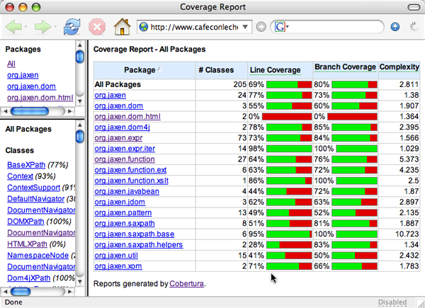
Cobertura Coverage Report – All Packages

Slide 30
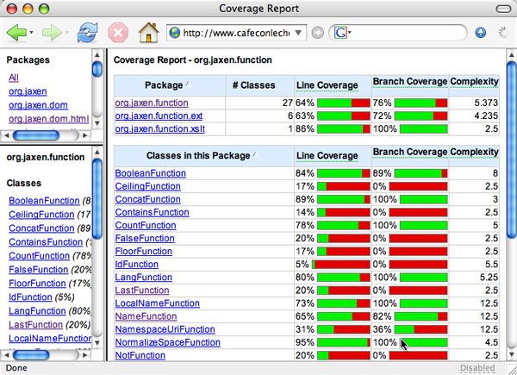
Cobertura Coverage Report – Package Overview

Slide 31
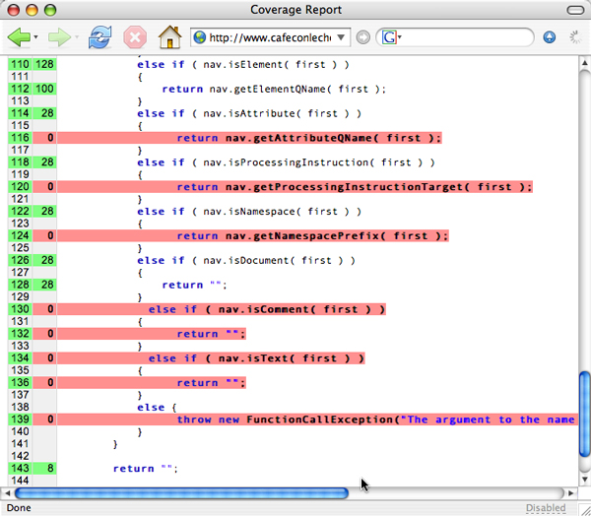
Cobertura Coverage Report – Class Details

Slide 32
Download & Install Cobertura
Download the latest Cobertura 2.1.1
  http://cobertura.sourceforge.net/
  Unzip to your local drive: COBERTURA_HOME
Look at example: Coverage1.zip (see slide 34)
Notes:
1.9.4.1

Slide 33
Stages of Running Cobertura
We will run Cobertura using Ant and in Eclipse
Four stages:
  Compile source code
  Instrument byte code
  Run tests (using instrumented byte code)
  Generate reports
    XML or HTML

Slide 34
Running Cobertura: Ant Tasks
Define classpath
  <path id="cobertura.classpath">
  <fileset dir="${cobertura}">
  <include name="cobertura-2.1.1.jar" />
  <include name="lib/**/*.jar" />
  </fileset>
  </path>
Task definition:
  Defines cobertura-instrument, cobertura-report
  <taskdef classpathref="cobertura.classpath"
  resource="tasks.properties"/>
Cobertura install location
COBERTURA_HOME
File located in
COBERTURA_HOME

Slide 35
Running Cobertura: Ant Tasks
Location of
Instrumented bytecode
Byte code instrumentation
  <cobertura-instrument todir="${instrumented}”>
  <fileset dir="${bin}”> <include name="**/*.class" /></fileset>
  </cobertura-instrument>
Generate coverage report
  <cobertura-report destdir="${coverage.html}">
  <fileset dir="${src}”><include name="**/*.java"/></fileset>
  </cobertura-report>
Location of
original bytecode
Location of
reports
Location of
source code

Slide 36
Using JUnit, Ant, and Cobertura
An Example

Slide 37
The Example Program: The Class Under Test
package edu.depaul.se433;
public class BinarySearch {
public static int search(int[] a, int x) {
…
}
public static int checkedSearch(int[] a, int x) {
…
}
}

Slide 38
The JUnit Test
package edu.depaul.se433;
…
public class BinarySearchTest {
@Test
public void testSearch1() { … }
@Test
public void testSearch2() { … }
@Test
public void testCheckedSearch1() { … }
@Test
public void testCheckedSearch2() { … }
@Test
public void testCheckedSearch3() { … }
}

Slide 39
The Ant Build File: Set Properties
build.xml
  project name="MyProject" default="coverage" basedir=".">
  <!-- The properties are set in build.properties -->
  <property file="build.properties" /> ...
build.properties
  junit=/Users/jia/Java/Junit/
  cobertura=/Users/jia/Java/Cobertura/cobertura-2.1.1
  src=src
  bin=bin
  instrumented=instrumented
  reports=reports
  reports.xml=${reports}/junit-xml
  reports.html=${reports}/junit-html
  coverage.xml=${reports}/cobertura-xml
  coverage.summaryxml=${reports}/cobertura-summary-xml
  coverage.html=${reports}/cobertura-html
Set to locations on your computer (Windows)
junit=C:\Users\jia\Java\Junit\
cobertura=C:\Users\jia\Java\Cobertura\cobertura-2.1.1

Slide 40
The Ant Build File: Defining Classpath
<path id="junit.classpath">
<fileset dir="${junit}">
<include name="*.jar" />
</fileset>
</path>
<path id="cobertura.classpath">
<fileset dir="${cobertura}">
<include name="cobertura-2.1.1.jar" />
<include name="lib/**/*.jar" />
</fileset>
</path>

Slide 41
The Ant Build File: Defining Tasks and Initialization
<taskdef classpathref="cobertura.classpath"
resource="tasks.properties"/>
<target name="init”>
<tstamp/> <!-- Create the time stamp →
<mkdir dir="${bin}"/><!-- Create the build directory -->
<mkdir dir="${instrumented}" />
<mkdir dir="${reports.xml}" />
<mkdir dir="${reports.html}" />
<mkdir dir="${coverage.xml}" />
<mkdir dir="${coverage.summaryxml}" />
<mkdir dir="${coverage.html}" />
</target>

Slide 42
The Ant Build File: Compilation
<target name="compile" depends="init"
description="compile the source " >
<!-- Compile the java code from ${src} into ${bin} -->
<javac includeantruntime="false"
srcdir="${src}"
destdir="${bin}"
debug="on">
<classpath refid="junit.classpath"/>
</javac>
</target>

Slide 43
The Ant Build File: Run JUnit Test, No Coverage Data
<target name="test1" depends="compile">
<!-- Run junit tests -->
<junit printsummary="yes" fork="yes" haltonfailure="off">
<classpath location="${bin}"/>
<classpath refid="junit.classpath"/>
<formatter type="plain"/>
<test name="edu.depaul.se433.BinarySearchTest"/>
</junit>
</target>

Slide 44
The Ant Build File: Instrumentation of Bytecode
<target name="instrument" depends="init,compile">
<delete file="cobertura.ser"/>
<delete dir="${instrumented}" />
<cobertura-instrument todir="${instrumented}">
<ignore regex="org.apache.log4j.*" />
<fileset dir="${bin}">
<include name="**/*.class" />
<exclude name="**/*Test.class" />
</fileset>
</cobertura-instrument>
</target>

Slide 45
The Ant Build File: Run JUnit Test, With Coverage Data
<property name="testcase" value="edu.depaul.se433.BinarySearchTest" />
<target name="test2" depends="init,compile">
<junit fork="yes">
<classpath location="${instrumented}" />
<classpath location="${bin}" />
<classpath refid="junit.classpath" />
<classpath refid="cobertura.classpath" />
<formatter type="xml" />
<test name="${testcase}" todir="${reports.xml}" if="testcase" />
<batchtest todir="${reports.xml}" unless="testcase">
<fileset dir="${src}”><include name="**/*Test.java" /></fileset>
</batchtest>
</junit> …

Slide 46
The Ant Build File: Run JUnit Test, With Coverage Data
<property name="testcase" value="edu.depaul.se433.BinarySearchTest" />
<target name="test2" depends="init,compile">
<junit fork="yes"> …
</junit>
<junitreport todir="${reports.xml}">
<fileset dir="${reports.xml}">
<include name="TEST-*.xml" />
</fileset>
<report format="frames" todir="${reports.html}" />
</junitreport>
</target>

Slide 47
The Ant Build File: Generate Coverage Report (XML)
<target name="coverage-report-xml">
<cobertura-report srcdir="${src}"
destdir="${coverage.xml}"
format="xml" />
</target>
<target name="summary-coverage-report">
<cobertura-report srcdir="${src}"
destdir="${coverage.summaryxml}"
format="summaryXml" />
</target>

Slide 48
The Ant Build File: Generate Coverage Report (HTML)
<target name="coverage-report-html">
<cobertura-report destdir="${coverage.html}">
<fileset dir="${src}”>
<include name="**/*.java"/>
<exclude name="**/*Test.java"/>
</fileset>
</cobertura-report>
</target>

Slide 49
The Ant Build File: Run All Targets (Default Target)
<target name="coverage”
depends="compile,instrument,test2,
coverage-report-xml,
summary-coverage-report,
coverage-report-html"
description="Compile, instrument ourself, run the
tests and generate JUnit and
coverage reports."/>

Slide 50
Run Tests with Cobertura
At the command line
  ant

Slide 51
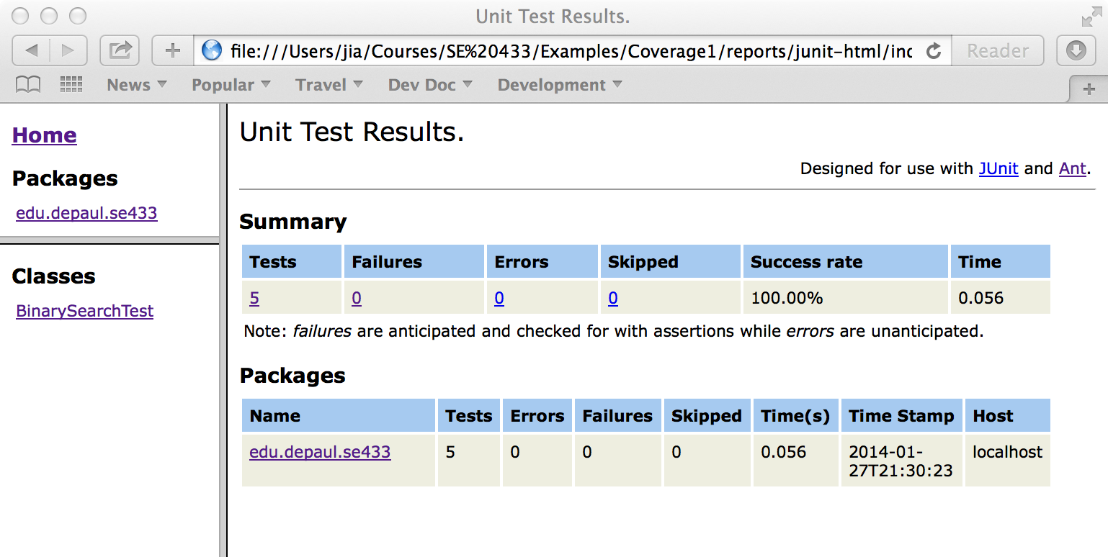
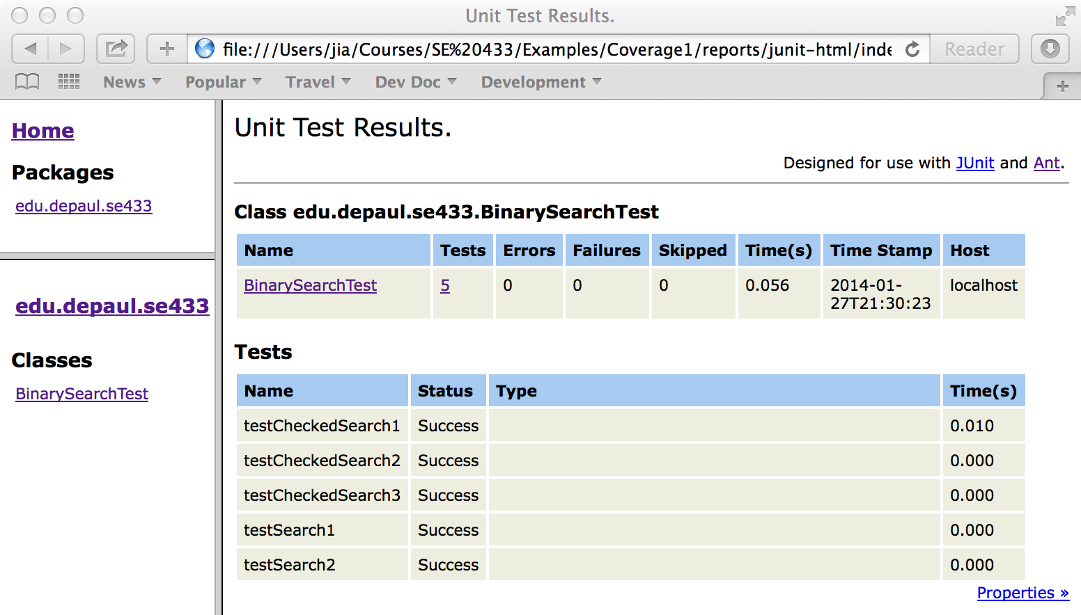
The JUnit Report (HTML)

Slide 52
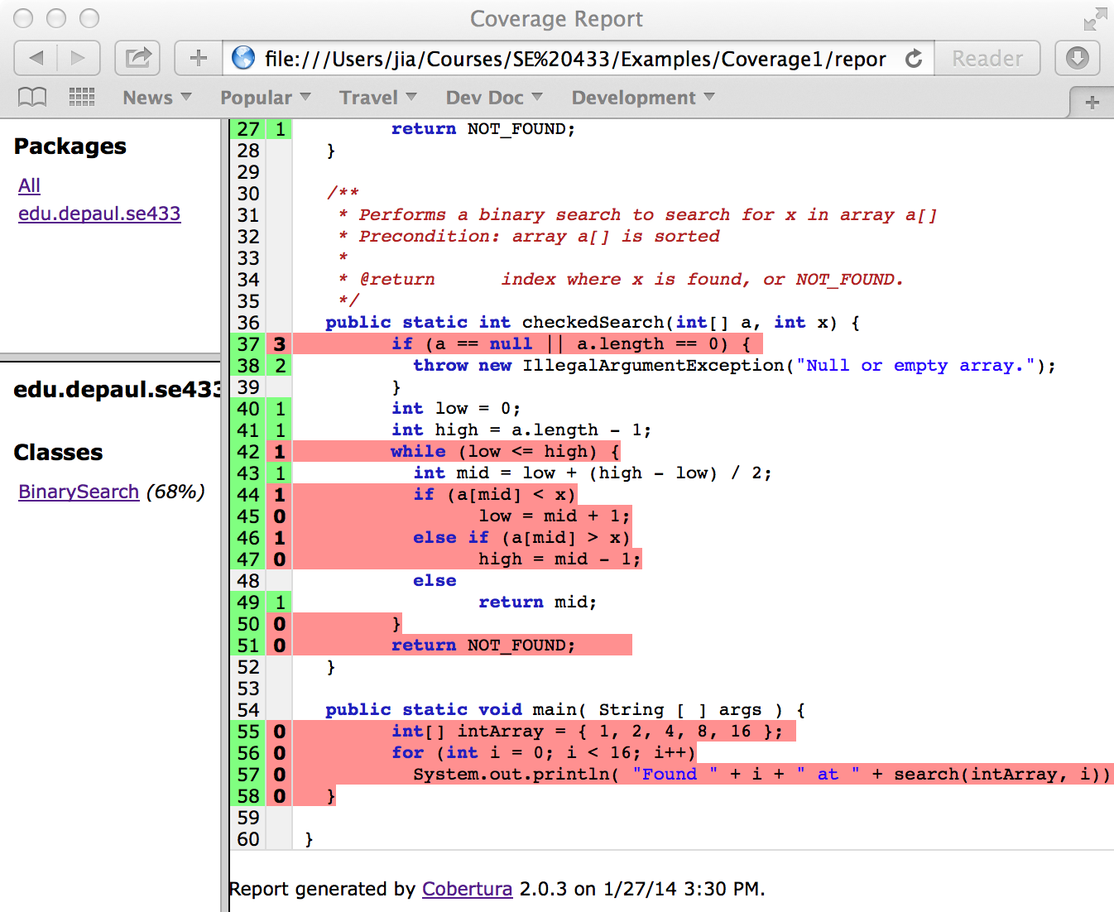
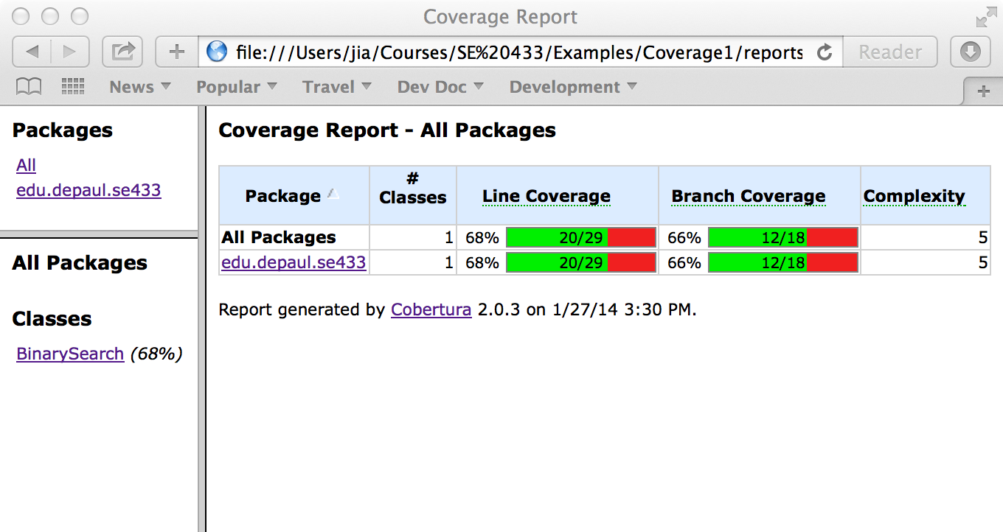
The Coverage Report (HTML)

Slide 53
Running Cobertura in Eclipse
Unzip Coverage1.zip in Eclipse workspace
New Java Project:
  JRE: JavaSE-1.7 !
  Project name: Coverage1
Add Library:
  JRE System Library: Java SE 7
  JUnit 4
Select build.xml
  In Outline, right click target coverage
  Run as: Ant Build
Notes:
Eclipse add JDK
Preference | Java | Installed JREs
Search

Slide 54
Running Cobertura in Eclipse

Slide 55
Readings and References
Cobertura documentation
  http://cobertura.github.io/cobertura/
An example of using Cobertura and JUnit
  Coverage1.zip in D2L

Slide 56
White Box Testing a.k.a. Structural Testing
Path Testing

Slide 57
Path Testing

Slide 58
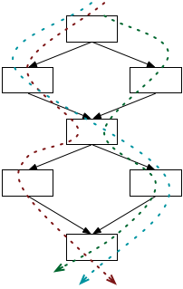
Paths Testing
Beyond individual branches.
Should we explore sequences of branches (paths) in the control flow?
Many more paths than branches
  A pragmatic compromise will be needed

Slide 59
Path Adequacy
Decision and condition adequacy
  Test individual program decisions
Paths testing
  Test combinations of decisions along paths
Adequacy criterion:
  Each path must be executed at least once
Coverage:
# executed paths
# total paths
Notes:
12.5 PATH TESTING
Path coverage simply requires each path to be executed at least once, thus helping in revealing failures that occur when loops are executed several times. Unfortunately, “pure” path coverage is impractical even for simple programs (the program on the slide has infinite many paths). An easy way to reduce the number of paths is to limit the number of times of executions of each loop.

Slide 60
Practical Path Coverage Criteria
The number of paths in a program with loops is unbounded
  the simple criterion is impossible to satisfy
For a feasible criterion:
  Partition infinite set of paths into a finite number of classes
Useful criteria can be obtained by limiting
  the number of traversals of loops
  the length of the paths to be traversed
  the dependencies among selected paths
Notes:
12.5 PATH TESTING
Path coverage simply requires each path to be executed at least once, thus helping in revealing failures that occur when loops are executed several times. Unfortunately, “pure” path coverage is impractical even for simple programs with loops. To ensure a finite number of paths, we must at least limit the number of times of executions of each loop (e.g., lump “5 iterations” and “105 iterations” in the same class “more than 1 iteration”, requiring only one representative execution from that class).

Slide 61
Boundary Interior Path Testing
Group together paths that differ only in the sub-path they follow when repeating the body of a loop
Follow each path in the control flow graph up to the first repeated node
The set of paths from the root of the tree to each leaf is the required set of sub-paths for boundary/interior coverage

Slide 62
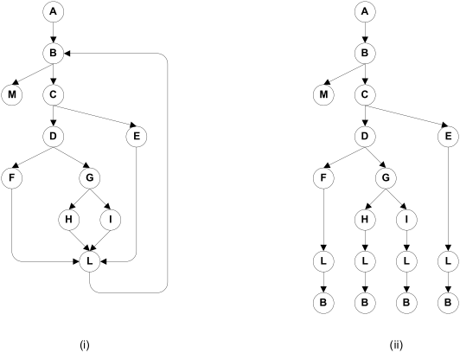
Boundary Interior Adequacy for cgi-decode
Notes:
The graph at the right shows the paths that must be covered in the control flow graph at the left, using the “boundary interior”
adequacy criiterion.

Slide 63
Limitations of Boundary Interior Adequacy
The number of paths can still grow exponentially
if (a) {
S1;
}
if (b) {
S2;
}
if (c) {
S3;
}
...
if (x) {
Sn;
}
The sub-paths through this control flow can include or exclude each of the statements Si
Total N branches result in 2^{N} paths that must be traversed
Choosing input data to force execution of one particular path may be very difficult
  even impossible if the conditions are not independent

Slide 64
Loop Boundary Adequacy
A test suite satisfies the loop boundary adequacy criterion iff for every loop:
  At least one test case: the loop body is iterated zero times
  At least one test case: the loop body is iterated once
  At least one test case: the loop body is iterated more than once

Slide 65
What is LCSAJ Testing ?
LCSAJ stands for Linear Code Sequence and Jump, a white box testing technique to identify the code coverage, which begins at the start of the program or branch and ends at the end of the program or the branch.
LCSAJ consists of testing and is equivalent to statement coverage.
LCSAJ Characteristics:
  100% LCSAJ means 100% Statement Coverage
  100% LCSAJ means 100% Branch Coverage
  100% procedure or Function call Coverage
  100% Multiple condition Coverage

Slide 66
Linear Code Sequence and Jump (LCSAJ)
Execution of sequential programs that contain at least one condition, proceeds in pairs where the first element of the pair is a sequence of statements, executed one after the other, and terminated by a jump to the next such pair.
A Linear Code Sequence and Jump is a program unit comprised of a textual code sequence that terminates in a jump to the beginning of another code sequence and jump.
An LCSAJ is represented as a triple (X, Y, Z) where X and Y are, respectively, locations of the first and the last statements and Z is the location to which the statement at Y jumps.

Slide 67
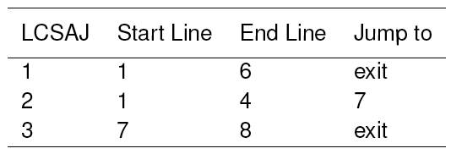
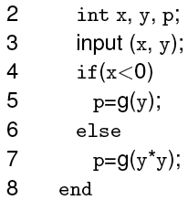
Linear Code Sequence and Jump (LCSAJ)
Consider this program.
The last statement in an LCSAJ (X, Y, Z) is a jump and Z may be program exit. When control arrives at statement X, follows through to statement Y, and then jumps to statement Z, we say that the LCSAJ (X, Y, Z) is traversed or covered or exercised.

Slide 68
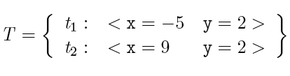
LCSAJ coverage: Example 1
t2 covers (1,4,7) and (7, 8, exit).
t1 covers (1, 6, exit).
T covers all three LCSAJs.

Slide 69
Call Tree
Look at the flow of control in a system
Compute function (method) calls and derive a tree of calls
  A -> B -> C -> D
  etc.
Depth of function call trees are a measure.
Good systems have a flat structure

Slide 70
Basis Path Testing
First proposed by Tom McCabe in 1976. Later expanded it into Cyclomatic Complexity.
Enables the test case designer to derive a logical complexity measure of the procedural design.
Uses this measure as the basis for defining an upper bound on the number of execution paths needed to guarantee that every statement in the program is executed at least once.
Uses a notation known as a flow graph.
  Each structured notation has a corresponding flow graph symbol.

Slide 71
Flow Graph Notation
Sequence
if
Case
until
while
Where each circle represents one or more nonbranching set of source code statements.

Slide 72
Flow chart and corresponding flow graph
1
1
2,3
R₁
2
6
R₂
3
7
R₄
8
4,5
9
6
4
7
8
5
R₃
10
9
10
11
R = Regions
11

Slide 73
Compound logic
A compound condition occurs when one or more Boolean operators (logical OR, AND, NAND, NOR) is present in a conditional statement.
Example:
if a OR b
then do X
else do Y
endif
a
a
b
x
b
y
x
y
x

Slide 74
Independent Program Paths
Any path through the program that introduces at least one new set of processing statements or a new condition.
In terms of a flow graph, an independent path must move along at least one edge that has not previously been traversed.

Slide 75
Basis Paths Example
Basis paths:
Path 1: 1-11
Path 2: 1-2-3-4-5-10-1-11
Path 3: 1-2-3-6-8-9-10-1-11
Path 4: 1-2-3-6-7-9-10-1-11
The path below is NOT a basis path 1-2-3-4-5-10-1-2-3-6-8-9-10-1-11 because it does not traverse any new edges.
1
2
3
6
4
7
8
5
9
10
11

Slide 76
Choose a Set of Basis Paths
Traverse the CFG to identify basis paths
  Each path contains at least one edge that is not in other paths.
  No iteration of sub-paths
There is more than one set of basis paths for a given CFG.

Slide 77
Basis Paths
These paths constitute a basis set for the flow graph.
Design tests to execute these paths.
Guarantees:
  Every statement has been executed at least once.
  Every condition has been executed on both its true and false sides.
There is more than ONE correct set of basis paths for a given problem.
How many paths should we look for?
  Calculate Cyclomatic complexity V(G)
    V(G) = E-N+2
    V(G) = P + 1 (Where P = number of predicate nodes)
    V(G) = R (Where R = number of regions) [slide 72]

Slide 78
Cyclomatic Complexity (CC)
Evaluates the complexity of an algorithm in a method. It measures the number of linearly independent paths through a program's source code
Three equivalent definitions
  V(G) = E-N+2
    Or given a flow graph: = edges – nodes + 2
  V(G) = P + 1 (Where P = number of predicate nodes)
    Defined to be one larger than the number of decision points (if/case-statements, while-statements, etc.) in a module (function, procedure, chart node, etc.).
      Note that in an if or while statement, a complex boolean counts each part, (e.g. if( a<b and c>0) counts as two decision points.
  V(G) = R (Where R = number of regions)
Notes:
http://satc.gsfc.nasa.gov/support/STC_APR98/apply_oo/apply_oo.html

Slide 79
Cyclomatic Complexity (CC)
Evaluates the complexity of an algorithm in a method.
Calculate the cyclomatic complexity.
A method with a low cyclomatic complexity is generally better. This may imply decreased testing and increased understandability or that decisions are deferred through message passing, not that the method is not complex
Notes:
http://satc.gsfc.nasa.gov/support/STC_APR98/apply_oo/apply_oo.html

Slide 80
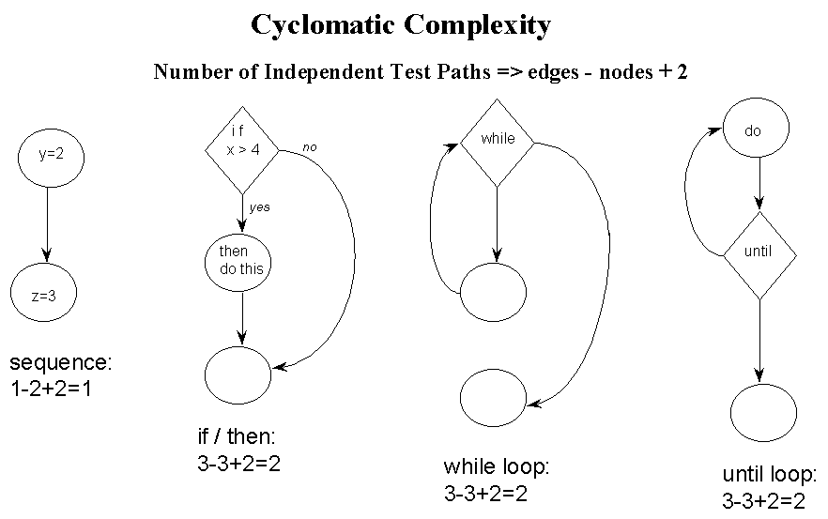
Cyclomatic Complexity (CC)
CC = edges – nodes + 2
Notes:
http://satc.gsfc.nasa.gov/support/STC_APR98/apply_oo/apply_oo.html

Slide 81
Cyclomatic Testing
A compromise between path testing and branch-condition testing
Cyclomatic testing, a.k.a., basis path testing
  Test all of the independent paths that could be used to construct any arbitrary path through the computer program
Steps:
  1. Calculate Cyclomatic complexity
  2. Choose a set of basis paths
  3. Design test cases to exercise each basis path

Slide 82
Cyclomatic Complexity (McCabe)
  A set of basis paths in a CFG
  Each path contains at least one edge that is not in other paths
  No iteration of sub-paths
The number of basis paths in a CFG is known as the Cyclomatic Complexity of the CFG
Calculate Cyclomatic complexity of CFG G
  e = #edges in G
  n = #nodes in G
The cyclomatic complexity of G
  V(G) = e - n + 2

Slide 83
Cyclomatic Complexity (McCabe)
If a CFG has a single entry and single exit point,
  the calculation of the cyclomatic complexity can be simplified
V(G) = #predicates + 1
Rules for counting predicates in CFG
  Condition in a if-statement: count each predicate
  Condition in a loop statement count as 1, even if it's a compound condition
  Switch statement: n-way choice count as (n -1)

Slide 84
Cyclomatic Complexity Examples
statement₁
statement₂
…
statement_{n}
if (x > 5) {
statement₁
}
if (x > 5) {
statement₁
} else {
statement₂
}

Slide 85
Cyclomatic Complexity Examples
statement₁
statement₂
…
statement_{n}
if (x > 5) {
statement₁
}
if (x > 5) {
statement₁
} else {
statement₂
}
V(G) = 2
V(G) = 1
V(G) = 2

Slide 86
Cyclomatic Complexity Examples
switch (exp) {
case v₁: statement₁; break;
case v₂: statement₂; break;
…
case v_{n}: statement_{n}; break;
default: statement_{n+1};
}
if (x > 5 || x <= 10) {
statement₁
}
if (x >= 0 && x <= 100) {
statement₁
} else if (x <= 30) {
statement₁
} else {
statement₂
}

Slide 87
Cyclomatic Complexity Examples
switch (exp) {
case v₁: statement₁; break;
case v₂: statement₂; break;
…
case v_{n}: statement_{n}; break;
default: statement_{n+1};
}
if (x > 5 || x <= 10) {
statement₁
}
if (x >= 0 && x <= 100) {
statement₁
} else if (x <= 30) {
statement₁
} else {
statement₂
}
V(G) = 3
V(G) = n + 1
V(G) = 4

Slide 88
Cyclomatic Complexity Examples
while (i < 100) {
statement₁;
}
while (i < 100 && a != null) {
statement₁;
}
for (i = 0; i < 10; i++) {
statement₁
}
for (i = 0; i <= 10 || j == 0;
i++) {
statement₁;
if (i > 5 || i <= 10) {
statement₂
}
}

Slide 89
Cyclomatic Complexity Examples
while (i < 100) {
statement₁;
}
while (i < 100 && a != null) {
statement₁;
}
for (i = 0; i < 10; i++) {
statement₁
}
for (i = 0; i <= 10 || j == 0;
i++) {
statement₁;
if (i > 5 || i <= 10) {
statement₂
}
}
V(G) = 2
V(G) = 2
V(G) = 4
V(G) = 2

Slide 90
Cyclomatic Adequacy and Coverage
Cyclomatic adequacy criterion
  Each basis path must be executed at least once
  Guarantees:
    Every statement has been executed at least once.
    Every condition has been executed on both its true and false sides.
  Recommended by NIST as a baseline technique
Cyclomatic coverage
  the number of basis paths that have been executed, relative to cyclomatic complexity
# executed basis paths
cyclomatic complexity
Notes:
There is nothing deep to be grasped here about linearly independent paths, but cyclomatic complexity is
used in industry for test planning (estimating testing effort) and sometimes as an adequacy measure. Its
attractions are that cyclomatic complexity serves as a simple, rough estimate of the complexity of code,
and it requires more testing effort for code with complex control flow than for code with simple control
flow. “Linear independence” requires some differences between test cases that can be counted toward
thorough testing, even if it is not closely related to the programmer's case analysis.

Slide 91
An Example:
Float Function CalculateFees ( String mgroup, Integer mAge, Float mBaseFees, Integer mFamilyCount, Integer mMinFee)
/* How many months left in the year */
1 MonthsLeft = 12 – GetMonth(SystemDate())
/* Calculate base rate for the group */
2 if mgroup == 1 then
3 mRate = mBaseFees
4 else
5 if mgroup == 2 then
6 mRate = mBaseFees * 0.80
7 else
8 mRate = mBaseFees * 0.65
9 endif
10 endif
11 mBaseFees = mRate * MonthsLeft
12 while mFamilyCount > 1 and mBaseFees > mMinFee
13 if mAge >= 21
14 mBaseFees = mBaseFees – 10
15 else
16 mBaseFees = mBaseFees – 5
17 endif
18 mFamilyCount = mFamilyCount – 1
19 endwhile
20 return mBaseFees

Slide 92
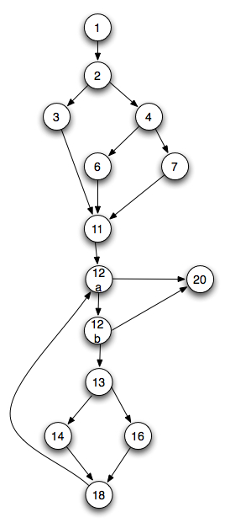
Steps for deriving test cases
Use the design or code
as a foundation and
draw corresponding
flow graph.
Determine the
Cyclomatic complexity
of the resultant flow graph.
V(G) = 5 predicate nodes + 1 = 6.
[Line 12 has two predicates]

Slide 93
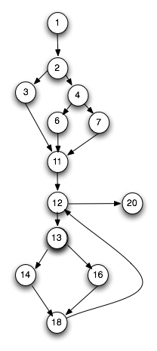
Steps for deriving test cases
Determine a basis set of linearly independent paths.
1-2-3-11-12-20
1-2-5-6-11-12-20
1-2-5-8-11-12-20
1-2-3-11-12-13-14-18-12-20
1-2-5-6-11-12-13-14-18-12-20
1-2-5-8-11-12-13-14-18-12-20
1-2-3-11-12-13-16-18-12-20
1-2-5-6-11-12-13-16-18-12-20
1-2-5-8-11-12-13-16-18-12-20
Prepare test cases that will force execution of each path in the basis set.

Slide 94
Infeasible Paths
Some paths are infeasible…
begin
1. readln (a);
2. if a > 15
then
3. b:=b+1;
else
c:=c+1;
if a < 10
then
6. d:=d+1;
7. end
V(G) = 3:
There are three basis paths:
Path 1: 1,2,3,5,7
Path 2: 1,2,4,5,7
Path 3: 1,2,3,5,6,7
Which of these paths is non-executable and why?

Slide 95
Comparing Criteria
Can we distinguish stronger from weaker adequacy criteria?
Empirical approach:
  Study the effectiveness of different approaches to testing in industrial practice
  What we really care about, but ...
  Depends on the setting; may not generalize from one organization or project to another
Analytical approach:
  Describe conditions under which one adequacy criterion is provably stronger than another
  Stronger = gives stronger guarantees
  One piece of the overall “effectiveness” question

Slide 96
The Subsumes Relationship
The subsumption relationship means that satisfying one test coverage criterion may implicitly force another test coverage criterion to be satisfied as well
  E.g.: Branch coverage forces statement coverage to be attained as well (This is strict subsumption)
“Subsumes” does not necessarily mean “better”

Slide 97
The Subsumes Relation
Test adequacy criterion A subsumes test adequacy criterion B iff, for every program P, every test suite satisfying A with respect to P also satisfies B with respect to P.
Example:
  Exercising all program branches (branch coverage) subsumes exercising all program statements
A common analytical comparison of closely related criteria
  Useful for working from easier to harder levels of coverage, but not a direct indication of quality

Slide 98
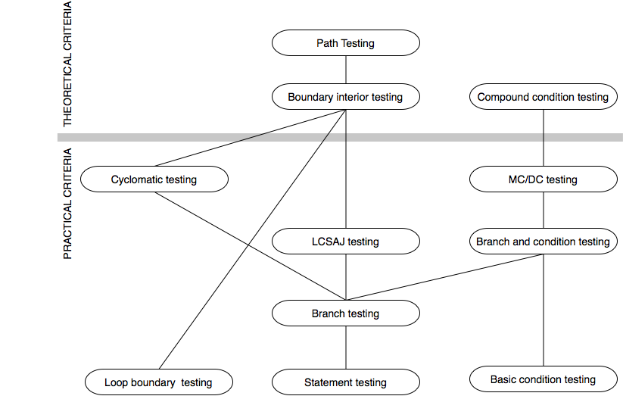
The Subsumes Relation among Structural Testing Criteria
Notes:
NOTE: This diagram is revised (corrected) from the version that appears in the book ---
the position of “loop boundary testing” has been changed to properly reflect the definition
given in the book.
12.7 COMPARING STRUCTURAL TESTLING CRIETERIA
See Chapter 9 for the definition of subsumption
The criteria above the bar are of theoretical interest, but can require
either an exponential number of test cases relative to program size
(compound condition testing, boundary interior testing) or a
potentially infinite number of test cases (path testing).
The criteria below the bar are “practical” in the sense that the number
of test cases they require, even in the worst case, is only linear in
program size, and all of them have been used in industrial practice.
Since MC/DC and loop boundary testing are mutually incomparable, and
since each is closely tied to program logic (reflecting the case analysis
that a programmer must consider to write and justify the code), they are
an attractive combination.

Slide 99
Satisfying Structural Criteria
Sometimes criteria may not be satisfiable
The criterion requires execution of
  statements that cannot be executed as a result of
    defensive programming
    code reuse (reusing code that is more general than strictly required for the application)
  conditions that cannot be satisfied as a result of
    interdependent conditions
  paths that cannot be executed as a result of
    interdependent decisions
Notes:
12.8 THE INFEASIBILITY PROBLEM

Slide 100
Satisfying Structural Criteria
Large amounts of fossil code may indicate serious maintainability problems
  But some unreachable code is common even in well-designed, well-maintained systems
Solutions:
  make allowances by setting a coverage goal less than 100%
  require justification of elements left uncovered
    RTCA-DO-178B and EUROCAE ED-12B for modified MC/DC
Notes:
12.8 THE INFEASIBILITY PROBLEM

Slide 101
Summary
Basis path testing should be applied to critical modules
Adequacy criteria and coverage
  statement
  branch
  condition, branch-condition, compound condition
  MC/DC
  paths
  boundary/interior
  loop boundary
  LCSAJ
  Cyclomatic, basis path
Full coverage is usually unattainable

Slide 102

Reading
Chapter 12 of the textbook.

Slide 103
Next Class
Topic:
  Static Analysis & Inspection
Reading:
  Pezze and Young, Chapter 18
  Articles on the Class Page
Assignments
  Assignment 7: Due May 11
  Assignment 8: Due May 16

