Slide 1
SE 433/333 Software Testing
& Quality Assurance
Dennis Mumaugh, Instructor
dmumaugh@depaul.edu
Office: CDM, Room 428
Office Hours: Tuesday, 4:00 – 5:30

Slide 2
Administrivia
Comments and feedback
Assignment discussion
  Ant
    Has command line option (-l <file>) for logging
  Pluralize
    Some words are irregular, others have special rules, some have same plural as singular
Assignments
  Assignment 5 Due May 2 (Today)
  Assignment 6 Due May 4
  Assignment 7 Due May 11

Slide 3
Assignments
Assignment discussion
  A student writes:
    “And assignment ## I was also deducted … for not enough tests when there was again, nothing mentioned about being a minimum amount of tests. I figured since it wasn't stated that we only needed to include as many as we think are needed.
  How many test cases?
    Enough to test thoroughly the software! This includes more than just a couple of numbers.
  For assignment 1:
    Need a set for each kind of triangle, each needs to be permuted in order e.g. ( {3,4,5}, {3,5,4}, {4,5,3}, {4,3,5}, {5,3,4}, {5,4,3})
    Illegal numbers (negative, floating)
    Special cases: 0, not a triangle (two kinds), maximum size numbers

Slide 4
Assignments
Assignment discussion
  A student writes:
    “And assignment ## I was also deducted … for not enough tests when there was again, nothing mentioned about being a minimum amount of tests. I figured since it wasn't stated that we only needed to include as many as we think are needed.”
  How many test cases?
    Enough to test thoroughly the software! This includes more than just a couple of numbers.
  For assignments 3 and 4:
    Usual numbers, high precision numbers (6-8 digits), large numbers, 0.0
    Special cases: 0.0, NaN, Infinity, Max_Num, Min_Num
  Testing, don't go overboard: minimal to exercise each possibility, but do not have too many. 8-12 tests should be enough (including special cases)

Slide 5
Assignment 7
Part 2: Test Case Implementation
Due Date: May 11, 2017
The objective of this assignment is to
  design unit test suites using black-box techniques,
  implementing the test suites using JUnit, and
  run the test suites using Ant.
The binary code of both programs under test is provided in a zip file named classes.zip.
Unzip this file, you will find a directory named classes, that contains the compiled byte code of programs under test.
The programs match the descriptions given in the assignment.
However, the implementations may contain defects. You must include the classes directory in your classpath to run or test the programs.

Slide 6
SE 433 – Class 6
Topic:
  Combinatorial Testing
  Program Models and Graphs
  White Box Testing a.k.a. Structural Testing
Reading:
  Pezze and Young, Chapters 5.1-5.3, 11.1, 11.3-4, 12
    Expands on lectures
  Articles on the Class Page and Reading List

Slide 7
Hints on Ant
How to add a new target testAll
  Change top of file from
  <project name="MyProject" default="test1" basedir=".”>
  to
  <project name="HW6" default="testAll" basedir=".">
  Change target from
  <target name="test1" depends="compile">
  to
  <target name="testAll" depends="compile">
Note the use of basedir=“.”
Implies the directory tree starts in current directory.
If the package name is edu.depaul.se433 there must be a directory tree edu/depaul/se433 under the src and bin directories

Slide 8
Thought for the Day
“If you don't like unit testing your product, most likely your customers won't like to test it either.”
– Anonymous

Slide 9
Combinatorial Testing

Slide 10
Objectives
Provide a rationale for systematic combinatorial testing
Combinatorial approaches
  pair-wise combination testing
  n-way combination testing

Slide 11

Finding 90% of Defects are Pretty Good, Right?
“Relax, our engineers found 90% of the defects.”

Slide 12
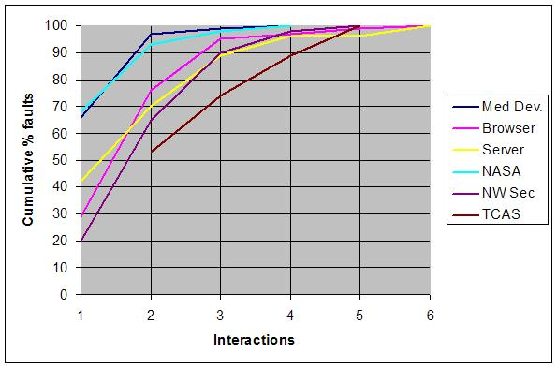
Defects Involving Multiple Vars – Interaction Defects
Number of variables involved in triggering software failures
- NIST

Slide 13
Defects Involving Multiple Vars – Interaction Defects
Vars | Medical Devices | Browser | Server | NASA GSFC | Network Security | TCAS
1 | 66 | 29 | 42 | 68 | 20 | *
2 | 97 | 76 | 70 | 93 | 65 | 53
3 | 99 | 95 | 89 | 98 | 90 | 74
4 | 100 | 97 | 96 | 100 | 98 | 89
5 |  | 99 | 96 |  | 100 | 100
6 |  | 100 | 100

Slide 14
Combinatorial Testing
Testing combinations of input conditions
Identify distinct attributes that can be varied
  Data, environment, or configuration
  Example:
    Browser: “Chrome” or “Firefox”
    OS: “Windows”, “Linux”, or “OS X”
Systematically generate combinations to be tested
  Example:
    Chrome on Windows, Chrome on Linux, Chrome on OS X,
    Firefox on Windows, Firefox on Linux, Firefox on OS X
Rationale: Test cases should be varied and include possible “corner cases”

Slide 15
Combinatorial Approaches
Pair-wise combinatorial testing
  systematically test interactions among values/attributes in the input space
  using a relatively small number of test cases
N-way combinatorial testing
  systematically test more than two-way interactions

Slide 16
Pair-Wise Combinatorial Testing
Without constraints, the number of combinations may be unmanageable
Pair-wise combination (instead of exhaustive)
Generate combinations that efficiently cover all pairs of value classes
Rationale:
  most failures are triggered by single values or combinations of a few values.
  covering pairs reduces the number of test cases, but reveals most faults

Slide 17
Pair-Wise vs. All Combinations
Consider the following example
Display Mode | Screen size | Fonts
full-graphics | Hand-held | Minimal
text-only | Laptop | Standard
limited-bandwidth | Full-size | Document-loaded

Slide 18
Pair-Wise vs. All Combinations
All combination of Display Mode x Screen size
Display Mode | Screen size
full-graphics | Hand-held
full-graphics | Laptop
full-graphics | Full-size
text-only | Hand-held
text-only | Laptop
text-only | Full-size
limited-bandwidth | Hand-held
limited-bandwidth | Laptop
limited-bandwidth | Full-size

Slide 19
Pair-Wise vs. All Combinations
Pair-wise combination of Display Mode x Screen size x Fonts
Display Mode | Screen size | Fonts
full-graphics | Hand-held | Minimal
full-graphics | Laptop | Standard
full-graphics | Full-size | Document-loaded
text-only | Hand-held | Standard
text-only | Laptop | Document-loaded
text-only | Full-size | Minimal
limited-bandwidth | Hand-held | Document-loaded
limited-bandwidth | Laptop | Minimal
limited-bandwidth | Full-size | Standard

Slide 20
A Larger Example: Display Control
Display Mode | Language | Fonts | Color | Screen size
full-graphics | English | Minimal | Monochrome | Hand-held
text-only | French | Standard | Color-map | Laptop
limited-bandwidth | Spanish | Document-loaded | 16-bit | Full-size
 | Portuguese |  | True-color
Total number of combination
432 (3x4x3x4x3) test cases
if we consider all combinations

Slide 21
Pair-Wise Combinations: 17 Test Cases
Language | Color | Display Mode | Fonts | Screen Size
English | Monochrome | Full-graphics | Minimal | Hand-held
English | Color-map | Text-only | Standard | Full-size
English | 16-bit | Limited-bandwidth | - | Full-size
English | True-color | Text-only | Document-loaded | Laptop
French | Monochrome | Limited-bandwidth | Standard | Laptop
French | Color-map | Full-graphics | Document-loaded | Full-size
French | 16-bit | Text-only | Minimal | -
French | True-color | - | - | Hand-held
Spanish | Monochrome | - | Document-loaded | Full-size
Spanish | Color-map | Limited-bandwidth | Minimal | Hand-held
Spanish | 16-bit | Full-graphics | Standard | Laptop
Spanish | True-color | Text-only | - | Hand-held
Portuguese | - | - | Monochrome | Text-only
Portuguese | Color-map | - | Minimal | Laptop
Portuguese | 16-bit | Limited-bandwidth | Document-loaded | Hand-held
Portuguese | True-color | Full-graphics | Minimal | Full-size
Portuguese | True-color | Limited-bandwidth | Standard | Hand-held

Slide 22
Adding Constraints
Simple constraints
Example:
  color monochrome not compatible with screen laptop and full size
Can be handled by considering the case in separate tables

Slide 23
Example: Consider Constraints
Monochrome Only With Hand-Held
Display Mode | Language | Fonts | Color | Screen size
full-graphics | English | Minimal | Monochrome | Hand-held
text-only | French | Standard | Color-map
limited-bandwidth | Spanish | Document-loaded | 16-bit
 | Portuguese |  | True-color
Display Mode | Language | Fonts | Color | Screen size
full-graphics | English | Minimal
text-only | French | Standard | Color-map | Laptop
limited-bandwidth | Spanish | Document-loaded | 16-bit | Full-size
 | Portuguese |  | True-color

Slide 24
Effectiveness of Pair-wise Testing
Pair-wise testing commonly applied to software testing
Pair-wise testing finds about 50% to 90% of defects

Slide 25
Interaction Defects
How many variables are involved in really tricky faults?
  Maximum interactions for triggering defects in these applications: 6
  n-way combinatorial
  test, where 2 ≤ n ≤ 6,
  appears to be
  adequate in practice

Slide 26
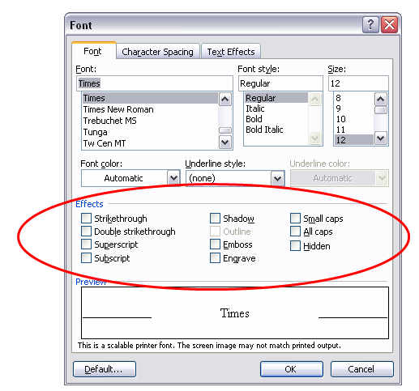
N-way Combinatorial Testing: A Simple Example
A GUI dialog

Slide 27
How Many Tests Would it Take?
There are 10 effects, each can be on or off
All combinations is 2¹⁰ = 1,024 tests
What if our budget is too limited for these tests?
Instead, let's look at all 3-way interactions.

Slide 28
How Many Tests Would it Take?
There are = 120 3-way interactions.
Naively 120 x 2³ = 960 tests.
Since we can pack 3 triples into each test, we need no more than 320 tests.
Each test exercises many triples:
10
3
0 1 1 0 0 0 0 1 1 0
We can pack a lot into one test, so what's the smallest number of tests we need?

Slide 29
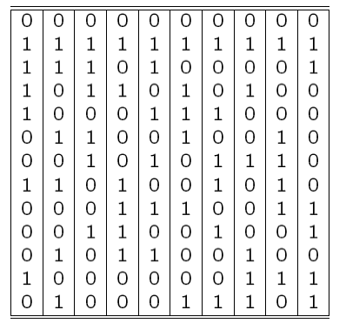
A Covering Array
10
All triples in only 13 tests, covering 2³ = 960 combinations
3
Each column is
a parameter:
Each row is a test:
Each test covers = 120 3-way combinations
Finding covering arrays is NP hard
10
3

Slide 30
0 = effect off
1 = effect on
13 tests for all 3-way combinations
2¹⁰ = 1,024 tests for all combinations

Slide 31
In reality you need only one
choice in each column.
This gives 3x3x4 = 36 choices.
0 = effect off
1 = effect on
13 tests for all 3-way combinations
2¹⁰ = 1,024 tests for all combinations

Slide 32
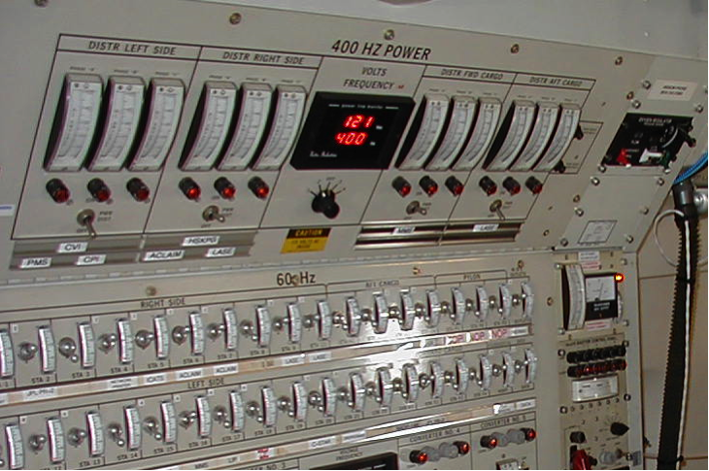
A Larger Example
Suppose we have a system with on-off switches

Slide 33
Exhaustive Combinatorial Test
34 switches = 2³⁴
= 1.7 x 10¹⁰ possible inputs
= 1.7 x 10¹⁰ tests

Slide 34
N-Way Combinatorial Test
What if we know no failure involves more than 3 switch settings interacting?
For 3-way interactions, only 33 tests cases needed
Or for 4-way interactions, only 85 test cases needed
Or for 2-way interactions,
only 8 test cases needed

Slide 35
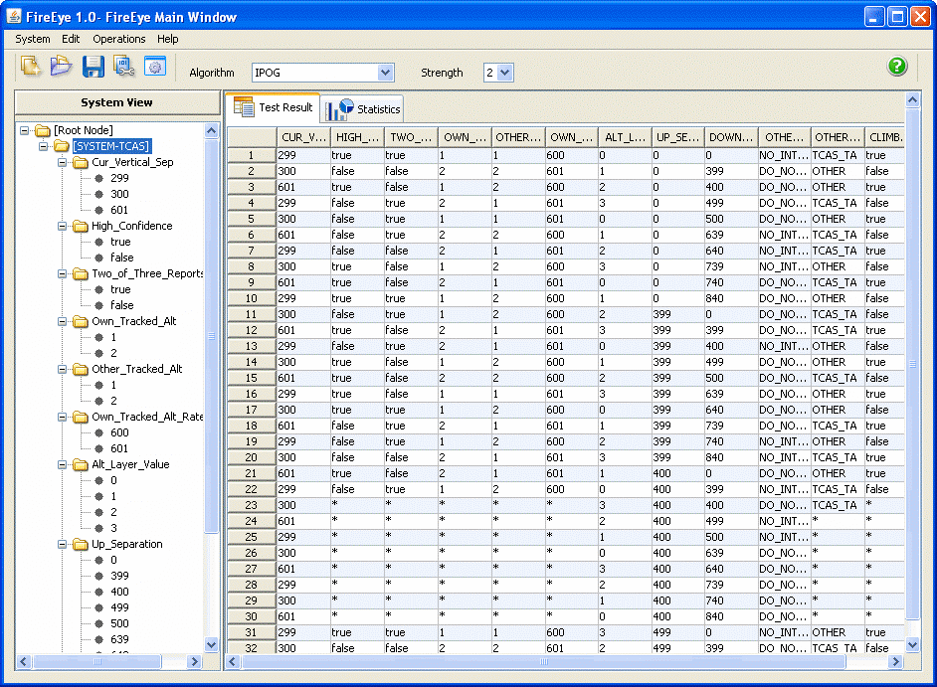
Tools for Combinatorial Testing
Advanced Combinatorial Testing Suite (ACTS)
  Available from NIST (nist.gov)
  compute tests for 2-way through 6-way interactions
  Variety of output format
    XML
    CSV
    Excel
  Eclipse plug-in

Slide 36
Case Study − Airbus A320

Slide 37


Case Study − Airbus A320
Launched in 1984
First civilian fly-by-wire computer system so advanced it can land plane virtually unassisted
No instrument dials – 6 CRTs
Notes:
5/3/17
37

Slide 38

Case Study − Airbus A320 – Fatal Accidents
Air France Flight 296
Alsace, France, June 26, 1988
  The airplane software interpreted the low altitude/downed gear as "We're about to land”
  Would not allow the pilot to control the throttle.
  3 people died, 133 survived
Indian Airline Flight 605
Bangalore, India, February 14, 1990
  92 people died, 56 survived
Air Inter Flight 148
Mont Sainte Odile, January 20, 1992
  87 people died, 9 survived
Notes:
Indian Airlines A320 during final approach
Speed drops to dangerously low level causing rapid descent
A320 slams into a golf course just short of runway
Airbus A320 plows into pine forest, approach altitude reads 4700 feet on instruments
Height at impact: about 2500 feet

Slide 39
Case Study − Airbus A320: What Were the Causes?
The fly-by-wire system could ignore pilot actions.
Warning system alerts only seconds before accident.
  no time to react
Programmed landing maneuvers with bug in altitude calculation
  Altimeter showed the plane was higher than its actual altitude
Flight path angle and vertical speed indicator have the same display format [see note]
  confuses pilots
Notes:
In vertical speed mode "-3.3" means a descent rate of 3300 feet/min.
In TRK/FPA (track/flight path angle) mode this would have meant a (correct) -3.3deg descent angle.

Slide 40
Program Models and Graphs

Slide 41
Properties of Models
Compact:
  representation of a system
Predictive:
  represent some salient characteristics
  well enough to distinguish between good and bad
  no single model represents all characteristics
Semantically meaningful:
  permits diagnosis of the causes of failure
Sufficiently general:
  general enough for practical use
Notes:
41

Slide 42
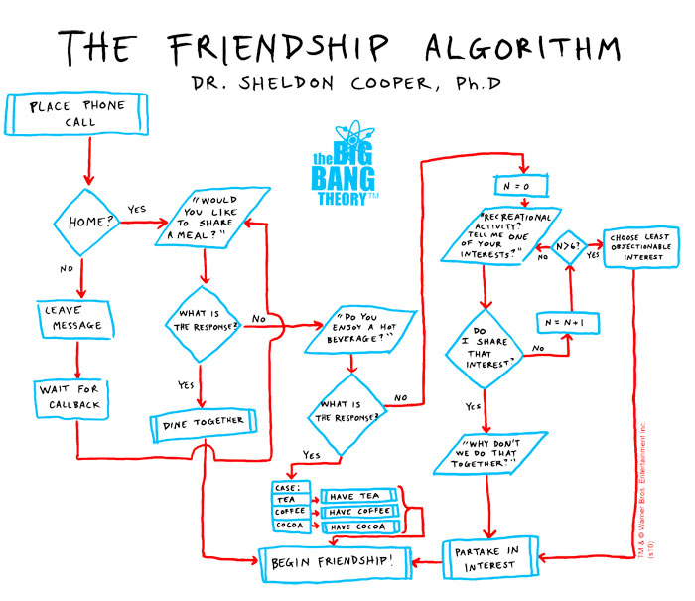
Flowchart: The Friendship Algorithm

Slide 43

Flowchart: The Friendship Algorithm

Slide 44
Control Flow Graph (CFG)
Intra-procedural control flow graph
Nodes = regions of source code, basic blocks
  maximal program region with a single entry and single exit
    Statements are grouped in single block
    Single statement can also be broken into multiple nodes
Directed edges = control flow
  program execution may proceed from one node to another

Slide 45
Control Flow Graph – An Example
public static String collapseNewlines(String argStr)
{
char last = argStr.charAt(0);
StringBuffer argBuf = new StringBuffer();
for (int cIdx = 0 ; cIdx < argStr.length();
cIdx++)
{
char ch = argStr.charAt(cIdx);
if (ch != '\n' || last != '\n')
{
argBuf.append(ch);
last = ch;
}
}
return argBuf.toString();
}
Notes:
45

Slide 46
White Box Testing a.k.a. Structural Testing

Slide 47
Structural Testing
Judging the thoroughness of a test suite based on the structure of the program
Compare to functional (requirements based, black-box) testing
  Structural testing is still testing product functionality against its specification.
  Only the measure of thoroughness has changed.
Usually done by the programmers as part of unit testing
[See notes]
Notes:
What do we mean by “structural” testing?
Note that this is only a distinction in how we judge thoroughness.
Structural testing, just like functional (spec-based) testing, still
requires program specifications of some kind to judge whether
a test execution was correct.

Slide 48
Why Structural Testing?
“What is missing in our test suite?”
If part of a program is not executed by any test case in the suite, defects in that part cannot be exposed.
What is a “part”?
  Typically, a control flow element or combination:
    Statements (or CFG nodes), branches (or CFG edges)
    Fragments and combinations: conditions, paths
Complements functional testing:
  Another way to recognize cases that are treated differently
[See notes]
Notes:
The fundamental rationale for any systematic (non-random) testing technique is
variation: Testing something different is more valuable than testing the same
thing again. There are many ways to consider “same” and “different”, and we
find value in any sense of “different” that might reveal faults that were not
revealed by other test cases. Functional testing uses the program specification
to say what is “different” (systematically covering cases that can be identified
in the specification). Structural testing

Slide 49
No Guarantee of Finding All Defects
Executing all control flow elements does not guarantee finding all defects
  Execution of a faulty statement may not always result in a failure
    The state may not be corrupted when the statement is executed with some data values
    Corrupt state may not propagate through execution to eventually lead to failure
What is the value of structural coverage?
  Increases confidence in the thoroughness of testing
  Removes some obvious inadequacies
[See notes]
Notes:
Structural testing provides a basic check: Did we completely leave miss
something that should have been tested? It doesn't guarantee that the
test cases we chose were good.
Despite the limitation, it's valuable because a good test designer does not
just blindly satisfy a structural coverage criterion. Structural criteria serve
as reminders to think carefully about what has been missed, and choose
good test cases for the underlying difference in treatment by the program.

Slide 50
Structural Testing Complements Functional Testing
Include cases that may not be identified from specifications alone
  Implementation of a single item of the specification by multiple parts of the program
  Example: hash table collision (invisible in interface spec)
Satisfying control flow adequacy criteria could still fail to reveal defects
  Missing path

Slide 51
Structural Testing in Practice
Typical process
  Create functional test suite first
  Measure structural coverage to identify what is missing
  Add additional test cases
Interpret unexecuted elements
  Natural differences between specification and implementation
  Flaws of the software or its development process
Attractive because it can be automated
  Coverage measurements are convenient progress indicators
  Sometimes used as a criterion of completion
    Caution: does not ensure effective test suites

Slide 52
Control Flow Coverage

Slide 53
Test Adequacy Criterion
Adequacy criterion of a test suite
  Whether a test suite satisfies some property deemed important to thoroughly test a program
e.g.,
  Cover all statements
  Cover all branches

Slide 54
Control Flow Based Adequacy Criteria and Coverage
Statement coverage
  Cover every statement at least once
Branch coverage, a.k.a. decision coverage
  Cover every branch at least once
(Basic) Condition coverage
  Cover each outcome of every condition
Branch-Condition coverage
  Cover all conditions and all branches
Modified condition decision coverage (MC/DC)
Compound condition coverage
  Cover all possible combinations of every condition

Slide 55
Condition Coverage
A decision can be composed of a simple condition such as x<0, or of a more complex condition, such as ((x<0 AND y<0 ) OR (p≥q )).
AND, OR, XOR are the logical operators that connect two or more simple conditions to form a compound condition.
A simple condition is considered covered if it evaluates to true and false in one or more executions of the program in which it occurs.
A compound condition is considered covered if each simple condition it contains is also covered.

Slide 56

Decision and Condition Coverage
Decision coverage is concerned with the coverage of decisions regardless of whether or not a decision corresponds to a simple or a compound condition. Thus, in the statement
there is only one decision that leads control to line 2 if the compound condition inside the if evaluates to true.
However, a compound condition might evaluate to true or false in one of several ways.

Slide 57
Decision and condition coverage (contd)
The condition at line 1 evaluates to false when x≥0 regardless of the value of y. Another condition, such as x<0 OR y<0, evaluates to true regardless of the value of y, when x<0.
With this evaluation characteristic in view, compilers often generate code that uses short circuit evaluation of compound conditions.

Slide 58
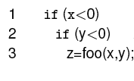
Decision and Condition coverage (contd)
Here is a possible translation:
We now see two decisions, one corresponding to each simple condition in the if statement.

Slide 59
A Simple Example of Coverage
  if ( a < b and c == 5) {
    y++;
  }
  x = 5;
Test cases:
(a) a < b, c == 5
(b) a < b, c != 5
(c) a >= b, c == 5
(d) a >= b, c != 5
Statement coverage:
  Test case (a)
Branch coverage:
  Test cases (a) and (b)
(Basic) Condition coverage:
  Test case (b) and (c)
  Problem: and (&&) short circuits! And second half of (c) not executed.
Branch-Condition coverage:
  Test case (a) (b) and (c)
Compound condition coverage:
  Test case (a) (b) (c) and (d)
* and is interpreted as logical-and

Slide 60
Statement Testing
Adequacy criterion:
  each statement (or node in the CFG) must be executed at least once
Coverage:
# executed statements
# statements
Rationale:
  A defect in a statement can only be revealed by executing the faulty statement
[Text 12.2 Statement Testing]
Notes:
12.2 STATEMENT TESTING

Slide 61
Statements or Blocks?
Nodes in a CFG often represent basic blocks of multiple statements
  basic block coverage or node coverage
  difference in granularity, not in concept
No essential difference
  100% node coverage ⇔ 100% statement coverage
    but levels will differ below 100%
  A test case that improves one will improve the other
    though not by the same amount, in general

Slide 62
An informal specification: cgi_decode
Function cgi_decode translates a cgi-encoded string to a plain ASCII string, reversing the encoding applied by the common gateway interface (CGI) of most web servers
CGI translates spaces to +, and translates most other non-alphanumeric characters to hexadecimal escape sequences
cgi_decode maps + to spaces, %xy (where x and y are hexadecimal digits) to the corresponding ASCII character, and other alphanumeric characters to themselves

Slide 63
An informal specification: input/output
[INPUT] encoded: string of characters (the input CGI sequence)
can contain:
  alphanumeric characters
  the character +
  the substring %xy, where x and y are hexadecimal digits
  is terminated by a null character
[OUTPUT] decoded: string of characters (the plain ASCII characters corresponding to the input CGI sequence)
  alphanumeric characters copied into output (in corresponding positions)
  blank for each + character in the input
  single ASCII character with value xy for each substring %xy
[OUTPUT] return value cgi_decode returns
  0 for success
  1 if the input is malformed

Slide 64
Step 1: Identify simple elements
Pre-conditions: conditions on inputs that must be true before the execution
  validated preconditions: checked by the system
  assumed preconditions: assumed by the system
Post-conditions: results of the execution
Variables: elements used for the computation
Operations: main operations on variables and inputs
Definitions: abbreviations

Slide 65
Step 1: cgi_decode (pre and post)
PRE 1 (Assumed) input string encoded null-terminated string of chars
PRE 2 (Validated) input string encoded sequence of CGI items
POST 1 if encoded contains alphanumeric characters, they are copied to the output string
POST 2 if encoded contains characters +, they are replaced in the output string by ASCII SPACE characters
POST 3 if encoded contains CGI hexadecimals, they are replaced by the corresponding ASCII characters
POST 4 if encoded is processed correctly, it returns 0
POST 5 if encoded contains a wrong CGI hexadecimal (a substring xy, where either x or y are absent or are not hexadecimal digits, cgi_decode returns 1
POST 6 if encoded contains any illegal character, it returns 1

Slide 66
Step 1: cgi_decode (var, def, op.)
VAR 1 encoded: a string of ASCII characters
VAR 2 decoded: a string of ASCII characters
VAR 3 return value: a boolean
DEF 1 hexadecimal characters, in range ['0' .. '9', 'A' .. 'F', 'a' .. 'f']
DEF 2 sequences %xy, where x and y are hexadecimal characters
DEF 3 CGI items as alphanumeric character, or '+', or CGI hexadecimal
OP 1 Scan encoded

Slide 67
Step 2: Derive initial set of test case specs
Validated preconditions:
  simple precondition (expression without operators)
    2 classes of inputs:
      inputs that satisfy the precondition
      inputs that do not satisfy the precondition
  compound precondition (with AND or OR):
    apply modified condition/decision (MC/DC) criterion
Assumed precondition:
  apply MC/DC only to “OR preconditions”
Postconditions and Definitions :
  if given as conditional expressions, consider conditions as if they were validated preconditions

Slide 68
Step 2: cgi_decode (tests from Pre)
PRE 2 (Validated) the input string encoded is a sequence of CGI items
  TC-PRE2-1: encoded is a sequence of CGI items
  TC-PRE2-2: encoded is not a sequence of CGI items
POST 1 if encoded contains alphanumeric characters, they are copied in the output string in the corresponding position
  TC-POST1-1: encoded contains alphanumeric characters
  TC-POST1-2: encoded does not contain alphanumeric characters
POST 2 if encoded contains characters +, they are replaced in the output
string by ASCII SPACE characters
  TC-POST2-1: encoded contains character +
  TC-POST2-2: encoded does not contain character +
Notes:
The list of Pre, post,... Is incrementally enriched with test cases, numbered to help us identifying them quickly

Slide 69
Step 2: cgi_decode (tests from Post)
POST 3 if encoded contains CGI hexadecimals, they are replaced by the corresponding ASCII characters
  TC-POST3-1 Encoded: contains CGI hexadecimals
  TC-POST3-2 Encoded: does not contain a CGI hexadecimal
POST 4 if encoded is processed correctly, it returns 0
POST 5 if encoded contains a wrong CGI hexadecimal (a substring xy, where either x or y are absent or are not hexadecimal digits, cgi_decode returns 1
  TC-POST5-1 Encoded: contains erroneous CGI hexadecimals
POST 6 if encoded contains any illegal character, it returns 1
  TC-POST6-1 Encoded: contains illegal characters

Slide 70
Step 2: cgi_decode (tests from Var)
VAR 1 encoded: a string of ASCII characters
VAR 2 decoded: a string of ASCII characters
VAR 3 return value: a boolean
DEF 1 hexadecimal characters, in range ['0' .. '9', 'A' .. 'F', 'a' .. 'f']
DEF 2 sequences %xy, where x and y are hexadecimal characters
DEF 3 CGI items as alphanumeric character, or '+', or CGI hexadecimal
OP 1 Scan encoded

Slide 71
An Example
T₀ = {
“”,
“test”,
“test+case%1Dadequacy”
}
17/18 = 94% Stmt Cov.
T₁ = {
“adequate+test%0Dexecution%7U”
}
18/18 = 100% Stmt Cov.
T₂ = {
“%3D”,
“%A”,
“a+b”,
“test”
}
18/18 = 100% Stmt Cov.
[See text figs. 12.1-12.3]
Notes:
T0, T1, T2 are test suites (sets of test cases)
In T0 (2 test cases):
“” covers nodes A, B, M
“test+case%1Dadequacy” covers nodes
A, B, C, D, F, L, ... B, C, E, L, ..., B, C, D, G, H, L, ... B, M
In T1 (one test case):
“adequate+test%0Dexecution%7U” covers nodes
A, B, C, D, F, L, ... B, C, E, L, ..., B, C, D, G, H, L, ... B, C, D, G, I, L, ... B, M
In T2 (4 test cases):
“%3D” covers A, B, C, D, G, H, L, B, M
“%A” covers A, B, C, D, G, I, L, B, M
“a+b” covers A, B, C, D, F, L, M, B, C, E, L, ...
“test” covers A, B, C, D, F, L, ..., M

Slide 72
Coverage is Not Size
Coverage does not depend on the number of test cases
  Compare T₀ , T₁ : T₁ >_{coverage} T₀ T₁ <_{cardinality} T₀
  Compare T₁ , T₂ : T₂ =_{coverage} T₁ T₂ >_{cardinality} T₁
Minimizing test suite size is seldom the goal
  Small test cases make failure diagnosis easier
  A failing test case in T₂ gives more information than a failing test case in T₁

Slide 73
“All Statements” Can Miss Some Cases
Complete statement coverage may not imply executing all branches.
Example:
  Suppose block F were missing
  Statement adequacy would not require false branch from D to L
T₃ =
{
“”, “+%0D+%4J”
}
100% Stmt Cov.
No false branch from D
[See text figs. 12.1-12.3]
Notes:
12.3 BRANCH TESTING

Slide 74
Branch Testing
Adequacy criterion:
  each branch (edge in the CFG) of every selection statement (if, switch) must be executed at least once
Coverage:
# executed branches
# branches
  T₃ = { “”, “+%0D+%4J” }
  100% Stmt Cov. 88% Branch Cov. (7/8 branches)
  T₂ = { “%3D”, “%A”, “a+b”, “test” }
  100% Stmt Cov. 100% Branch Cov. (8/8 branches)

Slide 75
Statements vs. Branches
Traversing all edges of a graph causes all nodes to be visited
  Satisfying branch adequacy implying satisfying the statement adequacy
The converse is not true (see T₃)
  A statement-adequate (or node-adequate) test suite may not be branch-adequate (edge-adequate)
Notes:
The example of two slides ago illustrates this point

Slide 76
“All Branches” Can Still Miss Conditions
Sample fault: missing operator (negation)
if (digit_high == 1 || digit_low == -1)
Branch adequacy criterion can be satisfied by varying only digit_low
  The faulty sub-expression might never determine the result
  We might never really test the faulty condition, even though we tested both outcomes of the branch
Notes:
Recall we're trying to exercise each of the significant cases in the code. A single
branch statement (“if”, “while”, etc.) may actually combine different cases in a
complex condition, and exercising both outcomes of the branch may not exercise
each part of the complex condition.

Slide 77
Condition Testing
Branch coverage exposes faults in how a computation has been decomposed into cases
  check the programmer's case analysis
  but only roughly: groups cases with the same outcome
Condition coverage considers case analysis in more detail
  individual conditions (predicates) in a compound condition
  e.g., both parts of digit_high == 1 || digit_low == -1
Notes:
12.4 CONDITION TESTING

Slide 78
(Basic) Condition Testing
Adequacy criterion:
  Both outcomes (true and false) of each basic condition or predicate, must be tested at least once
  Basic condition or predicate: a Boolean expression that does not contain other Boolean expression
Coverage:
# truth values taken by all basic conditions
2 * # basic conditions
[See note]
Notes:
the total number of truth values that the basic conditions can take is twice the number of basic conditions, since each basic condition can assume value true or false

Slide 79
Basic Conditions vs. Branches
Basic condition adequacy criterion can be satisfied without satisfying branch coverage
  T4 = { “first+test%9Ktest%K9” }
  satisfies basic condition adequacy
  does not satisfy branch condition adequacy
  if (digit_high == -1 || digit_low == -1)
  %9K false true
  %K9 true false
Branch and basic condition are not comparable
(neither implies the other)
Notes:
Unlike branches and statements (where covering all branches was enough to also cover all statements),
covering all basic conditions does not replace covering all branches.

Slide 80
Branch-Condition Testing
Branch and condition adequacy
Cover all conditions and all branches
  Both outcomes (true and false) of each basic condition must be tested at least once.
  All branches of every selection statement must be executed at least once .
Notice that due to the left-to-right evaluation order and short-circuit evaluation of logical OR expressions in the C language, the value true for the first condition does not need to be combined with both values false and true for the second condition.
Notes:
Notice that due to the left-to-right evaluation order and short-circuit evaluation of logical OR expressions in the C language, the value true for the first condition does not need to be combined with both values false and true for the second condition.

Slide 81
Beyond Branch and Condition Testing

Slide 82
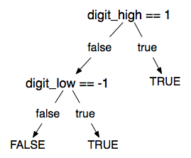
Compound Condition Testing
Compound (multiple) condition adequacy:
  Cover all possible combinations of compound conditions and cover all branches of a selection statement
  For a compound condition with
  n basic conditions,
  2^{n} test cases may be needed.
 | C1 | C2 | C
T1 | T | T | T
T2 | T | F | F
T3 | F | T | F
T4 | F | F | F
C = C1 and C2
Notes:
Notice that due to the left-to-right evaluation order and short-circuit evaluation of logical OR expressions in the C language, the value true for the first condition does not need to be combined with both values false and true for the second condition.

Slide 83
Compound Conditions: Exponential Complexity
(((a || b) && c) || d) && e
Test Case a b c d e
(1) T — T — T
(2) F T T — T
(3) T — F T T
(4) F T F T T
(5) F F — T T
(6) T — T — F
(7) F T T — F
(8) T — F T F
(9) F T F T F
(10) F F — T F
(11) T — F F —
(12) F T F F —
(13) F F — F —
short-circuit evaluation often reduces this to a more manageable number, but not always
Notes:
Why do we care? Because even one very complex condition in a program could require
an impractical number of test cases. For example, a condition with 16 basic conditions
could require more than 32,000 test cases (although this is unlikely in practice, because
very large conditions are more typically just one big disjunction or one big conjunction,
which are effectively reduced to a linear number of cases by short-circuit evaluation).

Slide 84
Modified Condition/Decision Coverage (MC/DC)
Motivation:
  Effectively test important combinations of conditions, without exponential blowup in test suite size
  “Important” combinations means:
    each basic condition shown to independently affect the outcome of each decision
Requires: For each basic condition C, two test cases,
  C evaluates to true for one and false for the other
  Values of all other evaluated conditions remain the same
  The compound condition as a whole evaluates to true for one and false for the other
Notes:
If we don't want to test all possible combinations, then we have to say which combinations are important.
One good choice is to choose combinations that show how each basic condition can affect the outcome,
i.e., how changing that one condition can change the value of the whole compound condition. That's
what the “modified condition/decision” criterion requires.

Slide 85
Construct Test Cases for MC/DC
MC/DC with two basic conditions
  C = C1 && C2
  C = C1 || C2
 | C1 | C2 | C
T1 | T | T | T
T2 | T | F | F
T3 | F | T | F
 | C1 | C2 | C
T1 | T | F | T
T2 | F | T | T
T3 | F | F | F

Slide 86
Construct Test Cases for MC/DC
MC/DC with three basic conditions
  C = (C1 && C2)&& C3
  Copy rows T1, T2, T3 in the (C1 && C2) table to the table below and
  Fill in true for column C3
  Operator || can be handled similarly (symmetric)
 | C1 | C2 | C3 | C
T1 | T | T | T | T
T2 | T | F | T | F
T3 | F | T | T | F
T4

Slide 87
Construct Test Cases for MC/DC
MC/DC with three basic conditions
  C = (C1 && C2) && C3
  Add a new row for T4
    Column C3: false
    Column C1 and C2: copy the values from one of T1, T2, or T3 with true outcome
 | C1 | C2 | C3 | C
T1 | T | T | T | T
T2 | T | F | T | F
T3 | F | T | T | F
T4 | T | T | F | F

Slide 88
MC/DC: Linear Complexity
Only n+1 test cases needed for n basic conditions
Adopted by many industry quality standards
(((a || b) && c) || d) && e
Test Case a b c d e Outcome
(1) true -- true -- true true
(2) false true true -- true true
(3) true -- false true true true
(6) true -- true -- false false
(11) true -- false false -- false
(13) false false -- false -- false
  Values in red independently affect the output of the decision
Notes:
This is the same table as two slides ago, omitting redundant cases.
Cases 4,5, 7-10, and 12 have been omitted.
In each column we find two rows in which that column is underlined. For example, the “a” column is underlined in rows (1) and (13). All the evaluated conditions in those two rows are the same except for that column. For example, to show that changing “a” from true to false in case (1) would change the outcome, we
* Fill in the “don't care” columns in row 1 with values from row 13 (because this doesn't change anything
* Then see that the rows are completely identical except in column “a” and the outcome so clearly changing the value of “a” changed the outcome.
The number of test cases needed is hardly more than for basic condition coverage, but MC/DC is much better than basic condition coverage at exposing faults in conditional expressions, so it is clearly superior (and therefore very widely used, and specified in some standards).

Slide 89
Analysis of MC/DC
MC/DC is
  basic condition coverage (C)
  decision (branch) coverage (DC)
  plus one additional condition (M):
  every condition must independently affect the decision's outcome
Subsumed by compound conditions
Subsumes all other criteria discussed so far
  stronger than statement and branch coverage
A good balance of thoroughness and test size
  therefore widely used
Notes:
(This mainly restates comments on the previous slide, and can be used
or skipped depending on lecture style)

Slide 90
Leave (Almost) No Code Untested
In general
  90% coverage is achievable
  95% coverage require significant effort
  100% not always attainable
Challenges in coverage
  Platform specific code
  Defensive programming
  Exception handling
  Non-public method, never invoked

Slide 91
Summary
Rationale for structural testing
Basic terms: adequacy, coverage
Characteristics of common structural criteria
  Statement, branch, condition, compound condition, MC/DC
Practical uses and limitations of structural testing

Slide 92

Reading
Chapters 11.1, 11.3-11.4 of the textbook.
Chapters 5.1-5.3, 12 of the textbook.

Slide 93
Next Class
Topic:
  White Box Testing Part 2, Test Coverage with Cobertura
Reading:
  Pezze and Young, Chapter 12
  Cobertura documentation: http://cobertura.github.io/cobertura/
  An example of using Cobertura and JUnit: Coverage1.zip in D2L
  See also reading list
Assignments
  Assignment 5 Due May 2 (Today)
  Assignment 6 Due May 4
  Assignment 7 Due May 11
  Assignment 8 Due May 16

