Slide 1
SE 433/333 Software Testing
& Quality Assurance
Dennis Mumaugh, Instructor
dmumaugh@depaul.edu
Office: CDM, Room 428
Office Hours: Tuesday, 4:00 – 5:30

Slide 2
Administrivia
Comments and feedback
Announcements
  Make sure your assignment has your name and assignment number on each page, and also the page number.
  Code should be similarly marked (as comment on first page)
  Make sure you have loaded the software and tested it:
    Eclipse – this week
    JUnit – next week
  We will use more software later:
    Ant – next week
    Cobertura

Slide 3
SE 433 – Class 3
Topic:
  Testing
  Unit Testing and JUnit: JUnit Part 1
Reading:
  Pezze and Young: Chapters 17.4-17.5
  JUnit documentation: http://junit.org
  An introductory tutorial http://www.vogella.com/tutorials/JUnit/article.html
  Using JUnit in Eclipse – https://courses.cs.washington.edu/courses/cse143/11wi/eclipse-tutorial/junit.shtml
  An example test: JUnit1.zip in D2L
  Articles on the reading list

Slide 4
Assignment 3
Using JUnit and Eclipse
The objective of this assignment is to develop a simple unit test using JUnit and run JUnit tests in Eclipse IDE.
First: download and get running Eclipse.
You should include test cases that test both valid and invalid input conditions.
Due Date: April 18, 2017, 11:59pm

Slide 5
Thought for the Day
Programs need not be idiot proof. Idiots don’t use programs.

Slide 6
Test selection

Slide 7
Test cases
A test case, in software engineering, is a set of conditions under which a tester will determine whether an application, software system or one of its features is working as it was originally established for it to do.
Test cases are often referred to as test scripts, particularly when written – when they are usually collected into test suites.
A Test Case is a set of actions executed to verify a particular feature or functionality of your software application.

Slide 8
Test cases
Why we write test cases? The basic objective of writing test cases is to validate the testing coverage of the application.
Keep in mind while writing test cases that all your test cases should be simple and easy to understand.
For any application basically you will cover all the types of test cases including functional, negative and boundary value test cases.

Slide 9
Writing test cases
First you must understand the language fundamentals
  Sizes and limits of variables, platform specific information
Second, you must understand the domain
Read the requirements
Think like a user – what possible things do they want to do
Think about possible “mistakes”; i.e. Invalid input
Think about impossible conditions or input
What is the testing intended to prove?
  Correct operation – gives correct behavior for correct input
  Robustness – responds to incorrect or invalid input with proper results
  User acceptance – typical user behavior
Write down the test cases

Slide 10
Writing Good Test Cases
Test Cases need to be simple and transparent:
Create Test Case with end user in mind
Avoid test case repetition.
Do not Assume
  Stick to the Specification Documents.
Ensure 100% Coverage
Test Cases must be identifiable.
Implement Testing Techniques
  It's not possible to check every possible condition in your software application. Testing techniques help you select a few test cases with the maximum possibility of finding a defect.

Slide 11
Writing Good Test Cases
Boundary Value Analysis (BVA):
  testing of boundaries for specified range of values.
Repeatable and self-standing
  The test case should generate the same results every time no matter who tests it

Slide 12
Writing a test case
While drafting a test case do include the following information
The description of what requirement is being tested
Inputs and outputs or actions and expected results
  Test case must have an expected result.

Slide 13
Test cases
Verify the results are correct
  Testing Normal Conditions
  Testing Unexpected Conditions
  Bad (Illegal) Input Values
  Boundary Conditions

Slide 14
Writing test cases
Cover all possible valid input
  Try multiple sets of values, not just one set of values
  Permutations of values
Check boundary conditions
  Check for off-by-one conditions
Check invalid input
  Illegal sets of value
  Illegal input
    Impossible conditions
  Totally bad input
    Text vs. Numbers, etc.

Slide 15
Writing test cases
Let’s consider Assignment 1 and testing
Cover all possible valid input
  all three possible conditions: equilateral, isosceles, scalene
  Try multiple sets of values, not just one set of values
  Permutations of values {3,4,5}, {4,3,5}, {5,4,3}
Check boundary conditions
  Check for off-by-one conditions: 0, MAX_INT
Check invalid input
  Illegal sets of value
    Wrong format: not integer
    Negative numbers
  Illegal input
    Impossible conditions: {2,3,8}, {2,3,5} {definition of a triangle}
  Totally bad input
    Text vs. Numbers, etc.

Slide 16
Writing test cases
Beware of problems with comparisons
  How to compare two floating numbers
    Never do the following:
    float a, b;
    . . .
    if ( a == b)
    Is it 4.0000000 or 3.9999999 or 4.0000001 ?
    What is your limit of accuracy?
  In object oriented languages make sure whether you are comparing the contents of an object or the reference to an object
      String a = “Hello world!\n”
      String b = “Hello world!\n”
      if ( a == b )
      vs.
      if ( a.equals(b) )

Slide 17
Writing test cases
Let’s consider Assignment 1 and testing
How to test the code?
Have the code read from the standard input
  java Triangle < testcases.txt
  or,
  java Triangle
  2 3 3
  3 4 5
Have the output print to standard output.
  java Triangle > results.txt
Combine the two and we have:
  java Triangle <testcases.txt >results.txt
This assumes we have the code read three numbers on the line, or have the code read three numbers whether they are on one line or more.

Slide 18
Tips for testing
You cannot test every possible input, parameter value, etc.
  So you must think of a limited set of tests likely to expose bugs.
Think about boundary cases
  positive; zero; negative numbers; infinity; very small
  right at the edge of an array or collection's size (plus or minus one)
Think about empty cases and error cases
  0, -1, null; an empty list or array
test behavior in combination
  maybe add usually works, but fails after you call remove
  make multiple calls; maybe size fails the second time only

Slide 19
Trustworthy tests
Test one thing at a time per test method.
  10 small tests are much better than 1 test 10x as large.
Each test method should have few (likely 1) assert statements.
  If you assert many things, the first that fails stops the test.
  You won't know whether a later assertion would have also failed.
Tests should avoid logic.
  minimize if/else, loops, switch, etc.
  avoid try/catch
    If it's supposed to throw, use expected= ... if not, let JUnit catch it.
Torture tests are okay, but only in addition to simple tests.

Slide 20
Test Execution

Slide 21
Automating Test Execution
Designing test cases and test suites is creative
  Like any design activity: A demanding intellectual activity, requiring human judgment
Executing test cases should be automatic
  Design once, execute many times
Test automation separates the creative human process from the mechanical process of test execution

Slide 22
Generation: From Test Case Specifications to Test Cases
Test design often yields test case specifications, rather than concrete data
  Ex: “a large positive number”, not 420023
  Ex: “a sorted sequence, length > 2”, not “Alpha, Beta, Chi, Omega”
Other details for execution may be omitted
Generation creates concrete, executable test cases from test case specifications

Slide 23
Scaffolding
Code produced to support development activities (especially testing)
  Not part of the “product” as seen by the end user
  May be temporary (like scaffolding in construction of buildings)
Includes
  Test harnesses, drivers, and stubs
  Example:
    JUnit – test harness
    Eclipse – IDE, scaffolding, JUnit built in

Slide 24
Scaffolding ...
Test driver
  A “main” program for running a test
    May be produced before a “real” main program
    Provides more control than the “real” main program
      To driver program under test through test cases
Test stubs
  Substitute for called functions/methods/objects
Test harness
  Substitutes for other parts of the deployed environment
    Ex: Software simulation of a hardware device
Notes:
Terminology note: “Harness” is also commonly used to refer to all three parts, a test driver, stubs, and replacements for other components.

Slide 25
Stubs

Slide 26
Drivers

Slide 27
Generic or Specific?
How general should scaffolding be?
  We could build a driver and stubs for each test case
  ... or at least factor out some common code of the driver and test management (e.g., JUnit)
  ... or further factor out some common support code, to drive a large number of test cases from data (as in DDSteps)
  ... or further, generate the data automatically from a more abstract model (e.g., network traffic model)
A question of costs and re-use
  Just as for other kinds of software

Slide 28
Oracles
Did this test case succeed, or fail?
  No use running 10,000 test cases automatically if the results must be checked by hand!
Range of specific to general, again
  ex. JUnit: Specific oracle (“assert”) coded by hand in each test case
  Typical approach: “comparison-based” oracle with predicted output value
  Not the only approach!

Slide 29
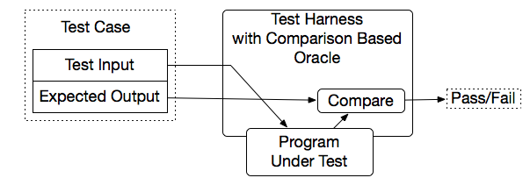
Comparison-based oracle
With a comparison-based oracle, we need predicted output for each input
  Oracle compares actual to predicted output, and reports failure if they differ
Fine for a small number of hand-generated test cases
  E.g., for hand-written JUnit test cases

Slide 30
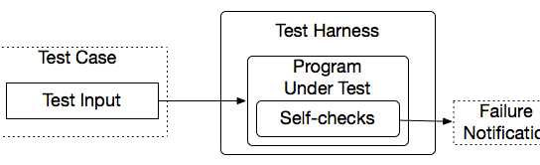
Self-Checking Code as Oracle
An oracle can also be written as self-checks
  Often possible to judge correctness without predicting results
Advantages and limits: Usable with large, automatically generated test suites, but often only a partial check
  e.g., structural invariants of data structures
  recognize many or most failures, but not all
Notes:
A typical approach is to add a few hand-written test cases with a comparison-based test oracle, to cover properties that are difficult or too expensive to check with a general oracle.

Slide 31
Capture and Replay
Sometimes there is no alternative to human input and observation
  Even if we separate testing program functionality from GUI, some testing of the GUI is required
We can at least cut repetition of human testing
Capture a manually run test case, replay it automatically
  with a comparison-based test oracle: behavior same as previously accepted behavior
    reusable only until a program change invalidates it
    lifetime depends on abstraction level of input and output

Slide 32
Summary
Goal: Separate creative task of test design from mechanical task of test execution
  Enable generation and execution of large test suites
  Re-execute test suites frequently (e.g., nightly or after each program change)
Scaffolding: Code to support development and testing
  Test drivers, stubs, harness, including oracles
  Ranging from individual, hand-written test case drivers to automatic generation and testing of large test suites
  Capture/replay where human interaction is required

Slide 33
Unit Testing and JUnit

Slide 34
Unit Testing
Testing of an individual software unit
  usually a class & its helpers
Focus on the functions of the unit
  functionality, correctness, accuracy
Usually carried out by the developers of the unit
  can use black-box and white-box techniques to design test cases

Slide 35
JUnit

Slide 36
Unit testing
Unit testing: Looking for errors in a subsystem in isolation.
  Generally a "subsystem" means a particular class or object.
  The Java library JUnit helps us to easily perform unit testing.
The basic idea:
  For a given class Foo, create another class FooTest to test it, containing various "test case" methods to run.
  Each method looks for particular results and passes / fails.
JUnit provides "assert" commands to help us write tests.
  The idea: Put assertion calls in your test methods to check things you expect to be true. If they aren't, the test will fail.

Slide 37
JUnit..
JUnit helps the programmer:
  Define and execute tests and test suites
  Formalize requirements and clarify architecture
  Write and debug code
  Integrate code and always be ready to release a working version
What JUnit does
  JUnit runs a suite of tests and reports results

Slide 38
JUnit
JUnit is a framework for writing unit tests
  A unit test is a test of a single class
    A test case is a single test of a single method
    A test suite is a collection of test cases
Unit testing is particularly important when software requirements change frequently
  Code often has to be refactored to incorporate the changes
  Unit testing helps ensure that the refactored code continues to work

Slide 39
A JUnit test class
  import org.junit.*;
  import static org.junit.Assert.*;
  public class name {
  ...
  @Test
  public void name() { // a test case method
  ...
  }
  }
  A method with @Test is flagged as a JUnit test case.
    All @Test methods run when JUnit runs your test class.

Slide 40
The structure of a test method
A test method doesn’t return a result
If the tests run correctly, a test method does nothing
If a test fails, it throws an AssertionFailedError
The JUnit framework catches the error and deals with it; you don’t have to do anything

Slide 41
Test suites
In practice, you want to run a group of related tests (e.g. all the tests for a class)
To do so, group your test methods in a class which extends TestCase

Slide 42
Organize The Tests
Create test cases in the same package as the code under test
For each Java package in your application, define a TestSuite class that contains all the tests for validating the code in the package
Define similar TestSuite classes that create higher-level and lower-level test suites in the other packages (and sub-packages) of the application
Make sure your build process include the compilation of all tests

Slide 43
JUnit Best Practices
Separate production and test code
But typically in the same packages
Compile into separate trees, allowing deployment without tests
Don’t forget OO techniques, base classing
Test-driven development
  Write failing test first
  Write enough code to pass
  Refactor
  Run tests again
  Repeat until software meets goal
  Write new code only when test is failing

Slide 44
Why JUnit
Allows you to write code faster while increasing quality
Elegantly simple
Check their own results and provide immediate feedback
Tests are inexpensive
Increase the stability of software
Developer tests
Written in Java
Free
Gives proper understanding of unit testing

Slide 45
Problems with unit testing
JUnit is designed to call methods and compare the results they return against expected results
  This ignores:
    Programs that do work in response to GUI commands
    Methods that are used primarily to produce output
Heavy use of JUnit encourages a “functional” style, where most methods are called to compute a value, rather than to have side effects
  This can actually be a good thing
  Methods that just return results, without side effects (such as printing), are simpler, more general, and easier to reuse

Slide 46
JUnit summary
Tests need failure atomically (ability to know exactly what failed).
  Each test should have a clear, long, descriptive name.
  Assertions should always have clear messages to know what failed.
  Write many small tests, not one big test.
    Each test should have roughly just 1 assertion at its end.
Test for expected errors / exceptions.
Choose a descriptive assert method, not always assertTrue.
Choose representative test cases from equivalent input classes.
Avoid complex logic in test methods if possible.

Slide 47
An Introduction to JUnit
Part 1: The Basics

Slide 48
JUnit – Java Unit Testing Tool
A unit testing tool for Java programs
  JUnit home page: http://junit.org
A simple framework to write repeatable tests
  Test cases, test suites, assertions, etc.,
Automated execution of test suites
  Run all test cases, generate reports
Development methodology neutral
  Often used in agile development/test-driven development

Slide 49
JUnit Versions
JUnit 4
  significant (and not compatible) change from prior versions.
  requires JDK 5 or later
JUnit 3 is different.
  can be used with earlier versions of Java
  still in use
  We will use JDK 8 & JUnit 4.
  (JDK 7 also works)
Notes:
Current version 4.11 (Jan, 2014)

Slide 50
Running JUnit
JUnit has been integrated into most IDE’s
  We will use the latest Eclipse IDE (Luna, 4.4.1) [or Mars.2, 4.5.2]
  Download and install Eclipse IDE for Java Developers
JUnit can also be run independently
  Command-line, builder server
  Using a simple build tool Ant (next lecture)
We will use both methods of running JUnit.

Slide 51
Test Case Verdicts
A verdict is the result of executing a single test case.
Pass
  The test case execution was completed
  The function being tested performed as expected
Fail
  The test case execution was completed
  The function being tested did not perform as expected
Error
  The test case execution was not completed, due to
    an unexpected event, exceptions, or
    improper set up of the test case, etc.

Slide 52
JUnit Tests
A JUnit test is represented as a class (test class).
Each test case is a method in a test class.
A typical test case does the following
  create some objects/data to test
  do something interesting with the objects
  determine pass or fail based on the results
A test suite may consist of multiple test classes.

Slide 53
JUnit Assertions
Assertions are Boolean expressions
  An assertion failure exception is thrown if the assertion is false
Can check for many conditions, such as
  equality of objects and values
  identity of references to objects
Determine the test case verdict
  Pass: all assertions are true
  Fail: one or more assertions are false

Slide 54
A Simple JUnit Test Case
/** Test of setName() method, of class Value */
@Test
public void createAndSetName() {
Value v1 = new Value();
v1.setName("Y");
String expected = "Y";
String actual = v1.getName();
Assert.assertEquals(expected, actual);
}

Slide 55
A Simple JUnit Test Case
/** Test of setName() method, of class Value */
@Test
public void createAndSetName() {
Value v1 = new Value();
v1.setName("Y");
String expected = "Y";
String actual = v1.getName();
Assert.assertEquals(expected, actual);
}
Identify this Java method
as a test case

Slide 56
A Simple JUnit Test Case
/** Test of setName() method, of class Value */
@Test
public void createAndSetName() {
Value v1 = new Value();
v1.setName("Y");
String expected = "Y";
String actual = v1.getName();
Assert.assertEquals(expected, actual);
}
Confirm that setName
saves the specified name in the Value object

Slide 57
A Simple JUnit Test Case
/** Test of setName() method, of class Value */
@Test
public void createAndSetName() {
Value v1 = new Value();
v1.setName("Y");
String expected = "Y";
String actual = v1.getName();
Assert.assertEquals(expected, actual);
}
Check to see that the
Value object really
did store the name

Slide 58
A Simple JUnit Test Case
/** Test of setName() method, of class Value */
@Test
public void createAndSetName() {
Value v1 = new Value();
v1.setName("Y");
String expected = "Y";
String actual = v1.getName();
Assert.assertEquals(expected, actual);
}
Assert that the expected and actual should be equal. If not, the test case should fail.

Slide 59
Organization of JUnit Test
Each test method represents a single test case
  can independently have a verdict (pass, error, fail).
The test cases for a class under test (CUT) are usually grouped together into a test class.
Naming convention:
  Class under test: Value
  JUnit test for the class: ValueTest
  Test classes are sometimes placed in a separate package.

Slide 60
Using JUnit in Eclipse
Download and install JDK 7 or 8 (Java SE Development Kit)
  Download and install Eclipse IDE for Java Developers (Luna, 4.4.1) [or Mars.2, 4.5.2]
  JUnit is included in Eclipse

Slide 61
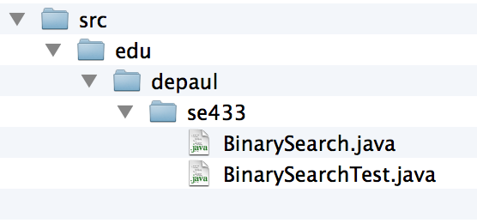
Run JUnit in Eclipse: An Example
Download the Sample Code from D2L
  JUnit1.zip
  Unzip to the Eclipse
  workspace folder
    A subfolder named
    JUnit1
The example contains
  edu.depaul.se433.BinarySearch.java
  edu.depaul.se433.BinarySearchTest.java
[see handout of JUnit1.zip]
Contents of JUnit1

Slide 62
The Example Program: The Class Under Test
package edu.depaul.se433;
public class BinarySearch {
public static int search(int[] a, int x) {
…
}
public static int checkedSearch(int[] a, int x) {
…
}
}

Slide 63
The JUnit Test
package edu.depaul.se433;
import org.junit.*;
import static org.junit.Assert.*;
import static edu.depaul.se433.BinarySearch.*;
public class BinarySearchTest {
@Test
public void testSearch1() {
int[] a = { 1, 3, 5, 7 };
assertTrue(search(a, 3) == 1);
}

Slide 64
The JUnit Test (cont’d)
@Test
public void testSearch2() {
int[] a = { 1, 3, 5, 7 };
assertTrue(search(a, 2) == -1);
}
@Test
public void testCheckedSearch1() { … }
@Test
public void testCheckedSearch2() { … }
@Test
public void testCheckedSearch3() { … }
}

Slide 65
Run JUnit in Eclipse: An Example
Start Eclipse IDE
New Java Project
  Project name: JUnit1
  Important: The project name matches the name of the folder that contains the sample code

Slide 66
Run JUnit in Eclipse: An Example
Click “Next”
Java Settings
  Click “Libraries”
  Click “Add Library …”

Slide 67
Run JUnit in Eclipse: An Example
Add Library
  Choose “JUnit”
JUnit Library
  Choose “JUnit 4”
Click “Finish”

Slide 68
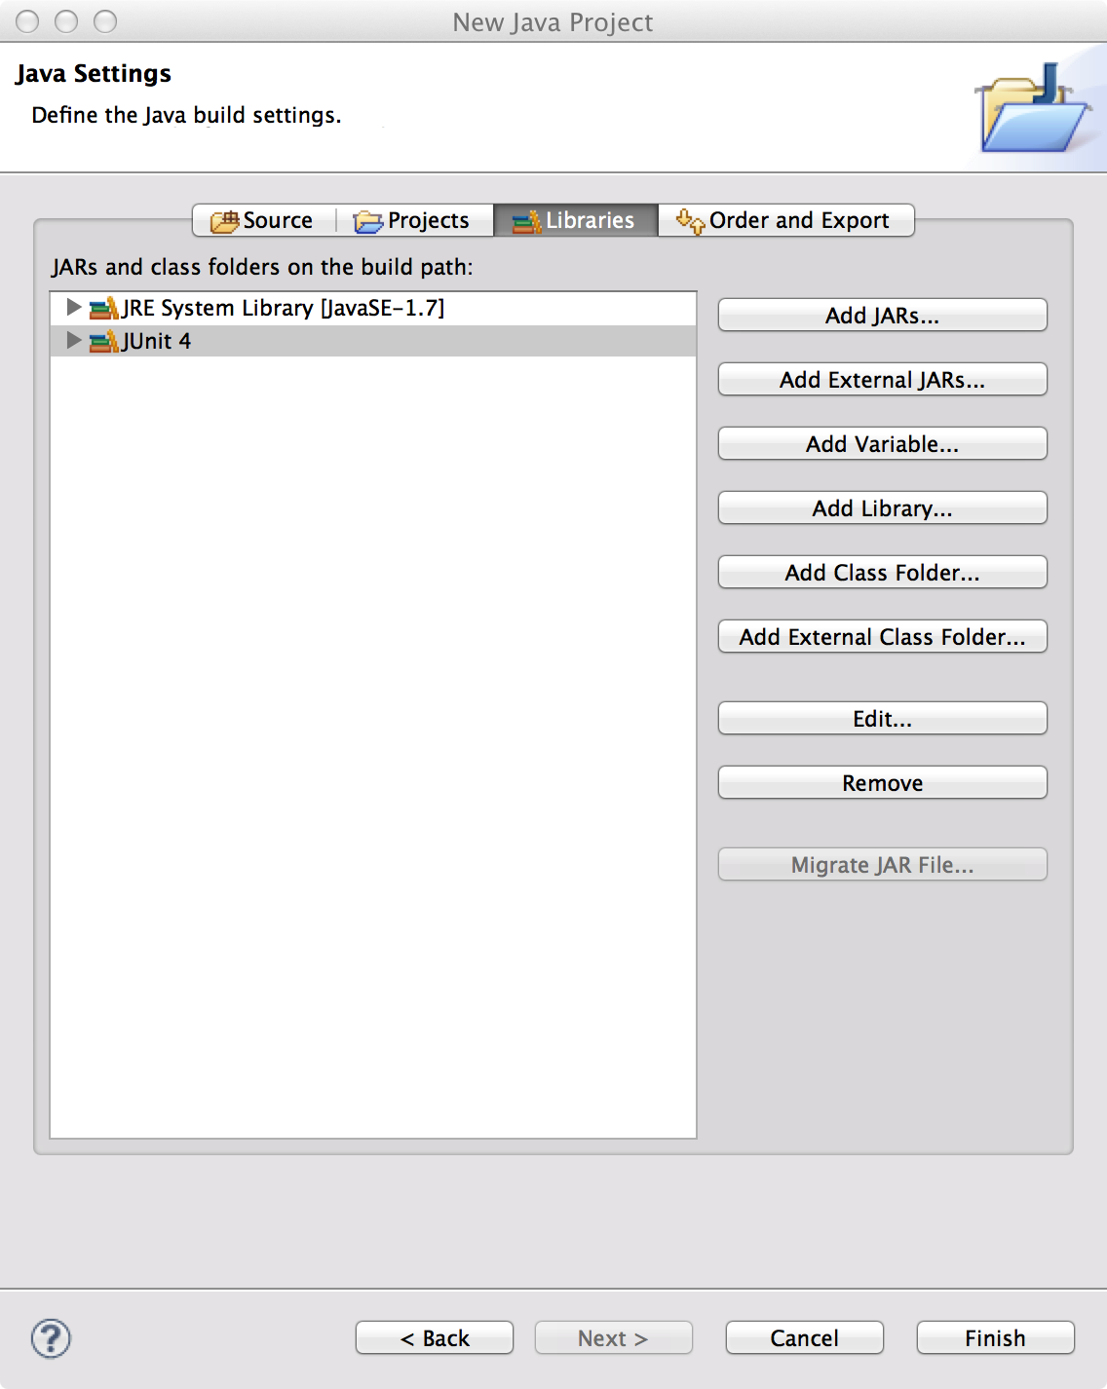
Run JUnit in Eclipse: An Example
Click “Finish”

Slide 69
Run JUnit in Eclipse: An Example
Run as
  JUnit test

Slide 70
Run JUnit in Eclipse: An Example

Slide 71
Assertion Methods

Slide 72
Assertions in Test Cases
During execution of a test case:
If an assertion is true,
  Execution continues
If any assertion is false,
  Execution of the test case stops
  The test case fails
If an unexpected exception is encountered,
  The verdict of the test case is an error.
If all assertions were true,
  The test case passes.

Slide 73
Assertion Methods: Boolean Conditions
Static methods defined in org.junit.Assert
Assert an Boolean condition is true or false
  assertTrue(condition)
  assertFalse(condition)
Optionally, include a failure message assertTrue(message, condition)
  assertFalse(message, condition)
Examples
  assertTrue(search(a, 3) == 1);
  assertFalse(“Failure: 2 is not in array.”, search(a, 2) >= 0);

Slide 74
Assertion Methods: Null Objects
Assert an object references is null or non-null
  assertNull(object)
  assertNotNull(object)
With a failure message
  assertNull(message, object)
  assertNotNull(message, object)
Examples
  assertNotNull(”Should not be null.", new Object());
  assertNull(”Should be null.", null);

Slide 75
Assertion Methods: Object Identity
Assert two object references are identical
  assertSame(expected, actual)
  True if: expected == actual
  assertNotSame(expected, actual)
  True if: expected != actual
The order does not affect the comparison,
  But, affects the message when it fails
With a failure message
  assertSame(message, expected, actual)
  assertNotSame(message, expected, actual)

Slide 76
Assertion Methods: Object Identity
Examples
  assertNotSame("Should not be same.",
  new Object(), new Object());
  Integer num1 = Integer.valueOf(2013);
  assertSame("Should be same.", num1, num1);
  Integer num2 = Integer.valueOf(2014);
  assertSame("Should be same.", num1, num2);
java.lang.AssertionError:
Should be same. expected same:<2013> was not:<2014>
76 of 60

Slide 77
Assertion Methods: Object Equality
Assert two objects are equal:
  assertEquals(expected, actual)
  True if: expected.equals( actual )
  Relies on the equals() method
  Up to the class under test to define a suitable equals() method.
With a failure message
  assertEquals(message, expected, actual)

Slide 78
Assertion Methods: Object Equality
Examples
  assertEquals("Should be equal.", "JUnit", "JUnit");
  assertEquals("Should be equal.", "JUnit", "Java");
org.junit.ComparisonFailure:
Should be equal. expected:<J[Unit]> but was:<J[ava]>

Slide 79
Assertion Methods: Equality of Arrays
Assert two arrays are equal:
  assertArrayEquals(expected, actual)
  arrays must have same length
  Recursively check for each valid index i,
    assertEquals(expected[i],actual[i])
      or
    assertArrayEquals(expected,actual)
With a failure message
  assertArrayEquals(message, expected, actual)

Slide 80
Assertion Methods: Equality of Arrays
Examples
    int[] a1 = { 2, 3, 5, 7 };
    int[] a2 = { 2, 3, 5, 7 };
    assertArrayEquals("Should be equal", a1, a2);
    int[][] a11 = { { 2, 3 }, { 5, 7 }, { 11, 13 } };
    int[][] a12 = { { 2, 3 }, { 5, 7 }, { 11, 13 } };
    assertArrayEquals("Should be equal", a11, a12);

Slide 81
Floating Point Values
Beware of problems with comparisons
  How to compare two floating numbers
    Never do the following:
    float a, b;
    . . .
    if ( a == b)
  Why? Floating point arithmetic is not precise.
    What is your limit of accuracy of the computer?
    Is it 4.0000000 or 3.9999999 or 4.0000001 ?
    Comparison is to subtract one of the numbers and look at the remainder. Hence to compare two floating numbers you must have a range/limit/delta.

Slide 82
Assertion Methods: Floating Point Values
For comparing floating point values (double or float)
  assertEquals requires an additional parameter delta.
  assertEquals(expected, actual, delta)
  assertEquals(message, expected, actual, delta)
The assertion evaluates to true if
Math.abs( expected – actual ) <= delta
Example:
double d1 = 100.0, d2 = 99.99995;
assertEquals(“Should be equal within delta.”, d1, d2, 0.0001);

Slide 83
Exception Testing
A.k.a., robustness testing
The expected outcome of a test is an exception.
  checkedSearch(null, 1);
public static int checkedSearch(int[] a, int x) {
if (a == null || a.length == 0)
throw
new IllegalArgumentException("Null or empty array.");
…
}

Slide 84
Exception Testing: Specify the Excepted Exception
Specify an expected exception in a test case
  A parameter of @Test annotation
  A particular class of exception is expected to occur
The verdict
  Pass: if the expected exception is thrown
  Fail: if no exception, or an unexpected exception
@Test(expected=IllegalArgumentException.class)
public void testCheckedSearch2() {
checkedSearch(null, 1);
}

Slide 85
Exception Testing: The fail() Assertion
Assertion methods
  fail()
  fail(message)
Unconditional failure
  i.e., it always fails if it is executed
Used in where it should not be reached
  e.g., after a statement, in which an exception should have been thrown.

Slide 86
Exception Testing: Use fail() Assertion
Catch exceptions, and use fail() if not thrown
Allows
  inspecting specific messages/details of the exception
  distinguishing different types of exceptions
@Test
public void testCheckedSearch3() {
try {
checkedSearch(null, 1);
fail("Exception should have occurred");
} catch (IllegalArgumentException e) {
assertEquals(e.getMessage(), "Null or empty array.");
}
}

Slide 87
Readings and References
JUnit documentation
  http://junit.org
An introductory tutorial
  http://www.vogella.com/tutorials/JUnit/article.html

Slide 88
Summary: Key Concepts
Test Cases play an important role in Software Testing Life-cycle. Make sure they are correct and cover all possible situations.
Unit testing refers to the practice of testing certain functions and areas – or units – of our code. This gives us the ability to verify that our functions work as expected.
Testing needs to be thorough
Eclipse provides a platform for doing unit tests using JUnit as a built-in feature.

Slide 89
Next Class
Topic:
  Black Box Testing, JUnit Part 2
Reading:
  Pezze and Young: Chapter 10
  JUnit documentation: http://junit.org
  An example of parameterized test: JUnit2.zip in D2L
  Articles on the Class Page and Reading list
Assignment 3 – Using JUnit and Eclipse
  Due April 18, 2017, 11:59pm

