Slide 1
Are you in the right course?
SE 433/333 Software Testing
& Quality Assurance

Slide 2
SE 433/333 Software Testing
& Quality Assurance
Dennis Mumaugh, Instructor
dmumaugh@depaul.edu
Office: CDM, Room 428
Office Hours: Tuesday, 4:00 – 5:30

Slide 3
Administrivia: Introduction
Dennis Mumaugh
  Undergraduate: BSEE – University of California, Berkeley
  MS Computer Science – University of Maryland
  Ph.D. Studies – University of Maryland
  Teaching at DePaul since September 2000
Work
  Senior Engineer – National Security Agency
    ARPANet Pioneer, Unix™ Technology Transfer
  Member of the Technical Staff – Bell Labs/Lucent Technologies
    Unix Development – Current Engineering
    IS&R Systems – Knowledge Based Systems
    Software Tools and OO Technology
Interests
  Operating Systems and System Programming
  Software Productivity, Compilers and Software Metrics
  Software Engineering

Slide 4
Administrivia: Basic Information
Contact Information:
  Email: dmumaugh@depaul.edu
  Phone: 630-983-1221 (10:00 am - 11:00 pm) except just before class (After 3pm)
Office Hours
  Tuesday: 4:00 pm to 5:30 pm, Loop, CDM, Room 428
  By arrangement

Slide 5
Administrivia: Basic Information
Class home page
http://condor.depaul.edu/dmumaugh/classes/SE433S17, contains syllabus and schedule, lecture notes, homework, more reading material
About the Lecture Notes – look at “notes” section of the slides
Also look at the expanded readings page:
http://condor.depaul.edu/dmumaugh/readings/SE433readings.html
Desire2Learn:
  Course materials, assignments, assignment submissions, assignment solutions, examinations and quizzes and grades will be available on the Desire2learn – https://d2l.depaul.edu/
Email
  All students are expected to have an email address.
  Please make sure it is valid and make sure Campus Connection has the current email address.

Slide 6
Administrivia: Basic Information
Course mailing list:
  se433@mailman.depaul.edu
  To subscribe to the list or unsubscribe from it, go to http://mailman.depaul.edu/mailman/listinfo/se433.
    I’ll bulk subscribe on Saturday.
  If necessary, update your spam filter to accept messages from the mailing list.
  Unless your message is personal, send it to the course mailing list!
I will respond to questions related to the lectures and assignments.
You are also encouraged to respond to other students’ questions.
The mailing list is archived. You may subscribe to a digest.
Last minute information will go to the mailing list

Slide 7
Administrivia: reading materials
Primary Textbook
  Software Testing and Analysis: Process, Principles and Techniques, by Mauro Pezze and Michal Young
References
  The Art of Software Testing, Second Edition
  by Glenford J. Myers et al
    Available in e-book through library
  Software Engineering: A Practitioner's Approach, 6th ed
  by Roger S Pressman (Chapters 13 and 14)
  Lecture notes and supplementary materials
    Available on D2L

Slide 8
Administrivia: reading materials
A note on reading list
  You are not expected to read all of the material on the reading list.
  Look at the various articles as you have time.
    Many say the same thing but with a different perspective.
  Don't get overwhelmed in reading

Slide 9
Administrivia: Course structure
Ten classes + Midterm Exam + Final Exam
Weekly reading, assignments (10)
Class structure: lecture (with short break near the middle).
Topics and reading assignments are on the class web page

Slide 10
Administrivia: required software
Access to MS Word and PowerPoint (or equivalent)
Java
  Java development and testing software:
    Eclipse,
    JUnit,
    Ant,
    Cobertura.

Slide 11
Administrivia: Support
Technical questions can be addressed during office hours or by email
Use the mailing list for all technical questions
  Provide appropriate support to each other
I do not preview homework, but I will answer questions or make suggestions to generic problems
If you contact me by e-mail
  Please include your name and the course number in all correspondence

Slide 12
Administrivia: Miscellany
Communications development:
  An essential part of this course is communicating your ideas in prose, as well as in technical graphical artifacts.
  The ability to communicate clearly and effectively is a skill that will pay off both in and out of class.
  Motivation from a recent NPR business report:
    Robert Half surveyed their corporate customers concerning resumes they had received.
    Corporate reviewers spent about 10-15 seconds deciding whether to examine the resume further.
    They instantly tossed the resume if they detected any grammatical or spelling errors.
  Treat your coursework as if it were being reviewed by the manager who does your performance review and sets your salary.

Slide 13
Administrivia: Miscellany
Intellectual property issues:
All material in this course is property of either the instructor or Xiaoping Jia.
  You are permitted to download and print copies of the material.
  You are not permitted to redistribute the material in any form.
Plagiarism:
  All individual assignments must represent your own work.
  It's a great idea to get together in study groups to discuss the problems, but you should then do the assignments individually.
  Plagiarism is to take and use as one’s own, or copy without acknowledgement, the works of another person. The provider of such material can be ruled equally culpable.
  If you hand in late homework with prior permission, it must be your own work, not a copy of the solutions presented in class.

Slide 14
Administrivia: Miscellany
There will be a lot of ambiguity and lack of firm direction in the assignments and the information.
  That is typical of much of engineering.
  This requires you to provide your own experience. Or to research and discover your information.
  Using previous solutions/techniques will not necessarily work. You may have to invent something.
Understanding a problem (statement):
  An essential part of this course is understanding written material, ideas in prose. The ability to understand a document, to "read between the lines", is a skill that will pay off both in and out of class.
Areas of concern:
  Projects are implemented with the wrong features.
  Students answer the wrong question on a test.
  People confuse the subsystems of a design.
  People do not read, really read things.

Slide 15
Administrivia: Feedback/Participation
Feedback/Participation
  Share your thoughts
  Ask questions – wave your hand forcefully to get my attention
  Speak loudly so all can hear
  Give me verbal and non-verbal feedback
  Don't just sit there . . . nod, smile, frown, shake your head
Make sure your email address is correct and works

Slide 16
Homework logistics
Homework must be submitted via Desire2Learn by 11:59 PM Chicago Time on the assignment due date.
  Do not rely on the deadline, clocks differ. Be early.
  Submit MS Word or Adobe PDF files only [I accept either format of MS Word]
No extra credit assignments.
Late Policy
  Late assignments will not be accepted except for special circumstances.

Slide 17
Grading – Attendance & Assignments
Attendance – 10%
  In-class students: attendance taken during class
  On-line students: must watch each lecture within 6 days
    Submit attendance confirmation
Assignments and projects (individual)
  SE333 – 50%
  SE433 – 45%
  Including several programming projects

Slide 18
Grading – Exams & Final Paper
Mid-term exam – 20%
Final exam – 20%
Final paper – 5% (SE433 only)
    No late submission will be accepted.

Slide 19
Administrivia: assessment
Regular assignments (10)
Midterm examination
Final examination
Each of the above will be weighted as follows:
  Attendance – 10%
  Assignments and projects – 50% for SE333
  45% for SE433
  Mid-term exam – 20%
  Final exam – 20%
  Final take-home exam, a short paper – 5% SE433 only,
Grading will be done on the usual 60/70/80/90 bands but will be adjusted to account for clustering and banding of scores. Bands may be adjusted if there seems to be a systemic bias to the scores.

Slide 20
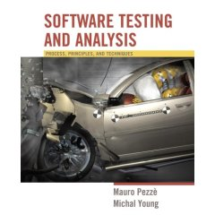
Assignments
Read the relevant chapters in the textbook and the relevant reference materials.
Understand all the materials covered in the lecture notes.
Use the mailing list for questions and discussions.

Slide 21
Course Specific Information

Slide 22
Prerequisites
Data Structures II (CSC 301, 403, 383, 393), or
Object-Oriented Modeling (SE430)
Proficient in programming and data structures
  Assignments will use Java
Familiar with object-oriented modeling and principles
Familiar with software development processes

Slide 23
Course Objectives
Understand how to achieve high quality in software development
Study the processes, techniques, and tools for software testing
Focus on software testing and analysis
  basic principles and techniques
  underlying theory
  organizational and process issues

Slide 24
Learning Outcomes
Applications of techniques and tools at the module and system levels
Understanding of the techniques, processes, and tools at the project and organization levels
Emphasis
  practical techniques to achieve an acceptable level of quality at an acceptable cost.
  realistic strategies for reliable and cost-effective software testing.

Slide 25
Some Topics
Introduction to software testing
Functional testing
Structural testing
Test case selection
Inspection
Static analysis
Unit testing
Test automation and tools
Integration and system testing
Regression testing
Performance testing
Web application testing
Security testing
Graphical user interface (GUI) testing
Usability testing
Fault-based testing
Planning and monitoring the software quality process
Testing of object-oriented software
We will cover a subset of the above.

Slide 26
Engineering Methodology
What is engineering and how does it differ from science?
Engineering is the application of science to the needs of humanity. This is accomplished through the application of knowledge, mathematics, and practical experience to the design of useful objects or processes in a cost effective way.
One of the objectives of this course is to teach some of the methodology of engineering
  Understanding the problem
  How to approach a problem
  Developing and following requirements
  Writing and reading specifications
  Analyzing a problem
  Designing a solution
  Verifying each step
  Testing the design against the original problem statement

Slide 27
Surviving SE433
Make sure you read things, sometimes more than once. People do not seem to read assignments and web pages (or do not follow instructions).
The pace is quick. The intent of the course is to learn by doing, not by reading; but there is a lot of information to process.
Read the assignments carefully. Note special requirements, such as formats and use of predefined templates!
Start your assignments right after they are handed out (assigned). They will take some time and starting on the night before it is due is not a good strategy.
Reading list:
  Is it required? No.
  Is it useful? Yes, especially if you are serious about a career in software development.
  The articles are usually short but informative. Most are supplemental – useful for understanding but the notes cover the major points.
Reading should be done in parallel with the lectures.
Pace yourself. Remember: “This too shall pass.”

Slide 28
SE 433 – Class 1
Topics: Introduction and Overview:
  Class Logistics and Administrivia;
  Introduction to Software Testing
Reading
  Pezze and Young: Chapters 1-4

Slide 29
Thought for the Day
Software Testing takes at least twice as long as estimated.

Slide 30
On Testing
For the Snark’s a peculiar creature, that won’t
Be caught in a commonplace way.
Do all that you know, and try all that you don’t:
Not a chance must be wasted to-day!
— Lewis Carroll
The Hunting of the Snark,
an Agony in Eight Fits (1876)

Slide 31
Why Programs fail
In Federalist 51, James Madison wrote: “If men were angels, no government would be necessary.”
If he lived today, Madison might have written: “If software developers were angels, debugging would be unnecessary.”

Slide 32
Why Programs fail
Congratulations!
Your code is complete. It compiles. It runs …
Your program fails. How can this be?
There is a defect in the code. When the code is executed, the defect causes bad behavior, which later becomes visible as a failure.
Before a program can be debugged, we must set it up such that it can be tested — that is, executed with the intent to make it fail.
The first step in debugging is to reproduce the problem in question — that is, to create a test case that causes the program to fail in the specified way.
  The first reason is to bring it under control, such that it can be observed.
  The second reason is to verify the success of the fix.
Now you will have the fun of testing and debugging!

Slide 33

Myth Busters
Software Testing

Slide 34
Myth #1 in Software Testing
Q: What is the objective of software testing?
A: Testing is to show that there are no
errors/bugs/defects in the software.

Slide 35

Myth #1 in Software Testing
Q: What is the objective of software testing?
A: Testing is to show that there are no
errors/bugs/defects in the software.
Fact:
  No!! The main objective of testing is to discover defects.
  Testing is a destructive activity.

Slide 36
Myth #2 in Software Testing
Q: What is the objective of software testing?
A: Testing is to ensure that the software does what it is supposed to do.

Slide 37
Myth #2 in Software Testing
Q: What is the objective of software testing?
A: Testing is to ensure that the software does what it is supposed to do.
Fact:
  Only partly true.
  Testing is also to ensure the software does not do what it is not supposed to do.

Slide 38
Myth #3 in Software Testing
Q: How challenging is software testing?
A: Testing is easier than design and
implementation.
Notes:
Though it’s simple to prepare straightforward test cases, at times testing can be a real challenging task.
Any production issues will, in many cases, backfire first to the testing teams. Why was this scenario not covered in the test plan??
Therefore, a Tester should develop the capability to look or think beyond the requirements mentioned in the test plan or specifications.
This is very important in case of System Testers who are responsible for ensuring that the software product works appropriately from "end-to-end ".

Slide 39
Myth #3 in Software Testing
Q: How challenging is software testing?
A: Testing is easier than design and
implementation.
Fact:
  Must consider all possible scenarios.
  Implied and unstated requirements and threats.
  Must be imaginative and creative.
Notes:
Though it’s simple to prepare straightforward test cases, at times testing can be a real challenging task.
Any production issues will, in many cases, backfire first to the testing teams. Why was this scenario not covered in the test plan??
Therefore, a Tester should develop the capability to look or think beyond the requirements mentioned in the test plan or specifications.
This is very important in case of System Testers who are responsible for ensuring that the software product works appropriately from "end-to-end ".

Slide 40
Myth #4 in Software Testing
Q: How challenging is software testing?
A: Testing is an extremely creative and
intellectually challenging task.

Slide 41

Myth #4 in Software Testing
Q: How challenging is software testing?
A: Testing is an extremely creative and
intellectually challenging task.

Slide 42
What is Software Testing ?
Software testing is the process of executing a program with the intent of finding bugs.

Slide 43
Cost of Software Errors
Estimated 50% of each software project spent on testing (spans from 30% to 80%)
Very rough approximation
  money spent on testing + cost of remaining errors = 66% of size of software industry
Remark: At Ericsson: 35% of code is test cases!

Slide 44
Failure and Specification
Some failures are obvious
  obviously wrong output/behavior
  non-termination
  Crash
  freeze
...but most are not!
In general, what constitutes a failure, is defined by a specification!
Correctness is a relative notion
— B. Meyer, 1997

Slide 45
Why Does
Software Testing Matter?

Slide 46
Economic Impact
NIST, “The Economic Impacts of Inadequate Infrastructure for Software Testing”
  Inadequate software testing costs the US alone around $59.5 billion annually
  Better approaches could cut this amount by $22.2 billion
We want our programs to be reliable
  Testing is how, in most cases, we find out if they are

Slide 47

Launch of MS Windows 98
Bill Gates and Blue Screen of Death

Slide 48
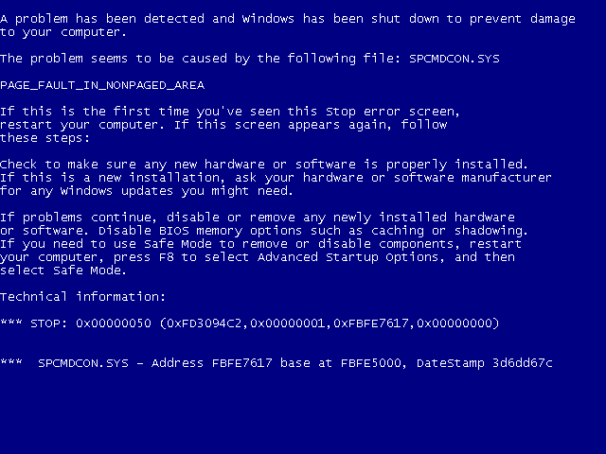
Launch of MS Windows 98
Bill Gates and Blue Screen of Death

Slide 49
Why Do We Test?
Testing is expensive.
  So are failures!
What do we gain from that cost?
  Finding bugs
  Leading to
    Fixing bugs
    Raising the quality of the program or system we are testing
Notes:
3/29/17
49

Slide 50
Why Do We Test?
Kinds of testing
  “Smoke test.”, aka “Hello World!”
  Check handling of inputs
    Illegal inputs – text instead of integers
    Impossible inputs – floating vs. integer
    Outrageous values – infinities, max and min values
    Not in domain – negative numbers,
    values outside specifications
    Input errors – wrong input, e.g. mis-spellings
  Stress test
    multiple inputs without restart
    run program for long periods of time
Notes:
3/29/17
50

Slide 51
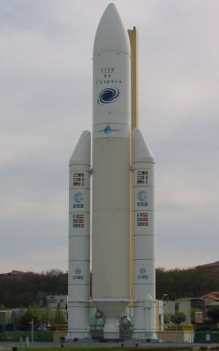
A Case Study: Ariane 5 Launch Vehicle
European expendable launch system
Double the payload capacity of its predecessor Ariane 4
  113 successful launches, 3 failures
Flight 501, maiden launch,
June 4, 1996,12:34pm
Notes:
The Guiana Space Centre or, more commonly, Centre spatial guyanais (CSG) is a French and European spaceport near Kourou in French Guiana.

Slide 52
Case Study − Ariane 5: What Happened?
T0 - T0 + 36s : normal
Within SRI 2:
  BH (Bias Horizontal) > 2¹⁵
  convert_double_to_int(BH) fails!
  exception SRI -> crash SRI 2 & 1
OBC disoriented
  angle > 20°, huge aerodynamics constraints
  boosters separating...
T0 + 39s: self destruction
  cost: € 500M

Slide 53
Case Study − Ariane 5: Why Did It Happen?
Not a programming error
  unprotected conversion = design decision (~1980)
Not a design error
  Justified against Ariane 4 trajectory & RT constraints
Problem with integration testing
  Theoretically detectable.
  But huge test space vs. limited resources
  Furthermore, SRI useless at this stage of the flight!
Reuse of a component with a hidden constraint
  Precondition : abs(BH) < 32768.0
  Valid for Ariane 4, but no longer for Ariane 5
    More powerful rocket

Slide 54
Case Study − Ariane 5:
Lessons Learned in Software Eng.
Test! Test! Test!
Test! Even when the code is reused.
When reuse, ensure the assumptions are still valid.
When write reusable code, document the assumptions.
Write fail-safe code.
Do not propagate errors.

Slide 55
Trade-Offs of Cost and Failures
Total Cost of Quality (CoQ) =
Cost of Conformance (CoC) +
Cost of Non-Conformance (CoNC)
Cost of Conformance
  Prevention: quality planning, investment in tools, quality training
  Appraisal: testing, inspection
Cost of Non-Conformance
  Internal failures: rework
  External failure: liability, loss of properties, loss of lives

Slide 56
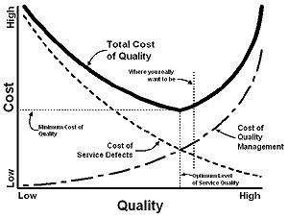
Trade-Offs of Cost and Failures
Testing adds to Cost of Conformance
It must directly reduce Cost of Non-Conformance

Slide 57
A Self Assessment Test

Slide 58
Test the Following Program
The program reads in 3 integer values that represent the lengths of the sides of a triangle.
The program prints a message that states whether the triangle is
  Equilateral (all 3 sides are equal)
  Isosceles (exactly 2 of the 3 sides are equal)
  Scalene (all 3 sides are of a different length)
Write a set of test cases that you feel would adequately test this program.

Slide 59
How Did You Do?

Slide 60
Test the Following Program
Write a set of test cases that you feel would adequately test this program.
How many cases are needed (look back at slide 50)?
How do you plan to test the program.
  Run it many times with different inputs.
  Once and manually enter the values.
  A file with a set of lines with test values.

Slide 61
Assignment
Assignment 1 Part I due April 4, 2017
Part I: Write a Java program to determine types of triangles.
The program reads 3 integer numbers from the standard input. The numbers represent the lengths of the sides of a triangle. The program prints a message to the standard output that indicates whether the triangle represented by the input is
  an equilateral (all 3 sides are equal), or
  an isosceles (exactly 2 of the 3 sides are equal), or
  a scalene (all 3 sides are of different lengths)
The program should print out appropriate messages when an erroneous input or condition is encountered.
Submission: The source code (i.e., the .java file) of your program.
Hint: Your program must read the numbers from the standard input, or a file fed to the standard input. One way to do this is to use the java.util.Scanner class.
Part II: Due date: April 11, 2017, Design a test suite to thoroughly test your program. And, Test it.

Slide 62
Software Testing
Terminologies

Slide 63
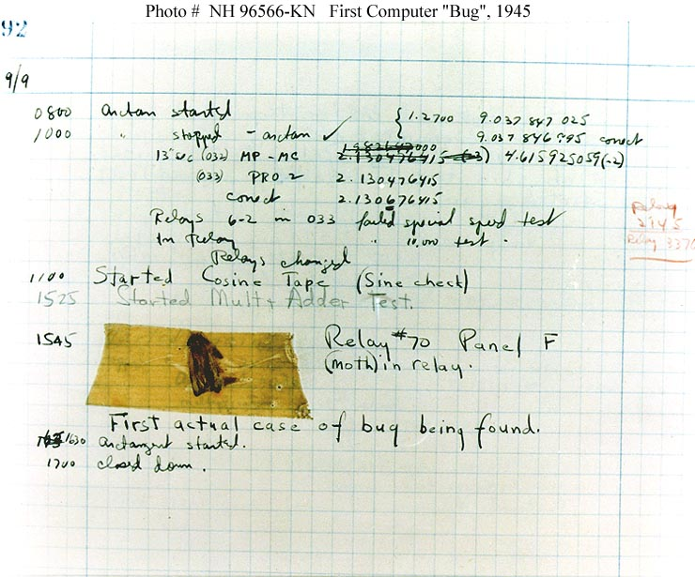
The Very First Software Bug
A moth found trapped between points at Relay # 70, Panel F
  Mark II Aiken Relay Calculator
  Harvard University
  September 9, 1945.
On display in Smithsonian

Slide 64
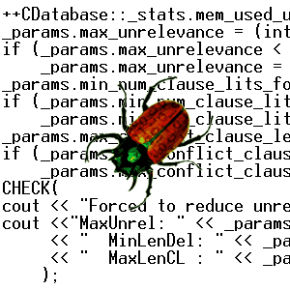
Failures
Failures are
  deviation of the observed behavior of a system from its specification, i.e., its expected behavior.
Failures can only be determined with respect to the specifications.
Failures are concerned with the observed behavior and outcome of the system.

Slide 65
Defects
Defects are
  flaws in a system that can cause the system to fail to perform its required function
    e.g. an incorrect condition or statement.
Defects are concerned with specific parts or components of the system.
Defects are synonymous with faults, bugs.

Slide 66
Errors
Errors are
  human actions that result in a fault or defect in the system.
Errors are concerned with the underlying causes of the defects.
Errors are synonymous with mistakes.

Slide 67
The Relations among Failures, Defects, and Errors
A human being makes an error (mistake)
  can occur in design, coding, requirements, even testing.
An error can lead to a defect (fault)
  can occur in requirements, design, or program code.
If a defect in code is executed, a failure may occur.
  Failures only occur when a defect in the code is executed.
  Not all defects cause failures all the time.
Defects occur because human beings are fallible
Failures can be caused by environmental conditions as well.

Slide 68
The Relations among Failures, Defects, and Errors
The terms error, failure and defect have different meaning when testing. Especially in using JUnit. In this case:
Test Case Verdicts
  Pass
    The test case execution was completed
    The function being tested performed as expected
  Fail
    The test case execution was completed
    The function being tested did not perform as expected
  Error
    The test case execution was not completed, due to an unexpected event, exceptions, or improper set up of the test case, etc.

Slide 69
Failures vs. Defects: A Simple Example
For any integer n, square (n) = n*n.
    int square (int x)
    {
    return x*2;
    }
square (3) = 6
A defect
A failure

Slide 70
Failures vs. Defects: A Simple Example
For any integer n, square (n) = n*n.
    int square (int x)
    {
    return x*2;
    }
square (2) = 4
A defect
Correct result
Not a failure

Slide 71
Software Testing
Software testing is
  the process of executing a program (or parts of a program) with the intention of finding defects
The purpose of testing
  to find defects.
  to discover every conceivable weakness in a software product.
Software testing ≠ Debugging.
Software testing ≠ Quality assurance

Slide 72
Software Testing vs. Quality Assurance (QA)
Testing is necessary, but not sufficient for quality assurance
  Testing contributes to improve quality by identifying problems.
Quality assurance sets the standards for the team/organization to build better software.

Slide 73
Test Cases and Test Suites
Test case
  A test case consists of inputs, steps/actions, and expected results, i.e., pass-fail criterion
Test suite
  A group of test cases (usually organized around some principles)

Slide 74
Test Plan and Testing Process
Test plan
  A document that specifies how a system will be tested, including criteria for success, i.e., the exit criteria.
Testing process
  The testing process involves developing test plans, designing test cases, running the test cases, and evaluating the results

Slide 75
Techniques for
Software Testing

Slide 76
Testing
Testing “Phases”
  Unit
  Integration
  System
  User Acceptance Testing
Testing Types
  Black-box
  White-box
Static vs. Dynamic Testing
Integration: 3 types
  Top down
  Bottom up
  Sandwich
Automated Testing
  Pros and cons
Defect tracking

Slide 77
Ad Hoc Testing
Ad hoc testing
  Testing carried out informally
  No formal test preparation
  No recognized test design technique is used
  Expected results not defined
  Arbitrariness guides the test execution activity
Ad hoc testing is not sufficient

Slide 78
Black Box Testing
Treats a program or system as a black box
Design test cases without the knowledge of internal structure and design of the system
Design test cases based on the functional requirements of the system
  a.k.a: functional testing
Send the system inputs, observe the outputs, decide if the system passed or failed the test
Sometimes you don’t have access to source code

Slide 79
White Box Testing
Open up the box!
  a.k.a: glass box, clear box, or structural testing
Design test cases by examining the internal design and source code of the program
Require detailed knowledge of its structure
Introduce the idea of measuring coverage:
  How adequate, or thorough, is the test suite?

Slide 80
Software Analysis
Software analysis is
  the process of finding defects in a program (or parts of a program) without executing the program.
  a.k.a. static analysis
Complementary to software testing
  Same purpose, different techniques
Software analysis can be
  automated, i.e., using tools, static analyzers
  manual, e.g., inspection, code review

Slide 81
Basic Principles of
Software Testing

Slide 82
Testing vs. Verification
TESTING
Goal: find evidence for presence of failures
  Testing: execute a program with the intent of detecting failure
  Testing cannot guarantee correctness, i.e., absence of failures
Related techniques: code reviews, program inspections
VERIFICATION
Goal: find evidence for absence of failures
  Verification guarantees correctness
Related techniques: code generation, program synthesis (from spec)

Slide 83
Testing vs. Verification
Both, testing and verification attempts exhibit new failures
Debugging is a systematic process that finds and eliminates the defect that led to an observed failure
Programs without known failures may still contain defects:
  If they have not been verified
  If they have been verified, but the failure is not covered by the specification

Slide 84
Make No Assumptions
Do not assume that no new defects will be found.

Slide 85
Define Expected Output
Each test case must include the expected output.
The output of each test must be thoroughly inspected.
  Preferably: automated inspection, assertions
?
Actual output
Expected output

Slide 86
Test the Invalid and Unexpected
Test input conditions that are
  valid and expected
  invalid and unexpected
Test a program to see whether it
  does not do what it is supposed to do
    perform some but not all the required functions
  does what it is not supposed to do
    perform unnecessary functions, undesired side-effects

Slide 87
Test Independently
A program should be tested by independent testers.
developer
independent tester
Understands the system
Must learn about the system,
but, will test "gently"
but, will attempt to break it
and, is driven by "delivery"
and, is driven by quality

Slide 88

Test Prudently
You have a 3-day fishing vacation
  Day 1: net 10 fish in Pond A
  Day 2: net 20 fish in Pond B
  Day 3: which pond do you return to?

Slide 89
Test Prudently
Defects tend to cluster rather than evenly distribute.
  The probability of the existence of more defects in a component is proportional to the number of defects already found in the component.
  A small number of modules usually contains most of the defects discovered during pre-release testing, or is responsible for most of the operational failures.

Slide 90
Tool Support is Essential
Some Reasons for Using Tools
  Automate repetitive tasks
  Avoid typos, etc.
  Cope with large programs
Tools Used
  Test script
  Automated compilation, build and testing: Ant
  Automated running of tests: JUnit
  Debugging: Eclipse debugger
  Code Coverage: Cobertura

Slide 91
Limitations of
Software Testing

Slide 92
Exhaustive Testing
Can we exhaustively test a
program?
Let’s consider this simple program
There are 10¹⁴ possible paths!
  If we execute one test per millisecond,
  it would take 3,170 years to test this program!!
Exhaustive testing is impossible!
loop < 20 iterations

Slide 93
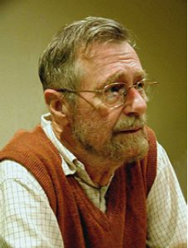
Absence of Defects
“Program testing can be used to show the presence of bugs, but never their absence.”
(Dijkstra, 1969)
Testing reduces the probability of
undiscovered defects remaining in
the software but, even if no defects
are found, it is not a proof of absence
of defects.
Edsger W. Dijkstra,1930 – 2002

Slide 94
When to Stop Testing?
One of the most difficult problems in testing is not knowing when to stop.
You can use metrics to make a guess. Keep track of the defect rate. When it goes towards zero you can use it as an indicator. Or, …
Even if you do find the last bug, you’ll never know it.

Slide 95
How Much Testing is Enough?
Take into account
  the level of risk, including technical, safety, and business risks, and
  project constraints such as time and budget.
Testing should provide feedback to stakeholders to make informed decisions
  about the release of the software,
  for the next development step, or
  handover to customers.
In Lecture 10 we will discuss some techniques for making this decision.

Slide 96
Summary – Key Concepts
Objective and principles of testing
Cost of quality
Fundamentals and basic terminologies in testing
Failures, defects, faults, errors, mistakes
Testing, analysis, black-box and white-box testing
Test cases, test suites, test plan, test process
Independent testing
Limitations of testing, exhaustive testing

Slide 97
Reading
Chapters 1-4 of the textbook.

Slide 98
Next Class
Topic:
  Software Quality
Reading:
  Pezze and Young: Chapters 1-4
Assignment:
  Assignment 1: Determining Types of Triangles

