Slide 1

Introduction to Cryptology
IT-233
Yosef Mendelsohn
Lecture #7:
Introduction to Cryptology:
World War II & Enigma
Review

Slide 2
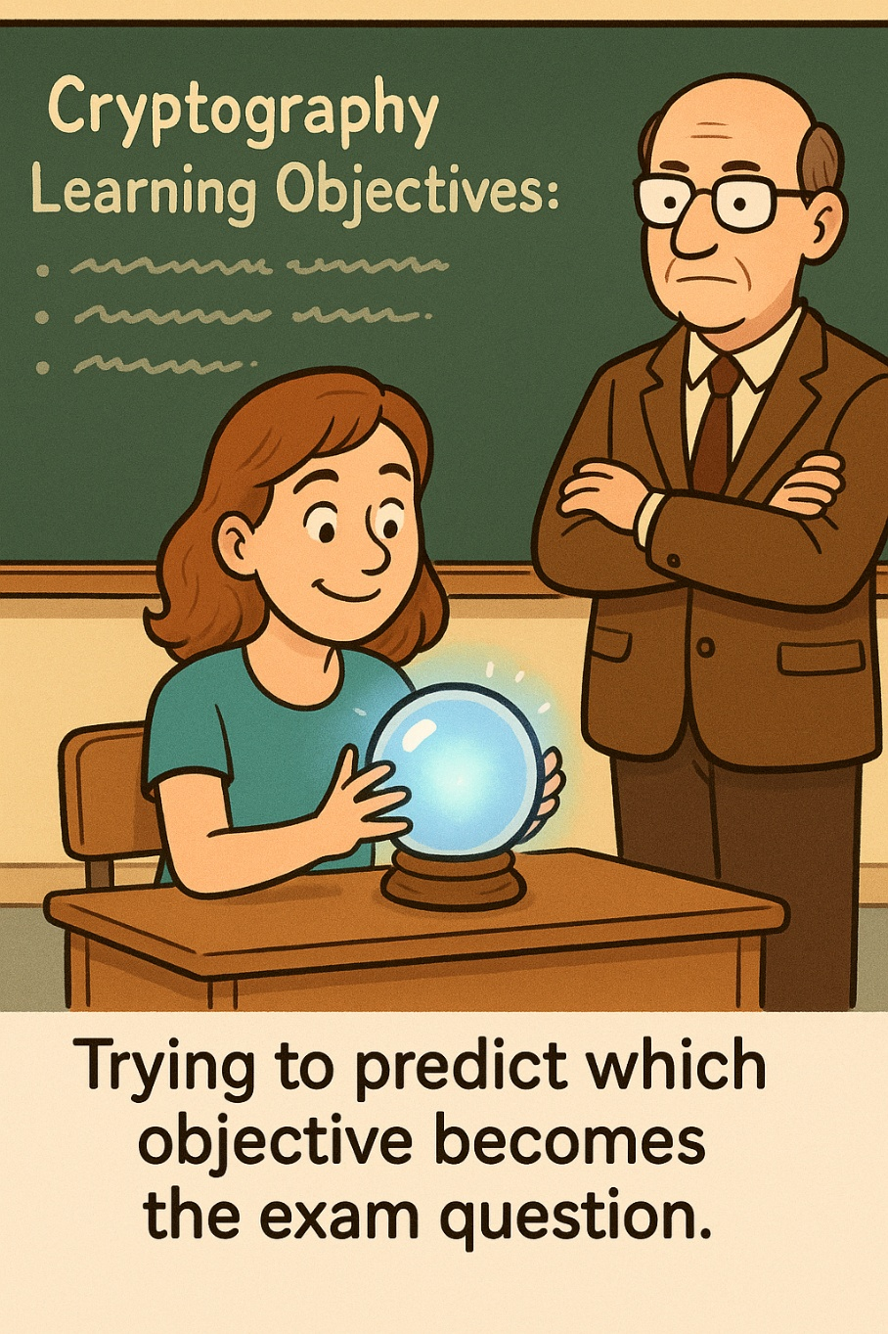
Lecture objectives
Blah
  More blah

Slide 3
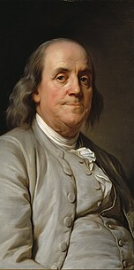

“Three may keep a secret if two of them are dead.
- Benjamin Franklin
A truism from Benjamin Franklin.
Or is it???
Thousands of people knew about the breaking of Enigma, and for reasons of patriotism, legal threats, and recognition of the stakes involved, maintained their silence for decades.
A common reaction to conspiracy theories is “There’s no way they could keep something like that secret.” Turns out that sometimes, there is!
  That being said, it is VERY rare for things not to get out there in this day and age!

Slide 4
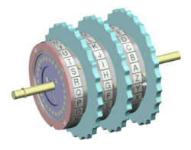
Introducing:
The Rotor
As WW1 was ending, the idea of using rotors for purposes of encipherment was introduced.
At least four people in four separate countries appear to have come up with the idea over the same period of approximately 1917-23.
These rotors specialized in substitution as letters passed from one side of the rotor, through the wires, and out to different positions (letters) on the other side.
A time-consuming, laborious – and error-prone – encipherment (and decipherment) task could now be done by machine.
In addition, it was soon appreciated that rotors could be combined to ofter stronger encryption.
A 3-Rotor System
(such as was used in Enigma)

Slide 5
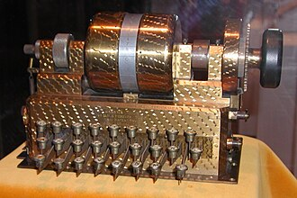
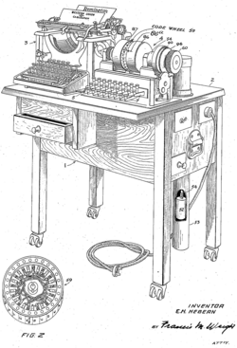
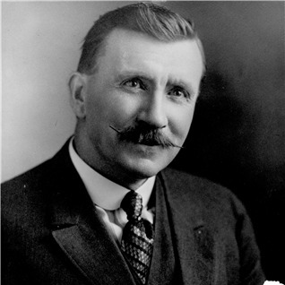
First one:
Hebern Electric code
Edward Hugh Hebern is credited with the first known sketches of a rotor system in 1917. (He was also jailed in 1908 for stealing a horse!)
“Hebern Electric Code Company” began to offer cipher machines commercially
Mis-spent investment capital.
  His investors eventually sued him for stock manipulation for which he, again, spent time in jail.
Not as secure as hped for - Friedman and others were able to easily crack it
Hoped to sell to Navy, but sales didn’t go well
Single-rotor Hebern machine
Patent Applicaton for the
Single-rotor Hebern machine

Slide 6
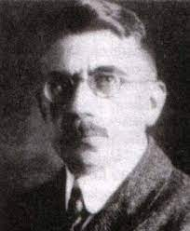
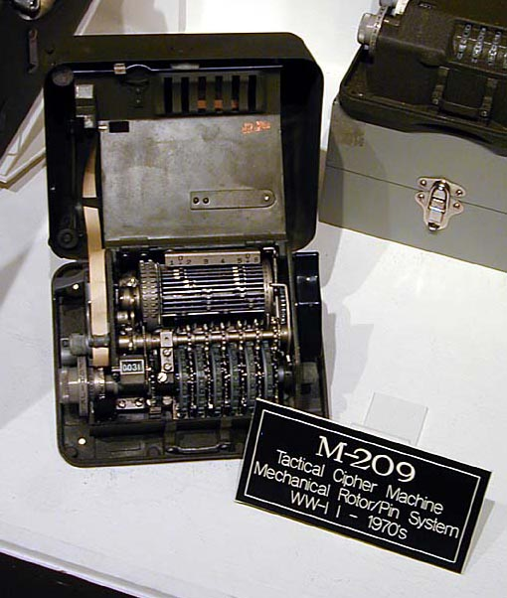
First Enigma machines
Hugo Alexander Koch (Netherlands) had the same idea in 1919, but never followed up commercially.
Koch sold patent to Arthur Scherbius in 1927. Scherbius came up with everything from electric pillows (no idea what that was all about!) to producing Koch’s machine commercially in 1923. Marketed under the trade name “Enigma”.
  Schrebius was kiled in a horse-carriage accident in 1929 and never saw his Enigma in military use.
Arvid Gerhard Damm filed a patent in Sweden for a machine using multiple rotors just days after Koch. When Damm died, his company was taken over by fellow Swede, Boris Hagelin who emigrated to America, formed the company CrytpoAG and sold his machines to the US Army.
  M-209 was not the most secure machine, but was lightweight and easy to use.
  So effective, was used as late as the Korean War
Arthur Scherbius
M-209B Cipher Machine

Slide 7
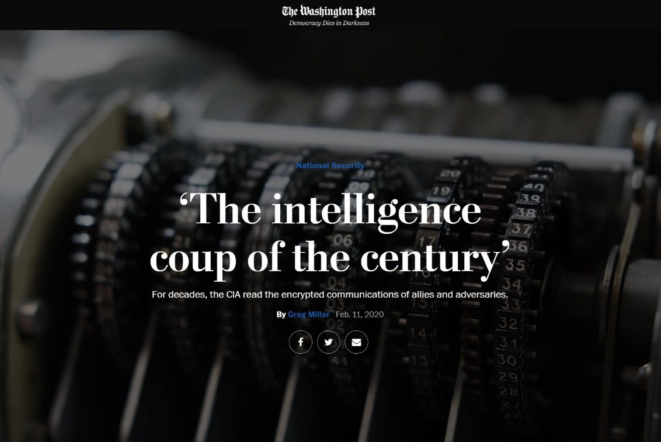
Can’t Trust anybody!
CryptoAG became far and away the dominant company selling cryptographic machines worldwide. However, it also sold fraudulent machines to customers including foreign governments. However, by this point, the company was secretly owned by the CIA and West German intelligence. These agencies rigged many of those machines so that they could easily break the codes of those machines.
From the above Washington Post article:
  “It was the intelligence coup of the century,” the CIA report concludes. “Foreign governments were paying good money to the U.S. and West Germany for the privilege of having their most secret communications read by at least two (and possibly as many as five or six) foreign countries.”
  Monitored:
  Iran’s mullahs during the 1979 hostage crisis
  Argentina’s military during the Falklands War (which they promptly gave to the British)
  Libyan officials congratulating themselves on the 1986 bombing of a Berlin disco
  Assisination attempts (and successes) in South America

Slide 8
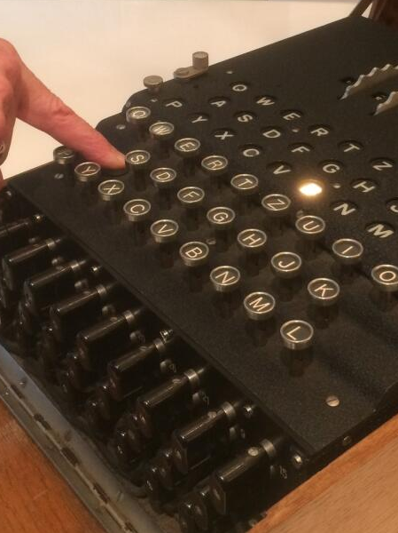
Introducing: Enigma
A cipher device used extensively in commercial and military capacities in the 20th century.
In particular by Nazi Germany during WW2.
Essentially a cipher device.
  A plaintext letter is typed on the keyboard --> a ciphertext letter lights up which is then recorded for subsequent transmission.
  Works in reverse: If a ciphertext letter is typed, the plaintext letter will light up.
    Convenient, yes, but……
      Turns out to be a HUUUUUGE flaw in the system!
    A plaintext letter can never map to itself. For example, a plaintext A will never map to a ciphertext A
      This also turns out to be massively unsafe!
Notes:
In this case, pressing A results in ‘B’ lighting up

Slide 9
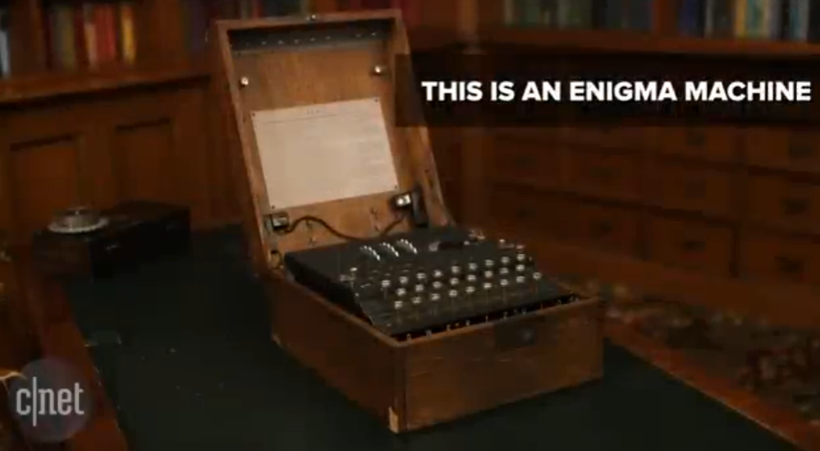
Video with discussion
We will view the following short CNet video together in class, and I will discuss it with you.
We will then elaborate on the details for the remainder of the lecture.
https://www.youtube.com/watch?v=-qcOCBfRRzg

Slide 10
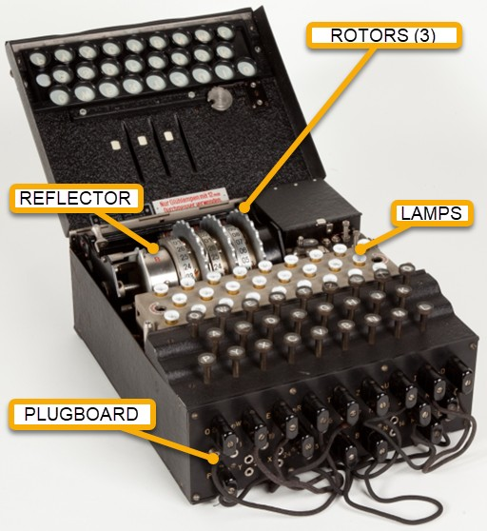
Enigma components & pathway
When a key is pressed on the keyboard, a series of letter substitutions occurs. The sequence is as follows:
Plugboard: 0 or more substitutions happens at the plugboard. If, for example, the letter A is plugged into the letter D, then A will be swapped with D.
    The plugboard was only used in military settings. The Germans typically used between 6 and 10 substitutions at this level.
Rotors: At the first rotor, another substitution is made. There are 3 rotors, so 3 substitutions occurred at this level.
    The rotors could (and would) be set to different starting positions. Knowing which starting positions was the main part of the encryption (and decryption) key.
    The rotors would step. That is, they would move at various point. The right-most rotor (“fast” rotor) would step after every key press. The other two would step less frequently. This turned the system into a polyalphabetic substitution cipher.
Reflector: In order for the single machine to be used for both encipherment and decipherment, the signal had to be sent back the way it came. This was done by the reflector. It made a further substitution – albeit a substitution with special properties.
    The substitution was fixed. i.e. It did not change – and could not be changed. For example, on the rotor if a T → B, then it ALWAYS mapped T to B.
    It was reversible. If an incoming T mapped to B, then an incoming B mapped to T.
    This turned out to be one of two significant flaws in the system, mainly because this particular substitution ensured that no plaintext letter could be mapped to itself. (i.e. A could never be substituted to A).
Return Journey: The ciphertext letter then returned through the same pathway, albeit through different wires, and the ciphertext letter (following the multiple substitutions that had just occurred) lit up the appropriate lamp.
Notes:
The reflector design was exploited relentlessly by cryptanalysts.

Slide 11
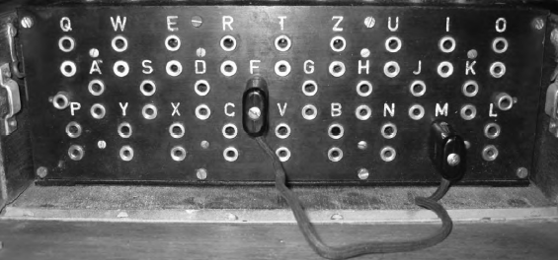
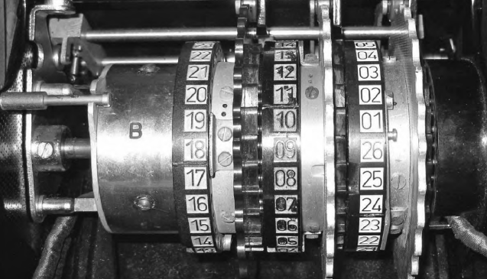
Substitution layers
Plugboard: In the military version, the first substitution happens at the layer of the “plugboard”. The operator has the option of choosing which substitutions happen. In the example shown here, only one cable is used, but by the end of the war, 10 cables were common. In theory, of course, could use 13 (more in German).
Rotor I: Next the signal travels to the first “fast” rotor. Another substitution happens here. In Rotor 1, A → E, B → M until all letters are substituted for.
Rotor II: Another set of all 26 letters, thereby incrasing the keyspace tremendously.
Rotor III: A third substitution.
Reflector: The impulse then travels to the reflector which makes a fifth substitution.
Plugboard with a single cable substituting F and M
Rotors (three) and Reflector (“B”)

Slide 12
…. But isn’t this ultimately just one substitution?
Does it really matter how many times we substitute? If one letter is ultimately converted to a different letter, what’s the point of doing the same thing five times??

Slide 13
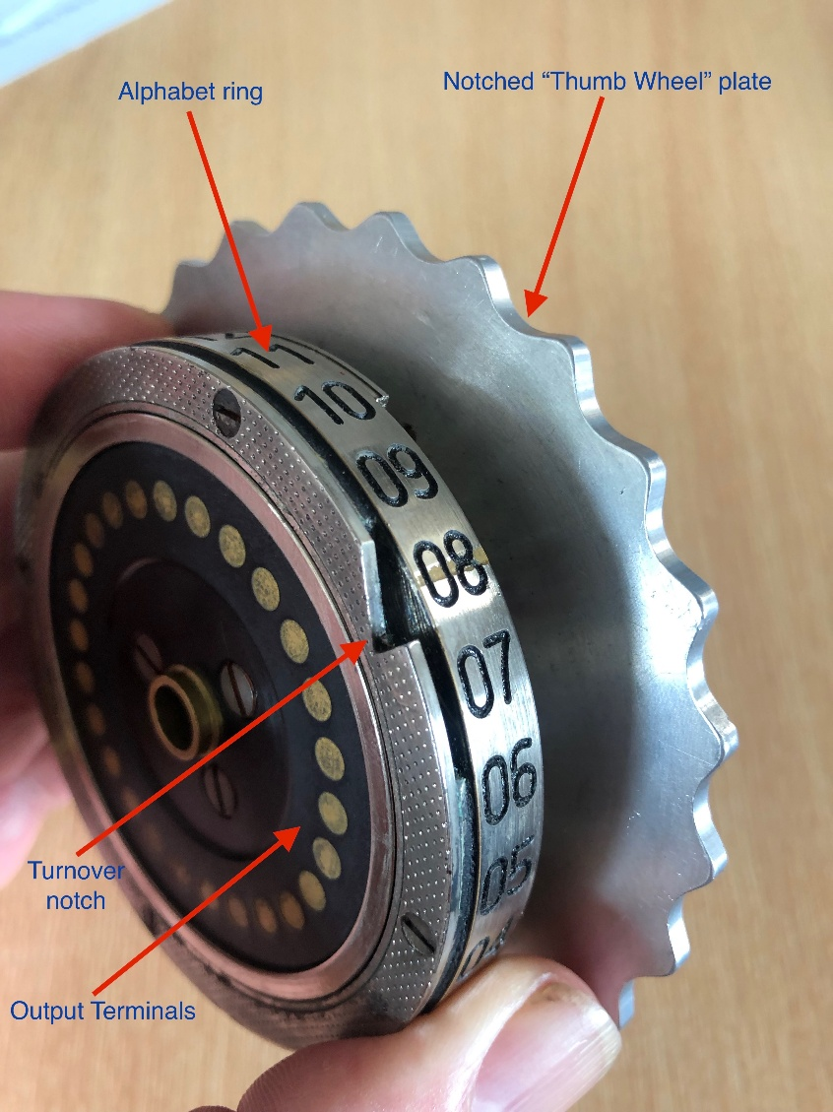
The Rotors shift!
The key difference here is that after every key press, the first rotor shifts. This means that an entirely different substitution happens for every single letter in the message. In other words we are using poly-alphabetic substitution (similar to Vigenere cipher system) at this point.
Notches: In addition, after the first rotor makes 26 turns, a notch in it then shifts the second rotor by one step. After the second rotor shifts 26 times, its notch shifts the third rotor.
This results in a gargantuan number of different substitutions.
Keyspace: Thus far, with the rotors alone, we have a situation analogous to a Vigenere Cipher with (26)*(26)*(26) = 17,576 alphabets*! Compare this with the 5, 10, or 20 alphabets used in earier time periods.
  *Slightly less for technical reasons which we won’t get into now.
Enigma Rotor
Image from JGAndrews.com
https://jgandrews.com/posts/the-enigma-machine/

Slide 14
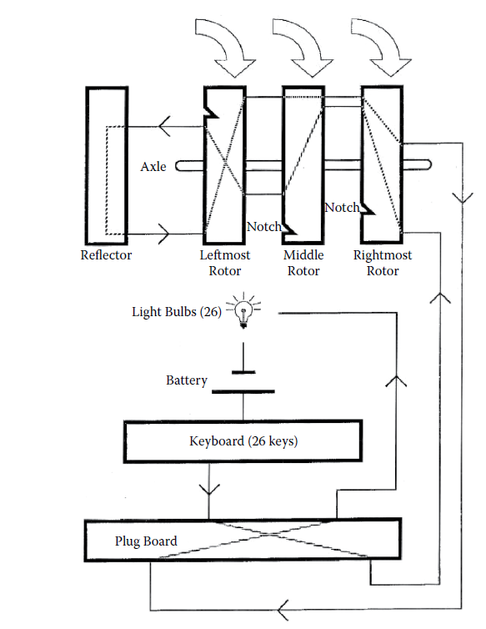
ENIGMA SCHEMATIC: ROUTE OF IMPULSE
Key press →
Plugboard →
Right rotor →
Middle rotor →
Left rotor →
Reflector →
Left rotor →
Middle rotor →
Right rotor →
Lamp

Slide 15
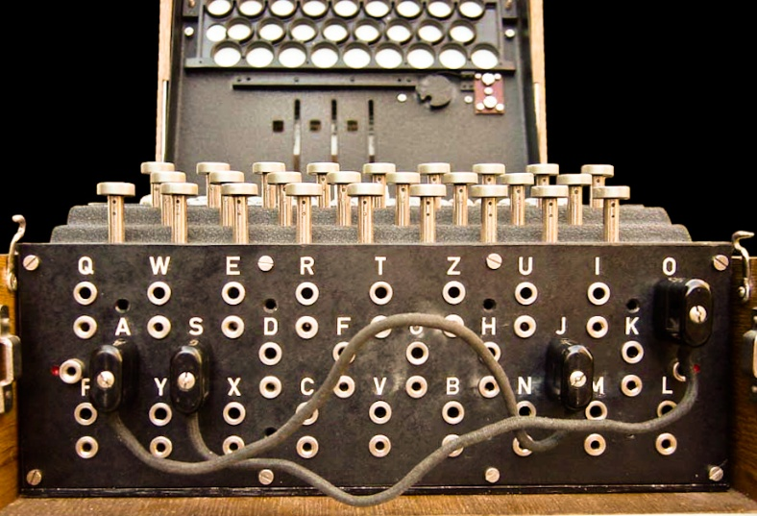
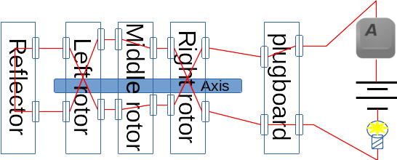
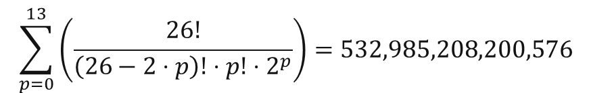
Enigma keyspace: plugboard
Plugboard
  0 <= p <= 13 cables
  Keyspace:
$$\sum_{p=0}^{13}{\left(\frac{26!}{\left(26−2⋅p\right)!⋅p!⋅2^{p}}\right)}=532,985,208,200,576$$

Slide 16
Enigma keyspace: plugboard to first rotor
Plugboard to Left Rotor
  26! different ways to connect
  = 403,291,461,126,605,635,584,000,000

Slide 17
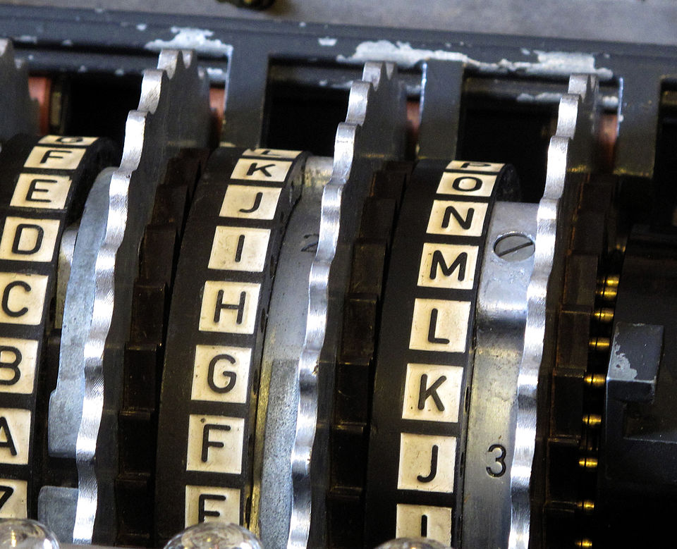
Enigma keyspace: rotors
Rotors
  26! different ways to wire 1st rotor
  26!-1 ways to wire 2nd rotor (if different from 1st)
  26!-2 ways to wire 3rd rotor (if different from first two)
  (26!)(26!-1)(26!-2)
= 65,592,937,459,144,468,297,405,473,480,371,753,615,896, 841,298,988,710,328,553,805,190,043,271,168,000,000

Slide 18
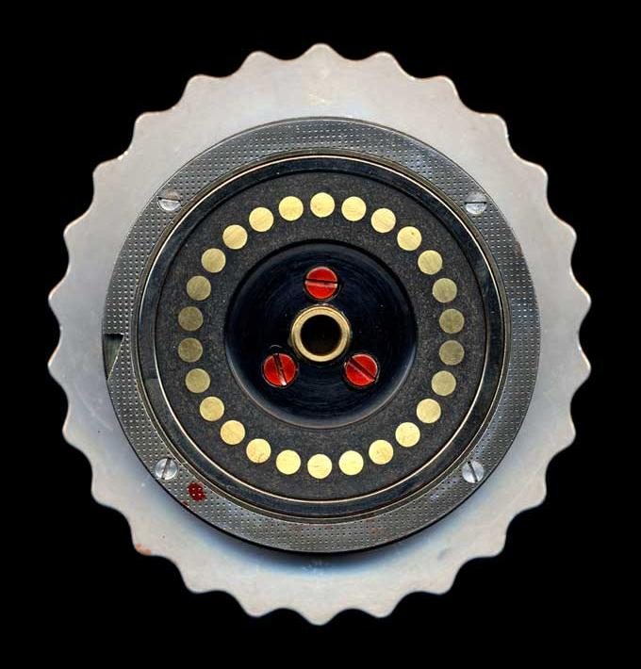
Reminder: rotor notches
Rotors have notches:
After 26 turns, rotor I (the right or “fast” rotor) rotates rotor 2 one step.
After 26 turns of rotor 2, a notch will rotate rotor 3 by one step.
26*26 = 676

Slide 19
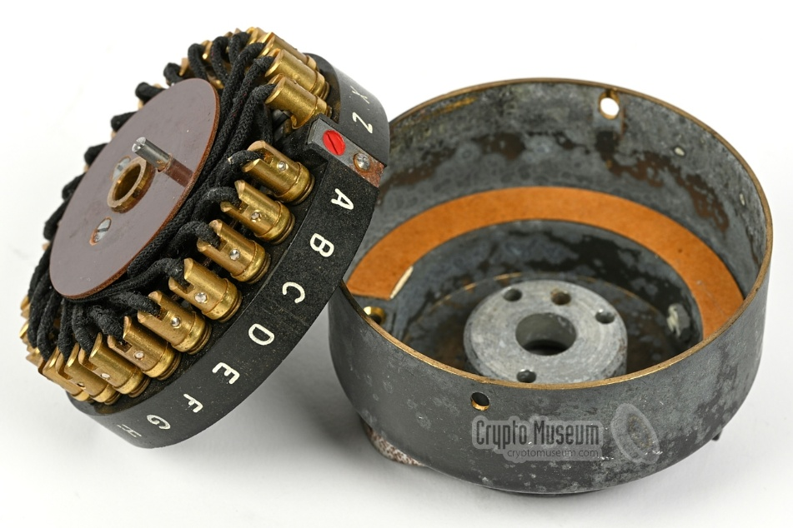
Enigma keyspace: Reflector
This keyspace is the number of ways that 26 letters can be combined in unordered pairs.
Without getting into details, the formula for the size of this keyspace is:
How we come by this number:
Pick a partner for A: Can be B through Z (recall that we are not allowed to have a letter pair to itself in order to allow Enigma to act as both encipher and decipher machine). So we have 25 choices. Let’s say it paired with “C”
Go to the next unused letter, i.e. B: We now have 23 remaining choices (since A paired with C). Let’s sy it pairs with Q.
C has already paired with A, so we move to D: We have 21 choices.
So the formula is: 25*23*21*…1, or (26-1)!! “double factorial”
7,905,853,580,625 possible settings
Limitations / Flaws:
The fact that a letter was not allowed to be keyed to itself was a major flaw in the system and was ruthlessly exploited by Enigma code breakers.
While the key space is theoretically high, in practice, only a handful of reflector wirings were used. So the effective keyspace of the reflector was actually pretty small. This was because the Germans did not think of the reflector wiring as being part of the key. They saw the refletor as a tool to ensure that the Enigma was reversible (encipherment ←→ decipherment). However, the Allies did not initially realize this.

Slide 20
Enigma keyspace: total size
753,506,019,827,465,601,628,054,269,182,006,024,
455,361,232,867,996,259,038,139,284,671,620,
842,209,198,855,035,390,656,499,576,744,406,
240,169,347,894,791,382,800,000,000,000,000
  Brute force aint-gonna cut it!!!

Slide 21

Whoa! That’s a big number!
Must be unbreakable, right???
Spoiler alert……
It wasn’t.
RECALL:
A large keyspace is necessary but not sufficient for security of a cipher.

Slide 22
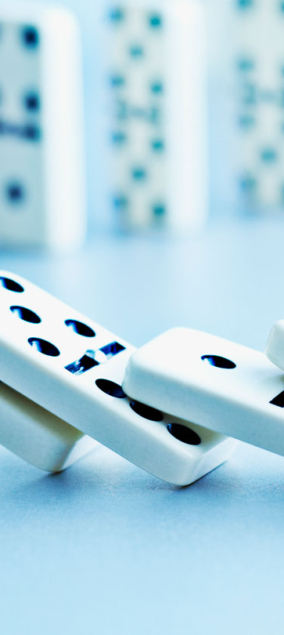
Exploiting the structure
How could a machine with millions of settings be broken systematically?
Answer: The structure of the cipher.
In other words, rules, consistencies, commonalities that may be deduced about the cipher that have nothing to do with the key.
With respect to cryptanalysis of the Enigma, this would include things like:
Awareness of the no self-encipherment property
Predictable stepping pattern of the rotors
Finding a crib
  “Weather Report”
  “Heil Hitler” (or even just “HH”)
Using known headers in messages (e.g. “daily report”)

Slide 23
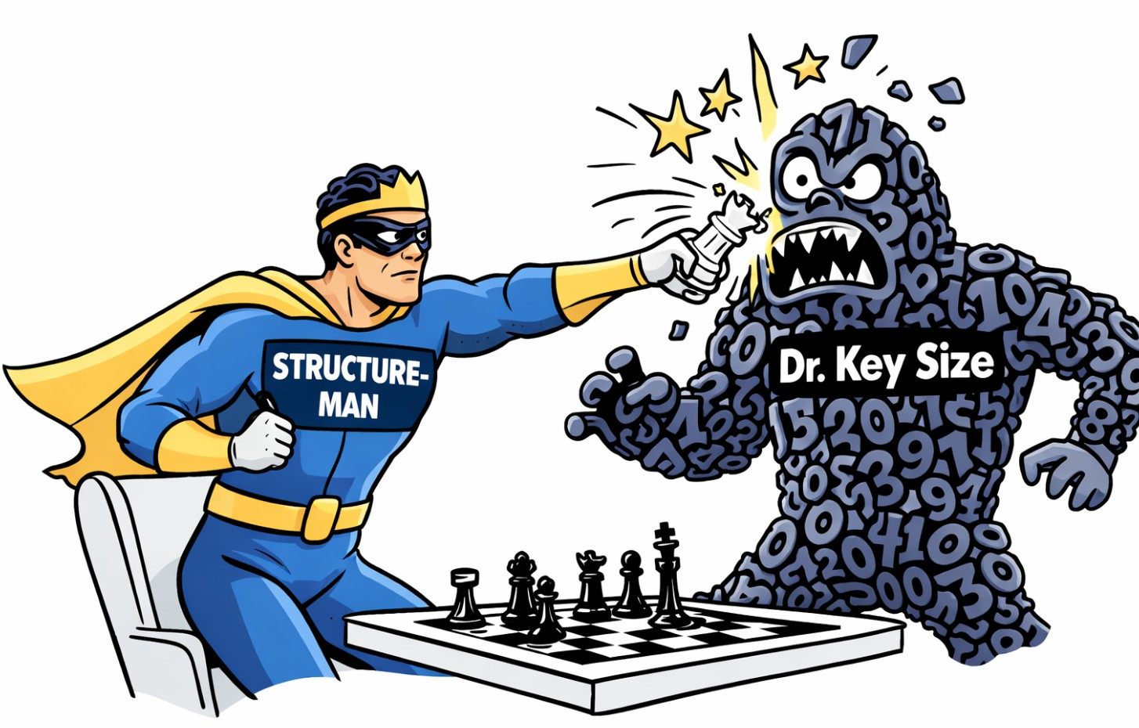
Structure can defeat key size
A very important cryptanalytic principle:
Large keyspaces will not save a cipher with exploitable structure.
Enigma is the canonical example:
Astronomical theoretical keyspace
Fatal structural constraints resulted in it being broken routinely in practice
Structural weaknesses enabled:
Cribs
Contradictions
Reductions in search space
Non-brute-force attacks

Slide 24
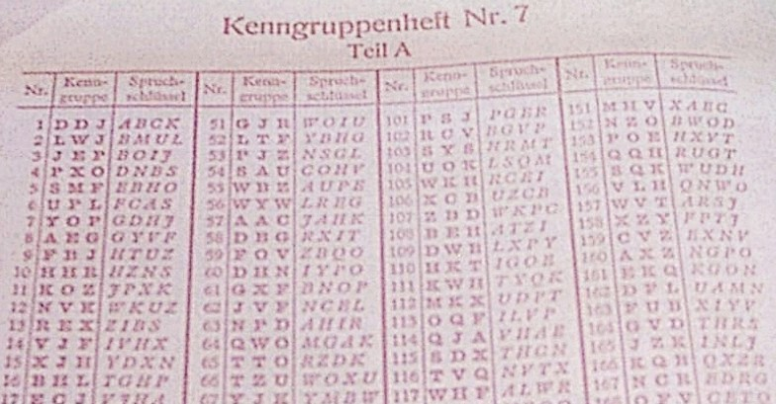
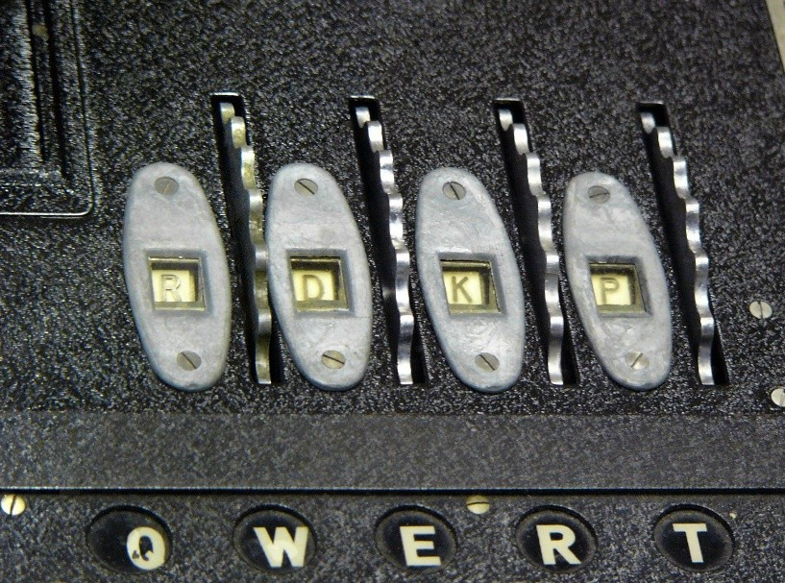
Enigma key
There was no one-item key for Enigma. Instead, the key required knowing several pieces of information.
Which rotors
    Typically Enigma operators were given 5 rotors – each of which had different wire pairings. Therefore, the operator needed to know which 3 of those rotors to choose from.
    The Navy later had more rotors to choose from, and even used a 4-rotor Enigma at one point.
Rotor order
    Once the proper rotors were selected, each oen could go into any of the three positions on the Enigma machine.
Rotor ring setting & initial position
    While the wiring that substituted letters on a given rotor wheel was not changeable as the internal wiring was fixed, changing the starting position did affect when the notch would engage thereby changing the 2nd and 3rd rotors.
    The starting position affected which external letter would show in the window
    Imagine a numbered wheel with a sticker: The wheel = rotor wiring. The sticker with letters = alphabet ring. Ring setting = where you place the sticker on the wheel. Starting position = how far you rotate the wheel before starting
Plugboard wirings
    Typically 10 pairs of letters were swapped
Page from a U-Boat Codebook
Wheels of rotors can be turned to configure to the key

Slide 25
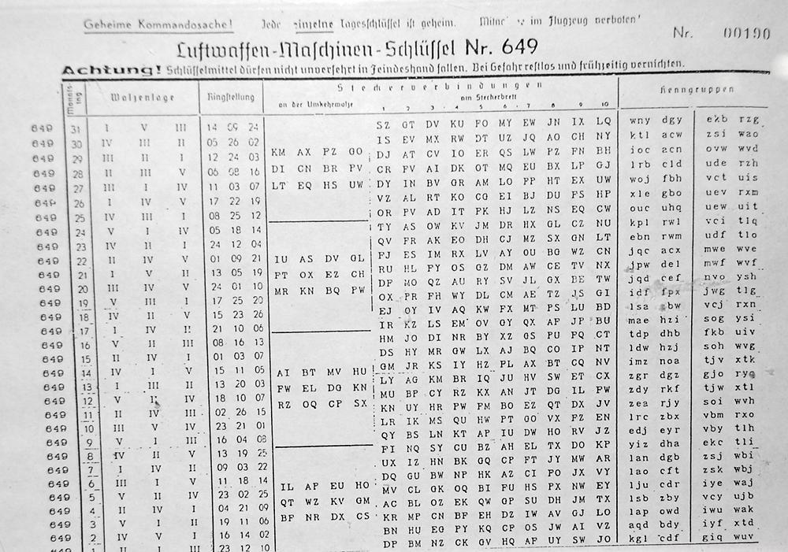
Walzenlage (Rotor Order):
Specifies which rotors and in which order (left to right). For day 31, this meant to use rotor I in the left position, V in the middle, and III on the right.
Steuerverbindungen (Control connections): Plugboard pairings. For example, SZ means S ←→ Z
Kenngruppen (Indicator groups): Three letter groups used for message identification and verification. Not intended as encrypted text. Used to confirm the correct key or detect improper setup.
Rigstellung (Ring settings): Indicates settings and starting position.
The warning at the top: “Achtung! Schlüsselmittel dürfen nicht unverschlüsselt herumgetragen werden. Bei Gefahr restlos und frühzeitig vernichten.”
Translates to: “Attention! Keying material must not be carried around unencrypted.
In case of danger, destroy it completely and in good time.”

Slide 26
Enigma key distribution
All of this information was issued in advance in codebooks.
Keys pubished in printed key sheets
Usually distributed monthly
    Sometimes more frequently, sometimes less
Each day had a complete specification of which rotors, which rings, which plugboard settings, etc.
U-Boats
Codebooks had to be loaded before departure
Often covered several months
Codebooks were sealed and closely guarded
Crews were trained to destroy codebooks immediately if capture was imminent
    Other techniques such as printing the codebooks in water-soluble ink were employed. In this example, if a any navy ship was sunk, the codebooks would be illegible.

Slide 27
Defeating Enigma was often an operational matter
Most of Enigma’s security came from operational discipline as opposed to from the machine itself.
Conversely, most of its failures came from procedures, habits, and structure – not insufficient key size!
As has been discussed previously: Structure can defeat key size.
We will discuss some examples now.

Slide 28
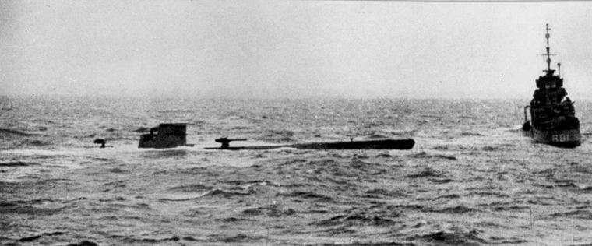
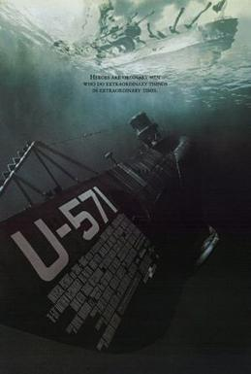
Capture of u-110 (15 April 1941)
What happened
German U-boat U-110 was damaged and forced to surface
The crew abandoned ship without properly destroying materials
British sailors boarded and captured:
    An Enigma machine
    Current key lists
    Kurzsignalheft (short-signal codebook)
    Wetterkurzschlüssel (weather cipher book)
Why this mattered
This provided live, current keys
It confirmed machine wiring assumptions
It allowed Bletchley Park to read naval traffic in near real time
The human factor
The captain assumed the boat would sink quickly
It didn’t
That single assumption cost Germany enormous strategic secrecy
Key Point:
Enigma didn’t fail because of weak math — it failed because destruction protocols failed under stress.
The 2000 film “U-571” was partially inspired by the capture of U-110.
U-110 after being depth-charged
HMS Bulldog capture codebooks

Slide 29
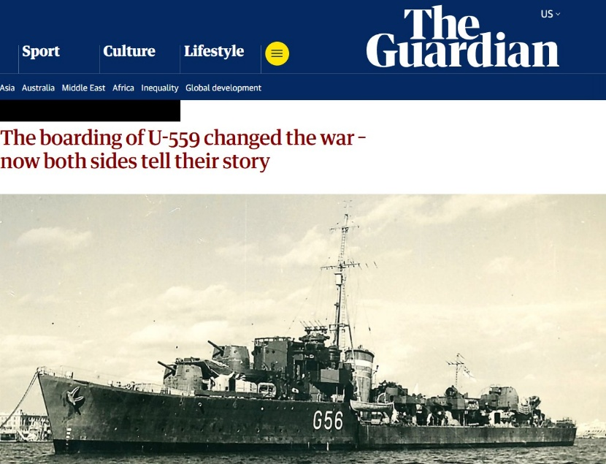
Capture of U-559: The Heroic scramble
One of the most dramatic crypto anecdotes of the war.
What happened
Spotted at 5 AM on Oct 20, 1942 70 miles north of the Nile delta
Attacked with depth charges and forced to surface
German crew scrambled to get out and neglectred to destroy codebooks
Crucially, neglected to properly scuttle the ship
As it sank, three British sailors swam aboard
Two drowned retrieving materials
The third survived, clutching codebooks
Why this mattered
Naval Enigma had recently changed
Bletchley had gone blind
These books restored decryption capability just in time
Article: https://www.theguardian.com/world/2017/oct/20/enigma-code-u-boat-u559-hms-petard-sebag-montefiori

Slide 30
Captured keys had to be kept hidden
Even from allies!!
When keys were captured, Allies had to pretend they were not reading Enigma
Convoys were sometimes allowed to be attacked
Rescue missions were delayed or rerouted
Otherwise:
Germans would suspect compromise
And change procedures

Slide 31
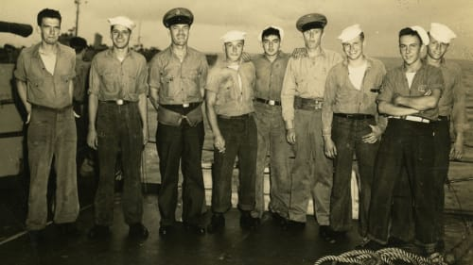
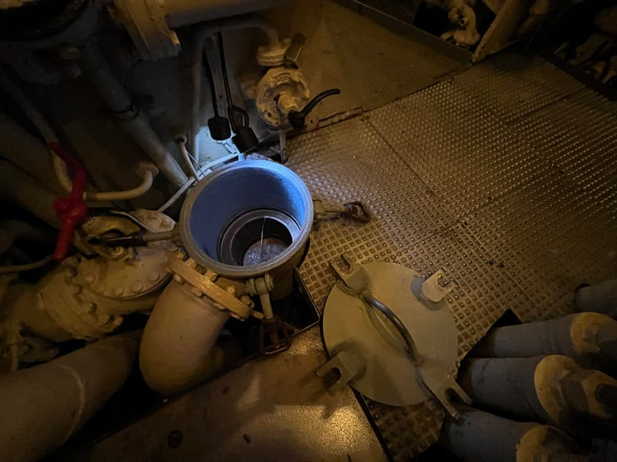
Capture of U-505
The boarding was explicitly about code material
During the capture:
  A U.S. Navy boarding party rushed aboard before the submarine sank
  Their top priority was not the vessel. It was codebooks and radio logs.
By 1944, the Allies fully understood that paper mattered more than steel.
The Germans failed to destroy everything — again
Despite strict orders (recall the Achtung! warning from earlier:
  The crew abandoned ship too quickly
  Scuttling charges failed
  Destruction procedures were incomplete
  In other words: German crypto security repeatedly failed not in design, but in the final seconds of human decision-making.
Fifty-eight of the 59 German crewmembers on board survived — one was killed by gunfire — and were taken as prisoners of war to Camp Ruston in Louisiana, where they remained until the end of the war.
    Not even the Red Cross as notified – which was very questionable from a “rules-of-war” perspective.
The U-505 was painted black to conceal its true identity and kept in Bermuda for the remainder of the war.
U-505 Boarding Party
Sea Strainger Valve at MSI

Slide 32
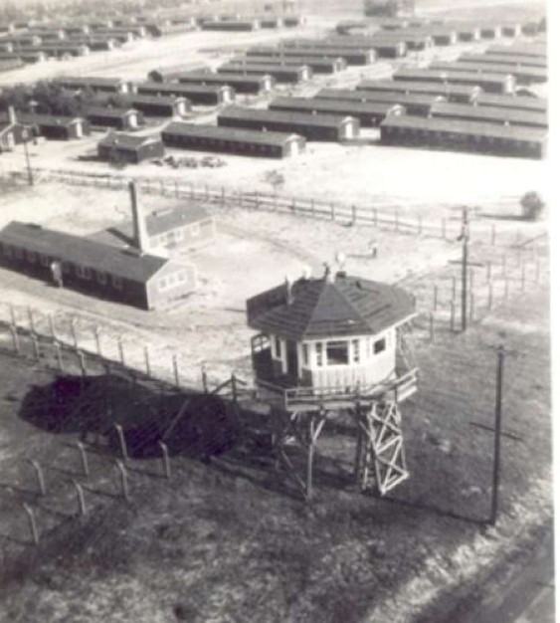
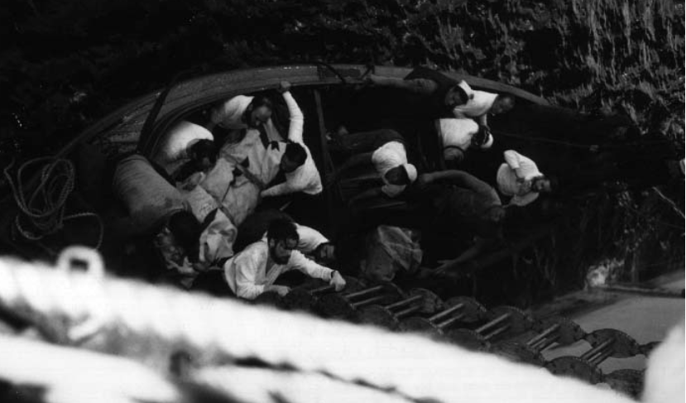
Capture of u-505 was kept secret
The capture was kept top secret — even from the Red Cross
U.s. Classified the capture as TOP SECRET
Officially listed U-505 as lost at sea
Held the crew incommunicado in the U.S.
Why?
  If Germany learned the sub was captured intact, they would assume code compromise.
This secrecy lasted until after the war.
The POWs made efforts to make their capture known. The even created balloons out of bags filled with hydrogen gas saying “U-505 Lives!”.
    Unfortunately for them, this too did not work as they had hoped.
POW Camp in Ruston, LA
Injured U-505 Captain, Harald Longe being transferred to the American ship.

Slide 33
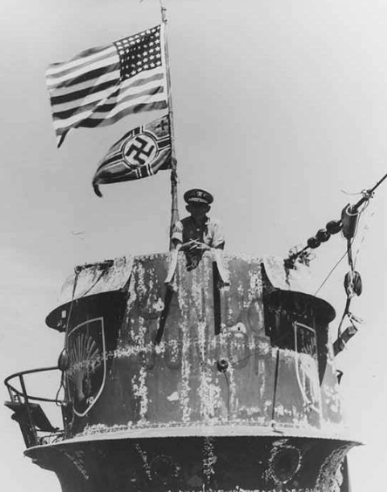
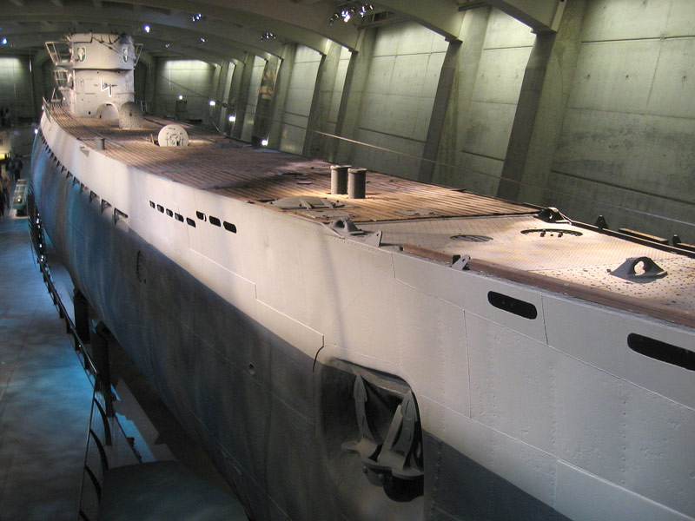
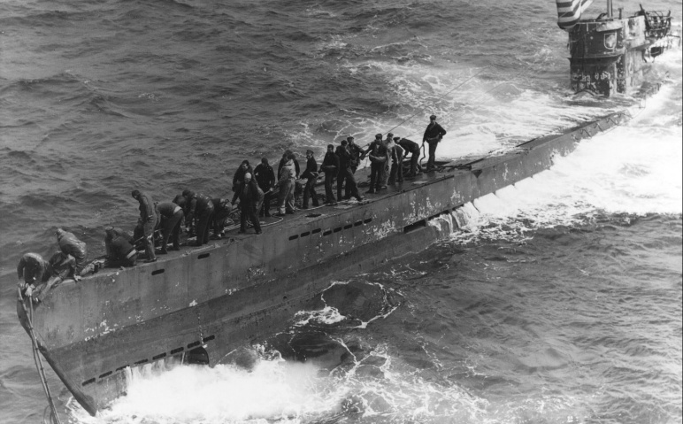
But U-505 DOES live!!!
U-505 is the only German U-boat captured at sea by United States forces.
And you can see it today at Chicago’s own Museum of Science and Industry
The U-505 sitting here in Chicago wasn’t captured for its torpedoes — it was captured for its paper.
The U.S. Navy boarded it under fire not to steal the machine, but to grab codebooks.
And then they pretended the submarine had sunk, because secrecy mattered more than victory parades.
Cpt. Gallery poses on the coning tower of U-505

Slide 34
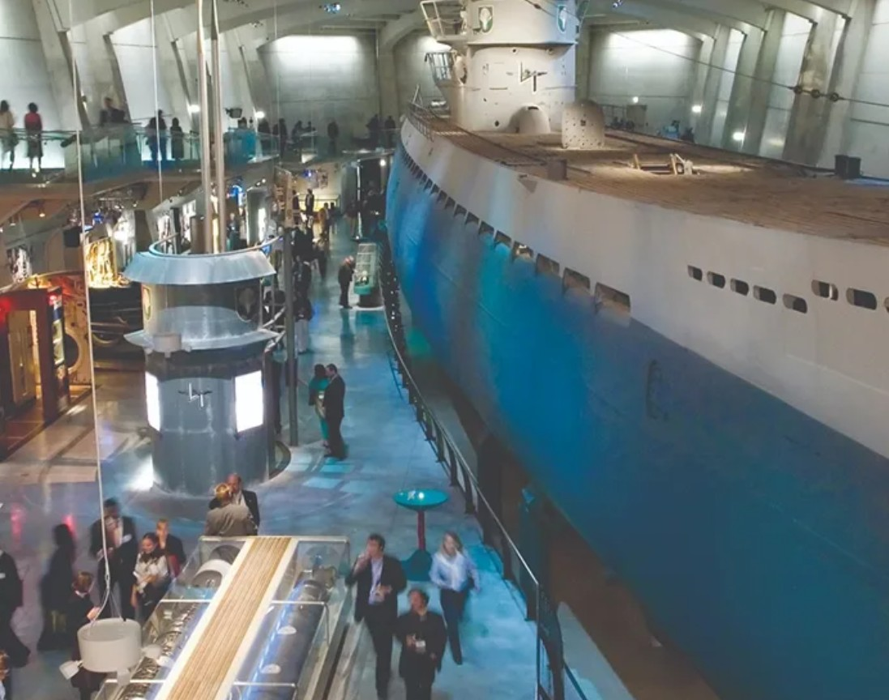
u-505 today
U-505 at the Museum of Science and Industry, Chicago, IL

Slide 35
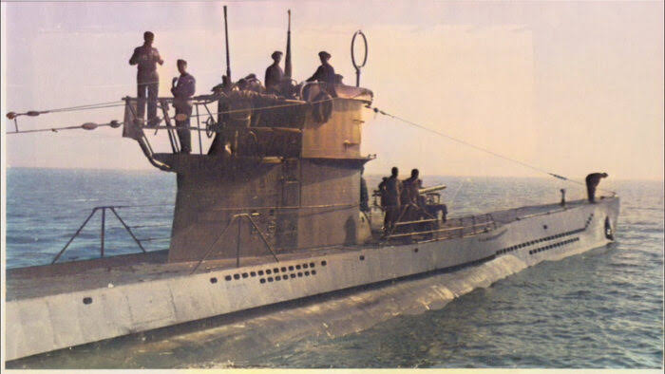
U-Boat type Vii-c
There are several class VIIC U-boats at the bottom of the ocean around the continental United States.

Slide 36
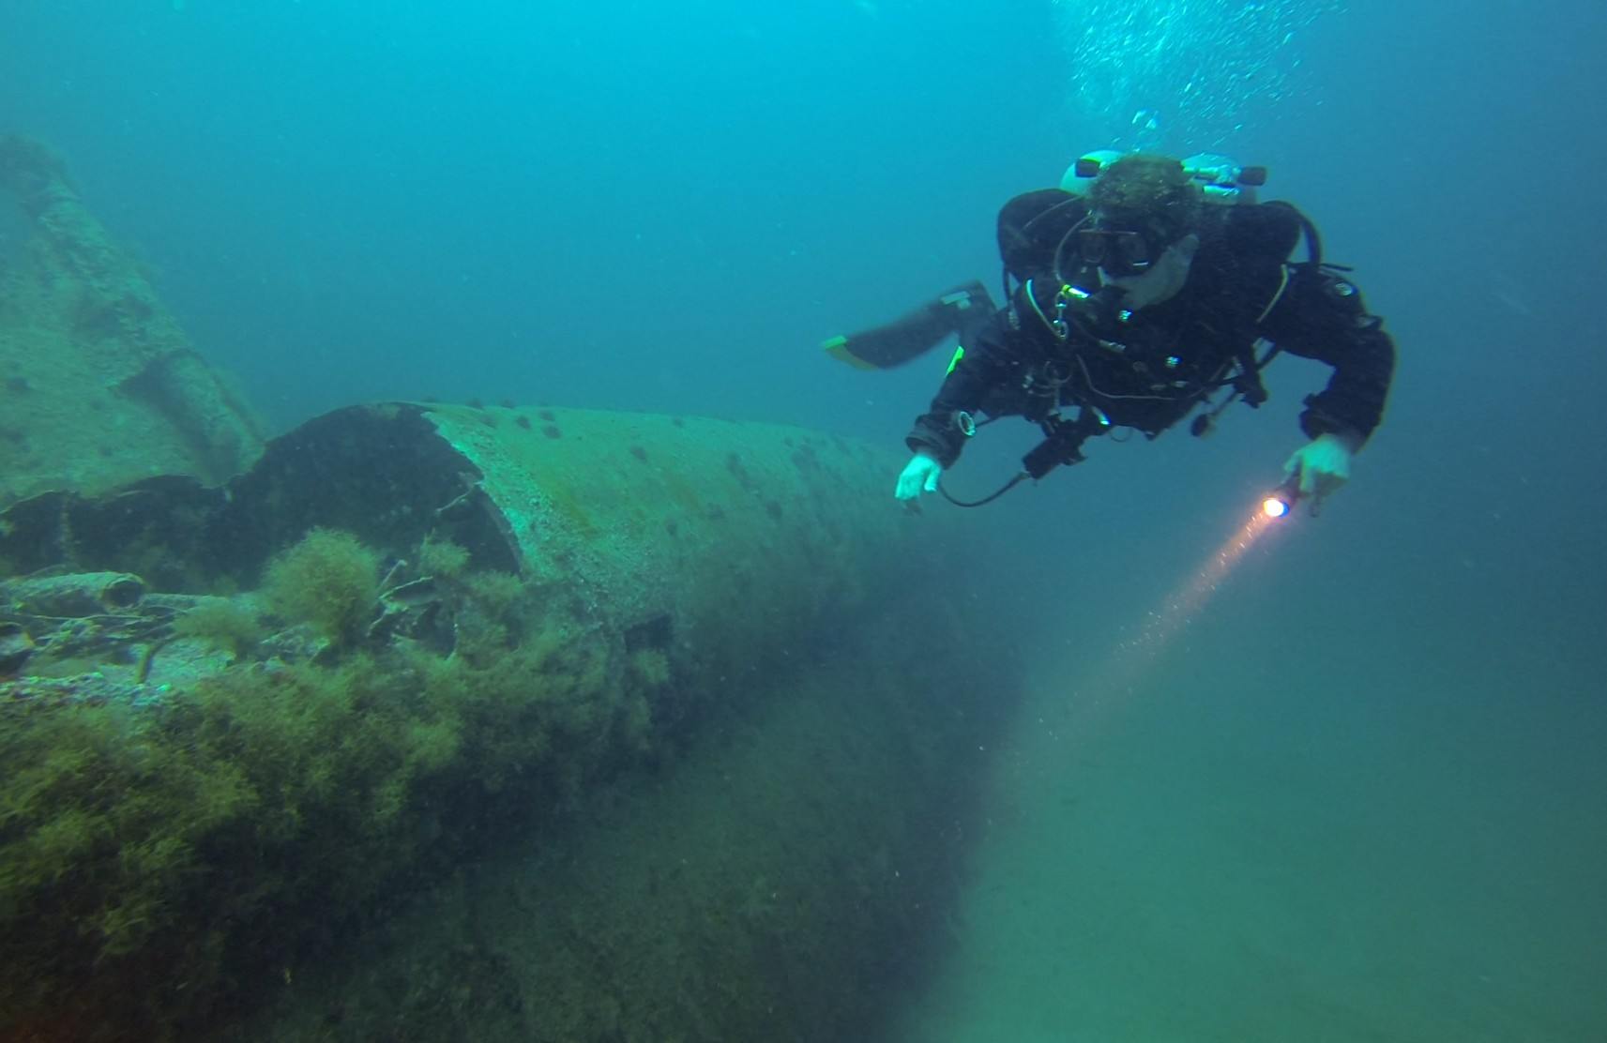
Yosef on U-352
(about 26 miles offshore of Morehead city, nc)

Slide 37
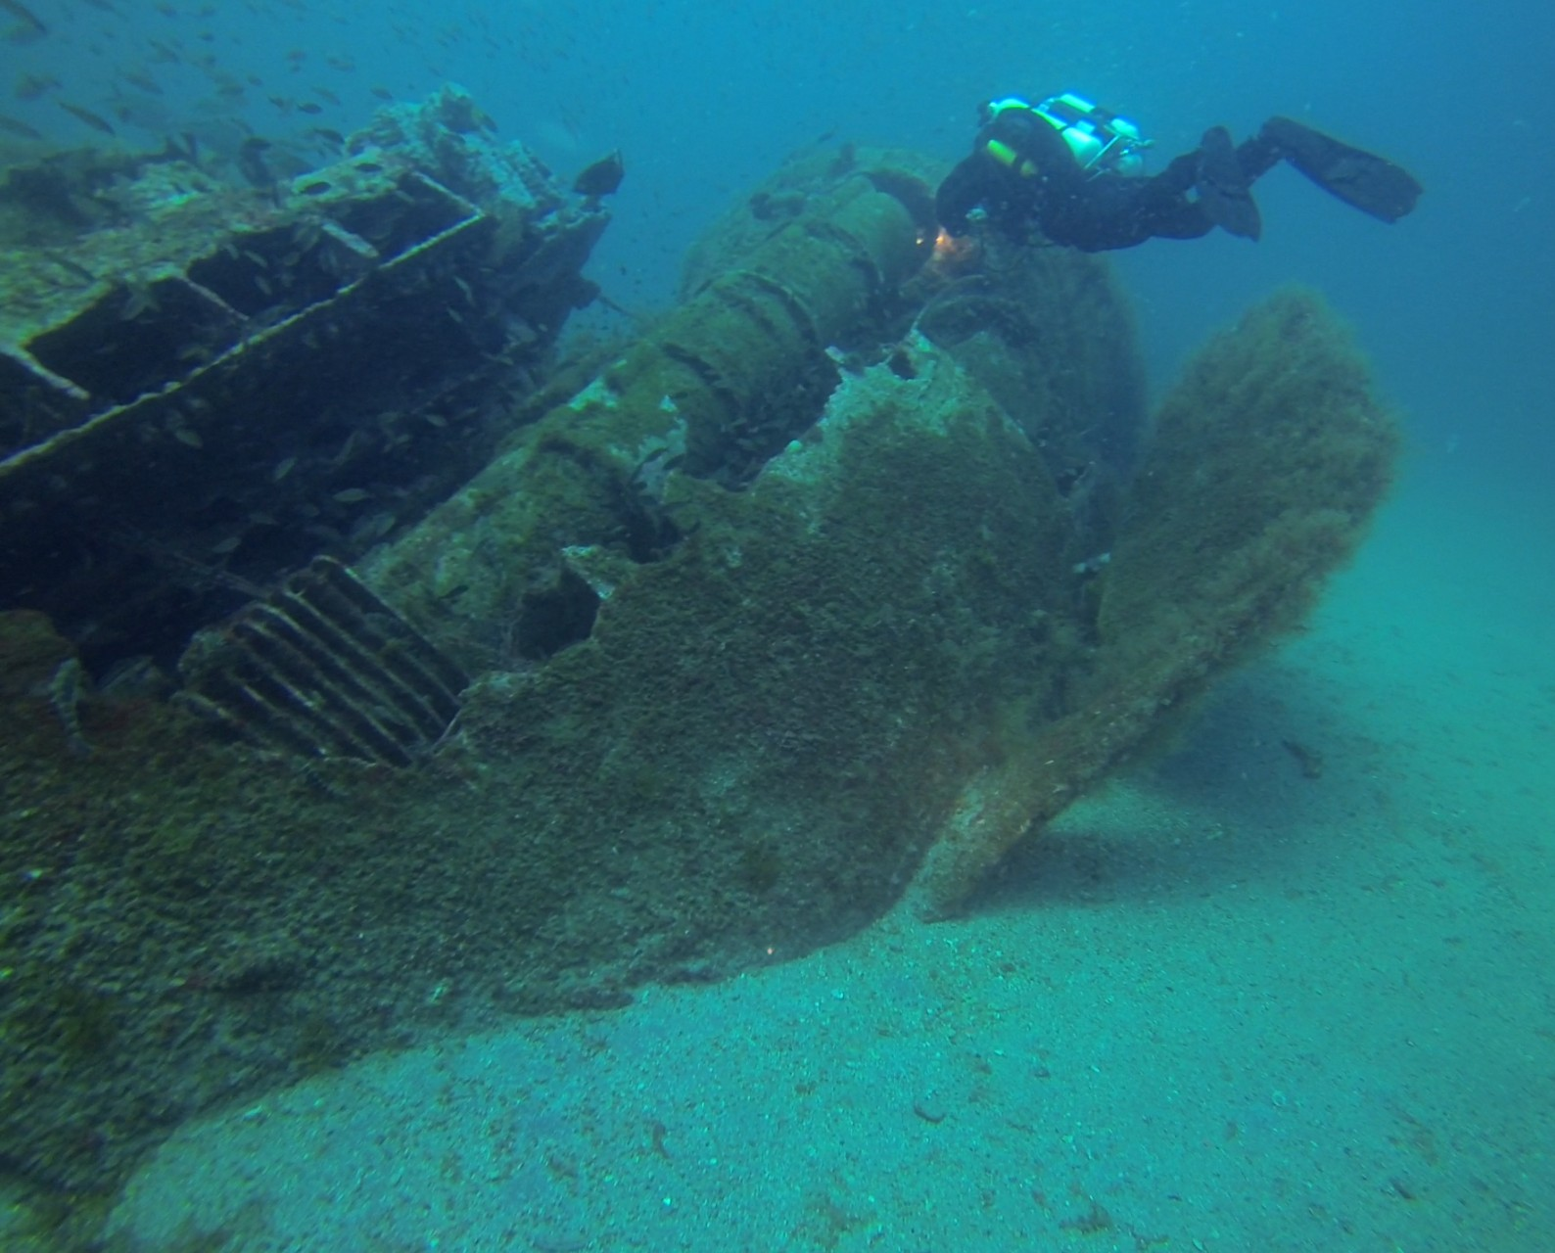
Damaged stern & rudder of U-352

Slide 38
Cryptanalysis of the enigma

Slide 39
Enigma as a Mathematical Object
Enigma does not 'encode messages'
It applies permutations to letters – just like we’ve seen repeatedly in our study of historical cryptography. So nothing new so far…
  Plugboard = permutation
  Each rotor = permutation
  Reflector = permutation
  The net result is that Enigma is simply a massive keyspace of permutations – one that is not computationally susceptible to cracking by brute force.

Slide 40
Permutations
A permutation rearranges a fixed set of objects
For Enigma:
Objects = letters A–Z
Each letter maps to exactly one other letter
Mapping is reversible.
  That is, if A is enciphered to say W, then typing W on the Enigma will encipher into A.
  This seemingly inconsequential detail is one of two things that allowed Enigma to be cracked.

Slide 41
Another huge weakness:
“No letter can encrypt to itself”
The rule 'no letter encrypts to itself' creates impossibilities (rules that are not allowed by the system)
This enforcement happened at the reflector.
These are logical exclusions, - far better than working with probabilities!
They can be exploited by attackers

Slide 42
Same Wiring, Different Positions
Because rotors rotate:
  The same wiring produces different substitutions
  Enigma applies a different permutation at each keypress
This explains why the same letter encrypts differently for the majority of keypresses.
Press A → W
Press A again → Q
Press A again → D
etc.

Slide 43
Reflector
The rule 'no letter encrypts to itself' creates impossibilities (rules that are not allowed by the system)
The reflector had fixed wiring.
The wire connected one letter to another.
The connections never changed. (Equivalent to a MASC).
It reversed the signals: If T was wired to B, then an incoming T was changed to a B. Similarly an incoming B was changed to a T.
None of the wires were mapped to themselves. This meant that no incoming letter could ever be mapped to the same letter.

Slide 44
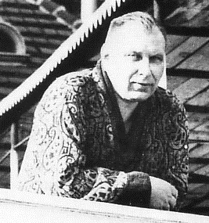
Cryptanalysis - spycraft
Hans-Thilo Schmidt, a disgruntled ex-military German.
Worked in the Chiffriestele, a top-secret office that included Enigma’s command center. Passed a series of documents to French agents detailing some of the workings of the Enigma.
Prior to outbreak of WW2, the French were “concerned” about German military builup, but not particularly concerned about invasion.
Poland: Sandwiched between Germany and USSR, the Poles appreciated the great need for intelligence. The French had a military understanding with Poland and turned over the Enigma information.
It was enough to allow the Poles to create an
accurate replica.
With the fear of invasion serving as a tremendous motivator, the Poles invested tremendous time and effort to cracking the Enigma code.
Hans-Thilo Schmidt

Slide 45
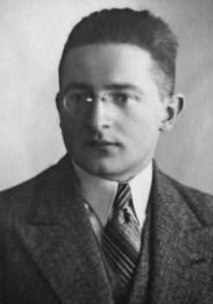
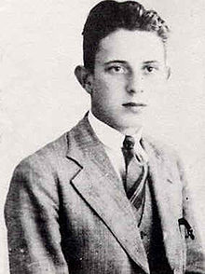
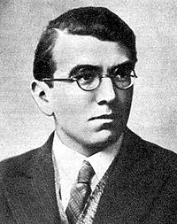
Polish Cryptanalysis
The Poles started a program specifically targeting cryptographic efforts.
In particular, three Polish mathematicians focused on attacking Enigma:
Marian Rejewski
Jerzy Różycki
Henryk Zygalski

Slide 46
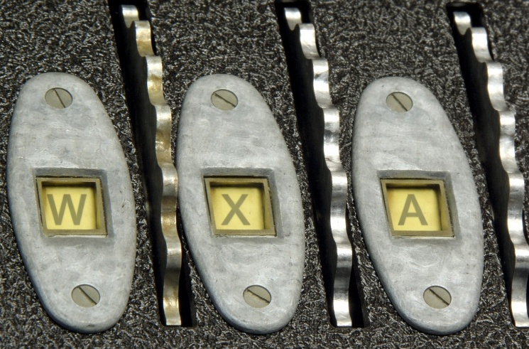
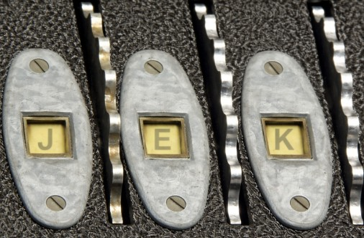
Day Key vs. message key
Codebooks specified a “day key” specifying the settings for the day (plugboard, rotor arrangement, rotor initial settings).
For example:
Plugboard settings: B/Q, O/S, I/N, C/V, L/F, Z/M
Rotor arrangement: 5-2-4
Rotor Setting: W, X, A
Approach:
Operator sets up the machine according to the daily key
Code is entered, and the ciphertext is telegraphed to recipient
Recipient (with same Enigma key applied) typed in ciphrtext, and the lamps output the plaintext.
Problem: Hundreds to thousands of messages each day all using the same key is a security risk. (Recall: more ciphertext → more opportunities to break the code)
Solution: Germans’ solution was to use a “message key”: Use the day key as delineated above, but provide a new rotor setting using that key. In other words, the length of the day key is only a few characters.
Suppose the new rotor settings are to be changed from W,X,A to J,E,K.
Because this message key was pivotal to the rest of the message, it was always repeated twice to ensure accuracy. So if the operator typed JEKJEK, the unit would output something like: ACHQHL.
  Recall that even though the JEK was typed twice in a row, the rotor stepping will result in different characters for both repetitions of the message key.
  So the ciphertext for JEKJEK → something like ACHBHL
On the receiving side, the recipient would then change the initial rotor setting to JEK.

Slide 47
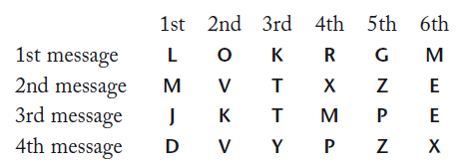


Message key: Major flaw!
Uh-oh! (If you’re a German)…. Do you see the (potential) problem?
Any pattern is risky when it comes to cryptography– and repititon is certainly a pattern!
Once Rejewski spotted this, he and his team eventually came up with the strategy as detailed in his wonderful book “The Codebreakers” by Simon Singh. We will go over this together in lecture. It comes from Chapter 3, and begins on page 127. The three images below come from the Singh book.
An example of the first 6 characters from four messages sent out that day. In all four cases those 6 characters are made up of the message key repeated twice in succession. In the first message, both the L and the R originate from the first letter of the message key. Similarly, the O and the G must originate from the second letter. The K and the M originate from the 3rd letter. This repeats for all messages.
Looking at all four messages, we can see that for the first letter of the message key, the following letters are related: L and R from message 1, M and X from message 2) J and M from message 3, D and Y from message 4. Thus, for the four messages we see the following relationship:
With enough messages, Rejewski could complete the set of relationships encomassping the whole alphabet:

Slide 48

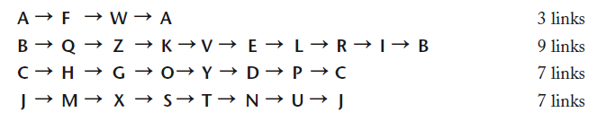
Cracking the Message key
Rejewski still didn’t know the day key or the message key – but he did know the relationships. On a different day, or course, the relationships would have bee entirely different. After no-doubt tremendous time and effort, he picked up on a pattern featuring “loops”, or chains of letters. Let’s proceed. As we do, bear in mind that all of the following only applies to the FIRST letter of the day key.
Note that A maps to F. F then maps to W. W then maps to A. We have now closed one loop.
If we repeat for all letters of the alphabet, we end up with all possible loops as shown here.
As mentioned above, recall that this is only for the first letter of the day key. This process would have to be rpeated for the other two letters as well.
Rejewski had, by this time, discerned that the characteristics of the loops were a clue to the key.
Still…. We are dealing with a key space of over: 10,000,000,000,000,000 → brute force would take more time than the age of the universe!
Rejewski’s brilliant insight: The plugboard settings and scrambler settings could be considered independently. Specifically the number of links in the chains were not affected by plugboard settings. They were only affected by the rotor settings! If plugboard settings were different, the the letters in the loops would be different, but the number of links would not!
The keyspace for the various rotor settings (selection and placement of rings + starting letters) is 103,301. This is billions and billions of times fewer.

Slide 49
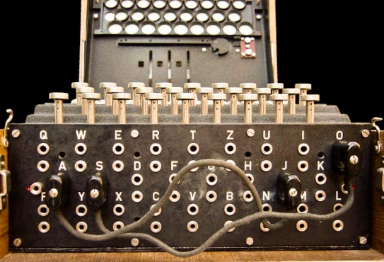
Cracking the Message key:
From message key to plugboard
Rejewski and his team then did the scutwork of typing in all 105K scrambler settings and created a catalog for every set of chain lengths. It took over a year, but the Enigma code could now be broken.
Once the catalog was complete, every day all the team had to do was determine the number of links for the day, and the catalog would tell them the rotor settings. This could often be accomplished in about 60 minutes!
But what about the plugboard? This turned out to be a surprisingly doable task. They would start with no cables and type in some of the day’s ciphertext. Most was of course, gibberish, but once in a while something interesting would appear. Consider the following hypothetical example:
alliveinberlin
This is likely to mean:
Arrive in Berlin
So now we know there is a plugboard connection between L and R. We also know that other letters such as A, B, I and others should NOT be connected. Once a few letters are known, it becomes progressively easier to ascertain remaining connections.

Slide 50

Cracking the Message key: automation
At one point the Germans modified their transmissions in a way that rendered Rejewski’s catalog useless. Undeterred, he came up with a primitive computing device that could rapidly check all 17K+ keyspace settings for the scramblers until it found a match.
Recall that with 3 rotors in 3 positions, there were 6 possible settings so to save time he had six machines working at the same time (or “in parallel” to use a modern computing term). This machine was nicknamed the “bombe”.
Schematic of the bombe. Only one of the 6 rotors is shown.

Slide 51



All good things must end
In 1938, the Germans went from 3 possible rotors to 5, and the plugboard cables went from 6 to 10. This alone was enough to render Rejewski’s bombe obsolete. The manpower and budgetary constraints were too much for Poland at the time.
Per Singh: “The sheer cost of building [the necessary] battery of bombes was fifteen times the Biuro’s entire annual equipment budget.”
At this point, the Polish authorities decided to give all of their information and materials over to the French and British authorities.
This was the germ of the project that eventually grew into the famed Bletchley Park that played such a pivotal role in the Allies victory in World War 2.
We all owe a tremendous debt to figures such as Rejewski, Różycki, and Zygalski.
Zygalski memorial in Chischester, UK
Monument to Rejewski in Poznan
Różycki memorial bench near Warsaw

Slide 52




Bletchley park, alan turing, and the “bombe”

Slide 53

Bletchley park
With the advent of WW2, the Allies recognized that codebreaking was going to be an absolute necessity, and that resources needed to be devoted to that purpose.
They were not wrong. In WW1 Germany transmitted an estimated 2 million words / month. WW2 was to occasionally result in upwards of 2 million words / day.
An estate called Bletchley Park just outside of London was reserved to house the new GC&CS (Government Code & Cypher School).
Successes at Bletchely were numerous and prevented countless deaths and loss of material. Successes included but were not limited to:
Breaking Enigma cipher
Breaking Lorenz cipher
Breaking Japan’s ciphers including PURPLE
Advance notice of enemy troop positioning and movements – most famous was prior to the D-Day attacks
Countless others
Secrecy was paramount. Everything was classified top-secret. Even communicating between each other at Bletchley had to be carefully monitored. “Do not talk at meals. Do not talk in the transport. Do not talk travelling. Do not talk in the billet. Do not talk by your own fireside. Be careful even in your Hut ...”
A team of codebreakers at Bletchley Park

Slide 54


Bletchley park: lessons from the Poles
Allies learned from the Poles that cryptanalysis should not rely exclusively on linguists and classicists. They now incorporated mathematicians and scientists.
Bletchley analysts carefully studied the successes of the Poles. Even though they could no longer use the mathematical formulas to solve the message keys, the Polish work allowed them to hit the ground running including:
-
The Poles didn’t give Bletchley answers – they gave them a way in. Or put another way, Bletchley Park inherited methods, not messages.
Bletchley learned from the Poles that:
Enigma was mathematically breakable.
  Prior to this pint, Enigma had been thought of as a “perfect” cipher machine and immune to theoretical attack
  Menu-based reasoning, How to exploit structure, Crib-based decipherment, Search by looking for contradictions
Enigma wiring as structural (i.e. did not change with the keys)
  In addition, the Poles recovered rotor wirings in the 1930s and turned them over. This knowledge remained valid throughout the war.
  The keys changed daily – the lock design did not! Poles essentially “handed over the lock design”.
Poles handed over reconstructred enigma machines and blueprints
Plaque at Bletchley Park commemorating the team’s monumental achievements

Slide 55


Women at Bletchley park
A moment should be taken to acknowledge the outsized role played by women at Bletchley. Though underrepresented in the cryptanalysis division, women made up about 75% of all individuals at Bletchely.
Involved in:
Construction, operation, and maintenance of the vital computers such as Bombe and Colossus
Translation
Traffic analysis
Clerical work
Code breaking
Famous names to emerge included:
Mavis Batey: breakthroughs in Enigma cryptanalysis such as working out the wiring of the Abwher Enigma.
  Became so familiar with the styles of various enemy operators that worked out that one of them had a girlfriend called Rosa.
Jane Fawcett: Decoded important ciphers resulting in sinking of the German pride-of-the-navy, Bismarck.
Jon Clarke: full-time cryptanalyst who worked closely with Turing and was credited for numerous successes. Made an MBE (Member of the Order of the British Empire)
Countless others
Colossus computer being operated by Doroty Du Boisson and Elsie Booker, 1943
Codebreakers at Bletchley

Slide 56
Bletchley park: next steps
Polish work allowed Bletchley to hit the ground running.
Notable / Interesting Successes:
Social Engineering
  Some German operators would get lazy and choose obvious messag keys such as consecutive alphabet letters (QWE, BNM)
  Keys of personal relevance, e.g initials of a girlfriend (see discussion of Mavis Batey)
Ideas for crib attacks – discussed momentarily
Mechanical approach – Bletchley developed its own version of the Bombe
Mathematical approach – Enigma was computationaly unbreakable – but by using math, this turned out not to be the case

Slide 57

Enigma – attacking the structure
Alan Turing was one of the first to recognize the importance of finding an alternative approach in case the Germans recognized the danger of repeating the message key.
Sure enough, the Germans eventually did – though they didn’t realize until years later just how unsafe it was!
In studying the huge quantity of German messages being stockpiled at Bletchley, Turing noticed that many conformed to a specific and fairly consistent structure.
For example, just after 6:00 in the morning every day, the Germans would send out an enciphered weather report. Not surprisingly, this message nearly always contained the word “wetter” (German for “weather”). The highly organized structure of German reports further meant that one could often deduce just where in the document this string of characters was likely to appear.
Still, there are a tremendous number of possible Enigma keys (Enigma settings) that could correspond to this text. Building on Polish successes, Turning developed his own version of the Bombe to do just that.
Encrypted 1943 German Navy message

Slide 58

Bletchley’s bombe
The Bombe was an electromechanical logic machine
It did NOT decrypt messages
It tested logical consistency
For each run, the Bombe assumed:
Ring choices (3 of 5 – 3 of 8 in the Navy)
Rotor order
Ring settings
One plugboard pairing
Propagated constraints through the menu
Checked for contradictions
Stopped immediately if one appeared

Slide 59
Bletchley’s bombe
The Fatal Contradiction:
Any implication of the form:
A → A
between plaintext and ciphertext is impossible under Enigma
Any such setting is discarded and Bombe immediately moves on.
If no contradiction appears in the crib throughout the entire message:
The setting might be correct → Bombe stops
Humans must evaluate manually
Most candidates fail quickly

Slide 60
cribs
A crib is a guessed plaintext fragment (e.g. “weather”, “heilhitler”, or “hh”)
Cribs rely on:
  Message formats (header, body, sign off)
  Repetition (“ship”, “fog”)
  Predictable structure (e.g. “ANX” – a German procedural marker)
  Example: Think of a web request from a browser to a server. In pretty much every message, somewhere very close to the beginning, the following string is guaranteed to appear: HTTP

Slide 61
Cribs: Exploiting an enigma constraint
We have discussed a couple of huge flaws in Enigma:
A letter can not encrypt to itself
Mapping is reversible
Turing and his team ruthlessly exploited the first one (via the Bombe) to crack each day’s codes. It worked the large majority of the time.

Slide 62
Aligning a Crib
A crib is slid under the ciphertext (e.g. “wetterbereicht” = “weather report”)
Alignments where a letter matches itself are impossible → Not “unlikely” (i.e. not “probabilistic”) → Impossible!!
Those alignments are immediately rejected
This technique immediately ruled out the vast majority of substitutions
x | a | t | g | b | g | g | y | w | c | r | c | b | g | d | q | …
w | e | t | t | e | r | b | e | r | i | c | h | t
x | a | t | g | b | g | g | y | w | c | r | c | b | g | d | q | …
 | w | e | t | t | e | r | b | e | r | i | c | h | t
x | a | t | g | b | g | g | y | w | c | r | c | b | g | d | q | …
 |  | w | e | t | t | e | r | b | e | r | i | c | h | t
x | a | t | g | b | g | g | y | w | c | r | c | b | g | d | q | …
 |  |  | w | e | t | t | e | r | b | e | r | i | c | h | t | …
If this decryption makes it all the way through without collisions, we have found a crib!!
We can now evaluate it to see if it makes sense in German.

Slide 63
Structural vs Computational Security
Enigma failed structurally.
Modern cryptography aims to:
Avoid fixed points (e.g. fixed substitution at the reflector)
Avoid Involutions (e.g. reflector mapping two letters to each other in both directions, i.e. if an incoming T maps to P, then an incoming P will map to T).
Avoid predictable permutations (e.g. simple shift ciphers, simple transpositions).
Destroy any predictable algebraic structure
  e.g. simple equations, low-degree polynomials, simple linear formulas
  Example: C = aP + b (mod 26) → having only 2 known letters can easily be cracked by solving a pair of equations.

Slide 64
Modern cipher thinking vs. enigma-style thinking
Enigma-style thinking | Modern cipher thinking
Large keyspace | Resistance to structural attacks
Fixed permutations | Rapid diffusion
Symmetry | Asymmetry
Deterministic constraints | Statistical randomness
Mechanical simplicity | Algebraic complexity

Slide 65


