Slide 1

Introduction to Cryptology IT-233 Yosef Mendelsohn
Lecture #5:
Introduction to Cryptology:
ADFGVX Cipher
Review of Polybius, Columnar Transposition
Encryption & Decryption of ADFGVX
Overview of Cryptanalysis of ADFGVX
Yardley

Slide 2
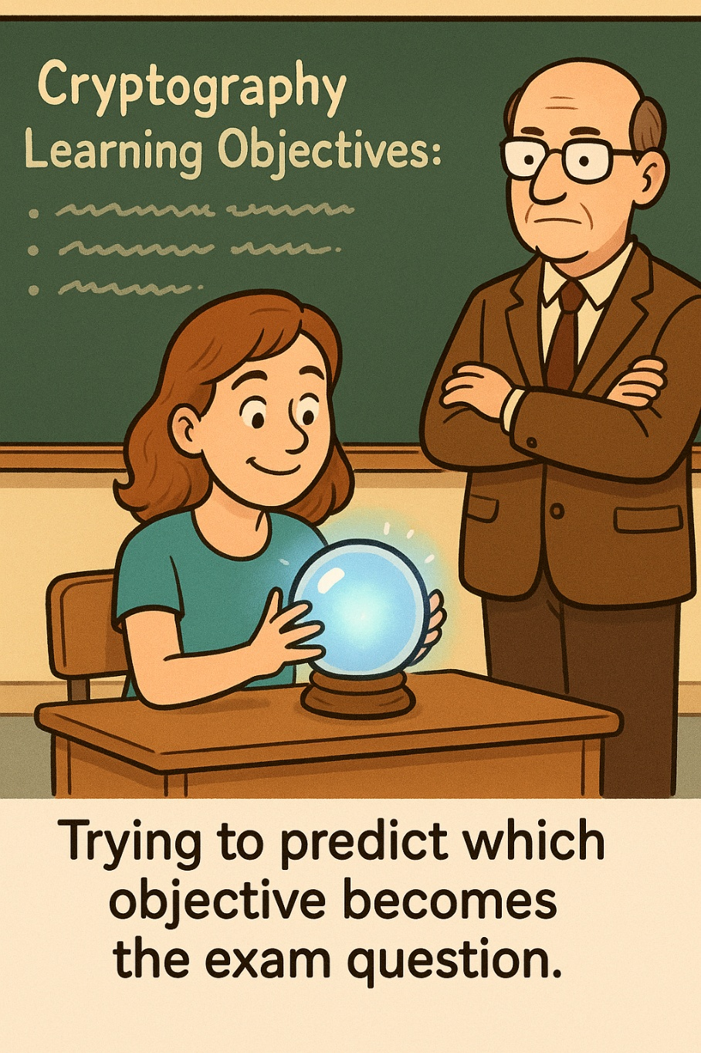
Lecture objectives
Blah
More blah

Slide 3
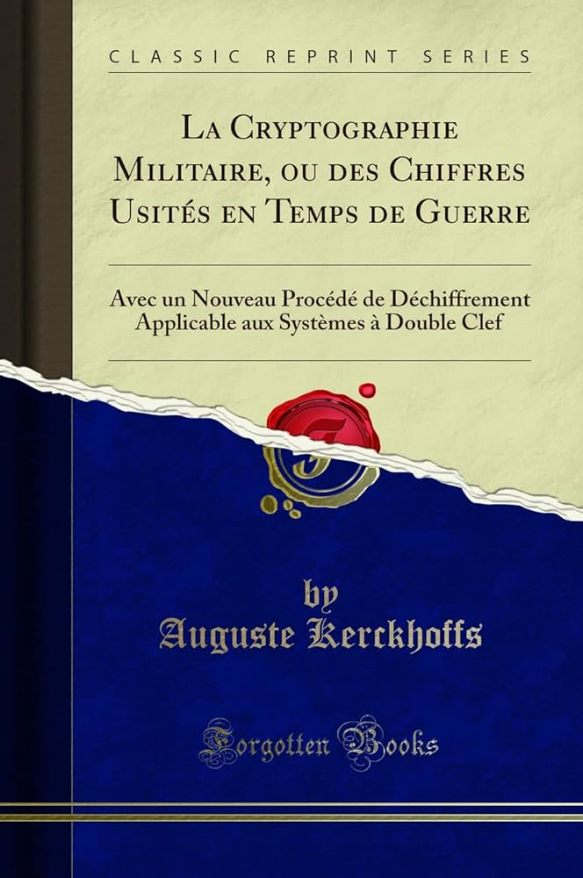
Auguste Kerchoffs Kerchoffs’ Rules
Dutch linguist and cryptographer (1835-1903)
Wrote the article “La Cryptographie Militaire” in which he posited 6 rules of thumb for creating a military cryptography system.
Most are still considered valid to this day.
The system should be, if not theoretically unbreakable, unbreakable in practice.
The design of a system should not require secrecy, and compromise of the system should not inconvenience the correspondents (Kerckhoffs' principle). The key should be memorable without notes and should be easily changeable.
The cryptograms should be transmittable by telegraph.
The apparatus or documents should be portable and operable by a single person.
The system should be easy, neither requiring knowledge of a long list of rules nor involving mental strain.

Slide 4
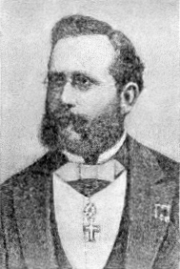
Kerchoffs’ Rules: K2
In particular, the idea that it is not only beneficial, but arguably necessary for the details of the algorithm to be known. There is no better acid-test to ensure security.
“If the world’s best cryptanalysts cannot crack it, you have an ad campaign that money can’t buy.” -Bauer
The system should be, if not theoretically unbreakable, unbreakable in practice.
The design of a system should not require secrecy, and compromise of the system should not inconvenience the correspondents (Kerckhoffs' principle).
Summarized and reiterated by Shannon to: “The enemy knows the system”
The key should be memorable without notes and should be easily changeable.
The cryptograms should be transmittable by telegraph.
The apparatus or documents should be portable and operable by a single person.
The system should be easy, neither requiring knowledge of a long list of rules nor involving mental strain.
The security of a cipher should not require concealment of the algorithm. Quite the opposite in fact. The security must lie in the secrecy of the key.

Slide 5
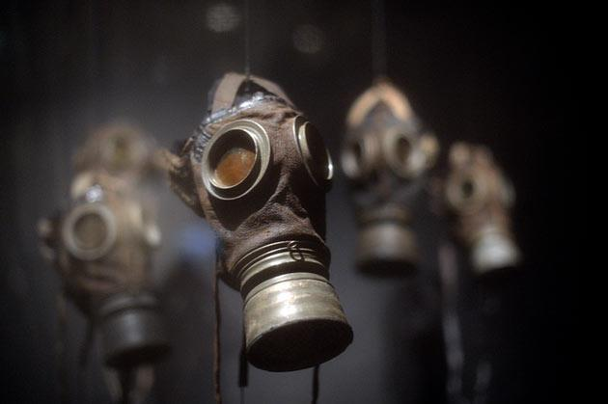
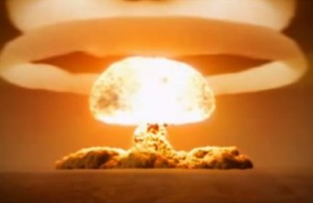

The Mathematicians’ War?
WW1 has often been referred to as “The Chemists’ War”
Chemical weapons
Industrial chemistry (advanced explosives technology)
WW2 has been thought of as “The Physicists’ War”
Atomic warfare
Should WW3 (or any major conflagration) occur in this era, it may well be remembered as “The Mathematicians’ War”.
Cybersecurity is already being weaponized on an international scale
Imagine the effects of shutting down water supply plants, power plants, communications services, etc.

Slide 6
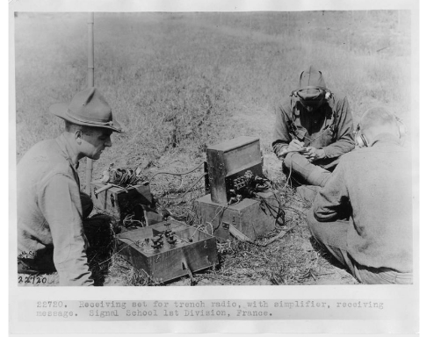
World War I
Many of the ciphers discussed so far were used in the First World War
Including some with rather lax security!
Among the more secure ones were ADFGX and shortly after, ADFGVX
Receiving set for trench radio 1914-1918

Slide 7
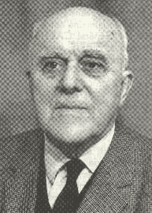
ADFG(V)X: A New Kind of Cipher
It is considered a good idea to introduce a new crypto system before a war or big operation
ADFGX and later ADFGVX (when they introduced an extra letter) was introduced by Germany shortly before their 1918 Spring Offensive
The name of this cipher is derived from the fact that ADFGVX are the only letters used in the ciphertext.
Those particular letters were chosen due to their distinctiveness when being transmitted via Morse Code.
Easy to distinguish when telegraphed
Designer Fritz Nebel had teams of cryptanalysts dedicated exclusively to trying to crack his system prior to its deployment.
A combination of two ciphers:
Polybius
Columnar Transposition
Fritz Nebel
A: * -
D: - * *
F: * * - *
G: - - *
V: * * * -
X: - * * -
Morse Code for ADFGX

Slide 8
Encryption of ADFGVX: A 2-Step Process
Step 1: Polybius Square
This particular square contains characters deemed necessary for one particular communication which is why it has atypical letters and numbers.
Consider the message “GOTT MIT UNS” (“God with us”).
Encoded into:
XX AD XG XG DA GF XG GX FA GD
However, recall that the Polybius Cipher had, by that point, been broken in various settings.
So….
 | A | D | F | G | V | X
A | c | o | 8 | x | f | 4
D | m | k | 3 | a | z | 9
F | n | w | 1 | 0 | j | d
G | 5 | s | i | y | h | u
V | p | l | v | b | 6 | r
X | e | q | 7 | t | 2 | g

Slide 9
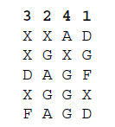
Encryption of ADFGVX: A 2-Step Process
Step 2: Columnar Transposition
From the Polybius encipherment we have:
XX AD XG XG DA GF XG GX FA GD
We will now add on a second step: Enciphgering the Polybius ciphertext via columnar transposition.
Suppose we decide on the key: “3421”. This means we will have 4 columns. As shown.
We then transpose the columns in numeric order, 1 through 4, and read down the columns as is done with columnar transposition.
Our ADFGVX ciphertext is now:
DGFX DXGA GAXX DXFA XGGG
In the real world, both the key and the message are likely to be longer than in this example. A common key length was in the neighborhood of 20 characters.
 | A | D | F | G | V | X
A | c | o | 8 | x | f | 4
D | m | k | 3 | a | z | 9
F | n | w | 1 | 0 | j | d
G | 5 | s | i | y | h | u
V | p | l | v | b | 6 | r
X | e | q | 7 | t | 2 | g

Slide 10
Exercise
 | A | D | F | G | V | X
A | c | o | 8 | x | f | 4
D | m | k | 3 | a | z | 9
F | n | w | 1 | 0 | j | d
G | 5 | s | i | y | h | u
V | p | l | v | b | 6 | r
X | e | q | 7 | t | 2 | g
Using the ADFGVX Polybius square, followed by columnar transposition with the key word “BRIE”, encipher the statement: GUTEN TAG
Answer:
We begin with the Polybius cipher and encrypt GUTEN TAG into: XX GX XG XA FA XG DG XX
Since our key is 4 characters, we will have 4 columns. We will therefore end up with 4 rows (since our message is 16 characters). We enter this information into the table. Remember to enter row by row.
We must now rearrange the rectangle into alphabetical order: B → E → I → R
We then read down the columns in that order to get our final ADFGVX cipher: XXFDX AGXGX XXXGA GFXAX*
B | R | I | E
X | X | G | X
X | G | X | A
F | A | X | G
D | G | X | X
B | E | I | R
X | X | G | X
X | A | X | G
F | G | X | A
D | X | X | G

Slide 11
Pop-Quiz! Not Really ☺
Note our final ciphertext: XXFDX AGXGX XXXGA GFXAX*
Why did I choose to write it out in blocks of 5 characters when the code was enciphered in blocks of 2 or 4 at a time?
Why are there extra letters at the end? The ciphertext ended at the final “G”. What’s up with the extra FXAX?
Answers:
We can write our ciphertext pretty much any way we like. We want to give as few clues as possible to any nefarious eavesdroppers. We could also have written it out in blocks of 3, or as one block with no spaces. However, putting in some spaces makes life much easier on our decrypting colleague without compromising the security of the cipher.
Had I not added the extra letters, it would have been clear that the message ended after 16 characters. This would hint (very strongly) at the possibility of our key being some factor of 16 – such as the actual value of 4! By filling in the remainder of the block with gibberish, we mask this to a certain degree.
B | E | I | R
X | X | G | X
X | A | X | G
F | G | X | A
D | X | X | G

Slide 12
ADFGX vs. ADFGVX
The extra “V” was added as an additional security measure. The main effect is that the Polybius square, instead of being 5x5 (as with ADFGX) and having 25 characters, is now 6x6, and has 36 characters.
Either one will work for our purposes. Shown on this slide are both squares. For the ADFGX square, note how, because we only have 25 squares but 26 letters, we have to combine I and J.
For the ADFGVX square, we have the opposite problem; too many squares! So in this case we need to fill them up with additional characters. In this case, we use digits.
 | A | D | F | G | X
A | A | B | C | D | E
D | F | G | H | I/J | K
F | L | M | N | O | P
G | Q | R | S | T | U
X | V | W | X | Y | Z
 | A | D | F | G | V | X
A | A | B | C | D | E | F
D | G | H | I | J | K | L
F | M | N | O | P | Q | R
G | S | T | U | V | W | X
V | Y | Z | 0 | 1 | 2 | 3
X | 4 | 5 | 6 | 7 | 8 | 9

Slide 13
Exercise with guidelines: Encrypt using ADFGX
Given the key: CLUE
Encrypt the following: DETECTIVE
Use ADFGX (not the longer ADFGVX)
Steps:
Convert the plaintext to ADFGX pairs
Write the results row by row into a rectangle with 4 columns. (4 columns since our keyword is 4 characters.)
Recall that the first column is “C”, the second is “L”, third is “U” and fourth is “E”
NOTE: If you have letters left over, fill the in the remainder of the rectangle with “F”s.
To generate the encoded message, we read down the columns – but do NOT forget to do so in order of the letters in the keyword. In this case, C, E, L, U.
Solution on the next slide.
 | A | D | F | G | X
A | A | B | C | D | E
D | F | G | H | I/J | K
F | L | M | N | O | P
G | Q | R | S | T | U
X | V | W | X | Y | Z

Slide 14
Solution to “DETECTIVE”
 | A | D | F | G | X
A | A | B | C | D | E
D | F | G | H | I/J | K
F | L | M | N | O | P
G | Q | R | S | T | U
X | V | W | X | Y | Z
Given a key CLUE,
Encrypt the following: DETECTIVE
Steps:
Convert the plaintext to ADFGX pairs
D=AG, E=AX, T=GG
Ciphertext from Polybius segment: AG AX GG AX AF GG DG XA AX
Write the results row by row into a rectangle with 4 columns. (4 columns since our keyword is 4 characters.)
Note how I added “F”s for the remaining two characters in the last row We should pick random characters for these. I told you to use “F”s just so that our solutions would match.
To generate the encoded message, we read down the columns – but do NOT forget to do so in order of the letters in the keyword. In this case, C → E → L → U
C=agada
E=xxgaf
L=ggfgx
U=aagxf
Ciphertext: AGADA XXGAF GGFGX AAGXF
C | L | U | E
a | g | a | x
g | g | a | x
a | f | g | g
d | g | x | a
a | x | f | f

Slide 15
Exercise with guidelines: DE-crypt using ADFGX
Let’s practice decryption. We’ll use the same phrases though since we’re just practicing.
You have been sent the following ciphertext:
AGADA XXGAF GGFGX AAGXF
Your spy agency has previously informed you that the keyword is CLUE.
Decrypt using ADFGX
Steps for DE-cryption:
Determine the number of columns and rows
Recall that the number of columns comes from the number of characters in the key.
The number of rows is the length of the message divided by the number of columns.
With this information, create a rectangle.
IMPORTANT: Be sure to label each column with the letters of the key – but in alphabetical order. Not in order of the word itself.
Enter the ciphertext into the rectangle – and be sure to enter them column by column (since that it how they were written out in the ciphertext.
Now reorder the columns so that they are in the order from the Key word (not alphabetical)
To get the plaintext, read ROW BY ROW – NOT down each column.
This is because when the ciphertext was first created, the letters were originally entered row by row in the very first step.
You can now use the ADFGX square to decipher the text.
Solution on the next slide.
ADFGX Square
 | A | D | F | G | X
A | A | B | C | D | E
D | F | G | H | I/J | K
F | L | M | N | O | P
G | Q | R | S | T | U
X | V | W | X | Y | Z

Slide 16
Solution to Decipherment Exercise
ADFGDX Square
 | A | D | F | G | X
A | A | B | C | D | E
D | F | G | H | I/J | K
F | L | M | N | O | P
G | Q | R | S | T | U
X | V | W | X | Y | Z
Decipher: AGADAXXGAFGGFGXAAGXF
Key = CLUE
Steps:
Determine the number of columns and rows:
Because the key word is CLUE (4 characters), we know there are 4 columns.
The number of rows is the length of the message (20 characters) divided by the number of columns. So 20/4 = 5 rows.
Label each column with the letters of the key, but remember to have the columns ordered it in ALPHABETICAL order. So the Column1 = C, column 2 = E, column 3 = L, column 4 = U
Enter the ciphertext COLUMN BY COLUMN into the rectangle with 4 columns. (4 columns since our keyword is 4 characters.)
Reorder the columns so that they match the word-order of the key word.
To generate the properly ordered ciphertext, we must now read off row by row. Recall that this was how the ciphertext was first entered into the square during the encryption process.
Properly ordered ciphertext: AGAX GGAX AFGG DGXA AXFF
Using the ADFGX square, convert to plaintext: AG=D, AX=E, GG=T, → DETECTIVE
C | E | L | U
Cols=4, Rows=5
C | E | L | U
A | X | G | A
G | X | G | A
A | G | F | G
D | A | G | X
A | F | X | F
We fill in column by column
C | L | U | E
A | G | A | X
G | G | A | X
A | F | G | G
D | G | X | A
A | X | F | F
Columns properly ordered

Slide 17
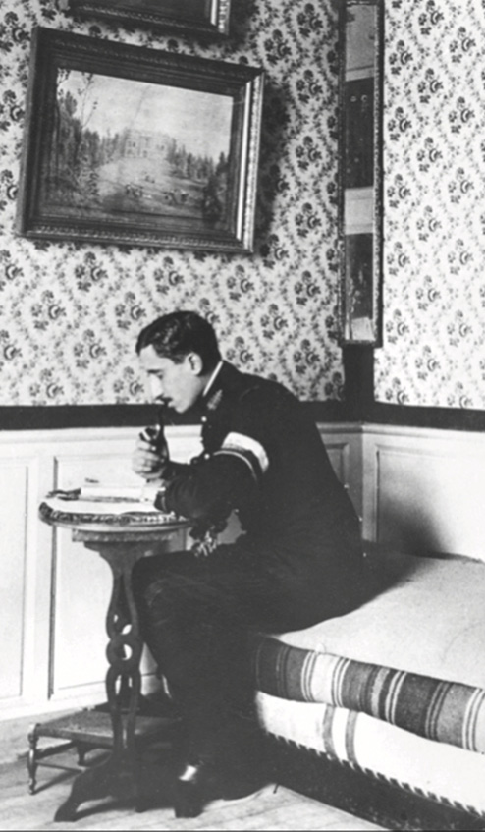
Cryptanalysis of ADFGVX
Very difficult given available tech at the time and had limited success – no general solutions / algorithms.
Georges Painvin had success, but only with specific cases as opposed to a general solution.
Even so: Per the American diplomat J. Rives Childs: “…Paris might have fallen but for the knowledge gained of German intentions by Painvin of where they would strike”.
His solutions didn’t allow all ciphers to be read, but he cracked several pivotal messages.
American continued this work after the end of the war. Modern computing methods have had more success due to techniques such as those developed by Painvin in conjunction with brute-force efforts.

Slide 18
Cryptanalysis: Painvin’s Approach
In-class review of Bauer 5.3: Painvin’s approach.
Overview of steps:
Guess rectangle geometry
Even or odd number of columns?
Which columns are the first in the pair and which are the second?
Guess column pairing
Which firsts go with which seconds
Guess column ordering
This might be the hardest step
How to arrange paired columns with each other
Guess ADFGVX letter pairs to letters
This is the easiest step
Attack like a Monoalphabetic Substitution Cipher

Slide 19
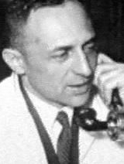
Historical Aftermath
Nebel never even knew that a system had been developed allowing some of his ciphers to be cracked. Only found out in 1966.
He commented: “I personally would have preferred the second stage to have had a double transposition rather than a single one, but, in discussion with the radiotelegraphy and decipherment chiefs, the idea was rejected. The result was a compromise between technical and tactical considerations. Double transposition would have been more secure but too slow and too difficult in practice”.
Nebel and Painvin met in 1968.
Nebel described it as “…the enemies of yesterday meeting as the friends of today.”

Slide 20
The Age of Dedicated Crytographic Agencies
As with previous wars, American spy agencies were dissolved, and codebreakers returned to their original jobs.
But the importance of this work was not lost on government officials, and evolution toward organizations dedicated explicitly to cryptography began.
The first peacetime cryptoanalytic organization in the United States was called the “Cable and Telegraph Section” or “Cipher Bureau”. However was more commonly (and colorfully) known as the “Black Chamber”. (1917-1929).
The organization had some shady methods such as bribing telegraph operators to turn over cables from foreign embassies and consulates.
Eventually its work was transferred to the Signal Corps.
Two important fascinating figures in this service (one of whom was highly controversial) were pivotal: William Friedman and Herbert O. Yardley. They had a rather intense rivalry and could not have been more different!

Slide 21
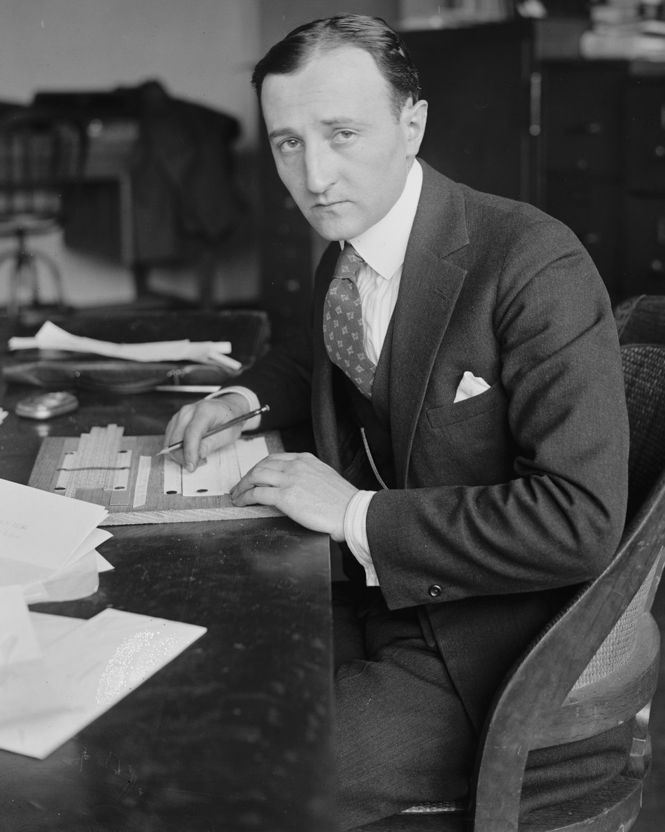
William Friedman
“Dean of American Cryptology”
US Army cryptographer, ran research division of the Signal Intelligence Service (SIS)
Born in Russian Empire, left due to pogroms against Jews and settled in Pittsburgh, PA.
First found fascination with cryptography due to Poe’s “The Gold Bug”.
Wrote numerous papers and monographs rising in the ranks. Introduced several terms (including “cryptanalysis” and algorithms for breaking various ciphers.
In particular, the Japanese “PURPLE” cipher was broken by his team. They constructed an analog of the PURPLE machine without ever having seen one.
One message they intercepted and cracked was to the Japanese embassy in Washington ordering an end to negotiations. This gave the US department warning that war was imminent.
Buried at Arlington National Cemetary

Slide 22
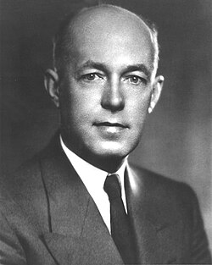
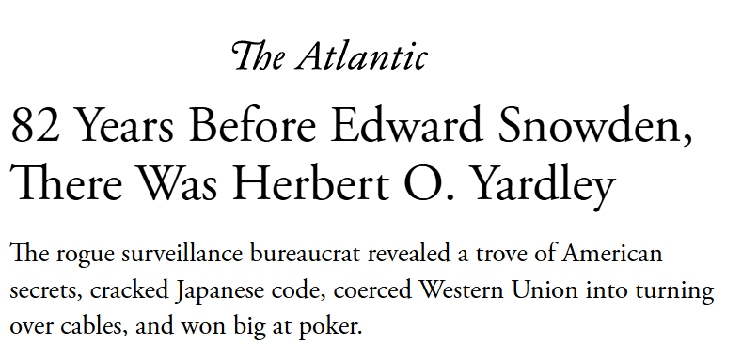
Herbet O. Yardley
Brilliant cryptographer. Started as a telegraph operator and as a hobby started trying to break ciphers. worked his way up to chief of an organization under the war department called the Cipher Bureau in 1917.
Also alleged to be a notorious gambler, womanizer, and eventually traitor. In 18 months his team, MI-8 has read almost 11K messages in over 500 cryptographic systems.
Major rivalry with Friedman. (It didn’t help that that Yardley was an avowed anti-semite whereas Friedman was Jewish.)
Very creative about gaining intercepts including bribing operators of the trans-Atlantic cable systems.
Immensely valuable accomplishments especially with respect to war with Japan.
Cipher Bureau had its funding withdrawn due to Hoover’s secretary of State, Henry L. Stimson’s disfavor: “Gentlemen do not read each other’s mail.” Was offered a job with Friedman’s SIS, but it at an insultingly low salary, and he turned it down.
Out of work, and with alleged gambling debts, Yardley wrote a tell-all book -- including a Japanese edition. Was eventually charged with treason.
Recommend reading 5.4-5.8 of Bauer – quite the story!!

Slide 23
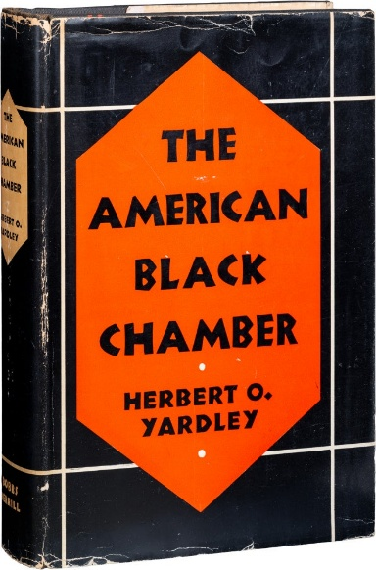
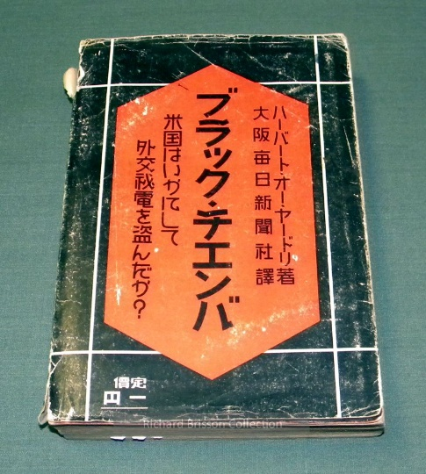
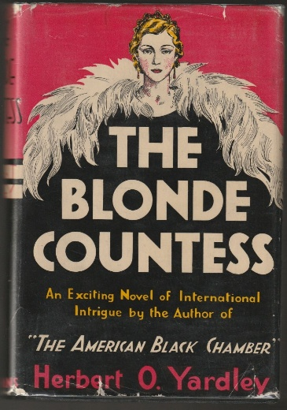
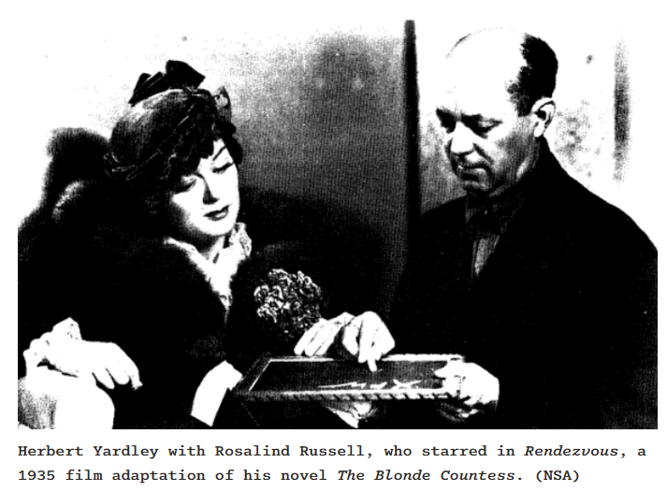
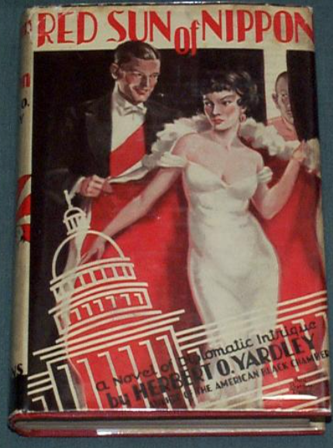
Yardley’s Post-War Shenanigans
Book: “The American Black Chamber”.
“Stimson destroyed the American cryptanalysis program . . . I might as well tell about it!”
Popular in Japan “(We got hacked!)”
US publicly denied it “We’re gentlemen! We don’t read other’s mail! ;)”
… but then privately tried to try Yardley for treason
Went on to write spy novels seeking commercial success.
From “The Atlantic” downloaded via LINK.

