Slide 1

Introduction to Cryptology
IT-233
Yosef Mendelsohn
Lecture #4:
Introduction to Cryptology:
Transposition
Etc

Slide 2

Lecture objectives
Blah
  More blah
Columnar Transposition
  Know how to encipher and decipher using either a text or numeric key.
  Know how to do a very simple cryptanalysis (single transposition) based on a suspected crib (which will be provided to you).
  Double Transposition: Know how to encipher and decipher, though on exams you will only be asked to encipher.
  Note: For exams I do not expect you to waste your valable time memorizing algorithms! I will give you the algorithms for encoding and decoding. They will not be as detailed as in the notes, but you will have them. (And remember that you can see your exam cheat-sheets ahead of time so that you know exactly what to expect).

Slide 3
overview

Slide 4
Transposition Ciphers
A different approach from substitution ciphers. We do not alter any of the letters at all! Instead we shift their positions.
Surprisingly difficult to crack.
What changes between the various transposition ciphers is the way in which the letters are scrambled.

Slide 5
Rail-Fence Transposition
Example: Consider the plaintext:
ANYONE WHO LOOKS AT US THE WRONG WAY TWICE WILL SURELY DIE.
Now let’s transpose every other letter in zig-zag fashion:
We read line by line to get the ciphertext:
AYNWO OKAUT ERNWY WCWLS RLDEN OEHLO STSHW OGATI EILUE YI

Slide 6
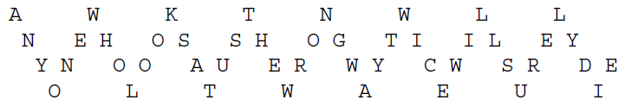
Rail-Fence Transposition, can add tiers
ANYONE WHO LOOKS AT US THE WRONG WAY TWICE WILL SURELY DIE.

Slide 7
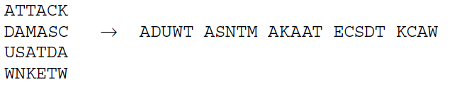
Rectangular Transposition
A commonly used technique.
The plaintext is first written in a rectangle row by row.
    We will discuss how to choose the number of rows shortly.
If there missing letters in the last row, fill in with random characters.
    Choose relatively common letters since it will make a cryptanalyst’s job harder. (Recall that we are not substituting letters – all letters in this cipher are directly in the plaintext.)
Ciphertext is obtained by reading column by column.
Example:
Ciphertext: ATTACK DAMASCUS AT DAWN

Slide 8
Exercise: Rectangular Transposition
The plaintext is first written in a rectangle (we try to avoid squares) row by row.
If there missing letters in the last row, fill in with random characters.
Ciphertext is obtained by reading column by column.
Exercise:
Encipher the following using 4 columns per row:
AI IS OUR NEWEST FRONTIER
Answer:
    AIIS
    OURN
    EWES
    TFRO
    NTIE
    REML → REMEMBER TO FILL IN WITH RANDOM LETTERS – CHOOSE MORE COMMON ONES
Ciphertext: AOET NRIU WFTE IRER IMSN SOEL

Slide 9
Rectangular Transposition: Cryptanalysis
We will briefly look at the example in section 3.1.2, but will not dwell on it as rectangular transposition encipherment is more commonly done by incorporating use of a key. This changes the preferred methods of cryptanalysis.
However there are a couple of important details that should be noted:
The importance of trying to ascertain reasonable values for the number of rows and columns.
    In this example we determine the number of rows. We can then simply divide the message length by the number of rows to determine the number of columns.
Once we know the dimensions, we write out the ciphertext column by column. We will then read off the plaintext row by row.
    This is very important to keep track of. When we start getting into more challenging decryptions, it is easy to get confused by this step and take some (time consuming) wrong turns!

Slide 10
Rectangular Transposition: Cryptanalysis
Exercise:
Decipher the following:
TCLTTOYHALHEUOEGSEARACOANMCEHBRBIITIUEANTF
The ciphertext is 42 letters long. To keep things simple I will tell you that there are 7 rows.
Answer:
7 rows with 42 letters means we have 6 columns
First step is to write out the ciphertext column by column.
  So the first column is going to be 7 characters long (since there are 7 rows): TCLTTOY
  2nd column: HALHEUO
  Etc.
  We end up with the following rectangle:
We read off the plaintext row-by-row.
THECHI
CAGOBU
LLSARE
THENBA
TEAMIN
OURCIT
YOAETF
THE CHICAGO BULLS ARE THE NBA TEAM IN OUR CITY

Slide 11
Columnar Transposition: Encipherment via Key
If no key is used, the key space of possibilities is huge, at n! (where n is the number of characters). In practice, encipherment is usually done by employing the use of a key. This is commonly called “columnar transposition”.
Key Points:
Each column must have a unique label: We choose a keyword (text or number string) and use it to label each column. For example, if we wanted 5 columns, we would have to come up with a keyword that is 5 characters long. Each character is the label for a column.
  If we use a number (e.g. PI 3.14159265), then any repeated numbers would be ignored. The first column would be 3, the 2nd column, 1, 3rd = 4, 4th = 5 (we skip the 1), etc.
  If we choose a text string, than repeated letters could either be ignored, or could be used as a column header – but we would have to keep track of which letter came first.
After entering the ciphertext (row by row, remember!!), we would then scramble the columns to put them in numeric or alphabetic order. In other words, we are now also moving columns around (i.e. “transposing columns”).
Examples: Bauer 3.1.3, Example 3 (use of a number), and Example 4 (use of a word).

Slide 12
Exercise: Encipherment via Key
As our key we will use Avogadro’s number: 6.0221408^23 – though we will leave out the exponent. So just focus on 6.0221408. When numeric duplicates are encountered, skip over them.
Use a key of 5 numbers (the first 5 unique numbers of Avogadro’s number), encipher the following:
CHEMISTRY IS IN THE STARS
Report the ciphertext in units of between 4 and 6 letters with a space between them. This is a common way of doing so.
Solution is on the next slide.

Slide 13
Solution: Encipherment via Key
Solution:
CHEMISTRY IS IN THE STARS
We were told to use a key of 5 numbers, so we must have 5 columns. The columns are labeled with the first 5 unique digits: 6,0,2,1,4.
Making sure that we enter the plaintext row-by-row, we end up with Table 1:
We then arrange the columns to place them in numeric order and end up with Table 2:
We form the ciphertext by writing it out column by column.
HTIS ZMYT ATER NTXI IHRL CSSE S
6 | 0 | 2 | 1 | 4
C | H | E | M | I
S | T | R | Y | I
S | I | N | T | H
E | S | T | A | R
S | Z | X | T | L
Table 1
0 | 1 | 2 | 4 | 6
H | M | E | I | C
T | Y | R | I | S
I | T | N | H | S
S | A | T | R | E
Z | T | X | L | S
Table 2

Slide 14
Example: Deciphering a rectangle (3.1.3)
The following algorithm is NOT explicitly covered in Bauer. Looking at example 4 on page 110 (Keyword “VALIDATE”), we will go backwards from the ciphertext to recover the plaintext.
ETNR CEOY EBGN IITT RENN CHIA YGFE SSNY
The algorithm works as follows:
Determine the number of rows and columns.
  Recall that the key dictates the number of columns. Therefore the number of rows can be determined by dividing the total number of letters (32) by the length of the key. In this case, because the keyword has 8 letters, we will require 4 rows.
Enter the ciphertext column by column.
  This is a HUGE potential point of confusion. Remember that because we are DE-ciphering, we need to start by thinking “column by column” instead of row by row. Row-by-row is the first step when EN-ciphering.
  First column is ETNR, second is CEOY, etc.
  Also note that because our key has TWO letter “A”s in it, we must keep track of which is which.
Move the columns to match the rows as indicated by the keyword.
  Note the alphabetical order of the key letters, e.g. A1, A2, D, E, I, L, T, V. This is the current order of the columns.
  Move the columns so that they reconstruct the original key, V,A,L,I,D,A,T,E
4. We then read off row-by-row.

Slide 15
Exercise: Deciphering a rectangle
Shown here is the ciphertext from the chemistry quote from an earlier exercise:
HTIS ZMYT ATER NTXI IHRL CSSE S
Through some clever social engineering, you have found out that the key came from the first 5 (unique) digits of Avogadro’s number, that is: 6,0,2,1,4.
Using this information, decipher the encrypted text (25 characters).
Solution is on the next slide.

Slide 16
Solution: Deciphering a rectangle
Deciphering:
HTIS ZMYT ATER NTXI IHRL CSSE S
Columns: Knowing that the key is made up of: 6, 0, 1, 2, 4 we know we must have 5 columns.
Rows: Given that there are 25 characters, this must mean that there are also 5 rows.
We enter the ciphertext letters into the table column by column.
Be sure to enter the values from the key at the top of each column.
Be sure to do so in their numeric order – not the order of the original key! This is because that’s how they were encoded.
We then reorder the columns to match the order of the key. We then simply read off row by row to get our plaintext.
0 | 1 | 2 | 4 | 6
H | M | E | I | C
T | Y | R | I | S
I | T | N | H | S
S | A | T | R | E
Z | T | X | L | S
6 | 0 | 2 | 1 | 4
C | H | E | M | I
S | T | R | Y | I
S | I | N | T | H
E | S | T | A | R
S | Z | X | T | L

Slide 17
But what if we don’t have the key?
(We rarely ever do!!)
Then it takes some real guess work, detective work, and sometimes luck – as is the case with so much of cryptanalysis!
Example: We will work through Bauer’s example in section 3.2.
In doing so we will make use of the columnar transposition spreadsheet as it makes moving columns around much easier.

Slide 18
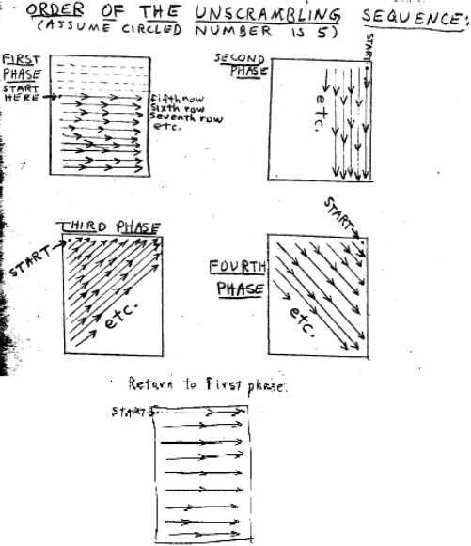
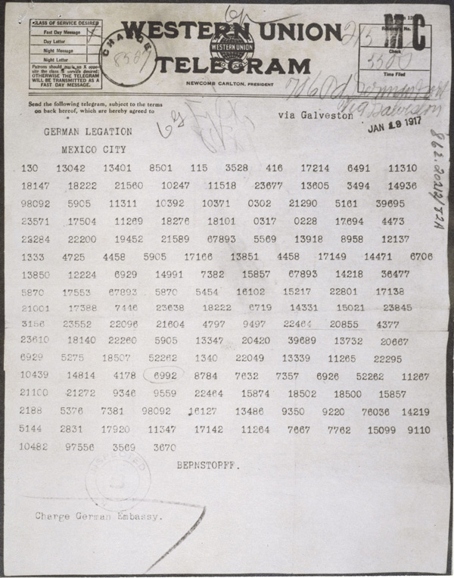
Historical Applications
The Unabomber left many notebooks containing ciphertext, and sometimes the techniques for deciphering them. He employed columnar transposition at times, though frequently in combination with other encipherment techniques such as null values, substitutions, words from other languages, etc.
German and French armies in WW1. However, they soon switched to double columnar transposition (discussed shortly). The most famous of which is the Zimmerman Telegraph – the modern world might well be a very different place had this message not been intercepted and successfully decrypted!
Unabomber Unscrambling Sequence
The Zimmerman Telegraph

Slide 19
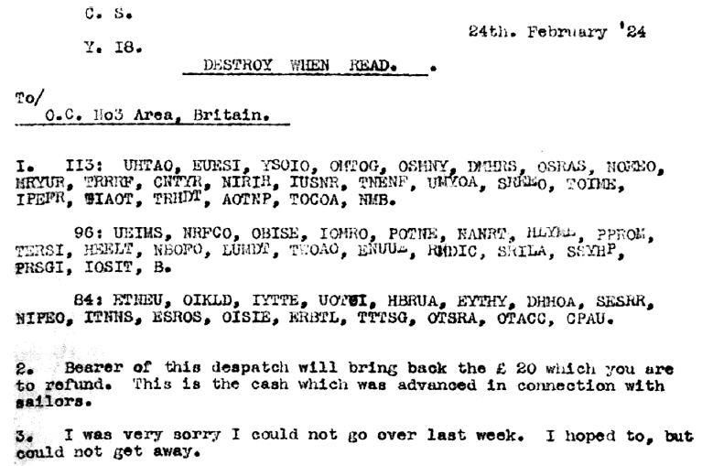
Historical Application: IRA
IRA
Ciphertext UEIMS NRFCO OBISE IOMRO POTNE NANRT HLYME PPROM TERSI HEELT NBOFO LUMDT TWOAO ENUUE RMDIO SRILA SSYHP PRSGI IOSIT B
deciphers to:
COULD YOU GET SOME TIME MINES OR INCENDIARY BOMBS PUT ON SHIPS OR PUT SRIPS ON FIRE WITH PETROL OR OTHER INFLAMMABLES
I find this particular message somewhat entertaining (in spite of its grim context) because it was written in a way that sounds like they were asking their colleage roommate to pick up groceries on the way home from work!
See Bauer 3.3
IRA ciphertexts from 1927
*The highlighted “R” was a typo! Typos, whether accidental or intentional, can make cryptanalysis even more challenging!

Slide 20
Double Transposition
From Bauer: “…when we encounter an attack on a cipher system, we can think about how to block it and thus create a stronger cipher system”
What important tenet of cryptography does this make you think of?
Answer: Kerckhoffs’ Rules. Specifically, K2 in which the method (algorithm) of encipherment should NOT need to be a secret. It’s better to put it “out there” and allow people to try to break it. Only then can one determine the flaws (if any) in a system.
In the case of columnar transposition, it was noted that in trying to form words, there are many rows that can be examined (as was demonstrated in an earlier example). With this in mind, the idea of double transposition was formulated. In this case, the process is begun with the usual algorithm for columnar encipherment. However, the resulting ciphertext is then entered as though it were plaintext back into the key and a second “layer” of ciphertext is generated.

Slide 21
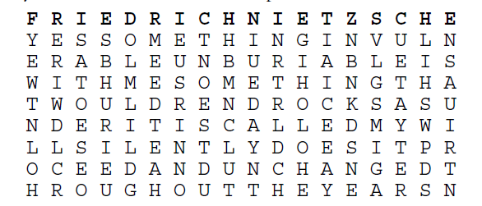
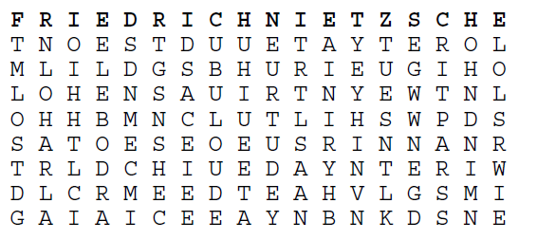
Example: Double Transposition
Consider the plaintext: YES SOMETHING INVULNERABLE UNBURIABLE IS WITH ME SOMETHING THAT WOULD REND ROCKS ASUNDER IT IS CALLED MY WILL SILENTLY DOES IT PROCEED AND UNCHANGED THROUGHOUT THE YEARS
Now we encipher into columnar transposition using the keyword: FRIEDRICH NIETZSCHE
For our first encipherment we end up with:
Column 1 (first “C” in the key): TNOESTDU
Column 2 (second“ C” in the key): UETAYTER
Column 3 (“D” in the key): OLMLILDG
Etc.
We then take the resulting ciphertext which begins with: TNOESTDUUETAYTEROLMLIDG, etc
And enter it again into the same key (as though it were the original plaintext). We end up with figure 2.
Our final ciphertext comes from the C1 column then C2, then D, then E1, E2, E3, F, , etc. to get:
UBULO UDERI TPARS SSDNM ECMIE LEBOD RAAIN IRYHB LOLSR WIETM LOSTD GUHIU EETAO HNDNI MNOIH HTLCI DSACE IEETR TLSAA NEURT UDEYN LOHAR LATGS NSHEC EGWWN EGDYE YHINV NTUES NTLK
Fig 1: Plaintext under the key
Fig 2: Double Encipherment

Slide 22
Double Transposition: Weaknesses
In principle, an excellent cipher.
However, subject to human flaws:
Interception of any one message in which the cryptographer neglected to do the second transposition. If that one is broken, all subsequent messages will also be broken – unless the key is changed.
Two messages of the same length
Square rectangle
Non-square rectangle that is completely filled
We won’t discuss how these can be broken, but they are all recognized portals with which to attack an encipherment using rectangular transposition.
Modern Day: Using a dictionary attack on the keyword can break the system even if everything else is done correctly.

