Slide 1
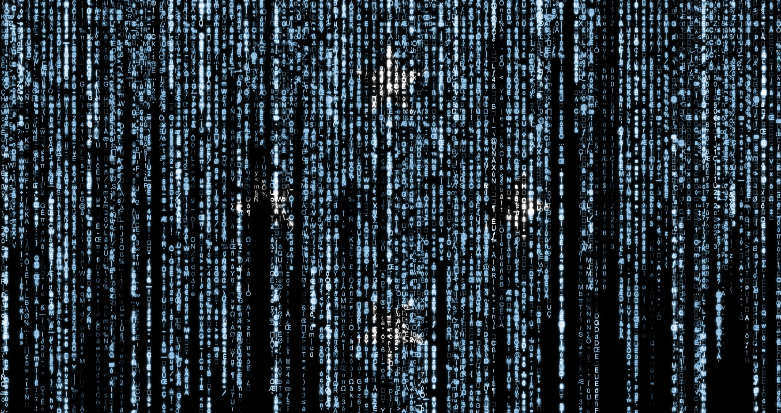
Introduction to Cryptology
IT-233
Yosef Mendelsohn
Lecture #3:
Introduction to Cryptology:
The Vigenere Cipher
Vigenere Cipher
Index of Coincidence
Kasiski Test

Slide 2
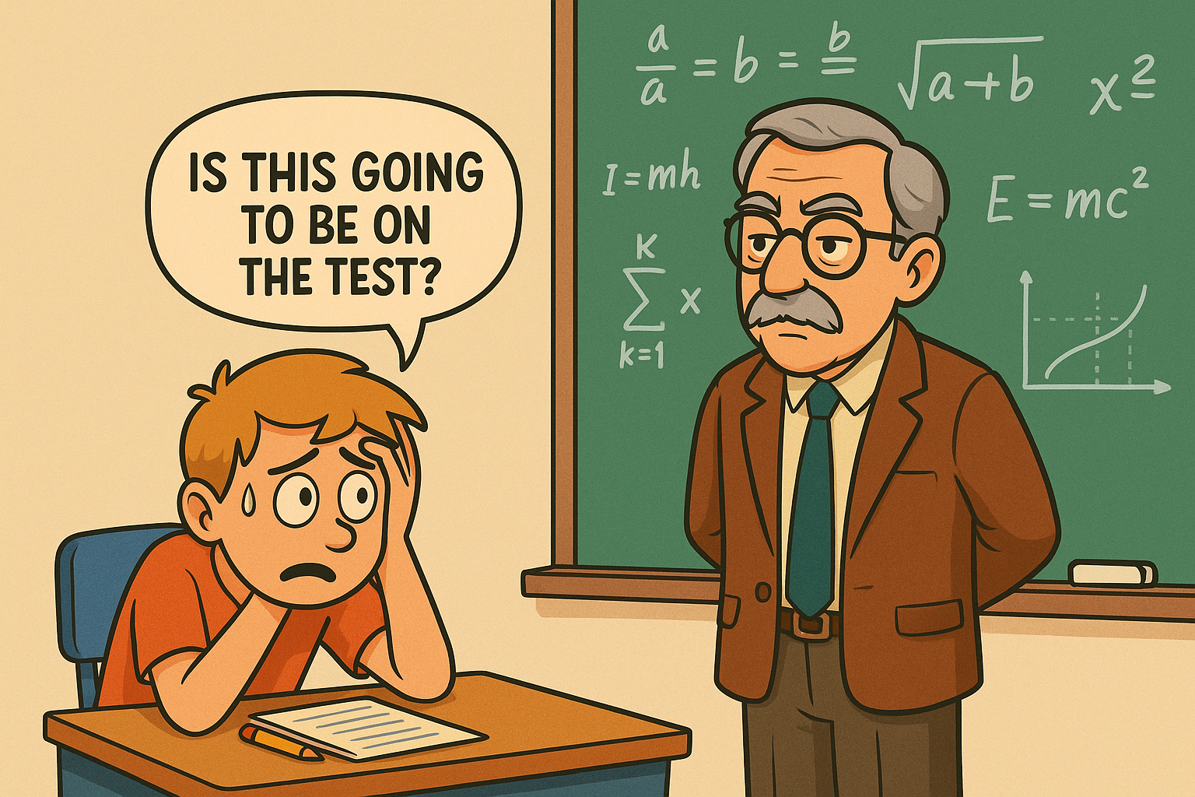
Lecture objectives
Understanding Vigenère Cipher
  Learn about the Vigenère cipher as a polyalphabetic substitution cipher and its functional principles.
Historical Development
  Explore the historical background and key contributors to the development of the Vigenère cipher. (Not on exams).
Cryptanalysis Techniques
  Understand cryptanalysis methods such as the Kasiski test and Index of Coincidence used to break the cipher.
Practical Application
  Apply formulas and examples to encrypt and decrypt messages using the Vigenère cipher effectively.

Slide 3
overview

Slide 4
NTS: Introduction to Vigenère Cipher
Poly-alphabetic Encryption
The Vigenere cipher uses multiple Caesar-shifted alphabets cycling through different keys to encrypt text.
To date, we have studied only ciphers that work with a single alaphabet, i.e. one group of substitutions used for all characters in the ciphertext.
Keyword-Driven Cipher
A keyword determines which alphabet is used for each letter, increasing encryption complexity.
Enhanced Security
The effect of using multiple alphabets for substitution (polyalphabetic substitution) is to make frequency analysis significantly harder. We say that it “flattens” the frequency distribution of the letters.
In other words, Vigenère cipher disguises repeating plaintext patterns, making frequency analysis difficult and enhancing security.

Slide 5
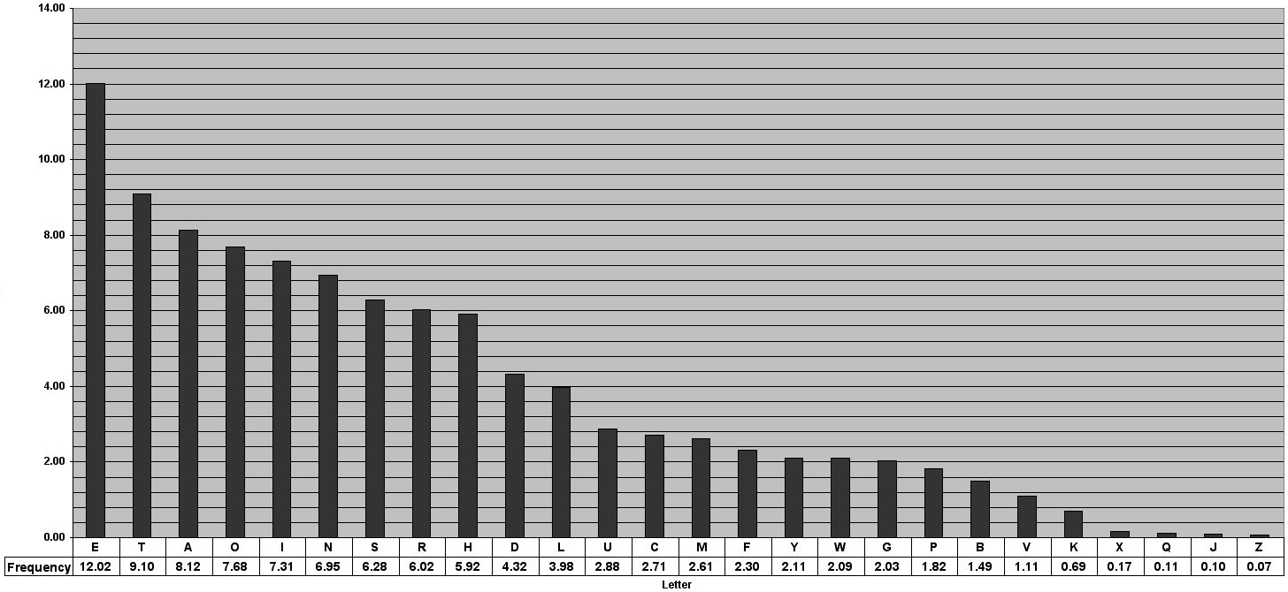
Frequency distribution of English language letters
Graph link: https://pi.math.cornell.edu/~mec/2003-2004/cryptography/subs/frequencies.html

Slide 6
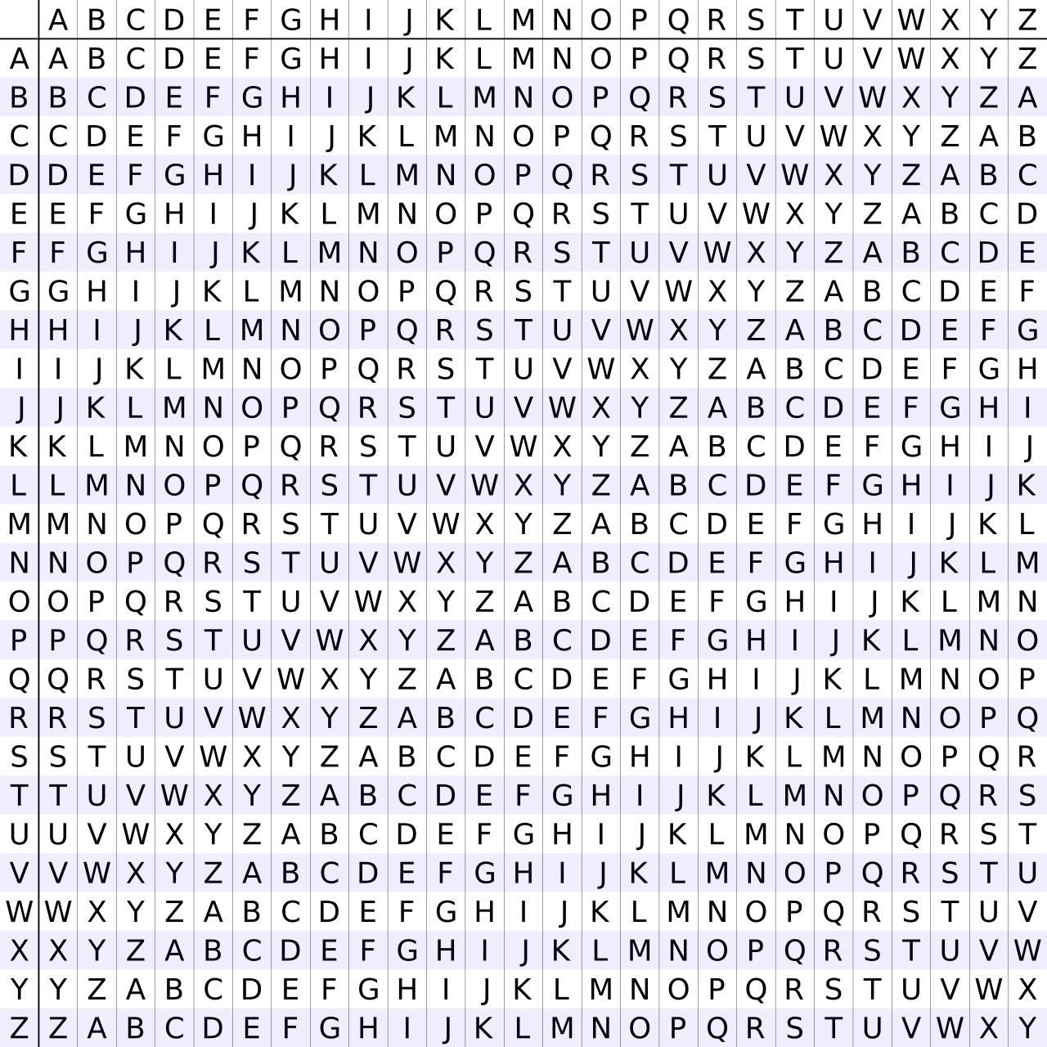
Introduction to Vigenère Cipher
Polyalphabetic Substitution
Two main weaknesses to mono-alphabetic systems (MASCs:)
  Preservation of letter frequencies (e.g. E >>> X)
  Preservation of word patterns (e.g. same 3 symbols represent “the”)
Vigenere cipher uses a variety of substitutions for each letter
  “Flattens” the frequency distribution (e.g. different symbols for ‘e’ used at different times in the cipher)
  For the same reason, disguises frequency patterns
Vigenere is an example of a “polyalphabetic” substitution cipher.
Example: The “Vigenere square” or “Tabula recta”
Essentially a group of multiple Caesar ciphers, having all possible shifts. We often call them “alphabets”.
At different points in a single encryption process, different shifts (i.e. different alphabets) are used.
Even so, this would be relatively trivial to decode as patterns could still be discerned. One way to make this more challenging is through the use of a keyword.

Slide 7
Encoding & Decoding Vigenere Using Tabula Recta
Top row represents PLAINTEXT CHARACTERS
First column represents KEY WORD characters
Where the plaintext row and keyword column intersect is the CIPHERTEXT character.
EXAMPLES:
If you have a plaintext “S” and a key letter “C”, what is the ciphertext character? → U
If you have a ciphertext “G” and a key letter “C”, what is the plaintext character? → E
  NOTE: It’s MUCH easier to start with the KEY letter and find the ciphertext G than to search the other way around.
EXERCISES
If you have a plaintext “D” and a key letter “E”, what is the ciphertext character?
  → H
If you have a ciphertext “X” and a key letter “V”, what is the plaintext character?
  → C

Slide 8
Using a keyword with the Tabula recta
Use of a Keyword
Suppose the message we wish to encode is “ATTACK ROME”
By using a keyword, the sender and recipient will know which of the 25 possible alphabets to use in use for each letter.
  Keyword: We might use a keyword such as “JULIUS”.
In this case, we start our encipherment by using the alphabet that begins with “J”
  Given plaintext “A” and key letter “J” we end up with ciphertext letter → “J”
The next alphabet that we use will be the one beginning with the letter “U”
  For the second letter of our plaintext message, “T” and key letter “U” we end up with ciphertext letter → “N”
For our 3rd plaintext letter, we use the 3rd character from our keyword, i.e. “L”. We use this “L” alphabet to encode the second “T” in our plaintext.
  In this case, T is encoded by “E”
  Note how our successive “T”s in “ATTACK” are now encoded by different letters.
  Recall that “T” is the 2nd most common letter in the English alphabet. Yet with a polyalphabetic cipher, this aspect will be mostly disguised since we have (already) encoded this “T” it with different letters.
  This is what we mean when we talk about “flattening” the frequency distribution of letters.
4th plaintext letter is “A” which we encode to “I” (using the “I” alphabet)
5th plaintext letter is “C” which we encode to “W” (using the “U” alphabet).
Once we get through all of all of the letters in our keyword, “JULIUS”, we continue our encipherment by starting again with the ”J” alphabet.

Slide 9
Exercise: Using tablula recta
Using the tabula recta, encipher “Viva Las Vegas” using the Keyword ELVIS.
Answer:
V: Use row “E” to encode V → Z
I: Use row “L” to encode I → T
V: Use row “V” to encode V → Q
  NOTE: How this second V of our plaintext is enciphered by a different letter than the first V.
A: Use row “I” to encode A → I
L: Use row “S” to encode L. → D
We must now restart our keyword:
A: Use row “E” to encode A → E
S: Use row “L” to encode S → D
V: Use row “V” to encode V → Q
  True, we used the “V” alphabet to encode the same plaintext letter earlier, but that is just a coincidence.
E: Use row “I” to encode E → M
G: Use row “S” to encode G → Y
A: Use row “E” to encode A → E
S: Use row “L” to encode S → D
Answer: ZTQI DEDQ MYED

Slide 10
Historical Development
Notes:
Historical Background, Alberti, Trithemius, Bellaso, Porta, and Vigenère

Slide 11
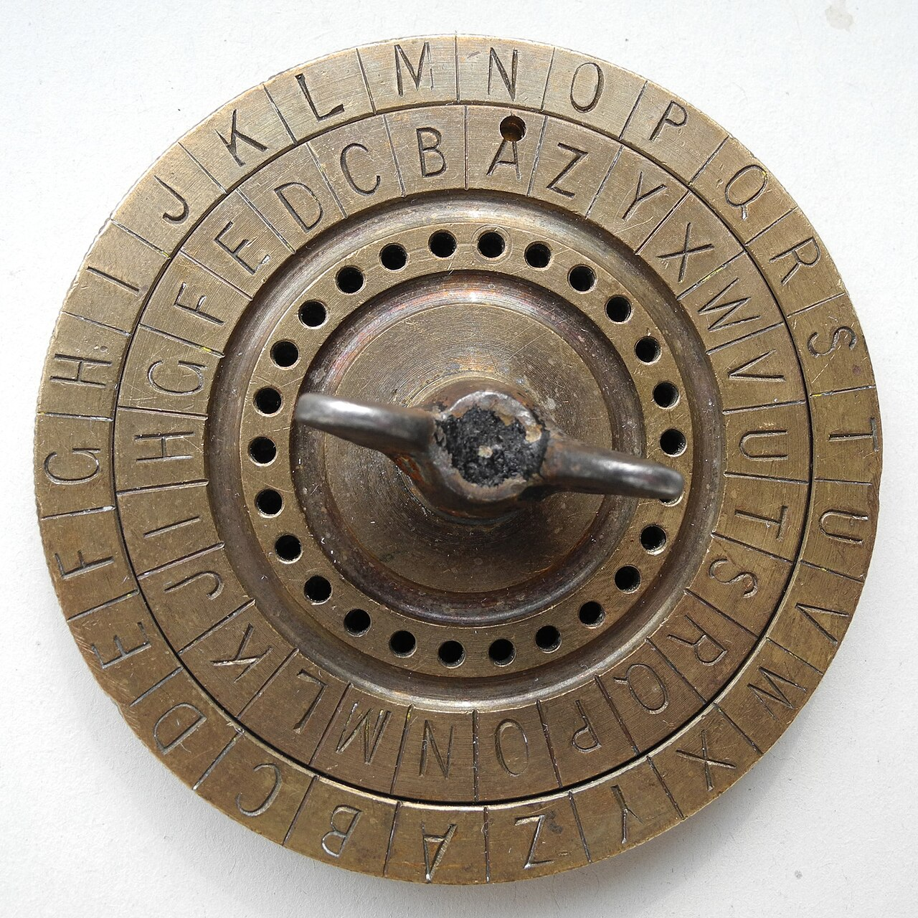
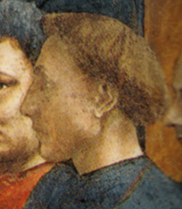
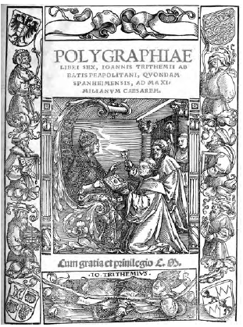
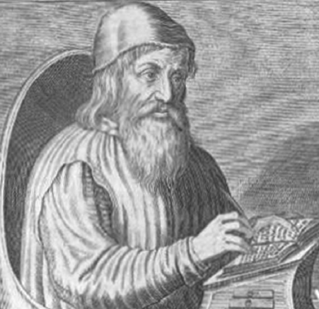
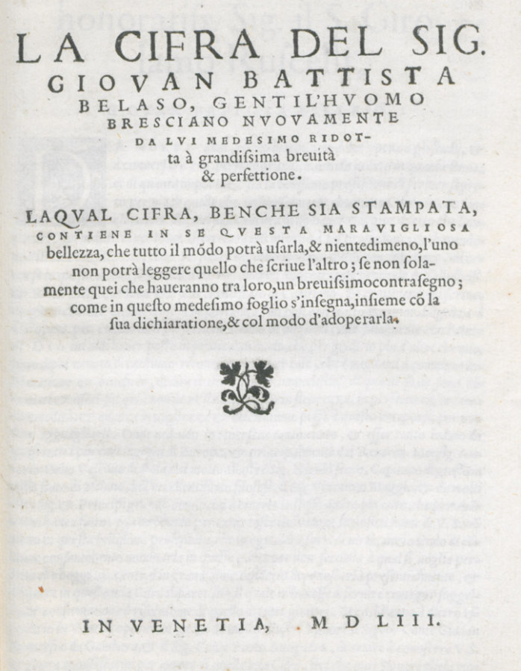
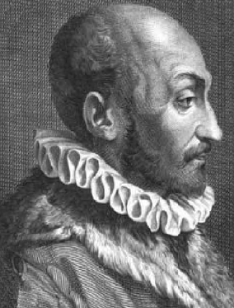
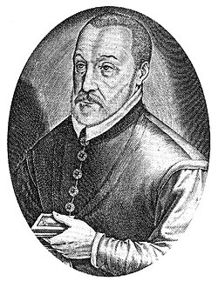
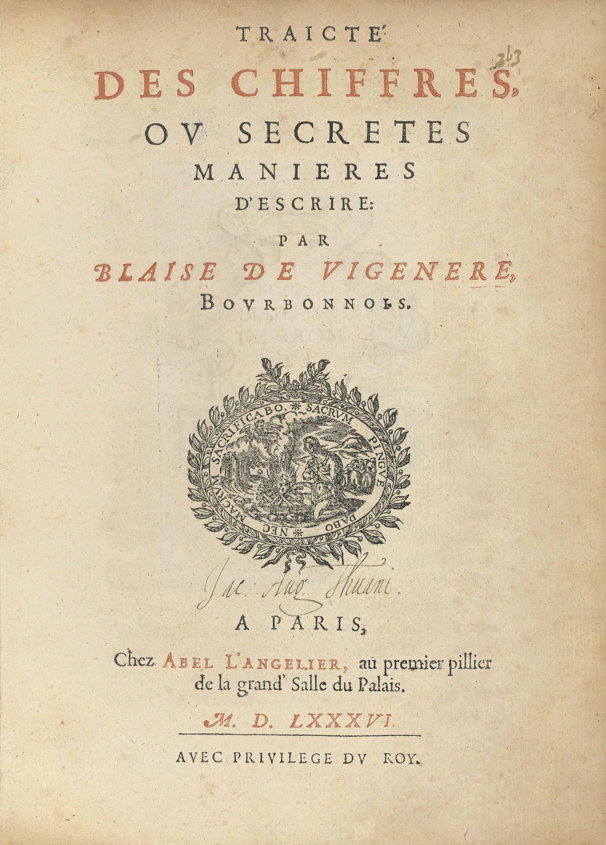
What’s in a Name?
Who really gets the credit?
Alberti:
  Turning cipher. Had the idea of changing the alphabet every few words so that we use a different shift.
  The first breakthrough to using polyalphabetic encipherment, circa 1466.
  Didn’t suggest keywords, or changing alphabets every letter.
Trithemius
  Wrote the first known book on cryptology: Polygraphiae, circa 1508.
    His 2nd book on cryptology – first one, Steganographia was banned by Roman Catholic Church
  Knew the real Dr. Faustus
  May have been a teacher of Paracelsus and Agrippa.
  In Polygraphiae, came up with the tabula recta discussed earlier.
Bellaso: In La Cifra Del Sig. 1553 came up with the idea of using a keyword
Porta: Put the ideas together in a work in 1563.
Vigenere: Reported and formalized all of this in Tracite des Chiffres in 1586. He did give credit to all of the above, but as his work was what brought the cipher into common use, his name stuck.
  That work also contained a recipe for making gold!

Slide 12
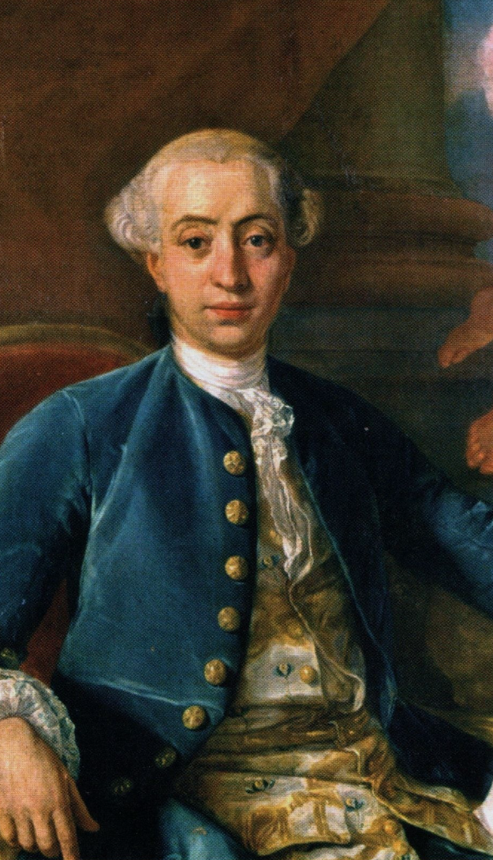

Casanova and Vigenère…
In his posthumous autobiography: “Histoire de Ma Vie” (The Story of My Life), discusses how in decrypting the Vigenere-enciphered code of a paramour, and claiming that it was told to him by a genie, he “…fettered her to me… and I became the master of her soul”.
For what it’s worth, he expressed considerable remorse for his behavior later in life.

Slide 13
Cryptanalysis Techniques
Notes:
Kasiski Test and Index of Coincidence, Worked Example of Cryptanalysis

Slide 14
Vigenère Cipher: Cryptanalysis
The best strategy is to figure out the ley length. If we can do this, deciphering the code is usually easy. Two well-known techniques for determining key length involve:
Looking for repeated sequences. This is the basis for the Kasiski test.
Calculate the probability that two randomly selected letters in the ciphertext are the same. This is known as the index of coincidence, or “IC”.
Note: These techniques require knowing baseline statistics of letter frequencies for the language of the plaintext. Each language will have different values for the IC. The Kasiski text will also be different.

Slide 15


Index of Coincidence (“IC”)
Index of Coincidence: The probability that two randomly chosen letters will be the same. (i.e. If you close your eyes and randomy point to two different letters in a book, what is the probability that those letters will be the same?)
Why do we use it? Answer: Can be used as an estimation of the key length in a Vigenere cipher.
For the English language, this value is approximately 0.0667 (or about 6.7%)
  Different languages will have different values.
  If the letters are from NO language, and were, in fact, selected from a group of random characters, this value would be about 0.039 (just under 4%).
* Example: Let’s start with the letter “Q”. That is, if we pick two letters at random, what is the probability that both of those letters are Q?
  Note: You might be tempted to ask: Wait – isn’t Q a rare letter? Will that change the probability? But remember, we are looking at ciphertext, so the particular letter is not relevant. Plus, as we will see in a minute, we are going to do this for all of the letters in our ciphertext.
  P(first letter is a Q) = Total Number of Qs in the text / Total number of letters in the text
  P(second letter is a Q) = (Total Number of Qs in the text-1) / (Total number of letters in the text – 1)
  We now repeat for all other letters. For example, for the letter “A” we would calculate:
  Now we repeat for all 26 letters. This gives us the formula:
Don’t get psyched out by this formula! The sigma character, Σ simply means we add a bunch of things together. For example, we start by calculating the frequency of A (i=“A”). We then calculate the frequency of B (i=“B”) and add the two. We then calculate the frequency of C and add it. All the way through i=“Z”. Once we have that sum, we divide by (N*(N-1)).
* You will not be asked to do any of these calculations on exams. But you must have a good understanding why we use IC.

Slide 16
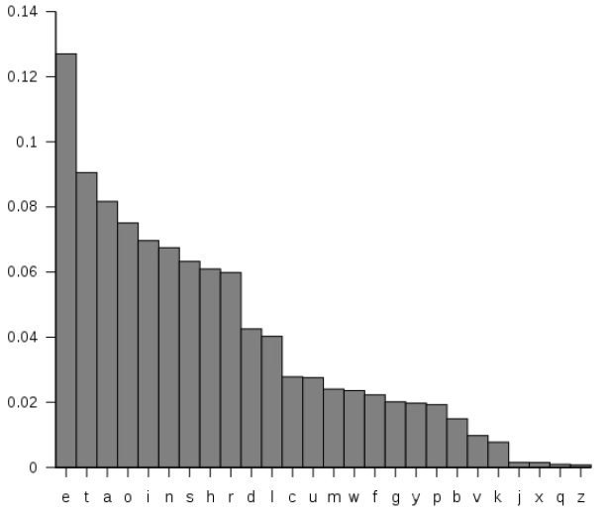
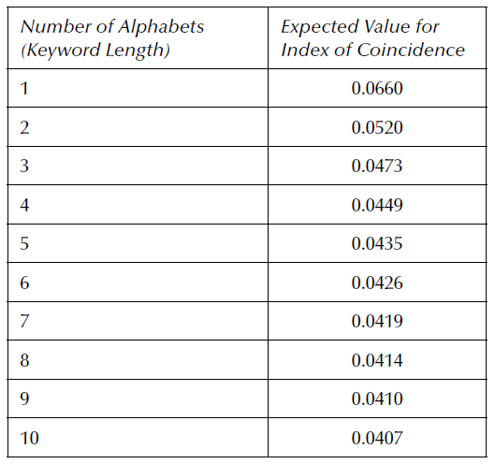
Index of coincidence: What does it tell us?
Letter Frequencies (English)
What does the IC tell us?
Recall:
Frequency Analysis: In nearly all spoken languages, letters appear with characteristic frequences and patterns. E.g In English, E makes up about 13% of all letters in a text – on average.
This means that we can calculate various statistical probabilities. One of which is the probability that two randomly selected letters will be the same. In English, this is about 0.066 (or 6.6%).
However, when we use multiple substitution alphabets, we flatten the frequency of the letter distribution. That is, most of the “peaks” in the bar chart will level out and they will all get flatter and flatter (i.e. more and more identical) as the number of alphabets increases.
In other words, the more alphabets we have (i.e. the longer the key word), the flatter the frequencies will become. So, perhaps ironically, this very flatness can be used as an estimate of key length!
IC measures the flatness of the frequency distribution.
  For example, if we have only 1 alphabet, then the regular English language frequency will be preserved. Therefore, IC would be the same as regular English, i.e. 0.066.
  If we have 2 alphabets, then we would get a little bit of flattening, so expected value for IC = 0.052.
Expected IC Values for Different Keyword Lengths
Notes:
Ironic b/c the cryptographer, by flattening the frequencies, is hoping to eliminate any form of frequency analysis.

Slide 17
Index of Coincidence: Interpretation
Interpreting the IC:
Note that the IC values drop significantly between from 1 to 2 alphabets, then again 2-3 and to on. However, as the key word length increases (more alphabets), the drops from one expected value to the next get smaller.
  Eventually as the number of characters (“N”) in the ciphertext gets lager, the value for IC approaches a limit of about 0.0388.
Suppose you calculate an IC of 0.0423. This suggests a keyword length of either 6 or 7.
  Best approach is to test using lengths with both of those values. If we start with 6, this means that the first group (alphabet) of encoded letters would start at ciphertext positions 1, 7, 13, 19, etc. We calculate the IC for this group of letters. If the key length is indeed appropriate, we should get an IC close to 0.066. If the IC is much closer to 0.038 (i.e random), we lose confidence in a key length of 6.
  BUT--- this could just be a low value by fluke. So we should repeat with all 6 different groups. Testing all 6 and getting consistently low values, tells us that this is almost certainly not the correct key length.
  We then repeat the process assuming a key length of 7.
  Note that it is entirely possible that neither of them will be valid. IC is a great approach, but it is hardly perfect.
We can also employ another technique to estimate key length called the Kasiski test.
  Often we use both of them. We will learn about the Kasiski test shortly.
Expected Value for IC for Different Number of Alphabets
(i.e. Keyword lengths)
What do we mean by “expected value”?
Statistical Term: The value you would expect to see in theory. In this context, the IC if you had a very large ciphertext such that the frequences of the letters matched almost perfectly with the English language as a whole. Obviously, with smaller-sized texts, the IC calculations could give very different results. This also means that small-sized ciphertexts may not give accurate results for IC

Slide 18
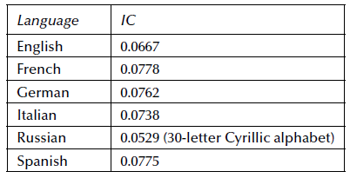
IC Can sometimes be used to distinguish between languages
Of interest: The IC has been calculated for a number of widely-spoken languages. This means that if one can determine the IC for a single alphabet, that value should suggest the language.
For this course, we will stick with English.

Slide 19

IC formula for estimating key word length
Shown here is a rearrangement of the IC formula to solve for key word length “L”.
L = length of the key word (i.e. # of alphabets)
N = Number of characters in the ciphertext
IC = Index of coincidence

Slide 20
Kasiski test for estimating key word length
The Kasiski test work on the assumption that there will be some repeated segments. E.g. the word “THE”.
As you know, a Vigenere key repeats its key. Say the key was “ORANGE”. We would end up with alphabets according to:
ORANGE | ORANGE | ORANGE | …
Now the word “THE” could appear under any of the keys word letters, i.e. under O or under R or under A, etc. And if at any point, the sequence aligns with the same letter of the keyword, e.g. “G”, that 3 character sequence will have the same letters.
So suppose that we encounter IQZ at a several different points and therefore suspect it is the word “THE”. Each time we encounter it, we measure the distance between the repeats. Suppose we see the first one at some position, and the next one 30 characters later. Later in the ciphertext we find another pair o IQZs that are 60 characters apart. And a ways down the road, we find yet another third pair of IQZs, this time 15 characters apart. So we find distances of: 30 characters, 60 characters, and 15 characters.
There seems to be a pattern that factors to 15 characters apart. So we have a possible key length that is some factor of 15 characters. By factor we mean that it could be: 3, 5, or 15.
To use another suspected repeated word example from Bauer: Suppose that we are eavesdropping on a conversation being sent out by Dell prior to a major computer release. As a result, we have reason to expect that the word “COMPUTER” will appear.
The Kasiski method finds the key length L by looking for repeated blocks in the ciphertext. These blocks occur when the same plaintext segment reappears at positions that are multiples of L apart. In Bauer’s example, the keyword ORANGE has length 6. If the word COMPUTER appears twice in the plaintext at positions differing by 6 or 12 or 18 or 24 (etc.) … characters, then it lines up with the same letters of the key each time, producing identical ciphertext blocks. Measuring these spacings and taking their common factors leads us to the key length.
Even if the above points are slightly confusing, for now, simply be sure to keep the following points in mind about the Kasiski test:
Used to help us come up with reasonable guesses as to the length of the key word
Relies on repeated sequences of characters – we usually start by looking for 3-letter sequences (a.k.a. “trigrams”)
  1-letter repeats are useless, 2-letter repeats are too common, 3-letter repeats are relatively rare, and therefore meaningful.
  A repeated 3-letter sequence in ciphertext is only likely to occur if it comes from repeateding plaintext that also lines up with the same Vigenere key letters. This means that the distance between them must be a multiple of the key length.

Slide 21
Example: Kasiski test
You are given the following ciphertext:
KLCQWBOZQWBOJFAMQWBOXTR
Look for any 3-letter blocks that appear more than once.
Record the starting positions of each repeated block.
Compute the distances (differences in positions).
List all factors of each distance.
Based on these factors, propose 1–2 plausible key lengths.
ANSWER:
Repeated 3-letter blocks:
QWB appears at positions starting 4, 9, 17 →Distances of 5, 8, and 13 (first QWB to the third)
WBO appears at positions starting 5, 10, 18 → Distances of 5, 8, and 13 (first WBO to the third)
So the repeated blocks are: QWB and WBO.
Factors of each distance: 5: 1, and 5 // 8: 1, 2, 4, 8 // 13: 1, 13
Reasonable guesses for key length: 5, 8 and 13
For shorter ciphertext lengths such as this one, we’d probably favor shorter key lengths, so we’d probably start our exploration using key lengths of 5 and 8.

Slide 22
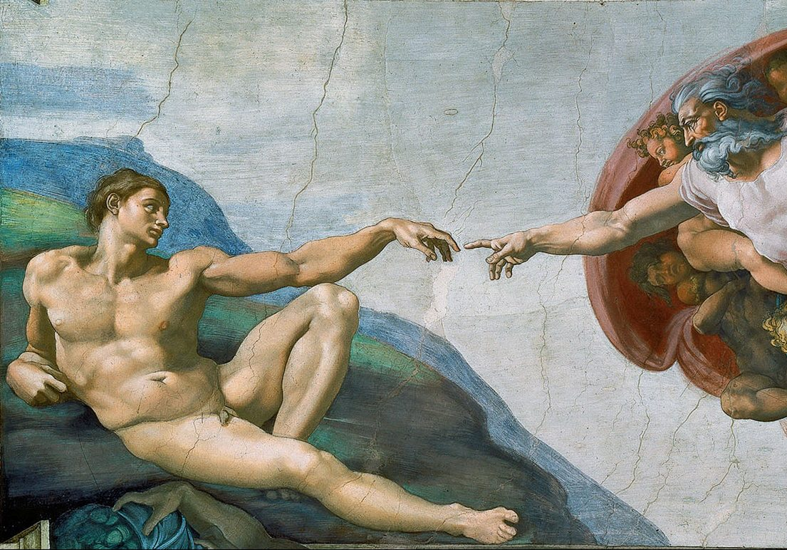
Example: Cryptanalysis of a Vigenere ciphertext
In lecture we will go over the example as discussed on pages 70-73 of the Bauer text. We will determine the key word length – and the keyword itself – for the ciphertext shown below.
Be sure that you understand how it is worked as you may be asked about it on homework and tests.
You do NOT need to worry about calculating IC, or working out detailed Kasiski patterns. But you must know how to interpret them.
See the next slide for notes…
IZPHY XLZZP SCULA TLNQV FEDEP QYOEB SMMOA AVTSZ VQATL LTZSZ
AKXHO OIZPS MBLLV PZCNE EDBTQ DLMFZ ZFTVZ LHLVP MBUMA VMMXG
FHFEP QFFVX OQTUR SRGDP IFMBU EIGMR AFVOE CBTQF VYOCM FTSCH
ROOAP GVGTS QYRCI MHQZA YHYXG LZPQB FYEOM ZFCKB LWBTQ UIHUY
LRDCD PHPVO QVVPA DBMWS ELOSM PDCMX OFBFT SDTNL VPTSG EANMP
MHKAE PIEFC WMHPO MDRVG OQMPQ BTAEC CNUAJ TNOIR XODBN RAIAF
UPHTK TFIIG EOMHQ FPPAJ BAWSV ITSMI MMFYT SMFDS VHFWQ RQ

Slide 23
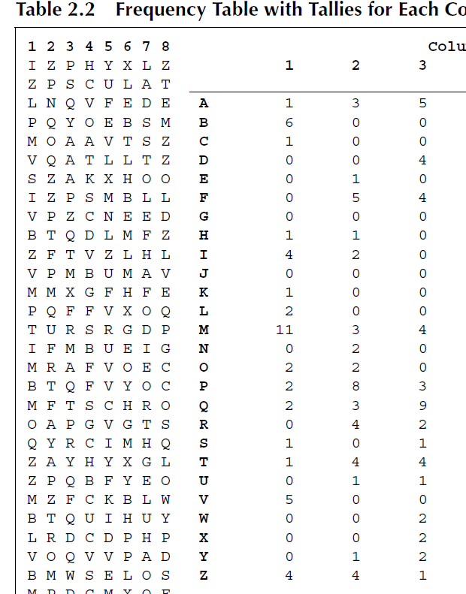
Example: Cryptanalysis of a Vigenere Ciphertext
(Bauer p. 70-73)
Important: Unofrtunately, Bauer (and in fact most texts) does NOT do a good job of explaining the method. In addition to going through the example in lecture, I am including a few clarifications here.
Assuming a keyword of 8 letters, convert the ciphertext into 8 columns: We create a table of 8 columns. We then write out the ciphertext along the first row, and move to the second row when we finish the 8 columns. So row 1: I Z P H Y X L Z, Row 2: Z P S C U L A T. When done we end up with with the table seen on the left in Table 2.2.
Key Point: All letters in column 1 (I, Z, L, P, etc) are enciphered by the same alphabet. All letters in column 2 (Z, P, N, etc) are enciphered by the same alphabet.
Most Frequent Letters:
In the Table 2.2 (right side), do NOT look for the three most frequent letters. Start with the most frequent letter and assume it is an E. (It won’t always be, but relatively often it will!) For column 1, assume that “M” is encoding the plaintext ‘e’. If that is the case, which letter is encoding the second most common English letter (T)? To do this, we need to calculate the shift. If M is ‘e’, then N is ‘f’, O is ‘g’, and so on. Continuing on, we see that the letter encoding ‘t’ is “B”. The expected third most common letter in English is “A”, we say: “Well, if M is encoding ‘e’, which letter encodes ‘a’? We look at the shift and see that this would be the letter “I”. We add up the frequency of these three letters: 11 + 6 + 4 to get 21.
Determining the Key Word
Not difficult – but Bauer really doesn’t explain this very well at all! To get the keyword, for each column, determine what the plaintext letter for "A" is.
For column 1, the highest 3-letter sum happens when M represents E. In this case, then the letter representing ciphertext "A" is I.
For column 2: The highest 3-letter sum happens when Q represents E. In this case, the letter representing ciphertext A is "M".
For column 3, ciphertext A is also M.
Column 4: S represents E, so A is represented by O.
5: A represented by R
6: A represented by T
etc:
We have our keyword!!!!! → IMMORTAL

Slide 24
Deciphering: Key = IMMORTAL
Now that we know the keyword, we can decipher!
Let’s do the first few ciphertext characters together:
IZPHY XLZZP SCULA
Ciphertext I → The first letter in our keyword “IMMORTAL” happens to also be I. (This is just a coincidence). We go across the I-row until we find the ciphertext letter I. It turns out to be the very first character in the row. Look at the top row to find the plaintext letter. This is the letter “A”.
Ciphertext Z → We now use the 2nd letter in our key. This is the (first) M in IMMORTAL, we go across the M-row until we find the ciphertext Z. Then we read off the top row and see it corresponds to the plaintext letter “N”.
Ciphertext P → We now use the 3rd letter in our key, whish is the (second) M in IMMORTAL, we go across the M-row until we find P. Then we read off the top row and see it corresponds to the plaintext letter “D”.
So far we have: “AND…”
Exercise:
  Repeat for the next few characters HYX
KEY | A | B | C | D | E | F | G | H | I | J | K | L | M | N | O | P | Q | R | S | T | U | V | W | X | Y | Z
A | A | B | C | D | E | F | G | H | I | J | K | L | M | N | O | P | Q | R | S | T | U | V | W | X | Y | Z
B | B | C | D | E | F | G | H | I | J | K | L | M | N | O | P | Q | R | S | T | U | V | W | X | Y | Z | A
C | C | D | E | F | G | H | I | J | K | L | M | N | O | P | Q | R | S | T | U | V | W | X | Y | Z | A | B
D | D | E | F | G | H | I | J | K | L | M | N | O | P | Q | R | S | T | U | V | W | X | Y | Z | A | B | C
E | E | F | G | H | I | J | K | L | M | N | O | P | Q | R | S | T | U | V | W | X | Y | Z | A | B | C | D
F | F | G | H | I | J | K | L | M | N | O | P | Q | R | S | T | U | V | W | X | Y | Z | A | B | C | D | E
G | G | H | I | J | K | L | M | N | O | P | Q | R | S | T | U | V | W | X | Y | Z | A | B | C | D | E | F
H | H | I | J | K | L | M | N | O | P | Q | R | S | T | U | V | W | X | Y | Z | A | B | C | D | E | F | G
I | I | J | K | L | M | N | O | P | Q | R | S | T | U | V | W | X | Y | Z | A | B | C | D | E | F | G | H
J | J | K | L | M | N | O | P | Q | R | S | T | U | V | W | X | Y | Z | A | B | C | D | E | F | G | H | I
K | K | L | M | N | O | P | Q | R | S | T | U | V | W | X | Y | Z | A | B | C | D | E | F | G | H | I | J
L | L | M | N | O | P | Q | R | S | T | U | V | W | X | Y | Z | A | B | C | D | E | F | G | H | I | J | K
M | M | N | O | P | Q | R | S | T | U | V | W | X | Y | Z | A | B | C | D | E | F | G | H | I | J | K | L
N | N | O | P | Q | R | S | T | U | V | W | X | Y | Z | A | B | C | D | E | F | G | H | I | J | K | L | M
O | O | P | Q | R | S | T | U | V | W | X | Y | Z | A | B | C | D | E | F | G | H | I | J | K | L | M | N
P | P | Q | R | S | T | U | V | W | X | Y | Z | A | B | C | D | E | F | G | H | I | J | K | L | M | N | O
Q | Q | R | S | T | U | V | W | X | Y | Z | A | B | C | D | E | F | G | H | I | J | K | L | M | N | O | P
R | R | S | T | U | V | W | X | Y | Z | A | B | C | D | E | F | G | H | I | J | K | L | M | N | O | P | Q
S | S | T | U | V | W | X | Y | Z | A | B | C | D | E | F | G | H | I | J | K | L | M | N | O | P | Q | R
T | T | U | V | W | X | Y | Z | A | B | C | D | E | F | G | H | I | J | K | L | M | N | O | P | Q | R | S
U | U | V | W | X | Y | Z | A | B | C | D | E | F | G | H | I | J | K | L | M | N | O | P | Q | R | S | T
V | V | W | X | Y | Z | A | B | C | D | E | F | G | H | I | J | K | L | M | N | O | P | Q | R | S | T | U
W | W | X | Y | Z | A | B | C | D | E | F | G | H | I | J | K | L | M | N | O | P | Q | R | S | T | U | V
X | X | Y | Z | A | B | C | D | E | F | G | H | I | J | K | L | M | N | O | P | Q | R | S | T | U | V | W
Y | Y | Z | A | B | C | D | E | F | G | H | I | J | K | L | M | N | O | P | Q | R | S | T | U | V | W | X
Z | Z | A | B | C | D | E | F | G | H | I | J | K | L | M | N | O | P | Q | R | S | T | U | V | W | X | Y

Slide 25
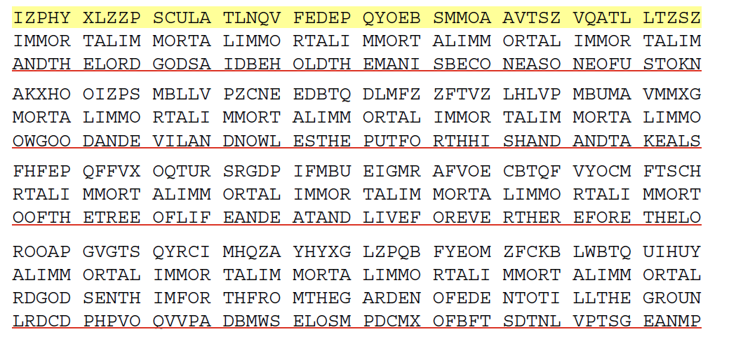
Example: Cryptanalysis of a Vigenere ciphertext
“And the lord god said behold the man is become as one of us…..”
A passage from the Bible pertaining to becoming immortal.
There appears to be a typo in the book! In the 3rd line of the text block above, the 40th character (NEASO) should show an “M” not an “N”.

Slide 26
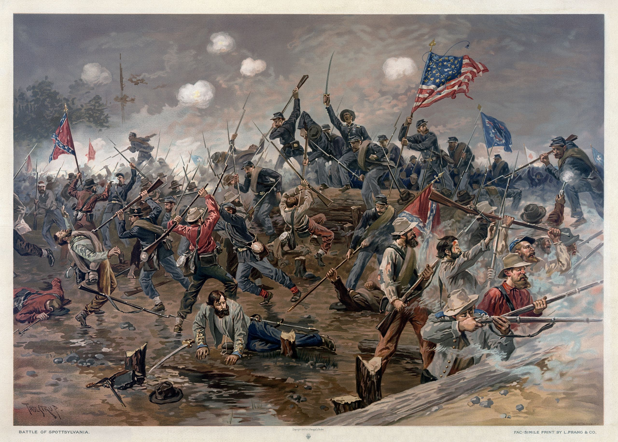
Real-world use of the Vigenère Cipher
This cipher has seen extensive use over the centuries. In this country, it was used by the Confederacy (armies and others) during the Civil War. However, it appears they only ever used 3 or 4) different keys for their Vigenere ciphers throughout the entire war!
MANCHESTER BLUFF
COMPLETE VICTORY
COME RETRIBUTION (after Lee’s surrender at Appomatox)
No doubt this limited number of keys made the Union codebreakers extremely happy!
Notes:
Aside: Spotsylvania was one of the few large scale hand-to-hand melees in the war.

Slide 27
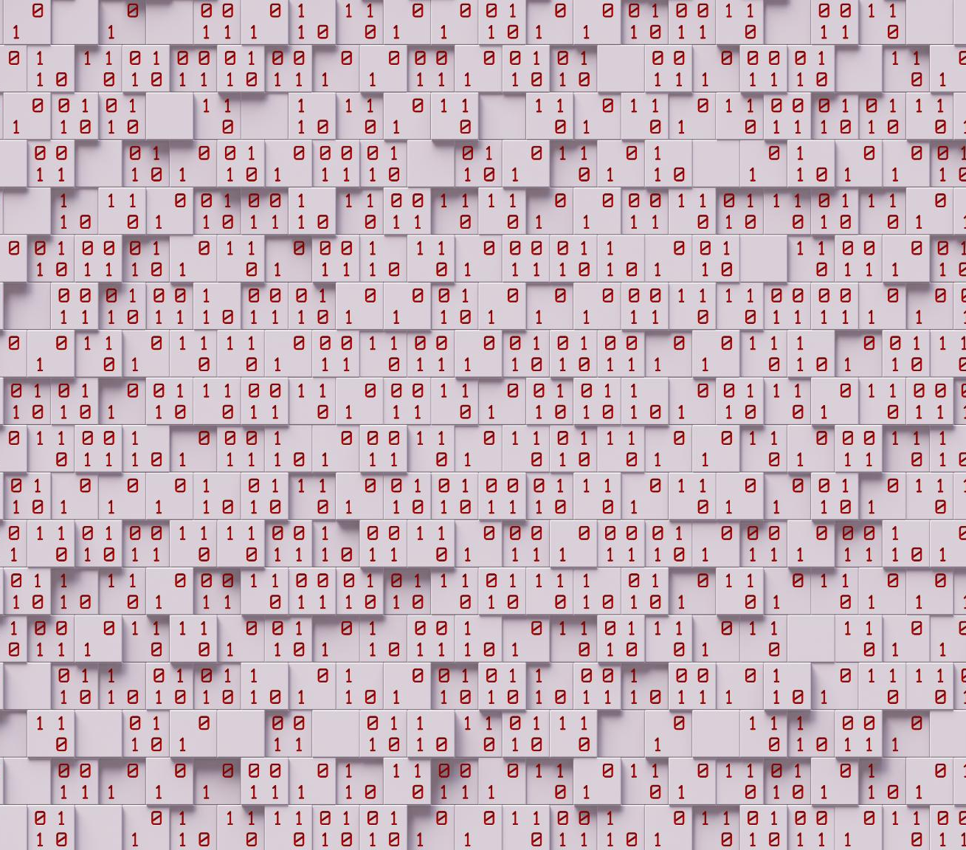
Review: Kasiski Test and Index of Coincidence
Kasiski Test
  Kasiski test detects repeated ciphertext segments to estimate the Vigenère cipher key length by measuring distances between repeats.
Index of Coincidence
  The Index of Coincidence measures the probability that two randomly chosen letters from text are identical, aiding key length confirmation.
Cryptanalysis of Vigenère Cipher
  These methods exploit repeating key patterns to reveal polyalphabetic cipher weaknesses and improve cryptanalysis accuracy.
Notes:
Breaking the Vigenère cipher relies on determining the key length. The Kasiski test identifies repeated segments in ciphertext and measures the distances between them, which often correspond to multiples of the key length. The Index of Coincidence (IC) is a statistical measure that estimates the likelihood of two randomly chosen letters being the same. By calculating IC for different assumed key lengths, cryptanalysts can confirm the results of the Kasiski test. These methods exploit the fact that polyalphabetic ciphers, while stronger than monoalphabetic ones, still exhibit patterns when the key repeats. Understanding these techniques is essential for appreciating both the strengths and weaknesses of the Vigenère cipher.

Slide 28

Full Vigenère
“Do you remember me? Everything you discussed so far was invented by my predecessors, like della Porta”
“My true unique contribution was the auto-key”

Slide 29
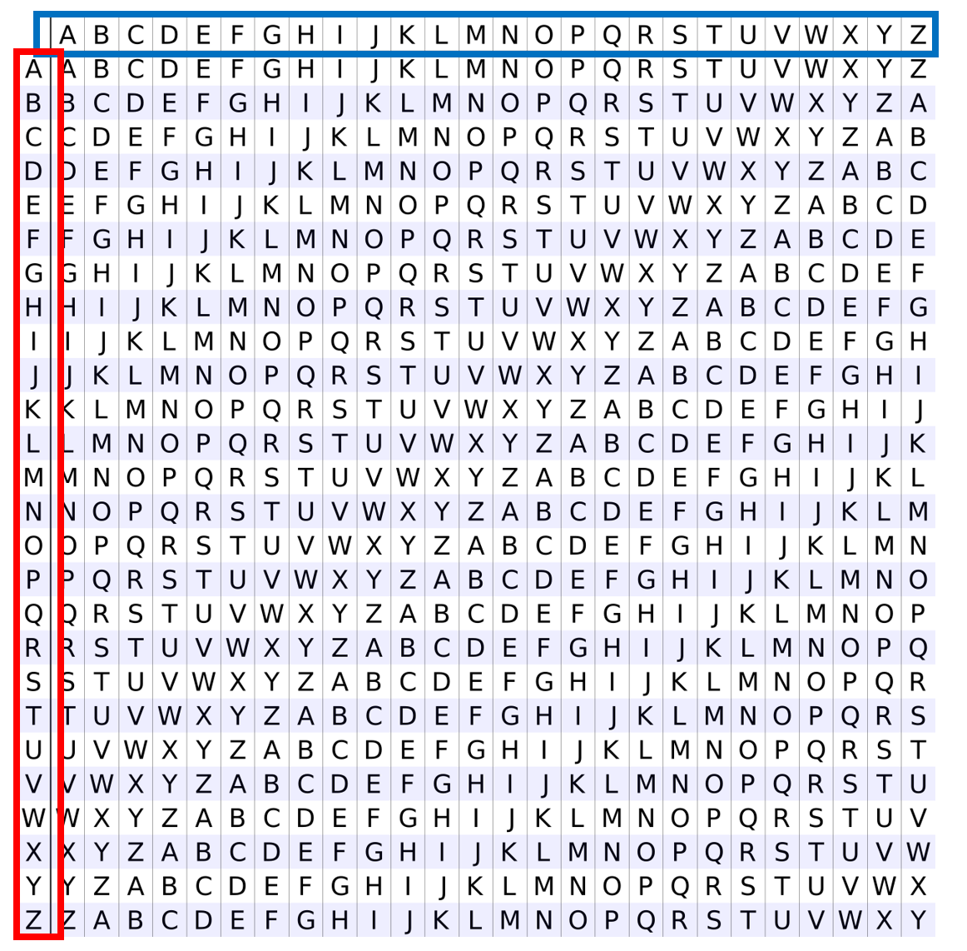
Reminder: Encoding & Decoding Vigenere Using Tabula Recta
Top row represents PLAINTEXT CHARACTERS
First column represents KEY WORD characters
Where the plaintext column and ciphertext row intersect is the CIPHERTEXT character.

Slide 30
Full Vigenère: Autokey
His idea was to only use the key once, e.g. “COMET” in the example. After the single use of the key word, the ciphertext that was generated by the keyword, starting from the first character of that ciphertext, is used as a continuing “running” key for the remainder of the message.
Variations on this technique are still used in other contexts with matrix encryption and modern block ciphers.
This turns out to be a surprisingly effective cipher!
HOWEVER….. There are some flaws. One is that this is still susceptible to brute-force attack. Another is that a single error in a position will then propagate for the remainder of the message! Note what happens in the example shown here if the 3rd character is mistakenly recorded as “N” instead of “Z”. As a result, every 5th character would be incorrect for the entirety of the message!
S E N D S U P P L I E S … message
C O M E T S E N D S U P … key
U S Z H L M T C O A Y H … ciphertext
S E N D S U P P L I E S … message
C O M E T U S Z H L O H … key
U S Z H L O H O S T S Z … ciphertext
S E N D S U P P L I E S … message
C O M E T U S N H L O H … key
U S N H L O H C S T S Z … ciphertext obtained
U S Z H L O H O S T S Z … ciphertext desired

Slide 31
It had a great run!
“The Vigenere cipher had an extremely successful run. We may never again see a system that survives for hundreds of years before successful attacks are discovered.”
-Bauer

Slide 32
Let’s Take Stock
What have we tried?
Encipher with repeating key
  Easy to attack as discussed previously (Kasiski, IC, brute-force)
Encipher with key + plain text
  Still easy to brute-force attack
Encipher with key + ciphertext
  Possible, but DO NOT MAKE ANY MISTAKES!
Ultimately, a major weakness in all the above variations of the Vigenere cipher is the fact that there are still some repetitive components to the key that can sometimes be exploited.
Next idea up:
How about using a LLLLOOONNNGGG key?

Slide 33
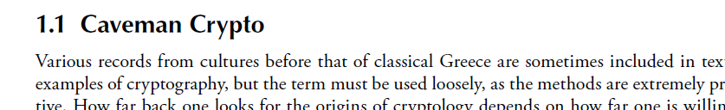
Running Key Cipher
Let’s encipher with a long passage. E.g. From a book
Conceptually the “simple” Vigenère, but with LONG key
  Plaintext: THISISMYSECRETMESSAGEUCANTREAD
  Book Passage: VARIOUSRECORDSOFCULTURESBEFORE*
  Ciphertext: OHZAWMEPWGQIHLAJUMLZYLGSOXWSRH
* Opening text from Chapter 1 of “Secret History: The Story of Cryptology” (2nd ed.)

Slide 34
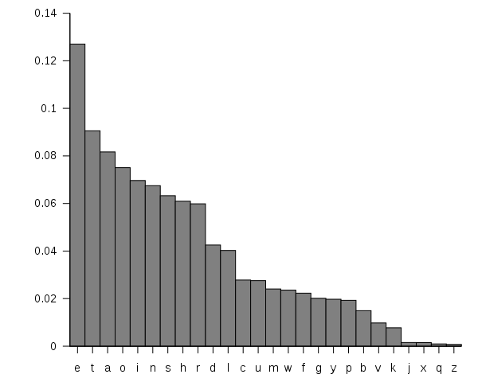
Running Key Cipher:
Kinda secure, but not quite…
Kasiski won’t work because the key never repeats
IC will only indicate that a large number of cipher alphabets was used
Problem: remember letters in a language are not random!
For English
  Plain E match with cipher E more common than plain Z match with cipher Z

Slide 35
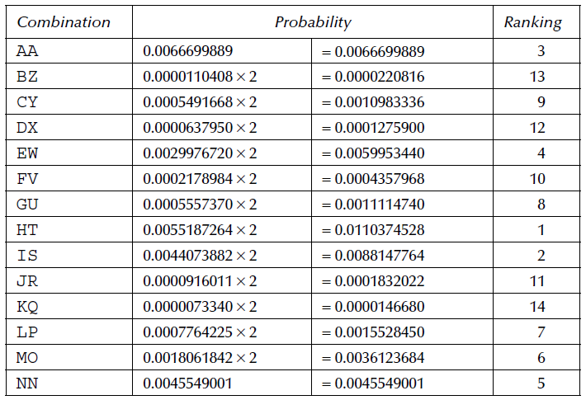
Example: Breaking a Running Cipher
Bauer 2.6 (p. 82)
We will work through the example from the Bauer text together.
Some key points / clarifications:
Suppose we see a ciphertext “A” that comes from a running key. Recall that this running key is assumed to be some kind of plaintext such as a book.
Looking at the tabula recta, what are the ways in which we can obtain a ciphertext A?
  A plaintext “A” matched with a key letter “A”
  A key “A” matched with a ciphertext letter “A”
  A plaintext “B” matched with a key letter “Z”
  A key “B” matched with a ciphertext letter “Z”
  …
  A plaintext “K” matched with a key letter “Q”
  Etc.
  If you had to guess, which key letter is more likely: A, B, K, etc. The answer is “A”. And sure enough, there are frequencies for all of these. The table at right shows the most likely pairings that would give a ciphertext A based on English language letter frequencies. That the top 3 most common are: HT, IS, and AA, EW, and NN.
  Someone has also gone in and calculated probabilities of the most likely pairings for every letter (see the text). The table at right shows us the most common ways to obtain the ciphertext letter “A”.
  Often, focusing on the 5 pairings with the highest probability will contain the actual ciphertext/plaintext combination that was used.
Plaintext/Key Combinations that will give the letter “A”, along with their probabilities.
This table tells us that the 5 most common combination sof key letter and plaintext letter that will results in a ciphertext A are:
H and T
I and S
A and A
E and W
N and N

Slide 36
Running Cipher Can Be Broken
What was the problem?
Answer: As ever….. Letter frequencies can be exploited. Any time our key ihas any kind of pattern to it, it exposes itself to attack.

Slide 37
The one-time pad
(aka vernam cipher)

Slide 38
Any New Ideas?
As discussed, the latest weakness in our encipherment journey is that we are using keys and messages made up of meaningful words.
Idea: How about staying with a nice long running key, but one in which the letters are completely random?
Yes! And it turns out that this is a cipher that is theoretically unbreakable.

Slide 39
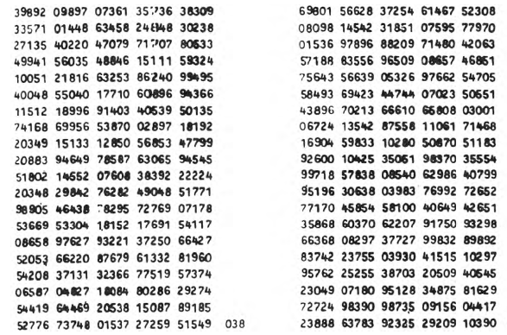
The One-Time Pad: Intro
The idea is that the key is:
Very long
Made up of random characters
Will only be used once
The ONLY thing that can be deduced about the message is its upper-bound length.
In fact, the message could be considerably shorter as people will sometimes pad the message to make it seem longer than it really is.
Essentially a running key cipher, but one in which every key character is selected at random.
Page from a one-time pad used by a Communist spy in Japan in 1961.

Slide 40
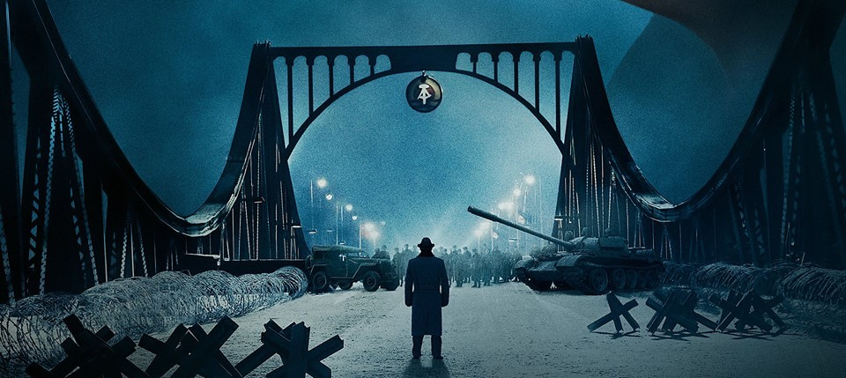
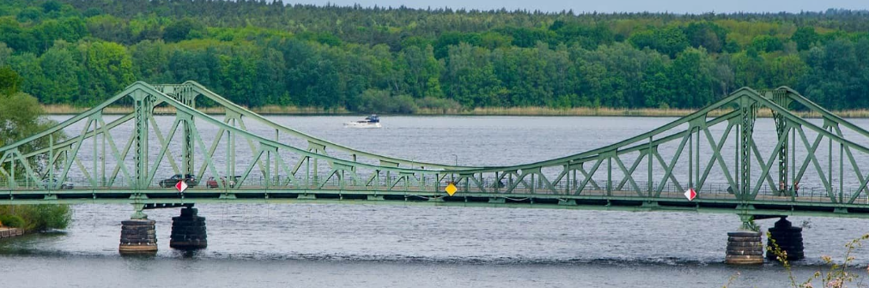
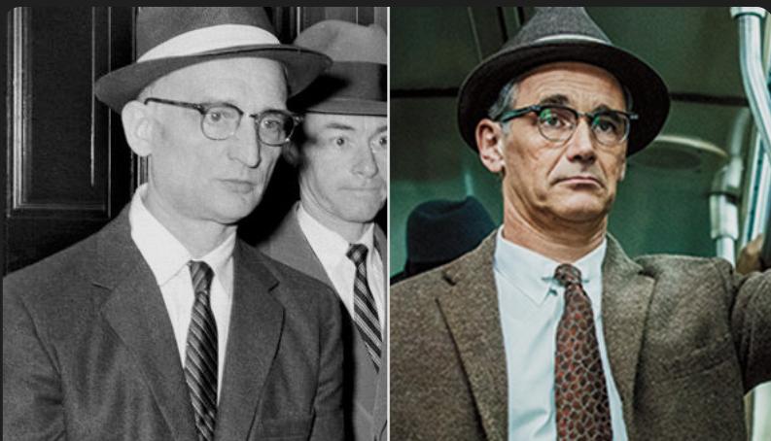
One-Time Pad: Real-World Uses
Powerful tool. Uses include:
Germany during WW1
OSS during WW2
CIA, Green Berets, Soviet Union, etc
When Che Guavera was killed in 1967 he was carrying a one-time pad.
Famous story of the capture of soviet spy Rudolf Abel. His downfall was being caught with a one-time pad in 1957. He was “traded” for American spy Francis Gary Powers. Depicted wonderfully in the 2015 movie “Bridge of Spies”.
Glienick Bridge (connecting East and West Berlin)

Slide 41
The One-Time Pad: Intro
The idea is that the key is:
Very long
Made up of random characters
Will only be used once
The ONLY thing that can be deduced about the message is its upper-bound length.
In fact, the message could be considerably shorter as people will sometimes pad the message to make it seem longer than it really is.

Slide 42
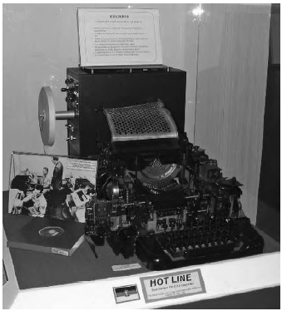
The “Hot Line”
The “hot line” depicted in countless movies and novels with which the American and Soviet leaders could communicate with each other employed one-time pad techniques. Set up after the 1963 shortly after the Cuban Missile Crisis (1962) during which misunderstandings and a lack of communication almost lead to the outbreak of war.
Both iconic and misunderstood. It was originally a text-based, secure teleprinter link established so that leaders could communicate quickly, reliably, and unambiguously during crises.
Was never a voice line!
The US and USSR delivered stacks of randomly generated OTP pages to each other via diplomatic pouches. Each page contained a long sequence of random characters or numbers. It was understood that they would be used only once.
Security for the world-changing communications was ensured through the use of a one-time tape.
Note the tape on the left side of the machine.

Slide 43
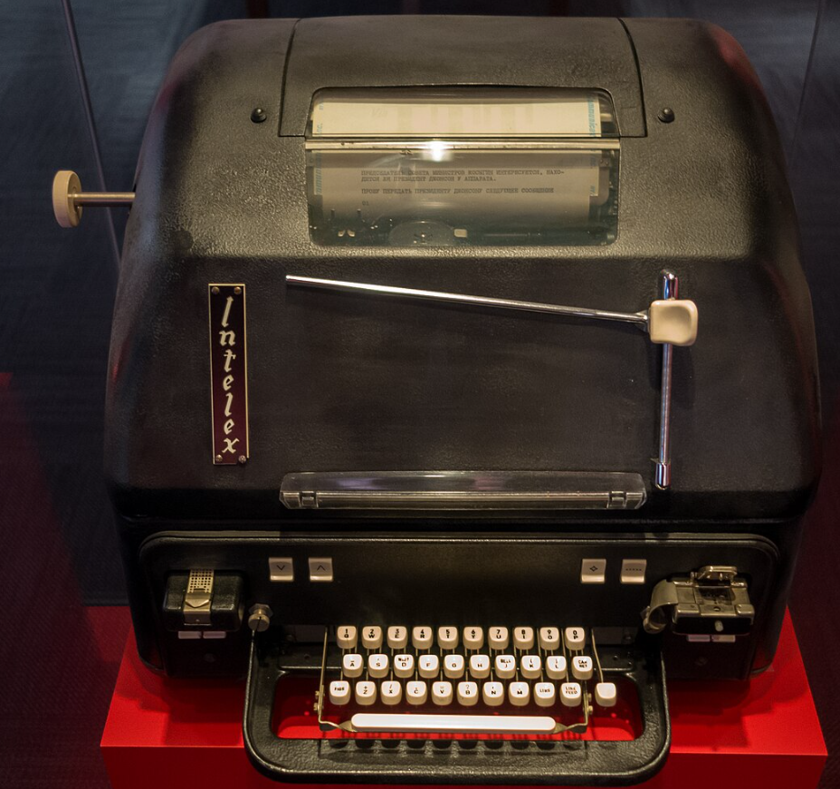
“Hot Line” Process
Encryption at origin:
A message is typed on the teleprinter.
Each character is matched with the next unused character from the OTP.
Encryption is typically done by mod 26 (letters) or mod 32 / mod 64 (teleprinter codes).
The resulting ciphertext is typed into the hotline link.
Decryption at destination:
Recipient receives ciphertext.
Applies the same OTP characters in the same order.
Subtracts the key mod 26 (or appropriate code).
Plaintext is recovered instantly.
Each side had to be careful to stay perfectly synchronized with key usage — if one side advanced the pad and the other didn’t, decryption would produce gibberish.
Key Lifecycle
After a page was used, it was burned or shredded.
New pages were periodically exchanged in sealed diplomatic pouches.
If a pouch were compromised, that entire batch of pad pages would be discarded.
The use of OTPs created absolute confidence that even if the physical hotline cable was intercepted, no intelligence value could be extracted.
The same model used by President LBJ to communicate with Moscow.

Slide 44
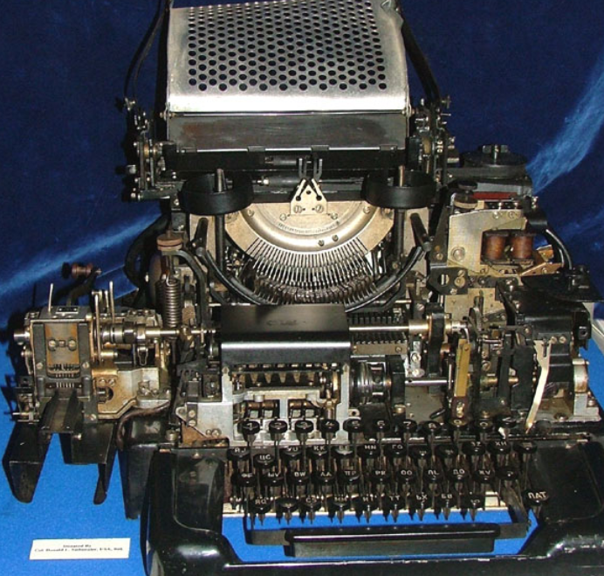
“Hot Line” Example: Six-Day War
Americans to USSR:
  “We have received indications of significant military actions in the Middle East. U.S. forces are not participating in these operations. We urge restraint and seek clarification of your intentions in the region.”
Moscow replied with:
  “Soviet forces are not engaged. We share your concern that the conflict may broaden. We will avoid steps that could cause misinterpretation.”
Note how these exchanges were structured to prevent the two superpowers from assuming the other was intervening militarily.

Slide 45
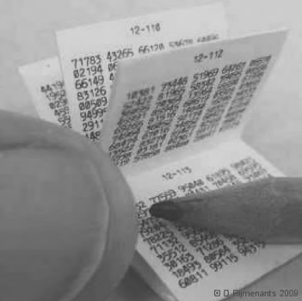
One-Time Pad: Downsides?
We apparently have an unbreakable cipher – why wasn’t it used everywhere?
#1 reason is key distribution: Imagine thousands or hundreds of thousands of messages. Generating an equal number of pages of keys and ensuring they are transported securely is a logistical nightmare – and certainly presents its own security risks.
Generating truly random numbers is far from trivial.
By “one time” – we mean one time! Using the same pad twice renders it susceptible to being broken.
  Using an OTP twice is no different than having a running key. (See Bauer for details)

Slide 46
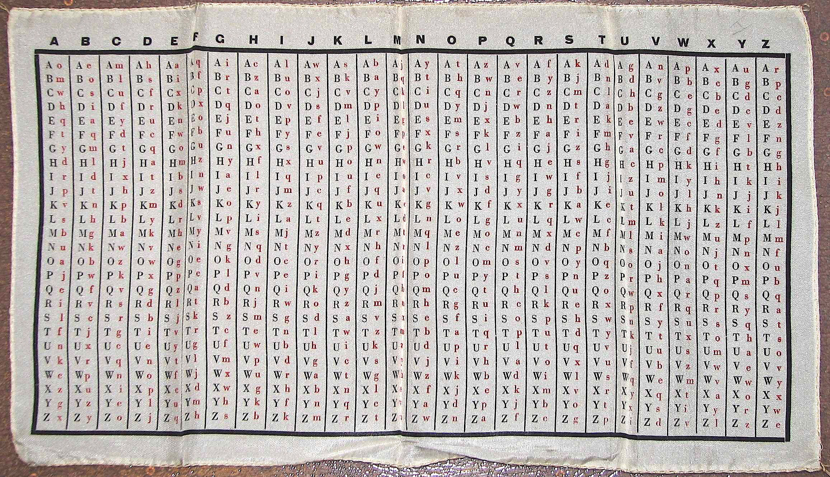
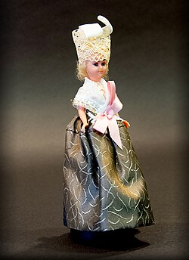
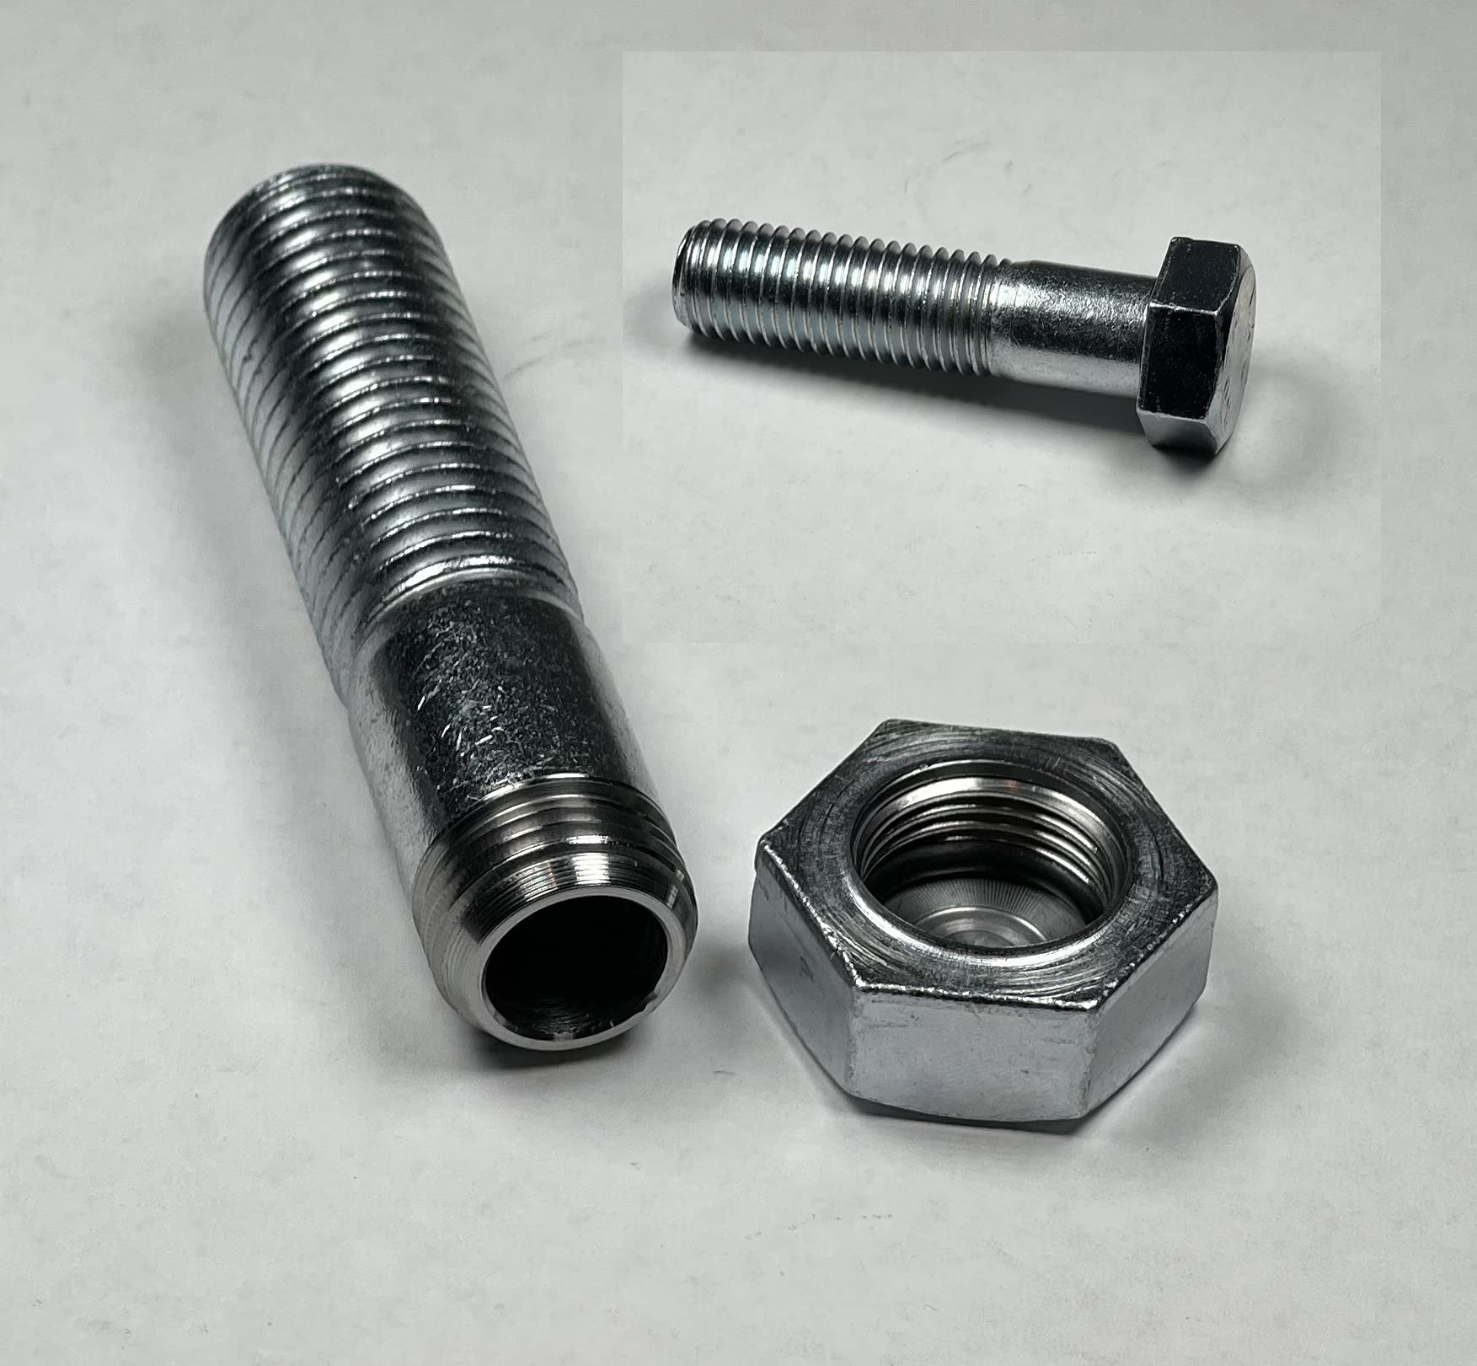
One-Time Pad: Need to carry the key!
An obvious downside to using the OTP system.
Techniques:
Issued on silk to undercover British agents in Nazi-occupied Europe
  No crinkling sound (critical in searches)
  Can be sewn into linings of coats, collars, hems, belts, hats
  Very thin
  Easily burned
  Can survive moisture (paper does not!)
Microdots (Nazi Abwehr, Soviet services)
  Inside punctuation in letters
  Reverse side of postage stamps
  Hidden under watch faces
Hollow materials
  Coins, Shoe soles, hollowed-out books
Silk OTP
Doll used by a German spy to smuggle
microdots into Nazi Germany
Hollow bolt

Slide 47
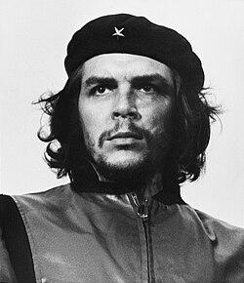
Why Am I Seeing Numbers?
As you’ve likely noticed, many of the OTP keypads are made up of numbers.
Adds an extra layer of security
Requires conversion to numbers. E.g. Che Guevera used Polybius cipher to first convert the text to numbers. Soviets used codebooks with numbers assigned to words.
OTPs for spycraft remained extremely popular well into the 20th century in spite of advances of machine encryption. One of the main reasons was that they can be used with pencil & paper – machines are difficult (and risky!) for spies to transport!

Slide 48
Randomness
Generating true randomness is hard to do!!
Yet it is essential in certain highly-specialized fields such as cryptography. As we’ve seen it’s necessary to make the OTP truly unbreakable.
Why?
Most things are “deterministic” (Newton’s laws of motion, Logic gates in computing, Maxwell’s equations in electricity, etc). If one knows initial conditions (e.g. position, momentum, velocity), the outcome is entirely determined.
If one builds a machine to generate numbers, it will follow rules not randomness.
Can’t we use a computer?
- Nope! Computers are deterministic
  Same input → Same output
  Same algorithm → Same sequence
Consider: random() → In fact, uses a formula to come up with a seemingly random number.
Known as a PRNG: Psuedorandom number generator.
To an attacker: Formulas = Patterns = Danger!
So how do we do it?
Physical processes – but can be very tricky to employ. Examples include cosmic (e.g. solar) radiation, radioactive decay, quantum events. Not trivial!
Known as “entropy sources”
In summary: “True randomness” is hard because the universe is mostly deterministic, computers are completely deterministic, and only a few physical processes generate truly unpredictable outcomes — and even those must be captured in huge quantities without introducing bias.

Slide 49
One Time Pads: What if you break the rules??
Let’s focus on two key components discussed previously, Randomness, and One-Time Use.
Randomness Requirement
Germans in WW2:
German foreign office (not military) used a system known as the “Foreign Office One-Time Pad” which was supposed to contain truly random sequences.
Used for sensitive diplomatic communications.
  You’d think they’d have known better after the Zimmerman catastrophe in WW1!
The Flaw: They used a pseudorandom number generator. There were extremely subtle – but exploitable – tendencies that included patterns, biases, unusual frequency distributions, etc. Specifically their machines tended to be somewhat deterministic based on their mechanical design.
Cracking the Code: Cryptanalysts from the US army’s Signal Security Agency (SSA) noted
  Some digits occurred more frequently than others
  Certain pairs of digits appears ore often
  Patterns of repetition
These tiny irregularities nevertheless allows the cryptanalysts to determine things such as:
  Identify when the same machine setting had been used twice
  Detect predictable patterns in the “random” digits
  Reconstruct parts of the key
  Exploit known-plaintext and guessed-plaintext (diplomatic messages often have predictable headers and phrases)
Note: The SSA did not break a true OT. -- they broke a flawed OTP in which the pad was created by a deterministic machine.

Slide 50
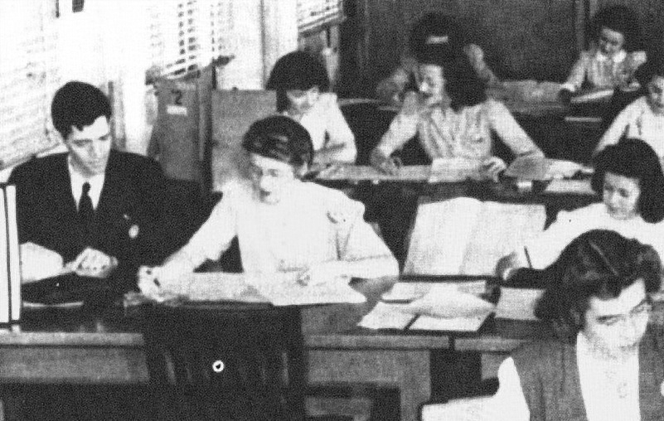
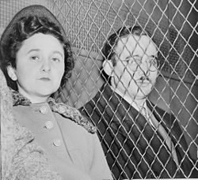
One Time Pads: What if you break the rules??
One-Time Use Requirement
VENONA Project
1943-1980s → declassified in the 90s
Created expressly to decrypt messages transmitted by Soviet intelligence agencies (NKVD, KGB, GRU)
Initiated by a mathematician, Gene Grabeel
During the cold war, the Soviets (accidentally) printed – and used – sections of some OTPs twice.
Even though the pads were randomly distributed across embassies and even over several years, American cryptanalysts involved with the VENONA Project eventually detected patterns which clued them in to code reuse.
VENONA decrypts revealed:
Existence of extensive Soviet espionage in the US – far beyond anything the Americans had previously imagined.
Code names and activities of spies
  E.g. Julius and Ethel Rosenberg
Soviet penetration of the Manhattan Project
Operations in Britan, Australia, and Canada
  Discovery of the Cambridge Five (Kim Philby, Anthony Blunt et al)
Many of the VENONA codebreakers were young women – highly unusual at the time.
Julius and Ethel Rosenberg
The VENONA project is considered one of the most important cryptanalytic episodes in history.
Notes:
Anthony Blunt working for the queen – AFTER she knew!

Slide 51
A Lesson to Cryptographers
A false sense of security is deadly (often literally!) in cryptography.
Notes:
The Germans believed they were using an unbreakable system.
But because their randomness was flawed, everything collapsed.
This parallels other failures:
VENONA (Soviets reusing pad pages)
Hagelin machine output predictability
Diplomatic codebook redundancies

