Slide 1

Introduction to Cryptology IT-233 Yosef Mendelsohn
Lecture #3:
Affine Ciphers
Affine Ciphers
Coprime Numbers & Multiplicative Inverse
Morse Code / Huffman Coding
Nomenclators

Slide 2
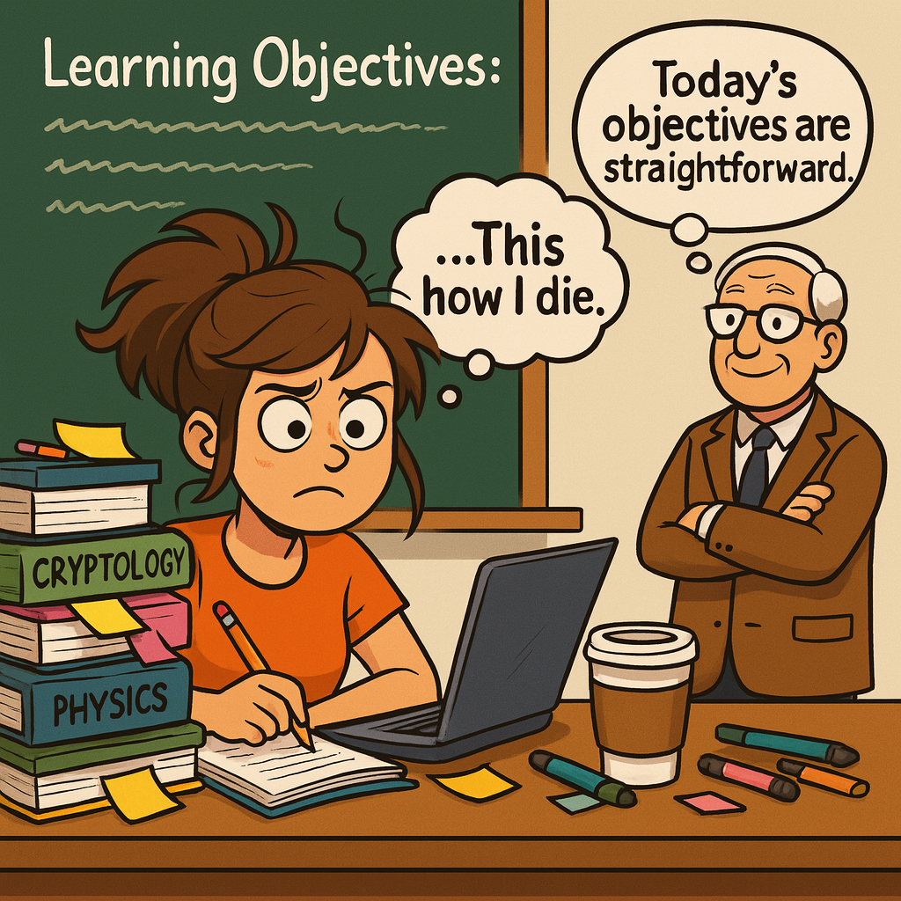
Lecture Objectives
Understand and apply the concepts of multiplicative inverse, coprime numbers, greatest common denominator
Encrypt and decrypt Affine ciphers given a key
Crack an Affine cipher given a crib

Slide 3
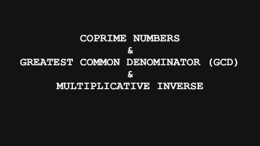
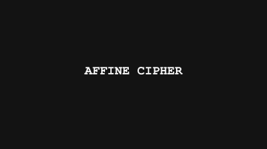
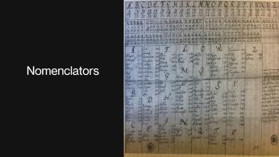
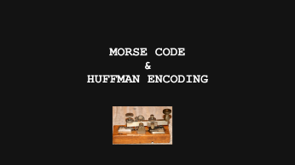
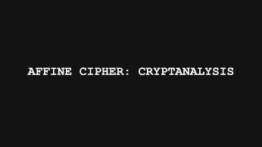
Lecture Overview

Slide 4
Affine cipher

Slide 5
Introduction
The Affine cipher is a variation on the Caesar cipher, but one in which we not only include a letter shift, but we also multiply by some value. While harder to crack than the Caesar cipher, the Affine cipher is not particularly powerful. In fact, it’s extremely susceptible to cryptanalysis in particular due to its small keyspace. However, by learning about the Affine cipher, we will introduce some topics that are extremely important to the study of cryptology. In particular:
Unique solutions / Reversibility
More modular arithmetic
Coprime numbers / greatest common denominator
Multiplicative Inverse

Slide 6
Affine Ciphers: Overview #1 Concept and Mathematical Foundation
OVERVIEW SLIDES
Don’t be alarmed if these overview slides are initially confusing to you. We will discuss all of the following points in detail over the course of the lecture. However, DO come back to these overviews as you review as they summarize the key concepts of this topic.
Affine Cipher Formula
Affine cipher uses the formula C = aP + b (mod 26) to encrypt plaintext letters with keys a and b.
Coprimality Requirement
'a' must be coprime with 26 to ensure the cipher can be decrypted using the multiplicative inverse.
Keyspace and Security
Affine cipher has 312 possible keys, larger than Caesar cipher but still extremely limited and easily breakable with a brute-force attack.
Role of Modular Arithmetic
Modular arithmetic and Euler’s totient function underpin affine cipher’s encryption and decryption processes.

Slide 7
Affine Ciphers: Overview #2 Encryption and Decryption Process
Affine Cipher Encryption
Each plaintext letter is converted to a number, then encrypted using the formula C = aP + b mod 26.
Decryption and Multiplicative Inverse
Decryption uses the multiplicative inverse of 'a' to retrieve the original message via modular arithmetic. The formula is: P = a⁻¹(C - b) (mod 26)
Security Limitations
Small keyspace: The affine cipher has a very small keyspace (312) making it trivially susceptible to breaking with brute-force attacks, rendering it insecure for real world use.
Monoalphabetic: We will shortly learn about “polyalphabetic” ciphers which increase security by increasing the keyspace.
Historical Importance
Affine ciphers incorporate modular arithmetic and inverse operations, bridging classical and modern cryptography.
Notes:
To encrypt using an affine cipher, each letter of the plaintext is converted to a numerical equivalent (A=0, B=1, … Z=25). The formula C = aM + b (mod 26) is applied to compute the ciphertext. For example, with key (11, 8), the letter H (7) becomes C = 11×7 + 8 = 85 mod 26 = 7, which corresponds to H again. Decryption requires finding the multiplicative inverse of 'a' modulo 26, denoted as a⁻¹, and applying M = a⁻¹(C − b) mod 26. For a = 11, the inverse is 19 because 11×19 mod 26 = 1. Using this inverse, the original message can be reconstructed. While affine ciphers are mathematically elegant, their security is weak due to the small keyspace and susceptibility to known-plaintext attacks. If two plaintext-ciphertext pairs are known, the attacker can solve for 'a' and 'b' using modular linear equations. This simplicity makes affine ciphers useful for learning purposes but unsuitable for real-world encryption.
Affine ciphers demonstrate the evolution from simple substitution systems to more mathematically grounded encryption methods. Their main strength lies in introducing modular multiplication, which adds complexity compared to Caesar shifts. However, the cipher’s weaknesses are significant: the keyspace of 312 is trivial for brute-force attacks, and frequency analysis remains effective because the cipher is monoalphabetic. Additionally, the requirement that 'a' and 26 be coprime limits key diversity. Cryptanalysis can exploit guessed plaintext fragments to derive the key algebraically. Despite these flaws, affine ciphers are historically important for illustrating modular arithmetic and inverse operations in cryptology. They serve as a bridge between classical ciphers and modern algebraic systems, highlighting why larger keyspaces and polyalphabetic approaches became necessary for secure communication.

Slide 8
Affine Cipher: Encryption
We increase the complexity of the Caesar Cipher: C = P + b (mod 26) by introducing a multiplier which we will call ‘a’
C = aP + b (mod 26)
Therefore, our key goes from: Key = b in the Caesar cipher, to: Key = (a,b)
That is, our key is made up of two different numbers.
Example: Using the key: K=(5,10), i.e. a=5, and b=10, determine the ciphertext letters for the following plaintext letters: QBYA
Answer: We start by convering each letter to a numbers
Remember that we always start with A=0
The PDF called “Mod26 Multiplication Table.pdf” will be convenient as it gives a handy cheat-sheet for the number to use with each letter.
You will end up using this table a LOT in this course, so keep it handy.
It will also be provided to you on exams.
Q
Q is represented by the number 16.
C=5*16 + 10 (mod 26) → 90 (mod 26) → 12 → M
B
C=5*1 + 10 (mod 26) → 15 → P
Y
C=5*24 + 10 (mod 26) → 0 → A
A
C=5*0 + 10 (mod 26) → 10 → K

Slide 9
Exercise: Affine Cipher, Encryption
Encrypt the following short message using the key (11, 8)
HOW ARE YOU? I’M AFFINE.
Answer:
Recall the Affine Cipher formula: C = aP + b (mod 26)
H=7, O=14, W=22, A=0, R=17, etc
H: C = 11*7 + 8 (mod 26) → 85 mod 26 → 7 → H (Yes, it’s the same letter, but that can happen and is not a problem).
O: C = 11*14*7 + 8 (mod 26) → 162 mod 26 → 6 → G
W: C = 11*22 + 8 (mod 26) → 250 mod 26 → 16 → Q
Etc.
Ultimately: HGQI NAMG USKI LLSV AZXV
Note:
I provided the ciphertext in groups of 4. Efforts must always made to transmit ciphertext in ways that do not give clues about the underlying message.
Groups of 4 or 5 letters are common.
I added a few random letters at the end. (“ZXV”) – to fill out the final group of 4. Once again, this is to remove any potential clues about the underlying message.
Remove punctuation.

Slide 10
Choosing an Appropriate Key
Encryption formula:
C = aP + b (mod 26)
However – there are some important restrictions that we must adhere to.
One very important requirement for an encryption system to work it the following: , Each plaintext character P must lead to one and ONLY one value for C.
This is referred to as the “uniqueness principle”.

Slide 11
Uniqueness: When decrypting a cipher, every ciphertext letter must resolve to only one plaintext letter.
Applied to the Affine cipher: Our formula must always give a unique value for C
C = aP + b (mod 26)
In an earlier example, we chose as our key (11, 8). In other words, the value we chose for a was 11.
When choosing a value for a there are some important restrictions that we must adhere to.
One absolute requirement for an encryption system to be decipherable is that: Any plaintext character P must lead to only ONE value for C. We sometimes say that there must be a unique solution. The reason for this requirement is that only with a unique solution can such an encryption system be decrypted with accuracy.
All classic ciphers depend on this.
This requirement limits the options that we can choose for ‘a’.
Uniqueness Principle: For an encryption system to be decipherable any plaintext character P must lead to only ONE possible value for C.

Slide 12
Affine Cipher: Collisions
Affine Encryption Formula:
C = aP + b (mod 26)
When two (or more) different values for P can lead to the same C, i.e. when more than one plaintext character can lead to the same ciphertext character, then the solution is not unique.
This means that our cipher can not be deciphered (or “reversed”) into a unique plaintext solution! Imagine a situation in which a given ciphertext character gave different plaintext characters as the solution. This would cause tremendous problems with decryption.
Consider the key K: (2, 10). Let’s encipher with the plaintext letter ‘B’, and then with the letter ‘O’
For B: C = 2*1+10 → 12 → M
For O: C = 2*14+10 → 38 (mod 26) → 12 → M
So we see that we have a “collision”. That is, two different plaintext letters gave the same ciphertext letter.
This means that when deciphering, we will not encounter a unique solution.
The problem was our having chosen a=2 for our multiplier.
We will next explore how to find acceptable values for a.
Sneak peek: It involves choosing an a for which the “coprime” of a and 26 is 1. So let’s start by learning about “coprime” numbers.

Slide 13
Coprime numbers & greatest common denominator (gcd) & multiplicative inverse

Slide 14
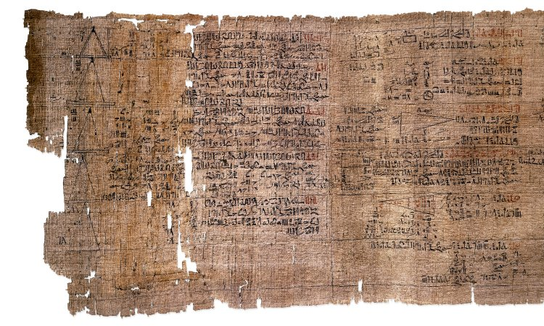
- Not covered -- Prime Numbers and Key Generation
Definition: Recall that a prime number (or simply, a “prime”) is a number greater than 1 that is not a product of any two smaller numbers. That is, it has exactly two divisors: 1 and itself.
Include: 3, 5, 7, 9, 11, 13, 17, etc.
Note that 1 is not technically a prime number because it does not have two divisors.
Role in Cryptography
Prime numbers are fundamental in cryptography, especially for generating secure keys in algorithms like RSA and DHKE.
Key Generation Process
Keys are created by multiplying two large primes to form a modulus used in public and private keys.
Security Through Factoring Difficulty
The difficulty of factoring large composite numbers protects private keys from unauthorized access.
The Rhind Mathematical Papyrus makes use of prime and composite numbers.

Slide 15
Coprime Numbers
The only way to ensure that we get a 1:1 map from a plaintext letter to a ciphertext letter (i.e. no collisions) is to choose a value for a such that the greatest common divisor of both a and 26 is 1.
Another way of saying this is that a and 26 must be coprime. (Or “relatively prime”).
Coprime: Two numbers are coprime if they have no common factors except 1.
A factor of a number is an integer that divides it exactly (i.e. no remainder).
For example, factors of 12 are 1, 2, 3, 4, 6, 12.
Factors of 14 are 1, 2, 7, 14
Factors of 21 are: 1, 3, 7, 21
Greatest Common Divisor (GCD): This is another way of referring to coprime.
To restate: Valid factors for ‘a’ require that gcd(a,26) = 1.
Examples:
Are the numbers 12 and 16 coprime?
Recall: To be coprime, two numbers must have NO common factors except for 1.
No. They share the factors 1, 2, and 4.
Are the numbers 12 and 15 coprime?
No. They share the factors 1 and 3. Again: Two numbers are coprime if their only common factor is 1.
Suppose we are choosing a value for a in our Affine cipher, and we choose 2. Is a=2 a valid choice?
Recall that a and 26 must be coprime. So are 2 and 26 coprime?
No! They share 1 and 2.
Suppose we are choosing a value for a in our Affine cipher, and we choose 5. Is a=5 a valid choice?
Yes, 5 and 26 are coprime as the only common factor they share is 1.
Two numbers are “coprime” if they have no common factors except for “1”.

Slide 16
Exercise: Coprime Numbers
Provide all factors of:
10
1, 2, 5, 10
9
1, 3, 9
8
1, 2, 4, 8
7
1, 7
26
1, 2, 13, 26
What is another way of referring to “coprime” numbers. Hint: On word in your answer will be “greatest”.
Two numbers are coprime if their greatest common divisor (GCD) is 1.

Slide 17
Exercises: Coprime and Greatest Common Divisor
What do we mean by the term coprime?
Answer: Two integers are coprime if their greatest common divisor is 1.
For the following indicate if the numbers are coprime. In all cases, indicate their factors:
14 and 20
Not coprime. They share the factors 1, 2, and 4. Recall that two numbers are coprime only if their greatest common divisor (i.e. their greatest factor) is 1.
14 and 21
No. They share the factors 1 and 3. Again: Two numbers are coprime if their greatest common divisor (factor) is 1.
What is the gcd(16, 24)?
Recall that GCD refers to greatest common divisor. Since the common factors of 16 and 24 are: 1, 2, 4, 8, the greatest common divisor is 8.
i.e. gcd(16,32) = 8.
What is the GCD requirement for choosing a in an Affine cipher?
gcd(a, 26) = 1.
What is another way of stating: gcd(a, b) must equal 1?
The numbers a and b are coprime.
Recall that when choosing a value for ‘a’ in an Affine cipher, a and 26 must be coprime. Suppose we choose 2. Are 2 and 26 coprime?
No! They share 1 and 2.
What is gcd(4, 26)? Is 4 a valid choice for ‘a’?
The factors are 1 and 2. So gcd(4,26) = 2. For a valid choice for ‘a’, the gcd must be 1. So 2 is not a valid value!
What is gcd(9, 26)? Is 9 a valid choice for ‘a’?
The only factor is 1. So this is a valid choice for a.
I fully appreciate that these questions are phrased in different, and possibly even confusing ways. However, the concepts are terminology are important, so do review these a few times until you really get it.

Slide 18
Calculating the Keyspace for Affine Cipher
b must be a value between 1 and 25
If b = 0, then there is no shift!
a must be coprime with 26
There are exactly 12 possibilities for a: 1, 3, 5, 7, 9, 11, 15, 17, 19, 21, 23, 25
See “Euler’s totient function” below
So the keyspace K is: K ∈ {a=1 & b=1, a=1 and b=2, a=1 and b=3…… a=2 and b=1, a=2 and b=2 ….. a=25 and b=25}
i.e. 12 * 26 = 312
This is a very small keyspace! We would not want to use this for real-world encryption.
Euler’s totient function (for background reading only):
A concept in number theory that counts how many positive integers are coprime (or “relatively prime”) to some number ‘n’. It is represented as: φ(n)
Note: The totient function does not tell us which numbers – just how many.
For example, recall that in calculating the keyspace for the Affine Cipher, we needed to know how MANY numbers were coprime with 26 * the number of possible values for b.
b = 26
a = φ(26) = 12
So we can now calculate the size of the keyspace: 12*26 = 312

Slide 19
Affine Cipher: Decryption
Affine Cipher encryption formula:
C = aP + b (mod 26)
The formula for decryption is:
P = a⁻¹(C - b) (mod 26)
The term a⁻¹ is called the “multiplicative inverse” of a
Multiplicative Inverse: The multiplicative inverse of some value ‘a’, is the number that gives us 1 when multiplied by a (mod 26).
Note that you DO need to know this term and have a (basic) understanding of what it means. However, never fear -- we will discuss it together.
Do NOT rephrase a⁻¹ as 1/a. In the context of modular arithmetic, it works differently.
In modular arithmetic, this expression means that we need to find some number x such that a*x ≡ 1 (mod 26)
There IS a slight difference between = and ≡ . We will discuss it later. Don’t worry about it just yet. Treat it as “=“.
In other words, we need to find some value for x so that when we multiply it by ‘a’ and take mod 26, we get a value of 1.
Good News!!! You do NOT have to do the math for this. Instead we will use the “Mod 26 Multiplication Table”.

Slide 20
Multiplicative Inverse: What it is, and How to Do It
PSA:
Coming up are a few busy-looking slides. But the truth is that the concepts are quite basic. The length of the slides is due to the fact that I am going to walk through the steps very slowly and systematically.
You may need to go through the slides a few times to get very comfortable with the overall concept, but I promise you that it is not that difficult! It just takes a little bit of time. (Not much time – but you do have to remain focused!)

Slide 21
Multiplicative Inverse: What it is, and How to Do It
Affine Cipher encryption formula:
C = aP + b
To decrypt, we must solve for P.
aP = (C-b)
Now the trick is to get rid of the “a”. You might be tempted to divide by “a” on both sides as is done in high-school math. So let’s review that:
How do we solve for P in the following equation? aP = (C-b)
Answer: Divide both sides by ‘a’. aP/a = (C-b) / a → P = (C-b) / a
This gets rid of the “a*P so we are left with: P = (C-b)/a
Example: If a=7, solve the formula for P:
Answer: If we have the formula → 7P = (C-b) → Then to get rid of the “a” (the 7), we multiply both sides by 1/7: 7*P/7 = (C-b)/7
Example: If a=13, solve the formula for P:
Answer: If we have the formula → 13P = (C-b) → Then to get rid of the “a” (the 13), we multiply both sides by 1/7: 7*P/13 = (C-b)/13
BUT WE HAVE A PROBLEM….. We must limit urselves to integers! That is, no fractions.
No doubt you are wondering why this is the case, but I’m afraid we are not going to get into it here as it would require getting a bit into the weeds with our modular arithmetic. Suffice to say, that because we are dealing with modular arithmetic, some additional constraints apply. In this situation, we can not deal with fractions. We must confine ourselves to integers, and keep them only as a numerator.

Slide 22
Multiplicative Inverse: What it is, and How to Do It
Affine Cipher encryption formula:
C = aP + b
To decrypt, we must solve for P.
aP = (C-b)
Once again: How do we get rid of the “a”? Recall that we can not divide by a since we are not allowed to use division. We must confine ourselves to integer numbers, and keep those integers in the numerator. In other words, we can not “divide” by anything!
So the new queston becomes: Is there some integer number that I can MULTIPLY to “a” to convert that “a” into a 1? If so, that gets rid of the “a” on the left-hand side of the equation.
Do note that would also have to multiply the right side of the equation by that same number.
In other words: (???? * a)P = ????? (C-b)
Okay, that’s not mathematically elegant. Recall that we 1)want an integer, and 2)need to keep it on the numerator. So let’s call this a-1
So now we have: (a⁻¹ * a)P = a⁻¹ (C-b)
The term a⁻¹ is called the “multiplicative inverse” of a.
By “multiplicative inverse” we are saying that we want an inverse of value for “a” such that when we multiply this value by “a” we get 1.
If we were allowed fractions, the inverse would simply be 1/a.
But we aren’t! It must be in the NUMERATOR. It must also be an integer.
The good news is that in this case, the fact that we are working with modular numbers makes it pretty easy.

Slide 23
Multiplicative Inverse: What it is, and How to Do It
So now we have: (a⁻¹ * a)P = a⁻¹ (C-b)
The term a⁻¹ is called the “multiplicative inverse” of a.
The good news is that in this case, the fact that we are working with modular numbers makes it pretty easy.
Recall that our formulas all are intended to work with mod-26. So our formula should properly be written as:
(a⁻¹ * a)P = a⁻¹ (C-b) mod26
So now that we recall that we are working with mod-26, let’s do a couple of mod-26 problems:
Suppose that a=7:
What is a*2 mod 26? → Answer: 14 mod 26 = 14
What is a*3 mod 26? → Answer: 21 mod 26 = 21
What is a*4 mod 26? → Answer: 28 mod 26 =2
What is a*5 mod 26? → Answer: 35 mod 26 = 11
What is a*15 mod 26 → Answer: 105 mod 26 = 1
REMEMBER OUR QUESTION: What value can we multiply by a (mod26) such that the product is 1? Well if a=7, then if we multiply 15 and do mod 26, we will indeed get a 1. In other words, the multiplicative inverse of 7 is 15.
To bring it back to our original formula: aP = (C-b) → if we multiply BOTH sides by the multiplicative inverse of a, i.e. a-1, we end up with:
(15*7)P = 15(C-b) mod26 → 15*7(mod26) = 1, so we are left with:
P = 15 *(C-b) mod26 → THIS IS OUR DECRYPTION FORMULA!

Slide 24
Multiplicative Inverse: What it is, and How to Do It
Example: Given a key of (15, 23), determine the decryption formula for the Affine cipher.
Affine Cipher encryption formula:
C = aP + b mod26
To ecrypt, we must solve for P.
aP = (C-b) mod26
To get rid of the ‘a’, we must multiply both sides by a⁻¹ (the multiplicative inverse):
a⁻¹*aP = a⁻¹*(C-b) mod26
So if a=15, what is a⁻¹? Recall that the multiplicative inverse is the number is asking: “What number do we multiply by such that the product is ONE?”
What is a*1 mod 26? → Answer: 15 mod 26 = 15
What is a*2 mod 26? → Answer: 30 mod 26 = 4
What is a*3 mod 26? → Answer: 45 mod 26 = 19
What is a*4 mod 26? → Answer: 60 mod 26 =8
What is a*5 mod 26? → Answer: 75 mod 26 = 23
What is a*6 mod 26 → Answer: 90 mod 26 = 12
What is a*7 mod 26 → Answer: 105 mod 26 = 1 → We have FOUND the number that when multiplied by a (i.e. 15) mod26 results in 1.
So given the key: (15,23) the formula for decryption is: P = 7*(C-23) mod26

Slide 25
Multiplicative Inverse: What it is, and How to Do It
Example: Given a key of (9, 16), determine the decryption formula for the Affine cipher.
Affine Cipher encryption formula:
C = aP + b mod26
To ecrypt, we must solve for P.
aP = (C-b) mod26
To get rid of the ‘a’, we must multiply both sides by a⁻¹ (the multiplicative inverse):
a⁻¹*aP = a⁻¹*(C-b) mod26
So if a=9, what is a⁻¹?
What is a*1 mod 26? → Answer: 9 mod 26 = 9
What is a*2 mod 26? → Answer: 18 mod 26 = 2
What is a*3 mod 26? → Answer: 27 mod 26 = 1 → We have FOUND the number that when multiplied by a (i.e. 3) mod26 results in 1.
So given the key (9,16), the formula for decryption is: P = 3*(C-16) mod26

Slide 26
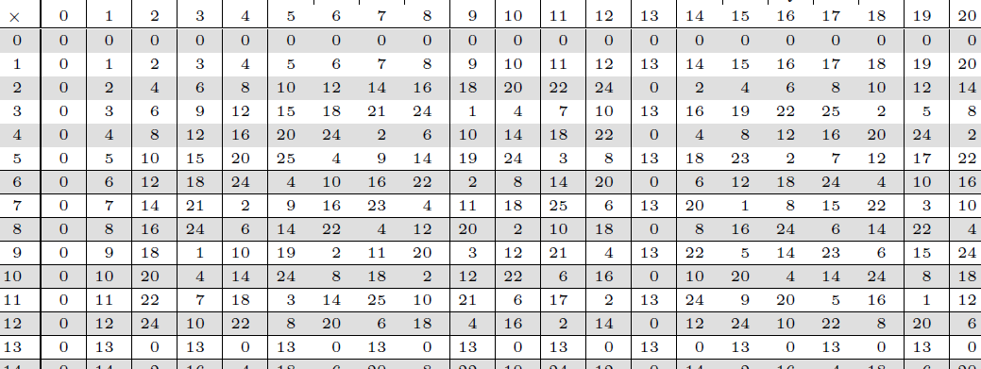
Multiplicative Inverse – Using a Table
Rather than painstakingly going through all the multiplication values until we find a 1, we can use our “Mod26 multiplication table” PDF document as follows:
Example:
Suppose that a=11. What is the multiplicative inverse of a? i.e. What is a⁻¹?
Use the Mod 26 Multiplication Table, go down the first row of numbers until you find 11. Note that 11*0 mod 26 = 0. 11*1 mod 26 = 11, 11*2 mod 26 = 22, 11*3 mod 26 = 7. Continue until you find a number such that 11*?? mod 26 = 1. This happens at 19.
So 11⁻¹ = 19.
Exercise: Suppose a=3. What is the multiplicative inverse of a?
Answer: Beginning at the row labeled 3, note that 3*0 mod 26=0, 3*1 mod 26=3, etc etc. However, when we reach 9, we see that 3*9 mod 26=1. Therefore the “multiplicative inverse” of 3 is 9. i.e. 3⁻¹ = 9. Rephrased: If a = 3, then a⁻¹ = 9.

Slide 27
Exercise: Multiplicative Inverse
Example: Given a key of (23, 5), determine the decryption formula for the Affine cipher. Use your mod26 table to save you a bunch of tiresome calculations!
Affine Cipher encryption formula:
C = aP + b mod26
To decrypt, we must solve for P.
aP = (C-b) mod26
Find the multiplicative inverse of a (i.e. 23) using the table.
For the row “23”, we see that 23*0 mod 26=0, 23*1 mod 26=23, 23*2 mod 26=20 etc etc until we find that 23*17 mod 26 = 1.
So a⁻¹ = 17. Therefore, given the key (23, 5), the formula for decryption is: P = 17*(C-5) mod26

Slide 28
Affine cipher: cryptanalysis

Slide 29
Example: Affine cipher – Decryption
Recall the ciphertext we came up with earlier: HGQI NAMG USKI LLSV AZXV
You are the recipient of this message sent by your partner in crime. Your partner has previously notified you that the key will be (11, 8). Decipher this message.
To start with, I will remind you of the formula for Affine decryption: P = a⁻¹(C - b) (mod 26)
Answer:
We first need to determine the multiplicative inverse of a.
a=11, therefore, 11⁻¹ = 19.
So our decryption formula is: P = 19(C-b) (mod 26)
For H: P = 19(7-8) mod 26 = -19 mod 26
Wait – how do we take the modulo of a negative number? Answer: Simply ADD the modulus: -19+26 = +7. = “H”
Or you can just use your calculator! -19 mod 26 = 7
For G: P = 19(6-8) mod 26 = 14 = O
For Q: P = 19(16-8) mod 26 = 22 = W
Etc.

Slide 30
Exercise: Affine cipher – Decryption
Note: In the “real world”, the person enciphering the message would not place the space between the words in its rightful spot. They would either provide the ciphertext as one long string of letters:
MXGGVSXADZG
Or chosen sequences of something like 4 or 5 characters:
MXGG VSXA DZG
In addition, to keep the above 4-character sequence consistent so as to avoid giving any additional clues, they would probably add some random character at the end:
MXGG VSXA DZGQ
Given a key of (5, 3) decipher the following ciphertext: MXGGV SXADZG
Answer:
Formula for Affine decryption: P = a⁻¹(C - b) (mod 26)
Multiplicative inverse:
a=5, therefore, 5⁻¹ = 21.
M (i.e. 12): P = 21*(12-3) = 189 → 189 mod 26 = 7 → H
X (i.e. 23): P = 21*(23-3) = 420 → 420 mod 26 = 4 → E
…
A (i.e. 23): P = 21*(0-3) = -63 → -63 mod 26 = 15 → P
Etc.
Ciphertext (i.e.C) | M | X | G | G | V | S | X | A | D | Z | G
Numeric Value | 12 | 23 | 6 | 6 | 21 | 18 | 23 | 0 | 3 | 25 | 6
Plaintext (i.e. P) | 189 | 420 | 63 | 63 | 378 | 315 | 420 | -63 | 0 | 462 | 63
P mod 26 | 7 | 4 | 11 | 11 | 14 | 3 | 4 | 15 | 0 | 20 | 11
Plaintext Letter | H | E | L | L | O | D | E | P | A | U | L

Slide 31
Affine Cipher: Further Weakness (and a little more math – sorry!)
In addition to the small keyspace which means that a brute-force attack will almost certainly reveal the message, another weakness is that if we can figure out the plaintext for just two of the ciphertext letters, we can determine the key. This might happen by frequency analysis, or any of the means discussed at an earlier point in this course.
In this case, let’s keep it simple. Suppose we intercept a message, and we’re pretty sure it begins with the salutation “Dear” as in “Dear John”. Suppose that the first two ciphertext letters are R and A.
Knowing just those two mappings, D → R and J →A is enough to crack the entire cipher!
It will involve further modular math, but as always, we will go through it together and with just a little review and practice, you can certainly get comfortable with it.

Slide 32
Affine Cipher: Cracking the Code With Known Plaintext Characters
Note: The next 2 examples are taken directly from the Bauer text. Feel free to review these examples there if you want more detailed explanations.
Suppose we intercept a message, and we’re pretty sure it begins with the salutation “Dear”* as in “Dear John”. Suppose that the first two ciphertext letters are “R” and “A”.
Recall the Affine cipher encryption formula: C = P*a + b (mod 26)
We know that one plaintext character is D and it corresponds to the ciphertext character R.
Therefore
“R” = “D”*a + b (mod 26)
We also know that another plaintext character is E and it corresponds to the ciphertext character A:
“A” = “E”*a + b (mod 26)
Replacing letters with numeric equivalents:
17 = 3a + b
0 = 4a + b
Next we solve the two-equation system to arrive at values for a and b.
* When we have a KNOWN bit of plaintext, such as the word “Dear” in this example, this is known as a “crib”.
Cribs have played a massive role in cracking codes even into the modern age. For example, The German Enigma machine was broken in part due to the fact that many messages signed off with “HH” for “Heil Hitler” or used the word “wetter” for “weather” (as in “weather report”).

Slide 33
Affine Cipher: Cracking the Code With Known Plaintext Characters, contd.
Given:
17 = 3a + b
0 = 4a + b
There are various ways of solving including:
Linear algebra
Solve for one variable in one equation and replacing it in the other
Subtract one equation from the other to eliminate one of the unknown variables
Choose whichever you think is easiest. This can change depending on the formula you end up with. In this case, I think option C is a good choice since it will allow us to remove ‘b’ from the equation. That way we can easily calculate ‘a’.
17 = 3a + b
- (0 = 4a + b)
=============
This yields:
17-0 = 3a-4a + b - b
Which results in: 17 = -a (which is the same as: a=-17)
→ Don’t forget that all values are mod-26 i.e. a = -17 (mod 26) → Therefore: a = 9
Now that we have our value for a, we can plug it into either formula: 0 = 4a+b → 0 = 36 + b → b = -36 (mod 26) → b = 10
We have come up with the key (a=19, b=10) and have therefore cracked the cipher!!!
Don’t forget that everything we do is mod-26….
I have left it out in places so as to reduce clutter.

Slide 34
Exercise: Cracking Affine Cipher With Known Plaintext Characters
A message is intercepted in which we guess that the very last 2 letters are the initials of the sender: “C.Y.” The ciphertext values are: “L.D.”. Determine the key for this Affine cipher.
Hint: Towards the end, you will probably need to consult your Mod26 Multiplication Table
Hint #2: You may find that you run into a little snag at the very very end!
ANSWER: Encryption formula: C = P*a + b (mod 26)
L = C*a + b
D = Y*a + b
Replacing letters with numeric equivalents:
11 = 2a + b
3 = 24a + b
Next we solve the two-equation system to arrive at values for a and b.
11 = 2a + b
- (3 = 24a + b)
8 = -22a → 22a = -8 (mod26)→ Note that the right side of the equation is -8 mod 26 → -8 mod 26 = 18.
So: 22a = 18
Now go to the mod26 multiplication table and look along line 22 to see what you need to multiply it by to get 18. Turns out to be 2 and also 15!!
This means if we try to solve for b, we will get 2 different possible answers. The only way around this at the moment is to decrypt the ciphertext using both values for ‘a’ and seeing which one gives us proper plaintext. More on this next…

Slide 35
Affine Cipher: Cracking the Code With Known Plaintext Characters Did we just violate the “uniqueness” requirement???
You might be tempted to ask if we didn’t just violate the requirement that the key must always give a unique ciphertext for a given plaintext message?
In fact, we did not! The uniqueness rule means that a given plaintext letter must give one and only one (i.e. unique) ciphertext letter.
However in the previous example, we were starting with ciphertext and working backwards. In this particular example, the two ciphertext / plaintext letters we knew got us pretty close to a solution (a value for ‘b’, and 2 possible values for ‘a’), but not perfect.
Look at the last equation we had when trying to solve for ‘a’: 22a = -18 (mod 26). The fact that we had 2 possible solutions simply tells us that we do not yet have enough information to get a definitive value for ‘a’. We would need to try and figure out another ciphertext / plaintext pair which would almost definitely do the trick. Or we could simply decipher using both values for ‘a’. One result would be English and the other would be gibberish. This would give us our answer!
Put another way:
The rule that ‘a’ must be coprime with 26 ensures that a given key always EN-crypts uniquely.
The rule does NOT guarantee that a cryptanalyst can determine the key uniquely if they only have limited data. Like any other puzzle, you need enough clues to start with if you wish to solve it.
In fact, this is very typical in cryptanalysis:
Not enough data → Multiple candidate keys
Enough data → Should be enough to determine the unique key

Slide 36
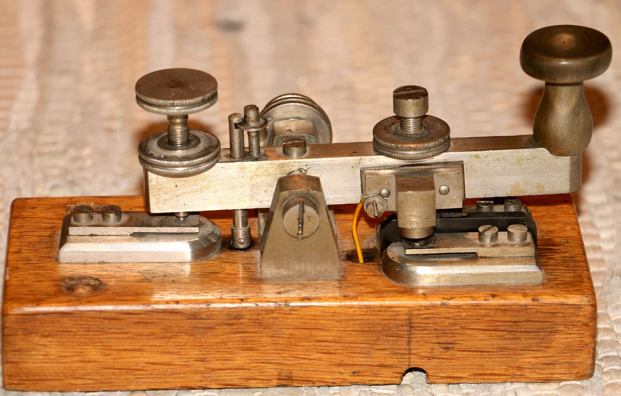
Morse code & Huffman encoding

Slide 37
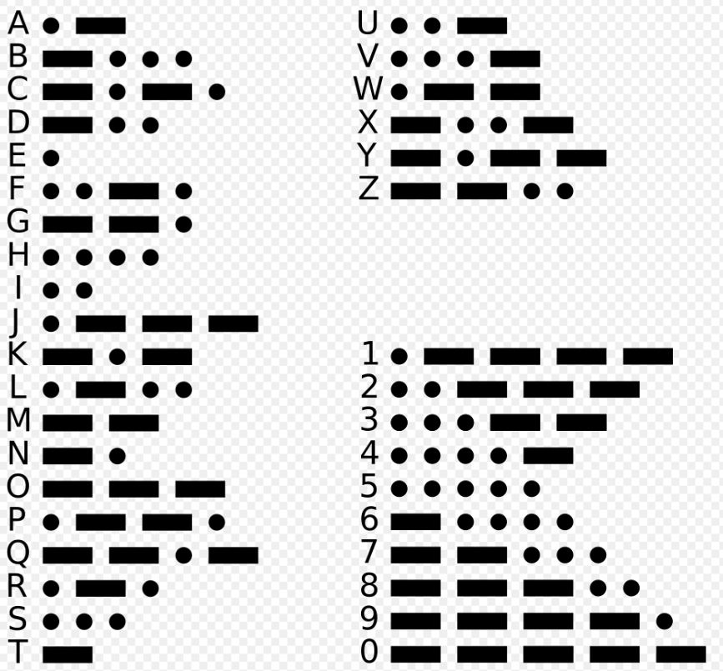
Morse Code as a Communication System
Encoding System Design
Morse code encodes letters and numbers using dots and dashes with fixed, public mappings.
Efficiency Optimization
Common letters have shorter codes to reduce transmission time, optimizing communication speed.
Military and Maritime Use
Morse code was vital for military and maritime communication, with SOS as the universal distress signal since 1909.
Versatility and Historical Impact
Morse code's use in unique situations highlights its adaptability beyond normal communication. (e.g. Jeremiah Danton blinking “torture”)

Slide 38
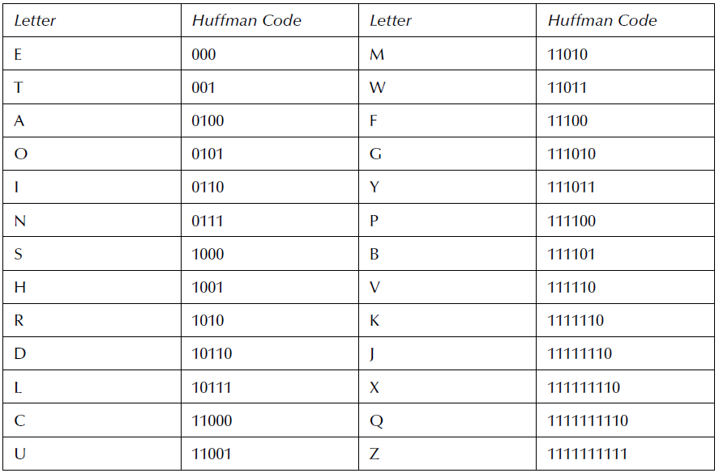
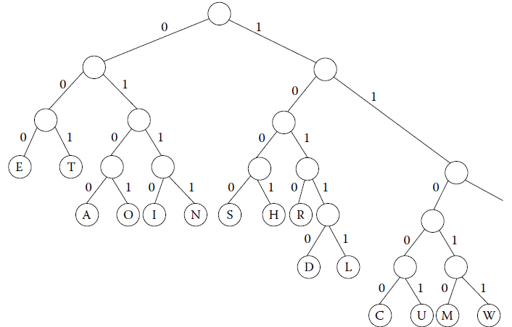
Introduction to Huffman Coding
Data Compression Technique
Huffman coding (1952) is intended as a method for data compression. Widely used in compression formats such as ZIP and image formats such as JPEG.
Variable-Length Codes
Huffman coding assigns shorter codes to frequent characters, optimizing compression efficiency.
Binary Tree Construction
Huffman algorithm builds a binary tree where paths represent codes to minimize redundancy. (Redundany can be a handle upon which codebreakers attack your cipher).
Not Encryption
But worth learning about as it serves as an introduction to entropy and redundancy which will be discussed later in the course.

Slide 39
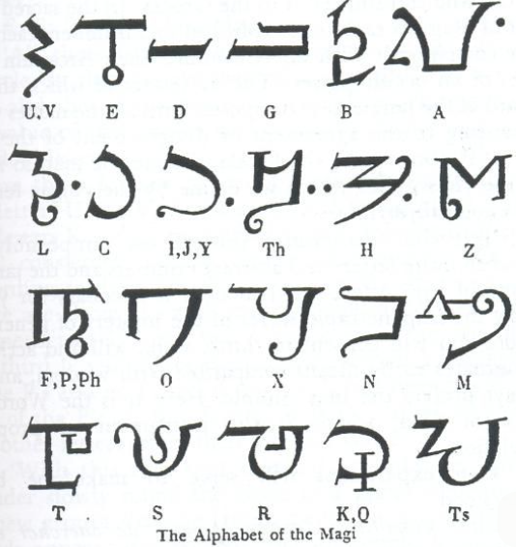
MASCs: Variations and Historical Legacy
Medieval Cryptology Stagnation
The Middle Ages and even into the Renaissance saw little innovation and slow development in cipher systems.
But interest can still be spotted on the historical record.
Innovations rare e.g. Polybius square essentially unimproved until the Rensaissance
Early Cryptographic Documentation
Figures like Roger Bacon documented cryptographic ciphers even in early European scientific texts.
Cryptology in Literature and Mysticism
Chaucer incorporated cryptographic elements in some of his writings and scientific interests. Alphabet of the Magi show cryptography’s intersection occult interests.
Cultural Significance and Evolution
Over time, cryptology evolved from an esoteric art to an increasingly scientific discipline.
Alphabet of the Magi
Seen in many occult practices over the centuries.

Slide 40
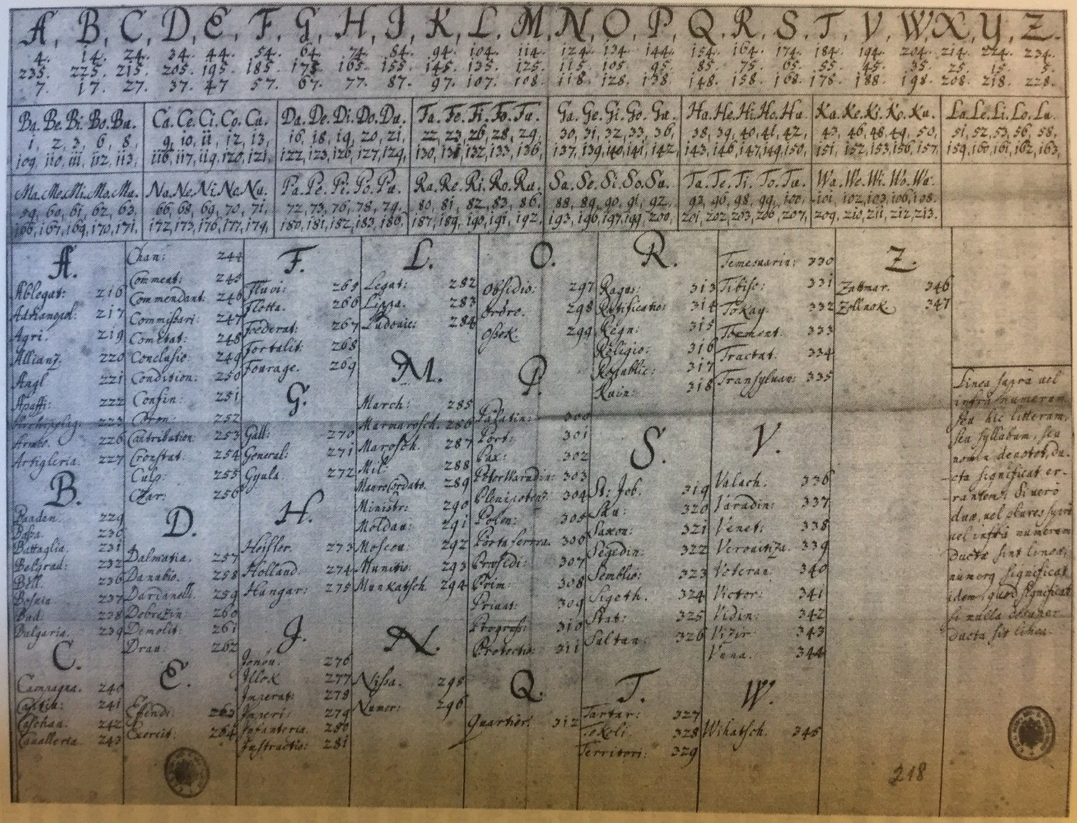
Nomenclators

Slide 41
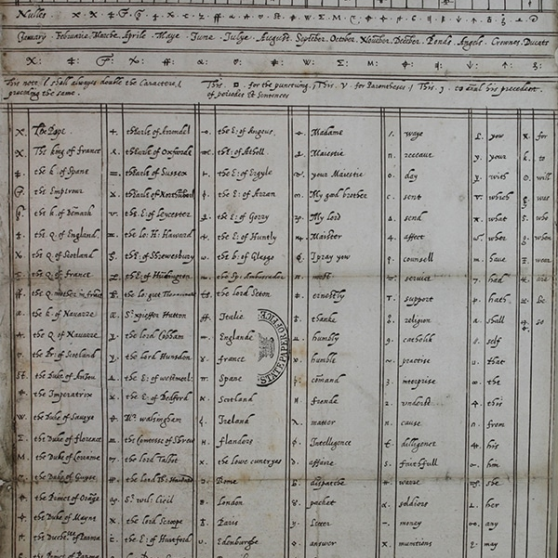
Nomenclators
Hybrid Cryptology Approach
Nomenclators combined monoalphabetic ciphers with codebooks to improve communication security and efficiency.
Dominated European Cryptology 15-18 Centuries
There was not a great deal of mathematical innovation for crypotology during this period. Many relied on nomenclators for security – which turned out to be a pretty bad idea!
Codebook Functionality
Codebooks included names, titles, and common expressions to simplify encoding frequent terms.
Cryptanalysis Vulnerabilities
Despite this increased sophistication, nomenclators were also susceptible to familiar codebreaking techniques such as pattern analysis and codebook capture.
Legacy in Security Design
Nomenclators anticipated modern layered security by balancing ease of use with secrecy.

Slide 42
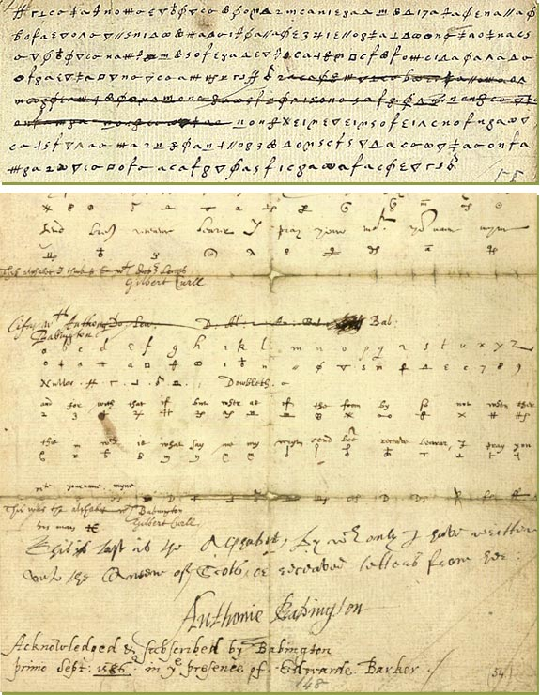
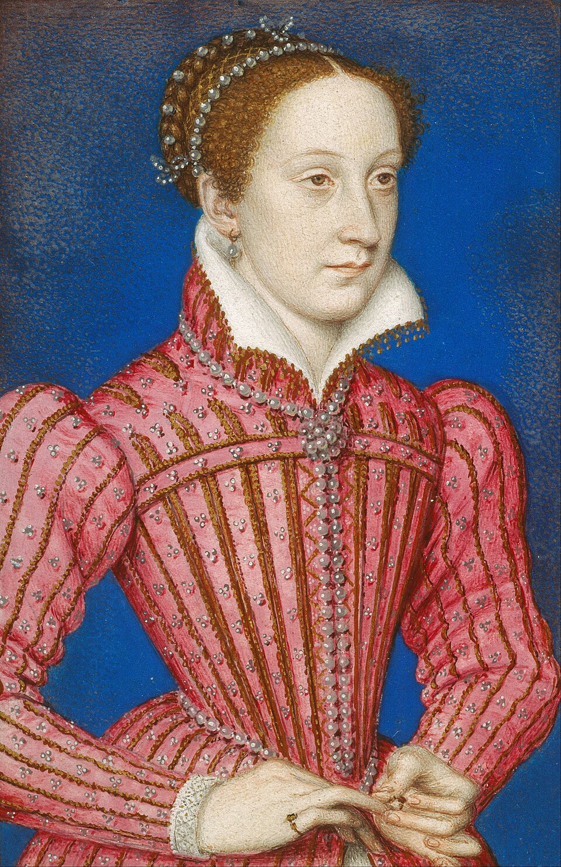
Historical Example: Mary, Queen of Scots
Execution of Mary Queen of Scots: Babington Plot Cipher
Mary, Queen of Scots used a nomenclator cipher in her plot to overthrow Queen Elizabeth I. Communications were hidden in barrels and other places by which she corresponded with her coconspirators. Her choice of cipher combined with careless application ultimately resulted in Mary’s conviction and subsequent execution.
Cryptanalysis of Baggington’s cipher by Thomas Phelippes
Thomas Phelippes, a linguist employed his skills to exploit cipher weaknesses in her cipher, demonstrating the impact of flawed encryption on security outcomes.
Mary, Queen of Scots

Slide 43
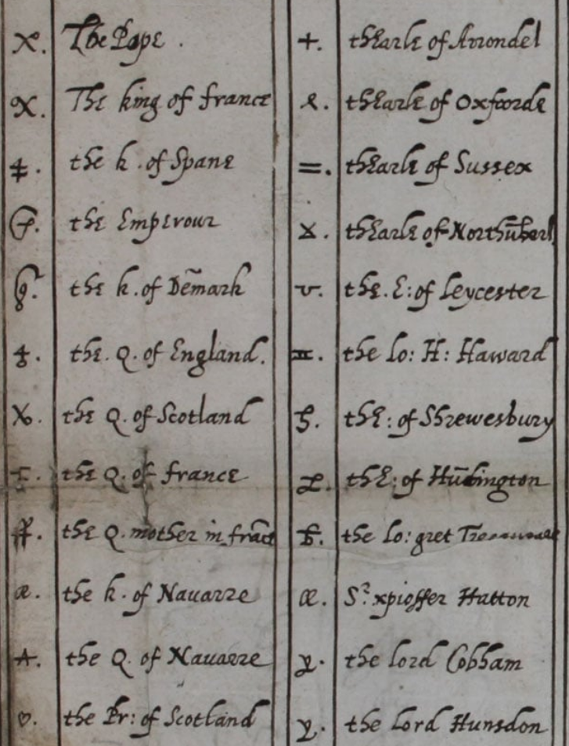
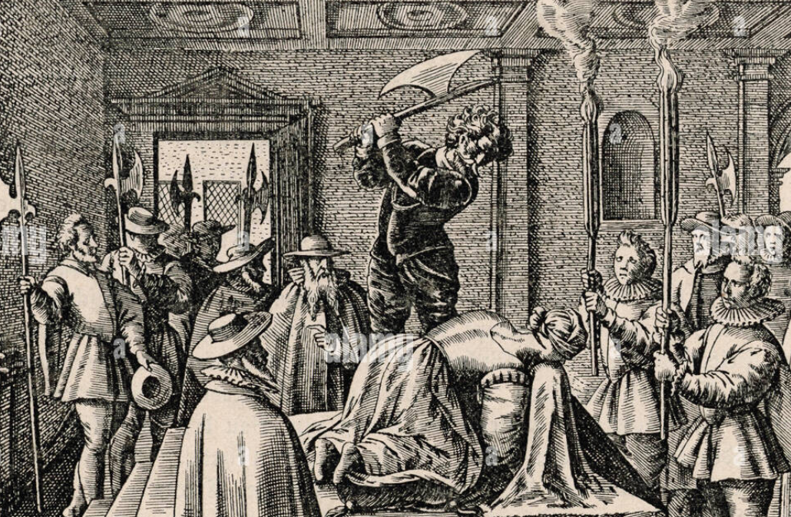
Codebook
Shown here is a close-up of a codebook used in the Babbington Plot.
Note symbols for:
The Queen of England (i.e. Elizabeth I)
The Pope
The king of France
Earl of Sussex
Discovery of this plot lead directly to the execution of Mary I.

Slide 44
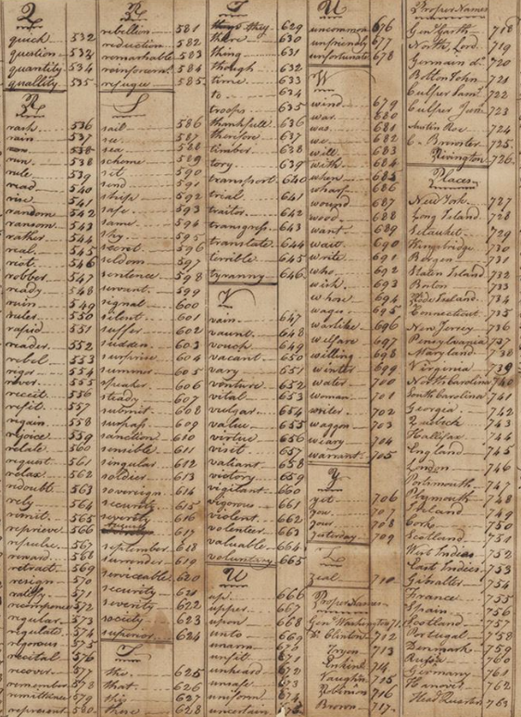
Historical Example: Culper Spy Ring (American Revolution)
Washington organized a spy ring in 1778 to obtain information about enemy (British) movements, embattlements, and future plans.
This spy ring used a nomenclature system in which the primary tool was a codebook that had almost 1,000 locations, names (cities and people) and key words encoded as numeric values. It was surprisingly effective.

Slide 45
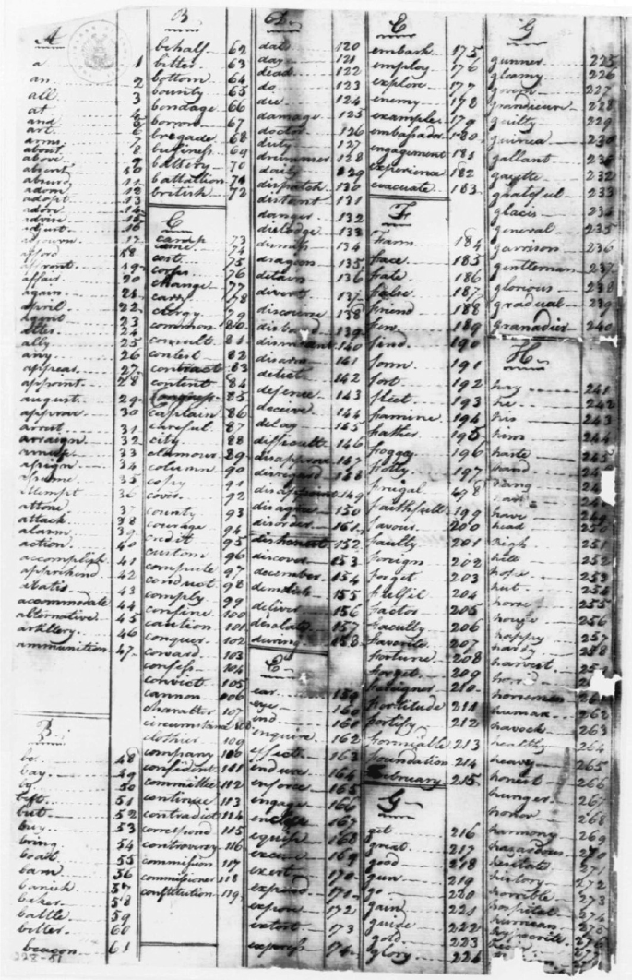
Impact on Cryptology
Role of Nomenclators
Nomenclators bridged simple substitution ciphers and advanced polyalphabetic systems in cryptographic history. (e.g. Vigenere cipher)
Key Distribution Challenges
Reliance on codebooks introduced key distribution and management challenges still relevant today.
Legacy and Influence
Nomenclators influenced diplomatic codes and innovations leading to machine ciphers and algorithmic encryption.
Continuous Cryptographic Evolution
Their legacy highlights adaptability and the ongoing evolution of cryptographic practices.

