Slide 1
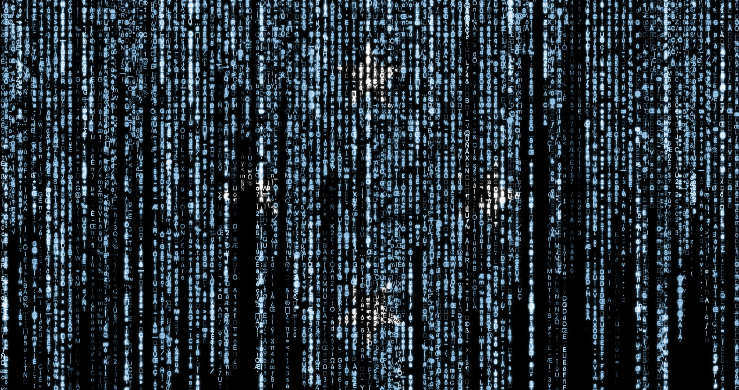
Introduction to Cryptology
IT-233
Yosef Mendelsohn
Lecture #2:
Monoalphabetic Substitution Ciphers (MASCs)
Shift Ciphers (e.g. Caesar)
Polybius Cipher
Language Analysis (frequency, patterns, etc.)
Modulo Operations

Slide 2

Lecture objectives
Understand and apply modulus 26 calculations
Understand the basic concepts behind frequency and pattern analysis.
    This topic is important and will be used throughout the duration of the course.
Know how to encipher and ecipher the following:
    Polybius cipher
    Caesar cipher using the mathematical formula
Know how to create a Polybius and Caesar cipher using a key word or phrase.
Note: You are NOT expected to memorize the names of all the different ciphers we cover in this course. On exams, I will give you a cheat-sheet naming the various ciphers along with basic reminders on how to use them.
    If a cipher is not named on your cheat sheet for a given exam, you are not expected to know how to use it.
    I will provide you with these cheat sheets in advance of the exam so that you know exactly what to expect.

Slide 3
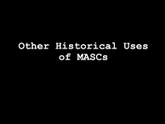
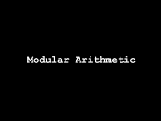
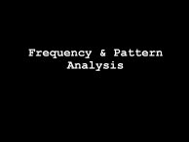
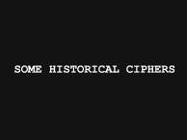
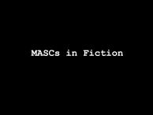
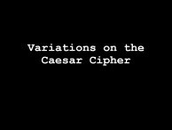
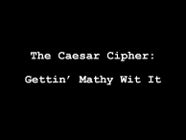
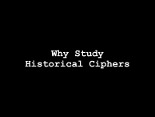
Overview of Lecture

Slide 4
Some historical ciphers

Slide 5
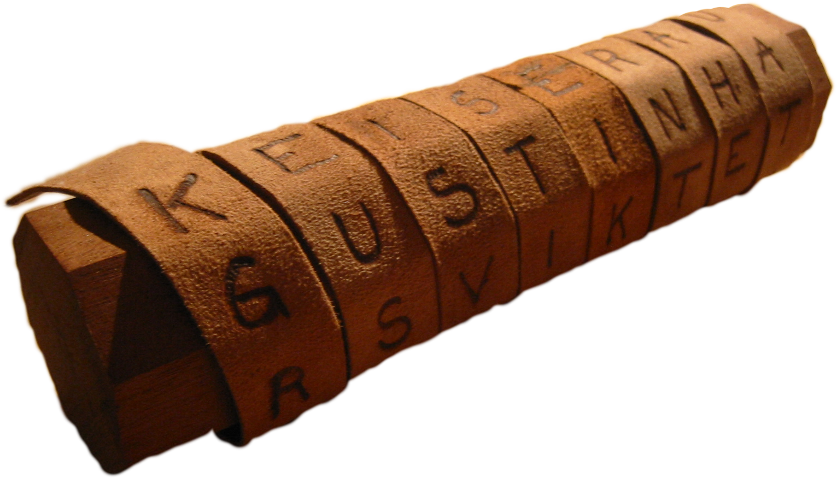
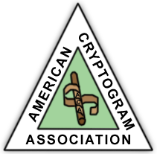
Greek Cryptography: Skytale
Pronounced “skih’-tuh-lee”
Used by Spartans around 400 BCE
Wrap strip around staff, write message
Transposition cipher: letters unchanged, order altered
YouTube video showing how it worked. And another version.
American Cryptogram Association has a skytale in its logo.

Slide 6
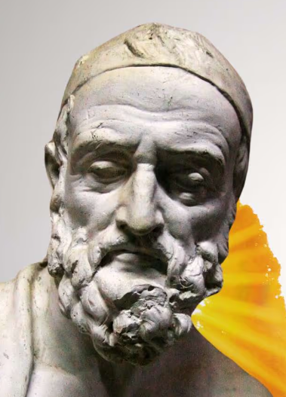
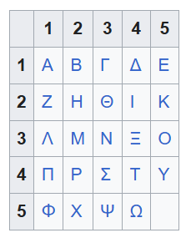
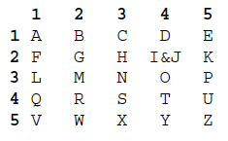
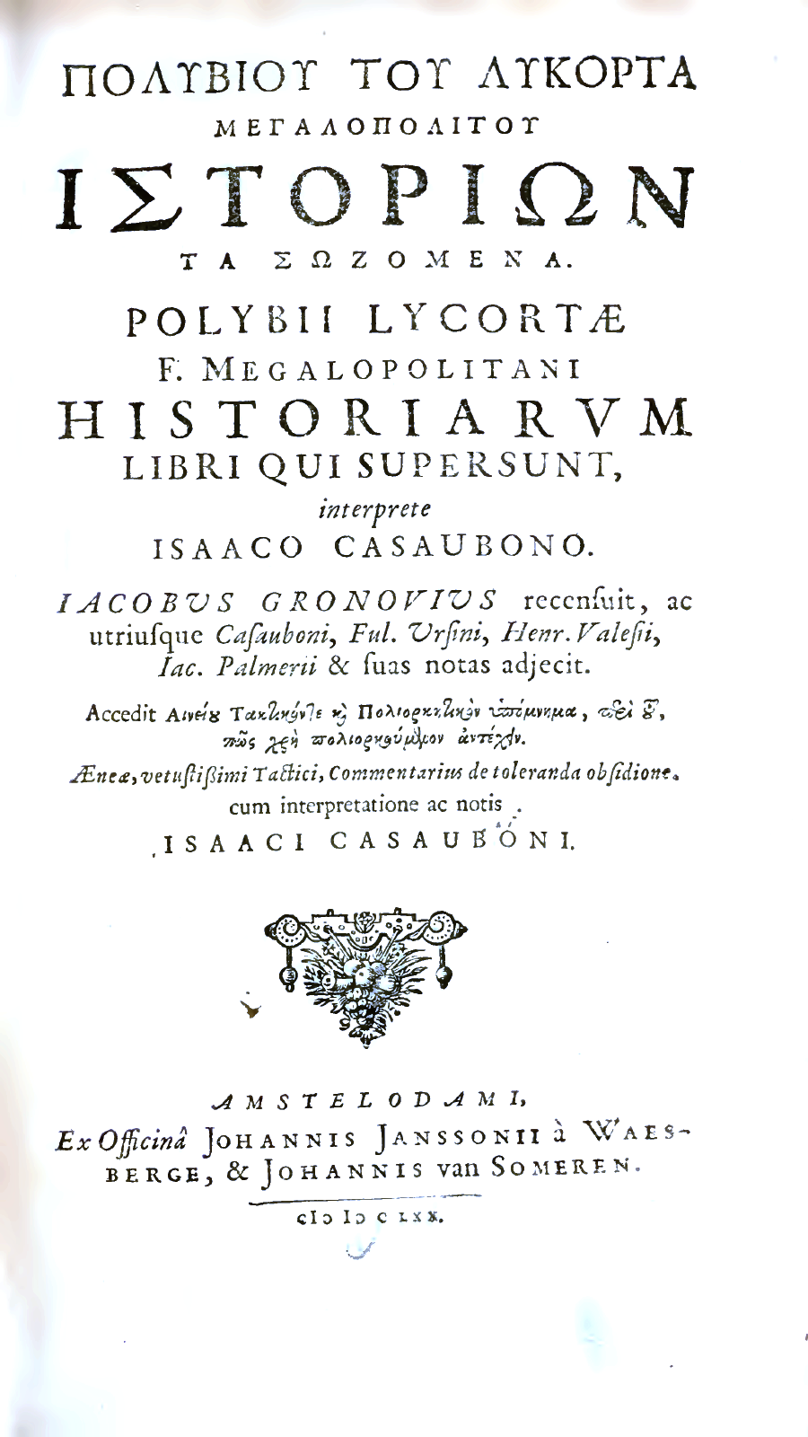
Polybius Square
Invented by the ancient Greeks, and made famous by Polybius in his published “Histories”.
5x5 square for letters
Each letter replaced by row-column pair
Example:
  K -> 25 (2,5)
  T -> 44 (4,4)
  I&J are combined. Which letter is determined from context.
Different alphabets could use different sized squares.
Originally intended for signaling over long distances. To send a “T”, hold 2 torches in right hand, and 3 torches in left hand.
Polybius square: Greek
Polybius square: English
Notes:
Polybius' most famous work, The Histories, originally consisted of 40 books, although only the first five books have survived in full. The work was intended to explain to a Greek audience how Rome came to dominate the Mediterranean world in a relatively short period.

Slide 7
Example: Polybius Square
Using Polybius square encrypt:
  KING
    Answer:
      K = 25
      I = 24
      N = 33
      G = 22
      Ciphertext: 25243322
Using Polybius square decrypt: 2434251542
    Answer: JOKER

Slide 8
Exercise: Polybius Square
Using Polybius square encrypt: SECRET
    Answer: 431513421544
Using Polybius square decrypt: 4311451315
    Answer: SAUCE

Slide 9
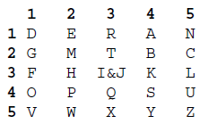
Polybius Cipher: Use of a Key
Instead of using a straight alphabet, we modify the order of the letters to form a far better cipher.
We will use a “key” with the word DERANGEMENT
  We start with our 5x5 grid (to ensure we have room for all letters). We begin with our key word and then continue with the remaining letters in alphabetical order.
  Skip any letters that have already been used. (Note how after “G” we skip E, after “M” we skip both E and N).
Following the key, enter all unused letters of the alphabet.
Exercise:
  ENCIPHER: Sparta
    Answer: 44 42 14 13 23 24
  DECIPHER: 211312123444
    Answer: GREEKS

Slide 10
Exercise:
Create a Polybius Square
Create a Polybius square using the keyword MIDNIGHT
  Start by creating a 5x5 square
  Enter the letters from the key. Skip any repeats.
  When done with the key, enter all remaining letters in the alphabet from A to Z – though again, skipping any letters that already appeared in the key.
  Remember to combine I and J.
2. Encode: ENJOY
  3114123554
  Note: For the 3rd letter, J, recall that I and J are given the same number, so J is encoded as 12
3. Decode: 443525253143
  SOCCER
Polybius square
Key: DERANGEMENT
Keyword: MIDNIGHT
 | 1 | 2 | 3 | 4 | 5
1 | M | I/J | D | N | G
2 | H | T | A | B | C
3 | E | F | K | L | 0
4 | P | Q | R | S | U
5 | V | W | X | Y | Z
Polybius square
Key: MIDNIGHT

Slide 11
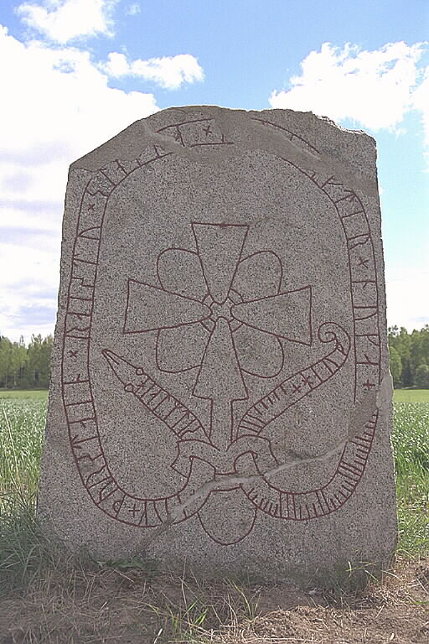

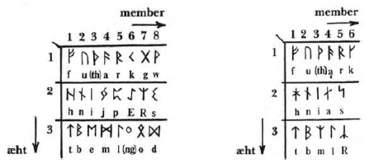
Viking Cryptography
Rotbrunna stone markings
Numeric encoding converted to runes
Essentially a variant of the Polybius cipher
Notes:
The Rotbrunna stone is a rune stone (U 1165) from the Viking Age located in Uppland, Sweden, commissioned by Hjalmdís and Þorsteinn to honor Nokki. The inscription includes a carved signature by the runecarver Eiríkr, who used special "ice runes" to write his name. The stone's inscription states, "Hjalmdís and Þorsteinn raised these stones in memory of Nokki. Eiríkr cut".

Slide 12
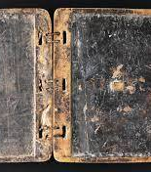
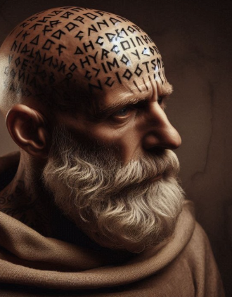
Early Steganography
Steganography: Physically concealing the existence of a message (as opposed to encipherment)
Examples:
Wax tablet
  Hide a second message under the layer of wax
  480 BCE: Greeks receive warning of Persian attack (Xerxes) → Leonidas & the 300 (- Herodotus)
Tattoo on head of a slave → allow hair to grow
  400 BCE: Histiaetus encourages revolt against Persians. (- Herodotus)
Other examples:
  Invisible ink
  Microdots (modern)
  Jeremiah Denton – Morse Code in Vietnam
    Video

Slide 13
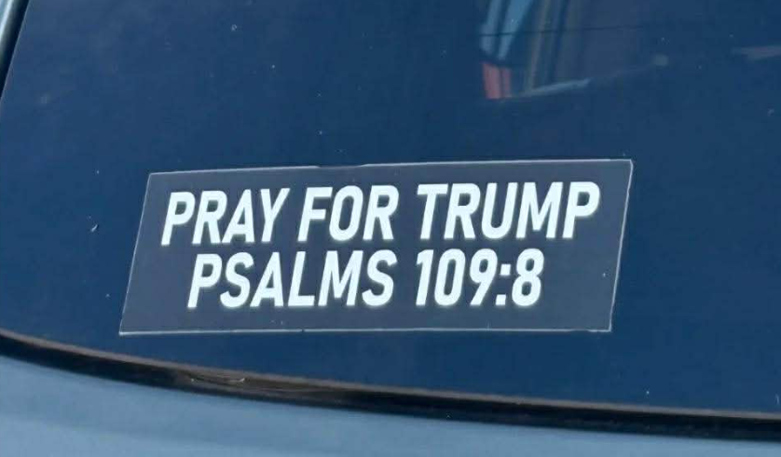
Modern Day Steganography
I am not trying to be political here – but shown at right is a good example of hiding a message in plain sight.
The story is that this bumper sticker was generating lots of high-fives and honks of approval from vehicles driven by (presumably pro-Trump) people.
However, the text of the psalm in question reads:
“May his days be few; may another take his place.”

Slide 14
Substitution Ciphers (MASCs)
MASC: Mono-alphabetic Substitution Cipher: Each letter is substituted for (i.e. replaced by) a different letter.
  We will soon learn about the use of more than one version of the alphabet.
We have already seen the one shown below.
Key
ET TU BRUTE? plaintext
HW WX EUXWH? ciphertext

Slide 15

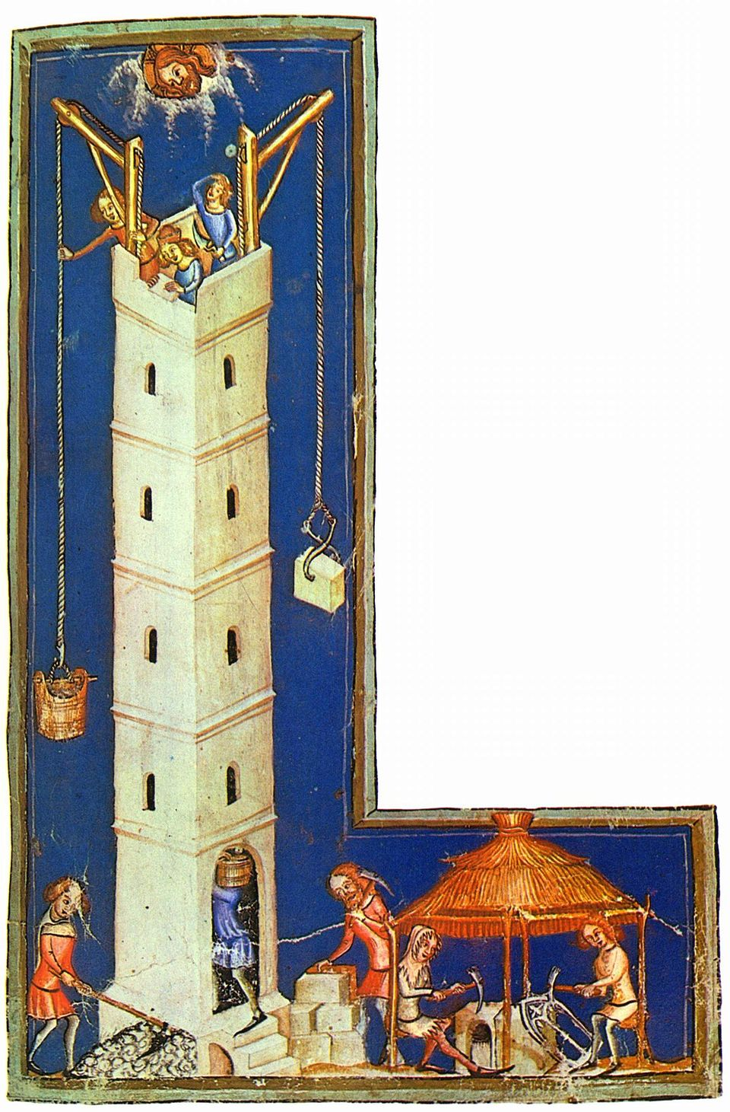
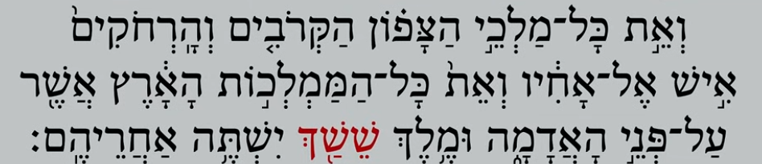
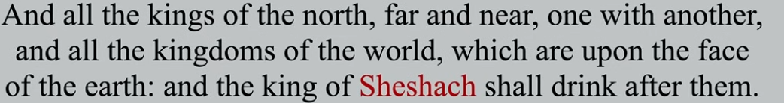
Early Substitution Cipher: ATBASH
Atbash Cipher
MASCs (mono-alphabetic substitution ciphers) have been used for thousands of years!
How old?? → Biblical Example: Atbash
  Hebrew alphabet in which first letter, “aleph” is replaced by last letter: “taf”. Second letter, “bet” replaced by second from last letter, “shin”.
  Example: In Jeremiah 25:26 and 51:41, (c.600 BCE), reference is made to “Sheshach”
    Letter “shin” maps to the letter “bet”
    Letter “chaph” maps to the letter “lamed”
    Sh-sh-ch → B-B-L → Babel!

Slide 16
Modular Arithmetic

Slide 17

Modular Arithmetic:
Importance
Foundation of Cryptography
  Modular arithmetic forms the basis for not only historical ciphers, but also for modern, cutting-edge cryptographic algorithms like RSA, Diffie-Hellman, and ECC.
Modular Operations Concept
  Numbers wrap around upon reaching a modulus, enabling operations within a finite set of integers.
Secure Encryption Mechanisms
  Modular arithmetic powers (exponents) secure key exchange and encryption, making decryption without private keys infeasible.
Support for Digital Security
  Also used with digital signatures and hashing, essential for secure communication protocols.

Slide 18
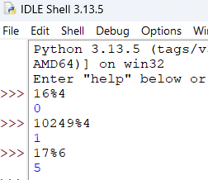
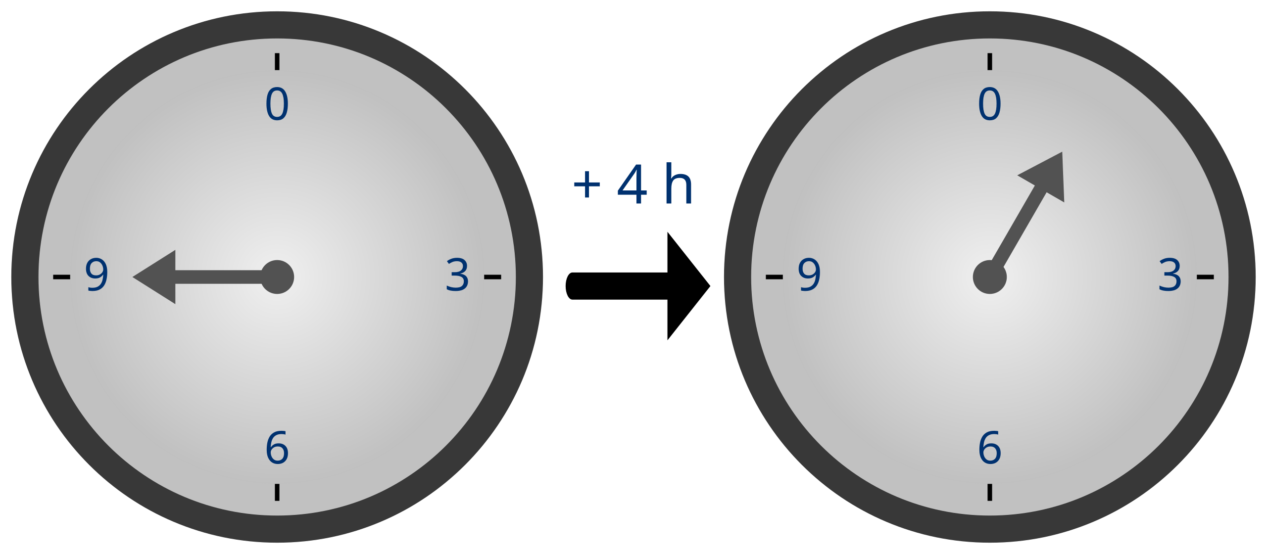
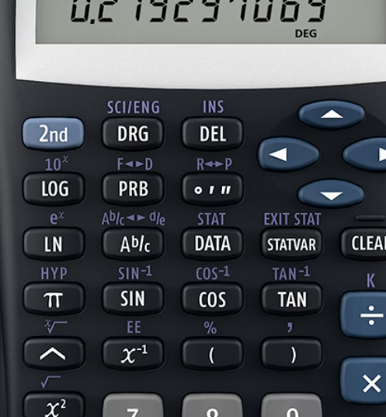
Modular Arithmetic: A Gentle introduction
Modular Arithmetic Basics
  Modular arithmetic operates with integers within a finite set defined by a modulus. The modulus function always gives us the REMAINDER integer after doing division.
  Examples:
  11 mod 3 ≡ 2 → 3 goes into 11 three times, but remember that ‘modulus’ is asking us what is left over. In this case, the answer is 2.
  13 mod 3 ≡ 1 → 3 goes into 13 four times, but again, all we want to know with modulus is what is left over. In this case, the answer is 1.
  8 mod 2 ≡ 0 → When we divide 8 by 2, we have 0 left over.
  Real World Example: Consider time as is spoken of in North America. In the U.S., time operates on a 12-hour cycle. That is, once we hit 12, we start over again. This would be a “mod 12” situation. So if someone tells you the time is 15:00, 15 mod 12 is 3. This is why we say it is 3:00.
  Other Notes:
  Note the use of the character: ≡ This is called the congruence character. We often use this in place of the equals sign when doing modular calculations. We will discuss further down the road.
  In programming, we often use the % character to do modular calculations. For example in Python: 16%4 would return 0.
  Calculators: Functionality is available in many calculators, but is usually buried inside a menu somewhere.
    Note: On a calculator, do not confuse the “%” with the modulus operation.
  IMPORTANT: If you take the modulus of a negative number, it will still work. However, we first need to ADD the modulus value until we get a positive number. For example: -18 mod 24 → Add +24 to -18 to get +6.
    If you still have a negative value, simply do it again: -35 mod 24 → +24-35 = -11. Now repeat: -11 mod 24 → +24-11 = 13.

Slide 19
Modular Arithmetic: Another notation
a ≡ r mod m
  Modular arithmetic is often denoted as a ≡ r mod m.
  In other words: a ≡ r mod m means that when a is divided by m, the remainder is r.
  For example, 42 ≡ 6 mod 9 because 42 divided by 9 leaves a remainder of 6.
    The value we are trying to calculate is “r” (for “remainder”).
    Note: Recall that the ≡ character is known as the “congruence” symbol.
    Start by dividing the value on the left of the congruence symbol, by the modulus value ‘m’ (on the far right). The value that is left over is “r”.
  Examples
  8 ≡ ____ mod 2 (Answer: 0)
  8 ≡ ____ mod 3 (Answer: 2)
  45 ≡ ____ mod 26 (Answer: 19)
  26 ≡ ____ mod 26 (Answer: 0)
  89 ≡ ____ mod 26 (Answer: 11 since 26 goes into 89 three times, with 11 left over.)
  -15 ≡ ____ mod 26 (Answer: 11 since we add +26 to -15 to get 11. 26 goes into 11 0 times with 11 left over.)
  -60 ≡ ____ mod 26 (Answer: 18 → =-60+26 = -34 → -34+26 = -8 → -8 mod 26 = 18)

Slide 20
Modular Arithmetic: Exercises
Exercises:
  16 mod 3
    Answer: 1
  16 mod 4
    Answer: 0
  27%5 (This is the programmer’s notation)
    Answer: 2
    Note: Do not confuse the programming “%” with the one on your calculators – they are not the same.
  27%26
    Answer: 1
  39 mod 26
    Answer: 13
  39 ≡ ____ mod 26
    Answer: 13
  63 ≡ ____ mod 26
    Answer: 11
  -11 ≡ ____ mod 26
    Answer: 15
  -83 ≡ ____ mod 26
    Answer: 21

Slide 21
Modular Arithmetic:
Equivalence Classes and the Congruence Symbol, ≡
Numbers that differ by an integer multiple of the same modulus are said to belong to the same equivalence class in modular arithmetic. Put another way, if two numbers differ by “full laps” around the modulus, they end up in the same spot, and we can treat them as interchangeable.
For example, if we are working modulo 7, then the values
9, 16, 23, 30, 37, …
are all part of the same equivalence class, since when we take each value modulo 7, they all produce the same remainder (2).
This is why we use the congruence symbol (≡) instead of =
With the congruence symbol, we are not saying two numbers are literally equal — we are saying they belong to the same equivalence class modulo “n”.
This concept is not especially important right now, but I am providing it here so that you understand why it’s considered better form to use the congruence symbol “≡” instead of the equals symbol “=“. The equals symbol, means an exact equality, and where there is only one correct value.

Slide 22
The Caesar Cipher:
Gettin’ Mathy Wit It

Slide 23
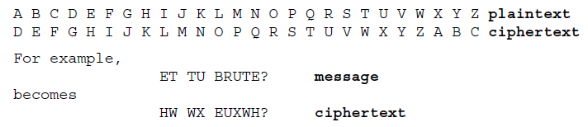
MASC: Caesar Cipher
Used by Julius Caesar during Gallic Wars.
  Described by Suetonius in his biography of Caesar, and by Caesar himself.
Shift by 3 letters (default)
  A → D
  B → F
  Etc.
Mathematical form: C = (M + K) mod 26

Slide 24
Exercise: Caesar Cipher
Encipher: Veni Vidi Vici
  Answer: YHQL YLGL YLFL
Decipher: L KDWH EUXWXV
  Answer: I hate Brutus

Slide 25
Caesar Cipher:
A (slight) improvement…
Obviously very easy to break.
Can be made at least a little stronger if we shift by a different number of “K” characters each time.
  E.g. The letter A (to which we will assign the number 0 – not 1)*, would be shifted K characters forward. So if K was 3 (as in the original Caesar cipher), the ciphertext letter would be D. If K=15, we would shift or “offset” by 15 characters to get the ciphertext letter would be P.
  *Important Note: We will begin our numbering at 0. This is because in many mathematics-based areas such as computing and cryptology, we are not simply counting, but rather calculating offsets. E.g. How many characters is A from A? The answer is 0. How many characters is A from J? The answer is 9. So even though J is the 10th letter of the alphabet, it’s offset from A is 9. It takes a little getting used to, but you will with practice!

Slide 26
Shift by K (mod 26)
As discussed, shifting by 3 is a pretty weak cipher. Not only is it easy to simply figure out by simply studying it for a little while, but it also never changes!
Let’s make our cipher a little more complex by shifting by some secret key value, K
We can represent* this cipher as: C = P + K (mod 26)
  Assign a number to each letter: A=0, B=1, C=2…. Z=25
    Don’t forget that we begin by assigning A=0 (not 1).
  C = ciphertext character
  P = plaintext character
  K = key value to shift by
  (mod 26)
    Short for ”modulo 26”
    If the sum of P+K is >=26, take the modulus of 26
* In cryptology we frequently represent the encipherment process mathematically.

Slide 27

Caesar Cipher with Variable Shift
C = P + K (mod 26)
Example: Encipher BRUTUS using K=9
  Plaintext: P=“B” → Assign B a value of 1 (since we start with A=0) → Add K to the 1 to get 10. → 10 corresponds to the letter “K”.
  R=17 → Add K to get 26 → Wait! There is no letter corresponding to 26! Remember that we are “mod 26” – so once we hit 26, we start again. 26 mod 26 = 0. So the R encodes to “A”.
  U=20 → Add K to get 29 → Because the formula uses “mod 26” we take the modulus of 26 → 29 mod 26 = 3 → 3 is the letter D
  T=19 → Add K to get 28 → 28 mod 26 = 2 → C
  Exercise:
    U = ?
      U = 20 → 20+K = 29 → 29 mod 26 = 3 = D
    S = ?
      S = 18 → 18+K = 27 → 27 mod 26 = 1 = B
    ANSWER: KADCDB
* Make use of your Mod-26 PDF Table (see “Resources” page)

Slide 28
Exercise: Caesar Shift
C = P + K (mod 26)
Encipher: ROME using the key K = 14
  Answer:
    R=17+14=31 → 31 mod 26 = 5 → F
    O=14+14=28 → 28 mod 26 = 2 → C
    M =12+14=26 → 26 mod 26 = 0 → A
    E = 4+14 = 18 → No mod needed: 18 → S
    FCAS

Slide 29
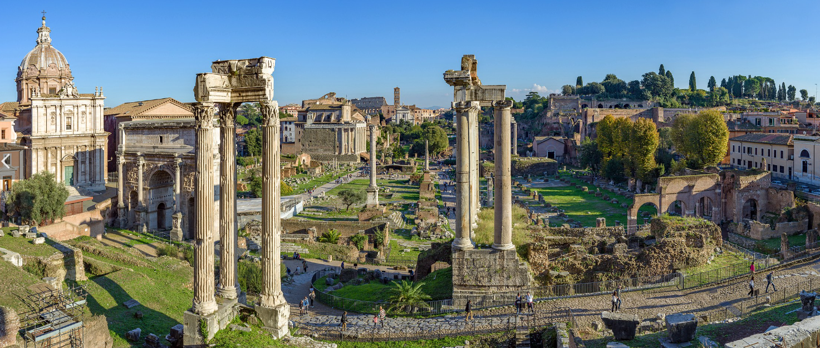
Example: Caesar Shift -- Decipherment
EN-Cipherment Formula: C = P + K (mod 26)
Decipher: TCFIY, with K=14
    Solve for P: P = C – K (mod 26)
    T=19-14, 5 → 5 = F
    C=2-14 →-12 → -12 mod 26 = 14 = O
      Remember: If your remainder is a negative number, keep adding the modulus until you get a positive value: -12+26 = 14.
    F=5-14 → -9 mod 26 → 17 = R
    I=8-14 → -6 mod 26 → 20 = U
    Y=26-14 → 12 = M
    FORUM

Slide 30
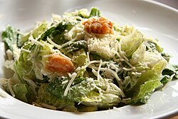
Exercise: Decipher Caesar Shift
Caear Shift Encipherment Formula: C = P + K (mod 26)
Exercise: Given the ciphertext: HPAPS decipher using Caesar shift with K=15
  Remember to start by rearranging the encipherment formula to solve for “P”
Answer:
  P = C-K (mod 26)
  H: 7-15 (mod 26) = -8 mod 26 = 18 → S
  P: 15-15 = 0 → A
  A: 0-15 = -15 mod 26 = 11 → L
  P: → A (as per above)
  S: 18-15= 3 → D
  Answer: SALAD

Slide 31
Variations on the Caesar Cipher

Slide 32
Course Concept: KEYSPACE
One key (pun intended) strategy for cryptanalysis is identifying the keyspace.
Recall that the keyspace is the set of all possible keys.
For a shift cipher, because we want to shift within the 26 letter alphabet, the keyspace “K” is made up of all possible values between 1 and 25.
In fancy math symbology, we would represent this as: K ∈ {1,2,3….25}
  What about 0? With a Shift Cipher, we would not ever use a key of 0 (K=0) since this would mean that there is no shift at all!
  If K=3, that would be an example of the classic Caesar Cipher.

Slide 33
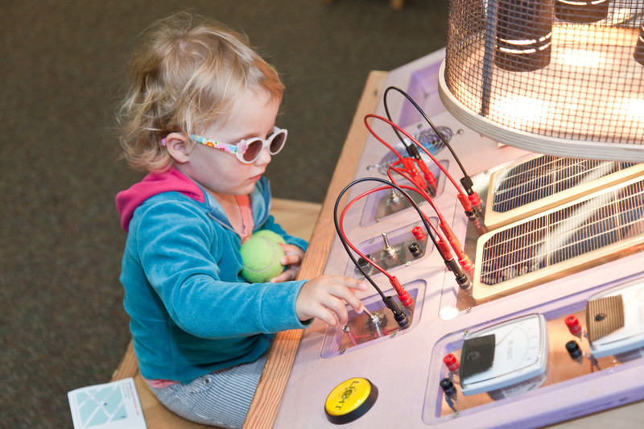
A Small Keyspace is VERY Weak!
Even when we add a variable amount of shift “K” to our Caesar cipher, it is extremely weak due to the very small keyspace.
For the shift cipher, the keyspace is: K ∈ {1,2,3….25}
In other words, we could do a “brute-force attack” on the cipher, and we would need to check only 26 keyspaces and could guarantee that we would find the plaintext.
  Decipher with K=1 → If this plaintext is English, we have solved it. If not…
  Decipher with K=2 → If this plaintext is English, we have solved it. If not…
  …
  Decipher with K=25
  ONE of these would be the plaintext.
So easy, a child could do it!
One requirement for a strong cryptosystem is a very large keyspace.

Slide 34
Other MASC Systems: Overview
Tremendous number of variation over the centuries. Examples include:
Random substitution: Newspaper cryptograms
  Would often appear in a puzzles section.
  Substitutions were random, e.g. A=L, B=W, C=B, etc.
  Answers could be deduced through hints about the subject, letter frequencies and so on.
Two-part keys and pangram keys
  E.g. Use a keyword, and place it in the middle
Keyword ciphers: Example with PRIVACY (demonstrated shortly)
  Use a key that can be memorized, and continue substitutions from the end of the key onward

Slide 35
Substitution Cipher Using a Keyword
In this case, the key of our substitution cipher begins with a key word or phrase.
Alphabet continues in order once the keyword is completed. Repeated letters are ignored.
Example: Keyword = PRIVACY
Example: Decipher WNPX → XRAY
Problem: The problem here is that once we are done with the keyword, the alphabet picks up again in its normal order. In other words, there is a known pattern involved (i.e. the English alphabet). This would make our cipher easier to crack. Remember that patterns often present an opportunity for an attacker to crack our cipher.

Slide 36
Substitution Cipher using Non-Alphabetic Ordered Key
Rather than using any shifts, we explicitly choose which ciphertext letter should represent every plaintext letter.
Because we’d like to avoid writing down keys, we might use a phrase that can be memorized relatively easily.
An ideal phrase would be one that incorporates every letter of the alphabet. This means that the alphabet would never proceed in alphabetical order in the key (other than by the occasional coincidence).
Example: Generate a keyword cipher using the key: “The Quick Brown Fox Jumps Over a Lazy Dog”
  All 26 letters in the alphabet are used in this phrase, so the alphabet never returns to its original order.
  If a letter repeats, simply ignore it and move to the next one.
Here is what the key would look like:

Slide 37
Keyspace Size of a Random Cipher
Consider the keyphrase we used previously: “The Quick Brown Fox Jumps Over a Lazy Dog”
What is the size of this keyspace?
Answer:
  Because every letter is replaced at random with another letter:
    A can be replaced with 26 possible letters
    B can be replaced with 25 possible letters (since we can’t use the letter that we used for A)
    C can be replaced with 24 possible letters
    Etc.
  Therefore, the keyspace is 26! (26 factorial). This is a very, very, very large number. We’ve seen it before: 403291461126605635584000000

Slide 38
An Unbreakable Cipher?
Wow, 403291461126605635584000000 is a massive keyspace! Does that make it unbreakable?
  No! As we will see, such this kind of cipher is easily breakable – in spite of the massive keyspace.
We therefore need to modify our earlier statement:
One absolute requirement for a strong cryptosystem is a very large keyspace.
A very large keyspace is necessary BUT NOT SUFFICIENT for a strong cryptosystem.
We will soon learn why.

Slide 39
MASCs in Fiction

Slide 40
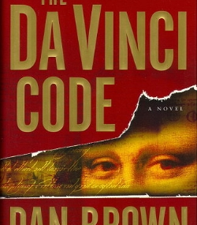

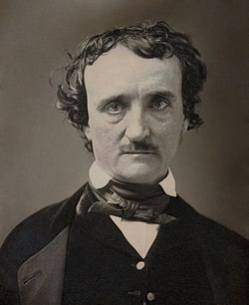
MASCs in Fiction
Popular in fiction:
  Edgar Allen Poe (“The Gold Bug”), and in real life
    Challenged readers to stump him
    Claimed that there is no such thing as an unbreakable cipher:
      “Yet it may be roundly asserted that human ingenuity cannot concoct a cipher which human ingenuity cannot resolve.”
      He was wrong. There are theoretically unbreakable ciphers.
  Dan Brown (DaVinci Code)
  Arthur Conan Doyle (Sherlock Holmes, “The Adventure of the Dancing Men”)

Slide 41
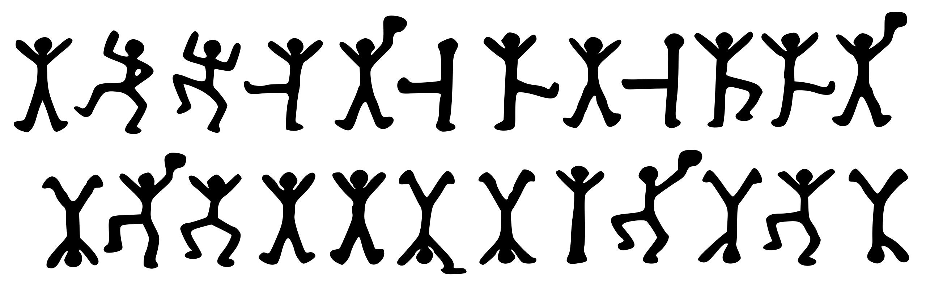
Sherlock Holmes: Dancing Men
Sherlock Holmes story (1903)
Cipher uses pictorial symbols (dancing men)

Slide 42
The Dancing Men
The ciphertext shown below was deciphered to yield the sentence: “Elsie prepare to meet they god”.
Question: What do you think the flags may represent?
  Answer: Spaces!
Question: Note how the first stick man shows up in positions 1, 5, 8, 12,16, and 17. Any guesss what that my represent? Hint: It’s the most common stick man pattern of any of them.
  Answer: It represents the letter "e".

Slide 43
MASCs are Easy to Break
Reasons MASCs are easy to break:
  Two things in particular:
  Each letter always enciphered the same way
  Statistics about the letters are very revealing (e.g. “frequency analysis” & “word patterns”)
Frequency Analysis and Patterns from the English language:
  Some letters are more common than others
  Letter positions matter: T common at start, E at end
  Double letters: LL, EE, SS frequent

Slide 44
Frequency & Pattern Analysis

Slide 45
Frequency Analysis
Invaluable in decrypting ciphertext
  In many languages, letters appear with a relatively consistent frequencies.
  For example, in English, the letters E, T, A, and O are very common.
  Not only can frequency analysis allow us to break ciphers, it can often be used to identify the language of the ciphertext

Slide 46
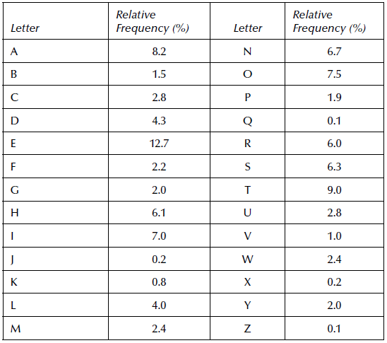
Frequency Analysis: Common Letters
In many languages, letters appear with relatively consistent frequencies.
In English, letters E, T, A, O are the most common and
Note that vowels are NOT always the most common!
  E.g. “T” is the second most common letter, probably due to the word “THE”

Slide 47
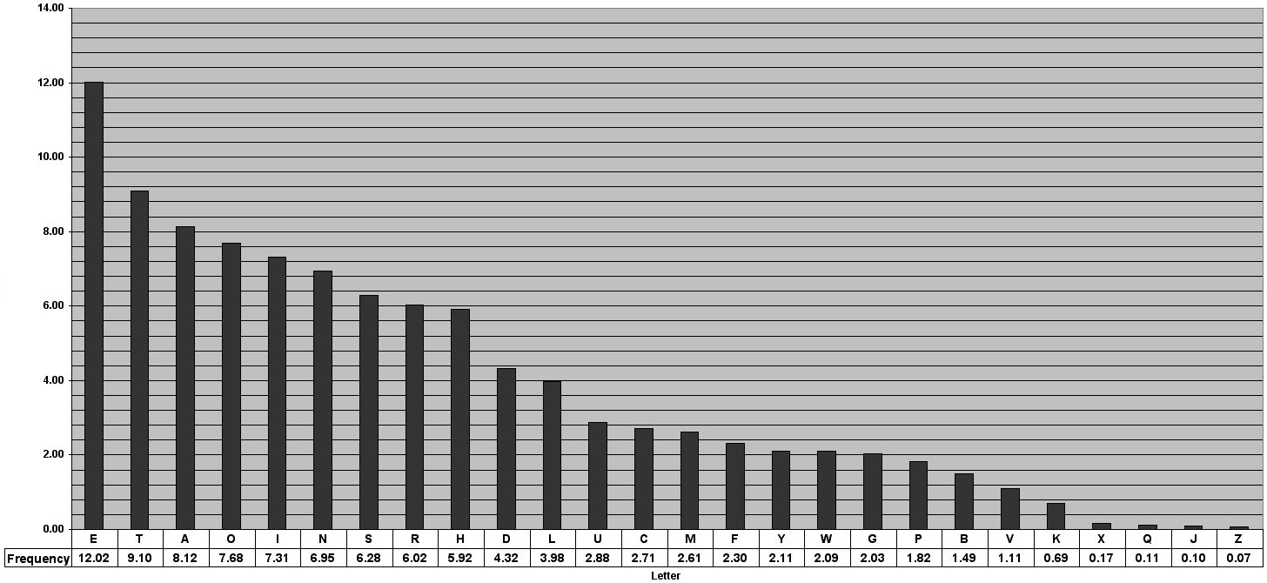
Frequency distribution of English language letters
Graph link: https://pi.math.cornell.edu/~mec/2003-2004/cryptography/subs/frequencies.html

Slide 48
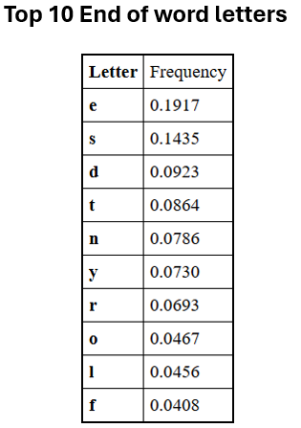
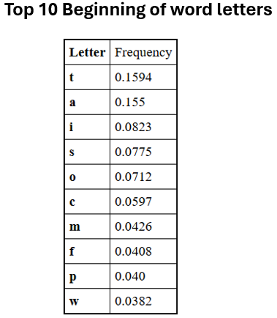
Frequency Analysis: Positions
Letter positions are great clues: e.g. T common at start, E at end

Slide 49
Pop Quiz
Why do you think “t” is so much more frequent than all other letters as the first letter of words?
Answer: The word “the”!!

Slide 50
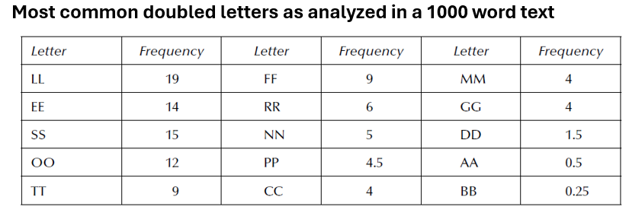
Frequency Analysis: Other Clues
Double letters: LL, EE, SS frequent
Bigraphs (2 letters that show up together)
Trigraphs (3 letters that show up together)
Most common English bigraphs (2-letter combinations) in order:
th, he, in, en, nt, re, er, an, ti, es, on, at, se, nd, or, ar, al, te, co, de, to, ra, et, ed, it, sa, em, ro
Most common English trigraphs (3-letter combinations) in order:
the, and, tha, ent, ing, ion, tio, for, nde, has, nce, edt, tis, oft, sth, men

Slide 51
Frequency Analysis:
Only Holds True for Long Ciphertexts
Statistics like those just discussed can only be used reliably with relatively long ciphertexts.
Consider this sentence:
MY BROWN DOG → This phrase contains no Es, Ts, or As
The longer the ciphertext, the likelier it adheres to predictable usage patterns.

Slide 52
Word Patterns
Can be very valuable for discerning a key
Consider the ciphertext: TPOTFSTS
We create a pattern out of this as follows: ABCADEAE
  1st, 4th, 7th letters are the same
  6th and 8th letters match
  Only a small number (<15) of words in the English language match this pattern:
    ARKANSAS
    EXPENDED
    EXPENSES
    Etc
  From there, context can be used to deduce the true plaintext. If this message was sent from a politician on an ad campaign to become mayor of Little Rock, then, ARKANSAS would be a good guess. If an attacker had worked this out, they would now know 5 letters of the key. This would be a huge foothold for working out the remainder of the entire key.
In the old days, there were large volumes of books that had been painstakingly put together that matched patterns. Now there are websites that automate the task.
  See this page: http://dcode.fr/en
    The frequency analysis page: https://www.dcode.fr/word-pattern-search

Slide 53
Exercise: Word Patterns
You intercept a ciphertext that you believe is related to identifying a spy you are trying to capture. This spy is known to be wearing a disguise.
The ciphertext is as follows: PUEXCFBVBXF.
Using a word pattern search and the website referenced earlier, decipher the word.
Answer:
The pattern is: ABCDEFGHGDF
Words that come up:
Adversities
Quickenance
Recognition
Understates
Versatilist
From the context, we guess that the word is: Recognition.
We now know 8 letters of the substitution cipher! This is very likely to be a strong enough foothold to determine the remainder of the key.

Slide 54
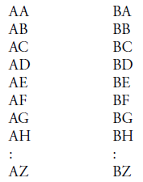
Vowel Recognition Algorithms
Vowels contact more letters than consonants
  Consider the following columns. Try to think of words that have the following digraphs in each column. Start with the column on the left. Then repeat with the column on the right.
  Note how it is much easier with the column on the left. This is because vowels contact more letters than consonants.
  As a result, we can deduce that A is far more likely to be a vowel than B. If in ciphertext, you found a letter Q contacting many more letters than say, E, you would conclude that Q is far more likely to be a vowel.
Sukhotin’s method: iterative vowel detection
  An imperfect, but sometimes highly predictive algorithm that iterates through the ciphertext varying numbers of times and can help separates vowels and consonants in a ciphertext.
  We will not go over the algorithm here but it can be easily found online.

Slide 55
Other Historical Uses of MASCs

Slide 56
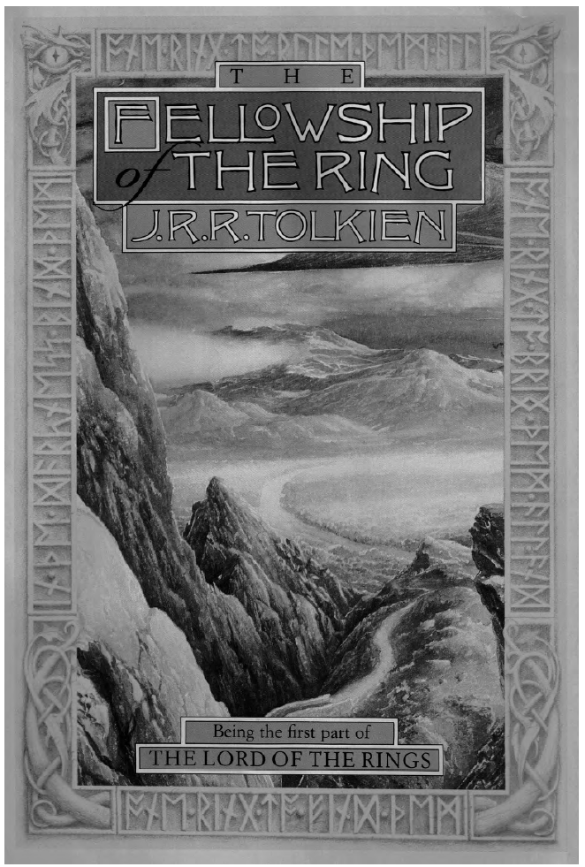

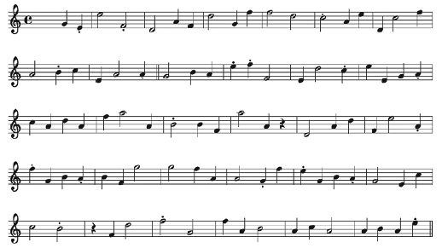
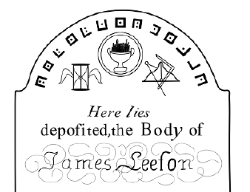
Other Uses of MASCs
For interest only.
Fantasy and SciFi authors have a noted history of embedding ciphers in images and on the covers of books.
An early edition of Tolkien’s LOTR. Note the runes around the border.
Mozart “composed” a cipher in which each note represented a letter (different from the proper note). Don’t try to play it!
Masons (and children!) have used a version of the “Pigpen” cipher.

Slide 57
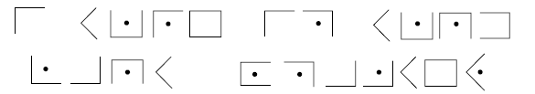
Just for fun
Decipher this message encoded by a Pigpen cipher.
KEY:

Slide 58
Example: MASC Cryptanalysis
Using some of the MASC cryptanalysis techniques discussed to date, we will attempt to decipher the following ciphertext. To make things a bit easier, we have preserved spaces between words. (Proper encryption does not do this!)
JDS CGWMUJNCQV NSIBVMJCBG QGW CJU ZBGUSHMSGZSU DQIS ASSG Q
Covered in detail in Bauer 1.14
Use the dcode.fr site for things like
  Frequency analysis: https://www.dcode.fr/frequency-analysis
  Repeated trigraphs and/or digraphs
  Pattern recognition (use for a large word)
Solution on the next slide

Slide 59
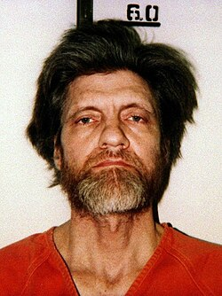
Decipherment: MASC Cryptanalysis
Answer:
Recorded by The Unabomber in encrypted form in his personal journal.
JDS CGWMUJNCQV NSIBVMJCBG QGW CJU ZBGUSHMSGZSU DQIS ASSG Q
THE INDUSTRIAL REVOLUTION AND ITS CONSEQUENCES HAVE BEEN A DISASTER FOR THE HUMAN RACE.
- Ted Kaczynski (The Unabomber)

Slide 60
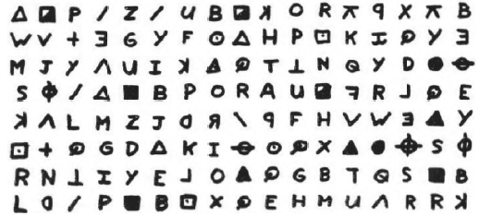
Another (Grim) Example
Zodiac Killer
  A still-unidentified serial killer from the 1960s and 1970s with over 30 reported victims.
  Sent taunting letters to police with enciphered messages. Used 4 ciphers, two of which are cracked, two are still undeciphered.
  NSA, CIA, FBI all unable to crack
  Amateur cryptologists Beth and Donald Harden solved it using, among other things, probable word search.
  Plaintext of the message: I like killing people because it is so much fun it is more fun than killing wild game in the forest because man is the most dangerous anamal of all to kill something gi…
    Note the error for the word “animal”. Errors in encipherment can complicate cryptanalysis.

Slide 61
Why Study
Historical Ciphers
Notes:
Shift Cipher (Caesar Cipher), Affine Cipher and keyspace, Security Limitations of Historical Ciphers

Slide 62
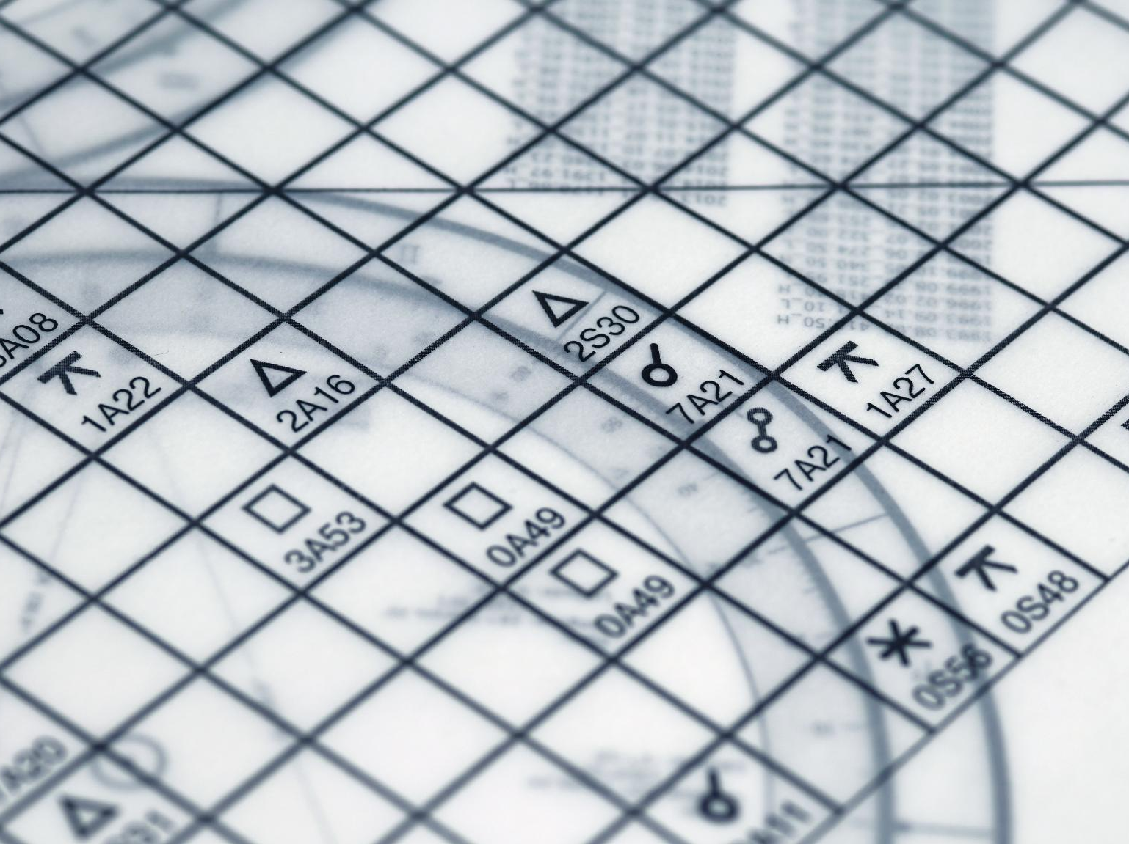
Security Limitations of Historical Ciphers
Vulnerable Keyspaces
  Historical ciphers though often ingenious for their time, have limited keyspaces making them vulnerable to brute-force attacks.
Frequency Analysis Weakness
  In addition, many of these ciphers do not hide various patterns such as letter frequencies enabling cryptanalysts to apply statistical techniques to break codes.
Evolution of Cryptography
  Through study of historical ciphers, cryptography has evolved from simple substitution to complex algorithms resistant to both brute-force and statistical attacks (e.g. frequency analysis).
Educational Importance
  While no longer in commercial or military use, historical ciphers serve as educational tools to understand encryption principles and to appreciate the need for mathematical rigor.

Slide 63
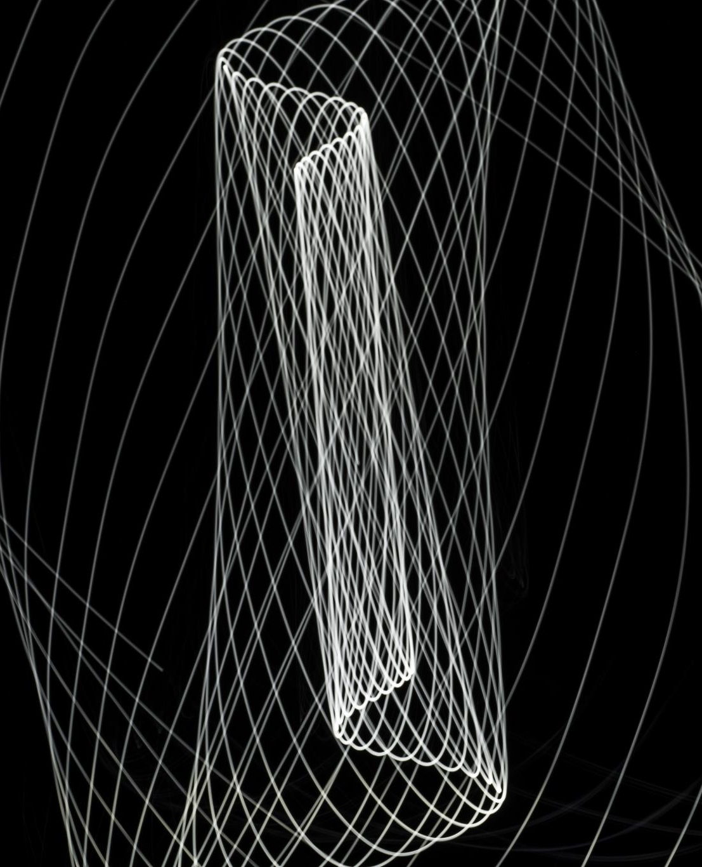
Core Concepts Recap
Historical Cipher Techniques
  Early ciphers like shift and affine ciphers illustrate practical applications of modular arithmetic in encryption.
Cryptography Evolution
  Understanding early methods and their limitations highlights the need for robust modern cryptographic algorithms and secure protocols.
Foundations of Modular Arithmetic
  Modular arithmetic forms the mathematical basis for cryptographic transformations and secure data handling.

