Slide 1

Introduction to Cryptology IT-233 Yosef Mendelsohn
Lecture #1:
Introduction to Cryptology
Terms and concepts
Key lengths
Historical ciphers
Modeling Computing Speed

Slide 2
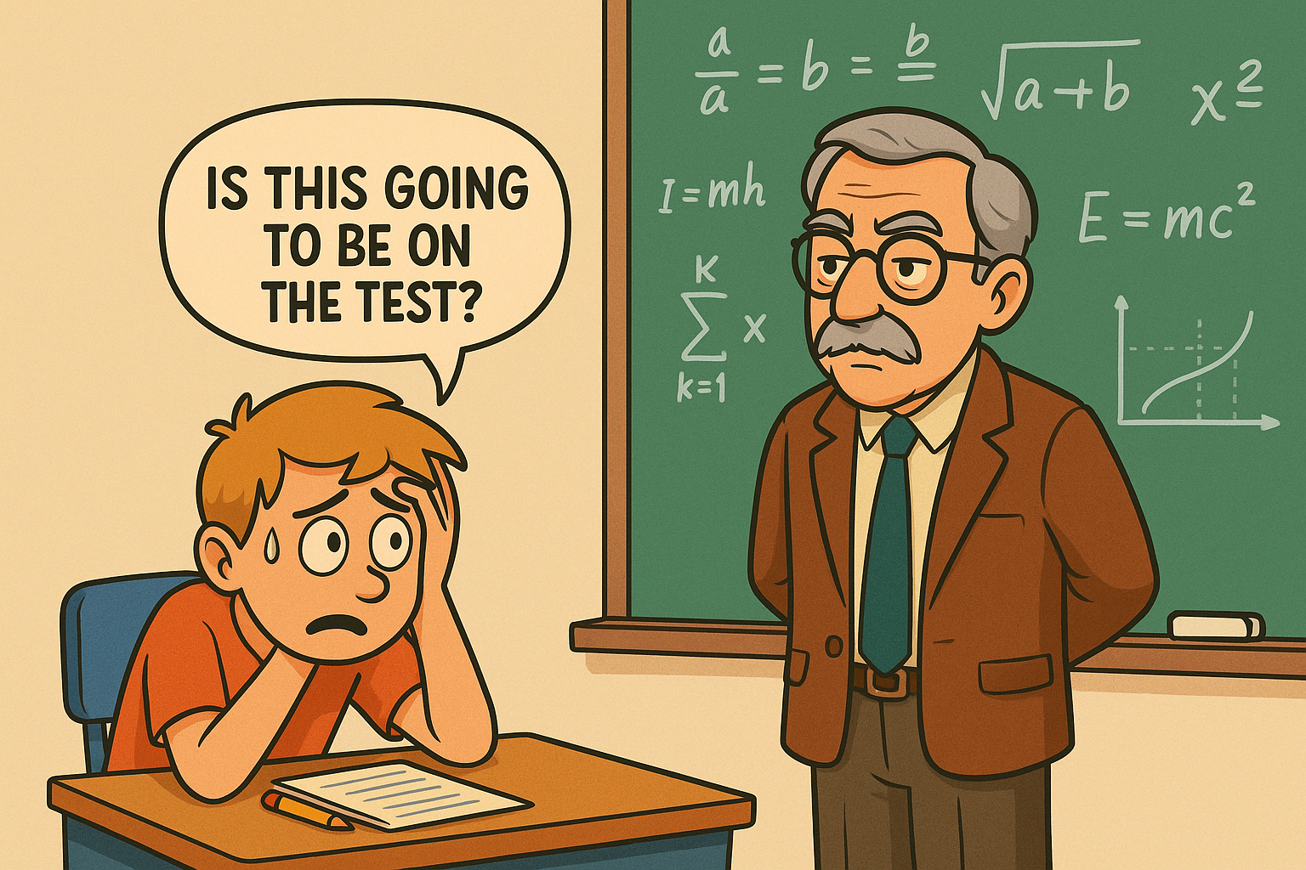
Lecture objectives
There will be quite a few terms and concepts introduced in this lecture. The purpose is to give you an overview of what to expect. As far as what you “need to know”, you can expect exam questions on the following terms / concepts. Also, I will not ask you to write out definitions. But if you see a definition, you should be able to identify which of the following words it associates with.
Data integrity, Authenticity
Symmetric vs Asymmetric ciphers
Cryptography vs Cryptanalysis
Encipherment vs Decipherment
Plaintext vs Ciphertext
Computationally secure
Brute Force Attack
Social Engineering
You also must know how to do basic calculations involving computing speed

Slide 3
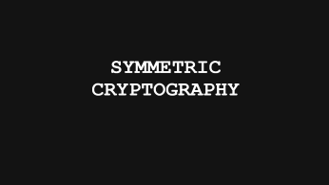
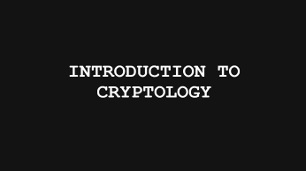
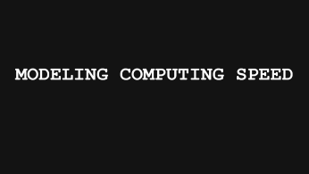
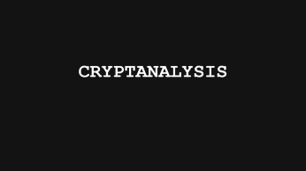
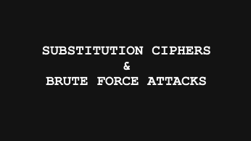
Lecture Overview

Slide 4
Introduction to Cryptology

Slide 5
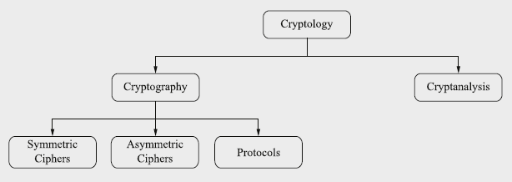
A few early terms
Cryptology: The study of encipherment (creating a cipher) and decipherment (decoding a cipher)
Cryptography: Creating a cipher out of plaintext
Cryptanalysis: Breaking or “cracking” a cipher when you don’t have the key.
Symmetric Cipher: The sender and recipient share the same key.
Asymmetric Cipher: The sender and recipient use different keys.

Slide 6
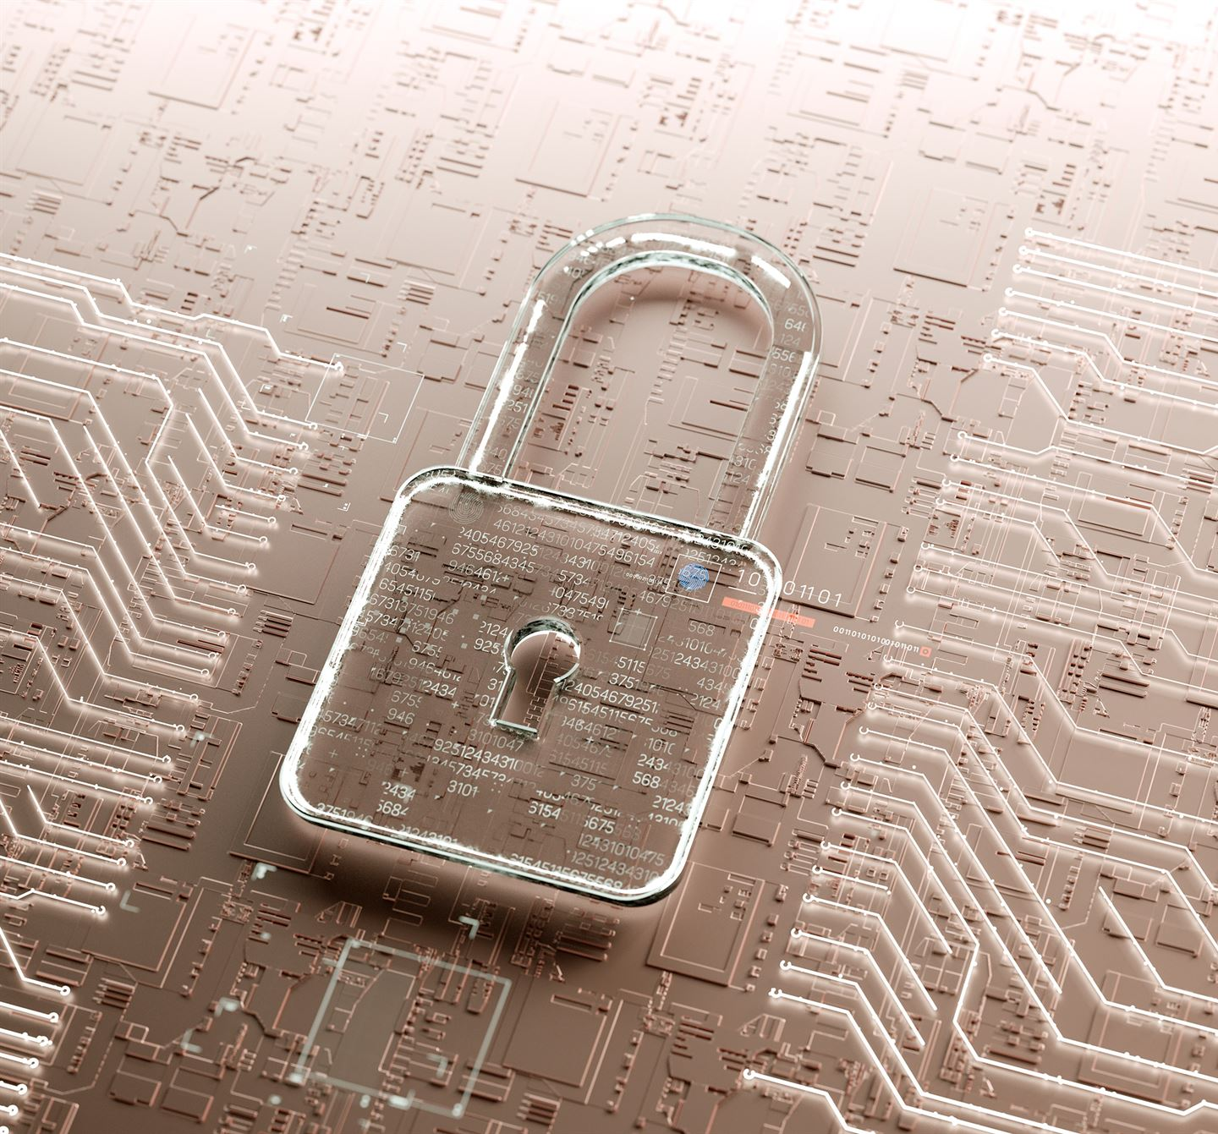
Definition and Purpose of Cryptography
Purpose of Cryptography
Cryptography ensures confidentiality, integrity, authenticity, and non-repudiation of information in digital systems.
Encryption and Decryption
Encryption transforms plaintext into ciphertext using keys, while decryption reverses the process for authorized users.
Historical to Modern Cryptography
Cryptography evolved from ancient ciphers to complex algorithms securing modern communications and financial transactions.
Role in Cybersecurity
Cryptography is foundational for cybersecurity, establishing trust and secure design in digital environments.

Slide 7

Historical Context and Evolution
Early Cryptographic Methods
Initial ciphers like Caesar's cipher used simple letter shifts to obscure information but offered limited security.
Mechanical Encryption Devices
Devices like the Enigma machine during WWII introduced complex mechanical encryption increasing security.
Computer-Based Cryptography
Post-war advancements led to DES and AES algorithms, foundational to current secure digital communication to this day.
Contemporary Cryptographic Uses
Contemporary cryptography now includes hashing, digital signatures, and key exchange securing internet communication.

Slide 8
Basic Terminology and Concepts
Plaintext and Ciphertext
Plaintext is the original readable message; ciphertext is the encrypted, unreadable form without the key.
Encryption Keys and Algorithms
Keys guide encryption and decryption, while algorithms define the mathematical methods of transforming data securely.
Symmetric vs Asymmetric Encryption
Symmetric uses one key for both processes. The example above shows symmetric encryption. It is the type of encryption most people think about when they think of cryptography. Asymmetric encryption uses a public-private key pair for secure communication. We will discuss asymmetric encryption later in the course.
ET TU BRUTE? plaintext
HW WX EUXWH? ciphertext
“Et tu Brute” is a famous line from Shakespeare’s Julius Caesar

Slide 9
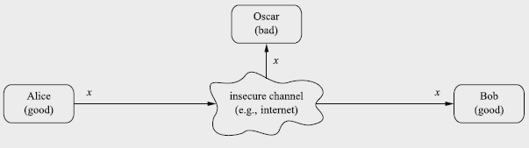
Core Objectives of Cryptography
Confidentiality
Confidentiality ensures information is accessible only to authorized parties using encryption techniques.
- Only Alice and Bob should be able to see the plaintext.
Integrity
Integrity guarantees data remains unchanged during storage or transmission using hashing and checksums.
- Nobody (e.g. Oscar) can make changes to the message during transmission.
Authentication
Authentication verifies the identity of entities via digital certificates and signatures.
- Ensures that it was Alice who sent the message.
Note: Names such as “Alice”, “Bob”, “Oscar” are commonly employed in discussions on cryptology. We will encounter them, and a few others along the way!

Slide 10

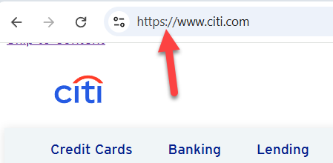
Applications of cryptography in Modern Systems
Secure Web Browsing
Relies on protocols such as HTTPS which uses SSL/TLS to encrypt data between clients and servers for secure web communications.
Financial Transaction Security
Cryptography protects online banking and e-commerce by securing transactions and user credentials.
Email Encryption
Encryption standards like PGP ensure confidentiality and authenticity of email communications.
Blockchain and VPN Security
Blockchain uses cryptographic hashing; VPNs safeguard data over public networks ensuring privacy.

Slide 11
Symmetric cryptography

Slide 12

Introduction to Symmetric Cryptography
Shared Secret Key
Symmetric cryptography uses a shared secret key for both encryption and decryption between communicating parties. We will see and make use of keys throughout this course.
Confidentiality and Integrity
Symmetric cryptography supports confidentiality and integrity of data over insecure channels against eavesdropping.
Practical Applications
Symmetric cryptography is widely used in secure messaging, file encryption, and Wi-Fi security protocols like WPA.
Challenges: Key Management
Managing and distributing secret keys securely remains a critical challenge in symmetric cryptography.

Slide 13
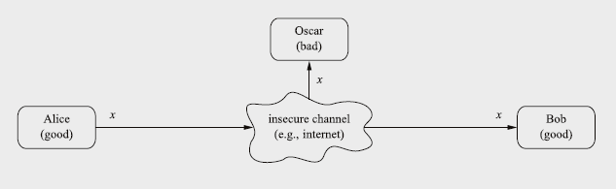
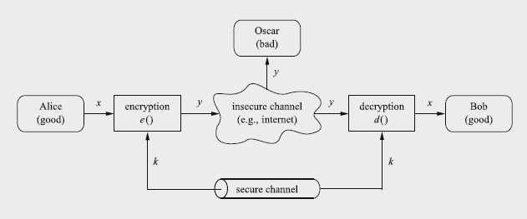
Symmetric cryptography: the basics
Sometimes referred to as a “single key” system.
Consider Alice and Bob who wish to send/receive some message “x” over some insecure channel
Insecure: a communication system where eavesdropping is possible. E.g. Internet, WiFi network, Over-the-air (phones), etc.
Oscar gains access to a router and is able to see the message “x” entering and leaving. This is known as “eavesdropping”.
This is where symmetric cryptography can be a powerful solution: Alice enciphers (or “encrypts”) the message “x” through some encryption algorithm (“e()” in this diagram) into the ciphertext “y”.
Oscar may be able to read the ciphertext, but he will have no idea of what it says!
Bob needs to be able to decipher (aka “decrypt”) the ciphertext back into plaintext.
In order to decrypt the text, Bob and Alice must share a key “k”.
There MUST be some secure channel by which Alice and Bob can share the key with each other.
This might be as simple as the two of them agreeing on the key in person at some earlier point. Or perhaps a trusted 3rd party personally provides Bob with a piece of paper on which is written the key. (Which Bob then eats).

Slide 14
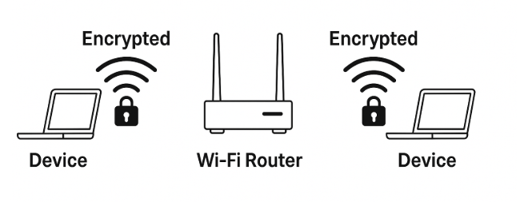
Example: a wifi router
A Wifi password encrypts data going into and out of a router.
Assuming the network uses an encryption technique such as WPA.
Once data has left the router, and is out on the internet, it is no longer encrypted.
Entering a WiFi password triggers a cryptographic process that:
Derives encryption keys
Uses those keys to encrypt your traffic over the air
Ensures nobody nearby can read your traffic just by listening to radio signals
Even if multiple users share the same Wi-Fi password:
Each device gets its own unique encryption key
Two users on the same network cannot normally see each other’s traffic
What does WiFi Password NOT Protect?
Wi-Fi encryption ends once the router sends information outside the network
Router itself can see:
Destination IPs and metadata
Sites visited (domain-level)
Bandwidth usage
Online times
ISP can see: Domains, IP addresses, metadata
True privacy requires HTTPS: Router can see you accessed example.com
But cannot see what you looked at inside the site
Cannot see passwords, messages, etc.
Again: Once the data reaches the router and exits “to the internet”, there is no longer any encryption.
A protocol such as HTTPS is essential for true end-to-end privacy.

Slide 15

Key Distribution Challenge
Secure Key Transmission
One of the most significant challenges in symmetric cryptography.
The secret key must be transmitted through a secure channel to both parties before communication begins.
Challenges in Large-scale Systems
Secure key distribution works well in small settings, but becomes impractical in large networks using pre-shared keys like WPA for Wi-Fi.
Hybrid Cryptographic Solutions
The key distribution problem has led to hybrid systems combining asymmetric cryptography for key exchange and symmetric cryptography for data encryption.
Examples
SSL/TLS protocols use asymmetric public-key cryptography to establish session keys for symmetric encryption in web security.

Slide 16
Substitution ciphers & brute force attacks

Slide 17
Substitution Cipher: e.g. the “Caesar cipher”
Basic Mechanism
Substitution cipher works by enciphering each plaintext letter with a different letter using a fixed key table.
Large Keyspace Limitations
Though the keyspace is large, it does not ensure security because there are many means of cracking the cipher.
Frequency Analysis Attack
Attackers can exploit letter frequency patterns to quickly identify ciphertext symbols and break the cipher.
Lessons for Modern Ciphers
Modern encryption uses confusion and diffusion to hide statistical properties such as frequency analysis, and thereby resist cryptanalysis.
ET TU BRUTE? plaintext
HW WX EUXWH? ciphertext
The Key

Slide 18
Exercise: Decipherment
Using the key below, decipher the following ciphertext:
LORYHLFHFUHDP
Answer:
I LOVE ICE CREAM
The Key

Slide 19
Exercise: Encipherment
Using the key below, encipher the following ciphertext:
Go DePaul!
Answer:
JRGHSDXO
The Key

Slide 20
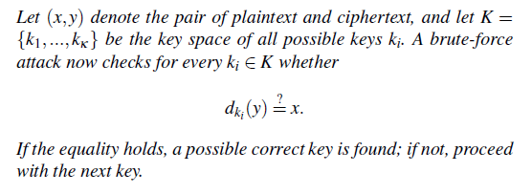
The Ciphertext
Substitution Cipher Cryptanalysis:
Brute-Force Attacks
ET TU BRUTE? plaintext
HW WX EUXWH? ciphertext
Oscar wishes to attack (break) the cipher.
Once an attacker (Oscar) has the ciphertext (e.g. by eavesdropping), and perhaps knows or suspects a part of the plaintext, he can decrypt by checking ALL possible keys. This is known as a “brute-force” attack.
He starts by randomly assigning the ciphertext letter A to ciphertext Q, B to L, C to Z and so on for all letters of the alphabet and sees if that set of substitutions yields a meaningful plaintext. If it doesn’t, he then assigns different letters and tries again.
A brute-force attack against a symmetric cipher is always possible in theory. Whether it will work in practice depends on the size of the keyspace.
The total number of keys, for the Caesar Cipher - known as the keyspace – is made up of 26! (26 factorial) possibilities. →≈ 2⁸⁸ which comes out to:
403,291,461,126,605,635,584,000,000
That’s a LOT of keys to check!!!
The Key
Brute-Force Attack: Exhaustive Key Search
You do not need to study this formula.
It is for descriptive purposes only.

Slide 21
But computers are FAST!!!
Is 2⁸⁸ truly a large keyspace?
Suppose you had 1000 supercomputers working simultaneously, 24 hours a day, 7 days a week (with no Christmas vacation)! How long do you think such a brute-force attack would take?
Answer:
Thousands of years!
On the order of 1-10 hours
On the order of 10-100 days
On the order of 1-10 years
On the order of 10-100 years
None of the above
Computationally Secure: For this reason, we say that this substitution cipher is “computationally secure”. Because the amount of computing time required to break this substitution cipher is far beyond the practical use of doing so, we say that this cipher is “theoretically breakable”, and yet is computationally secure.
As we will see, however, just having a super-large keyspace does not make this simple substitution cipher secure. It turns out that this cipher can be broken by other means…
The Key

Slide 22
How did we calculate the size of the keyspace?
Recall: The keyspace for this substitution cipher has 26! (26 factorial) possibilities. →≈ 2⁸⁸
How did we come up with that number?
Plaintext “A” could be mapped to: A, or B, or C, or D, etc. →
26 possible substitutions – and that’s just for the letter A!
Plaintext “B” could be mapped to B, or C, or D, etc
We don’t include “A” because we already counted it earlier.
So we have 25 possible substitutions.
Plaintext “C” could be mapped to D, or E, or F, etc
We have 24 possible substitutions
Therefore, the total size of the keyspace is: 26 * 25 * 24 * 23 all the way down to 1. We call this “26 factorial” and notate it as: 26!
The Key

Slide 23
Cryptanalysis

Slide 24
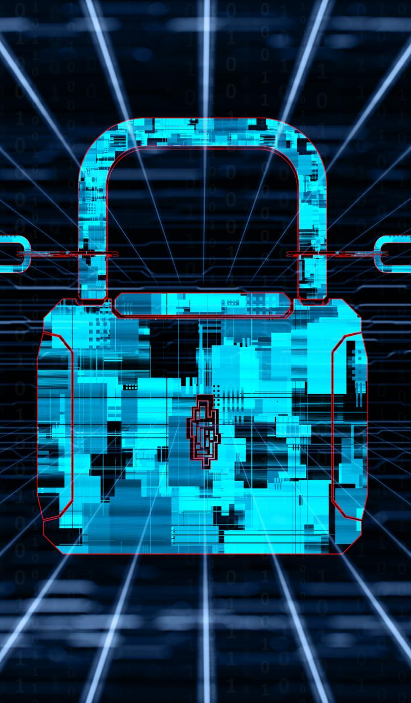
Cryptanalysis: Introduction
Definition and Purpose
Cryptanalysis is the study of breaking cryptographic systems by finding and exploiting weaknesses in algorithms. It is important to study because when “good actors” engage in cryptanalysis, they help improve security by identifying vulnerabilities before adversaries can exploit them.
In other words, the primary goal of cryptanalysis is to evaluate the security of an encryption scheme under various attack models, which helps in designing stronger systems.
Evolution of Techniques
Historically, cryptanalysis has evolved from manual techniques to highly sophisticated computational methods, leveraging mathematical theories and advanced computing power.
Role in Cybersecurity
Understanding cryptanalysis is essential for cryptographers and security professionals because it validates the strength of cryptographic algorithms and ensures they meet security standards. Without rigorous cryptanalysis, cryptographic systems could fail under real-world conditions, leading to catastrophic breaches. This section introduces the concept, its importance in cybersecurity, and its relationship with cryptographic design principles.
Importance in Cryptographic Design
Rigorous cryptanalysis helps ensure that cryptographic systems can withstand real-world attacks and breaches.

Slide 25

some common attack types
There are many, many kinds of attacks, but for substitution ciphers, these are the most common:
Ciphertext-Only Attack
Attackers analyze the ciphertext of the encrypted messages to deduce the original plaintext or encryption key.
Known-Plaintext Attack Using Cribs
Attackers know some pieces of the plaintext (e.g. header information of an encrypted file or email). E.g. “weather report” to U-Boats during WW2. A piece of known plaintext from the enciphered message is known as a “crib”.

Slide 26
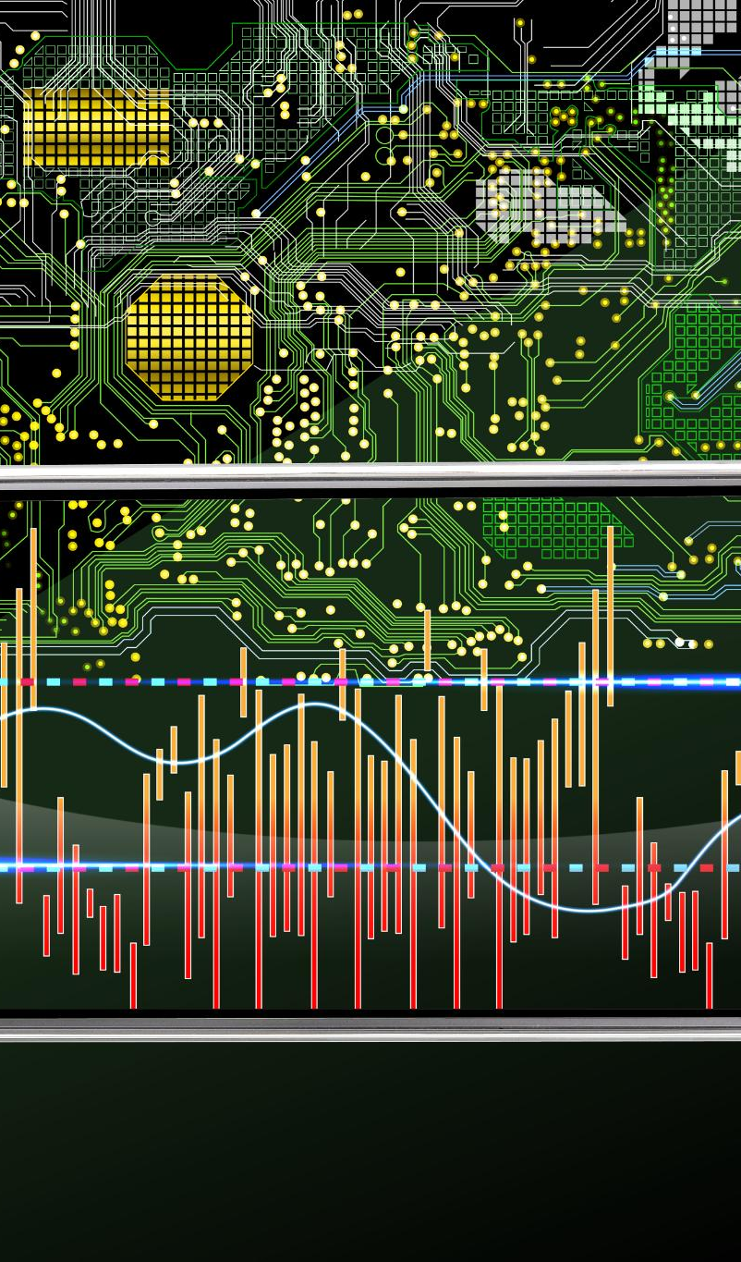
Implementation attacks
Side-Channel Attacks
These attacks analyze leaked information such as power usage or electromagnetic emissions to extract secret keys from cryptographic systems. During the Cold War, the NSA was flabbergasted to realize that pretty much everything from their “secure” areas was sending off electromagnetic emissions (e.g. typewriters!).
Timing Attacks
Timing attacks measure cryptographic operation durations to reveal patterns that correlate with secret key values (e.g. morning weather reports to U-Boats during WW2).
Software Side-Channel Vulnerabilities
Exploiting code execution weaknesses like cache behavior and memory access patterns can lead to secret key exposure.
Mitigation Strategies
Robust defenses might include shielding against emissions, usage of secure coding standards, avoidance of patterns, etc

Slide 27

Social Engineering
Psychological Manipulation
Social engineering exploits human psychology rather than technical vulnerabilities to access sensitive information.
Common Attack Techniques
Phishing, impersonation, and bribery are common social engineering methods targeting users.
Mitigation Strategies
User awareness, security training, policies, and multi-factor authentication reduce social engineering risks.
Social engineering is far and away the most attempted (and effective) form of cyberbreaches in the world today.

Slide 28
Moore’s Law and Cryptanalysis
Moore’s Law and Computing Power
Computing power (i.e. # transistors on a chip) doubles approximately every 18 months, significantly accelerating processing capabilities over time
More transistors: more processing power, lower costs, smaller devices
Not a law of nature – an economic and technological trend
May be slowing down: More of a linear (as opposed to exponential) increase in processing power since the mid-2000s.
Impact on Cryptanalysis
Faster hardware increases feasibility of brute-force attacks, reducing the effective security of fixed key lengths.
Need for Periodic Security Updates
Cryptographers must update key lengths and algorithms regularly to maintain security against advancing computation.

Slide 29
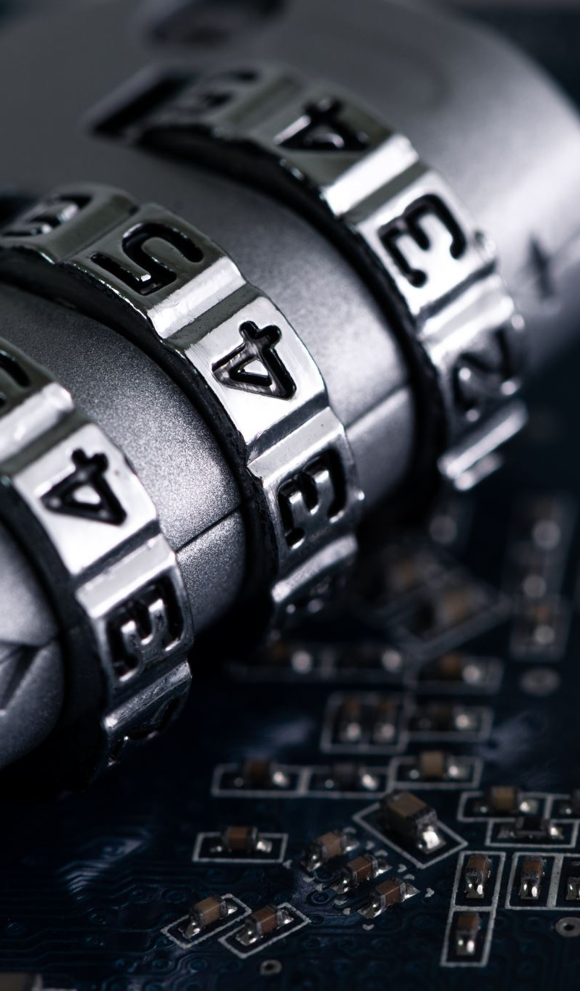
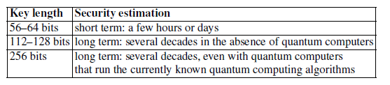
Key Length Recommendations
Importance of Key Length (i.e. key size)
Key length directly influences cryptographic system security by resisting brute-force attacks. That being said, we must always bear in mind that a large keyspace is necessary – but not sufficient – for a secure symmetric cipher.
Recommended Key Sizes
Use keys of at least 128 bits for strong long-term security in cryptographic systems.
Quantum Computing Resistance
256-bit keys offer enhanced protection against potential quantum computing attacks.
Security vs. Computational Resources
Choosing key length balances expected system lifespan and adversaries’ computational abilities.
Estimated time for successful brute-force attacks on symmetric cipher with different key lengths

Slide 30
Modeling computing speed

Slide 31
Quick review of basic exponential notation
Rather than get bogged down in specific numbers (e.g. 2,048,927,465) we will focus exclusively on powers of 10. (e.g. 2,048,927,465 would simply be thought of as a number in the billions, i.e. 10⁹).
10¹ = 10
10² = 100
10³ = 1000
10⁶ = 1,000,000
10⁹ = 1,000,000,000
Just count the zeros!
Examples:
How much bigger is 10⁴ than 10³?
Answer: 10 times as big
2. How much bigger is 10¹⁴ than 10¹³?
Answer: 10 times as big
3. . How much bigger is 10⁵ than 10³?
Answer: 100 times as big
4. How much bigger is 10⁶ than 10³?
Answer: 1000 times as big
5. How much bigger is 10¹⁷ than 10¹¹?
Answer: One million (10⁶) times as big

Slide 32
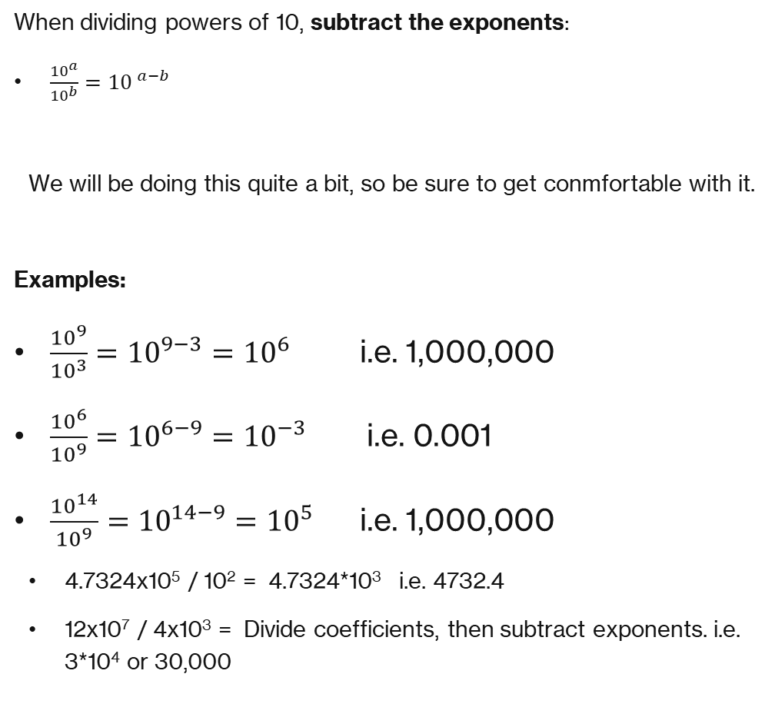
When dividing base-ten powers, simply subtract
When dividing powers of 10, subtract the exponents:
$\frac{{10}^{a}}{{10}^{b}}={10}^{ a−b}$
We will be doing this quite a bit, so be sure to get conmfortable with it.
Examples:
$\frac{{10}^{9}}{{10}^{3}}={10}^{9−3}={10}^{6}$ i.e. 1,000,000
$\frac{{10}^{6}}{{10}^{9}}={10}^{6−9}={10}^{−3} \text{i}\text{.}\text{e}\text{. }\text{0.001}$
$\frac{{10}^{14}}{{10}^{9}}={10}^{14−9}={10}^{5}$ i.e. 1,000,000
4.7324x10⁵ / 10² = 4.7324*10³ i.e. 4732.4
12x10⁷ / 4x10³ = Divide coefficients, then subtract exponents. i.e. 3*10⁴ or 30,000
Exercises:
10² / 10¹
Answer: 10¹, i.e. 10
10¹² / 10⁷
Answer: 10⁵, i.e. 100,000
10² / 10³
Answer: 10⁻¹ i.e. 0.1
6.022x10²³ / 10¹⁹
Answer: 6.022*10⁴
4.2x10⁶ / 2x10⁴
Answer: 2.1x10² or 210

Slide 33
Modeling Computer Speed
In this course we will very very often make references to the time needed for computers to break a cipher.
For the rest of this course, we’re going to make a deliberately simplified assumption: We will estimate that a computer that can perform one billion very simple operations per second. (10⁹ operations / second)
This is not a claim about any particular laptop, CPU, or GPU — it’s just a round number that lets us reason, come up with crude estimates, and gain a sense of scale.
At that speed, a single operation takes 1 billionth of a second, a.k.a. one nanosecond. That’s already unimaginably fast.
As we scale up:
A thousand operations (10³) → takes a microsecond.
A million operations (10⁶) → takes a millisecond.
A billion operations (10⁹) → takes a second.
What about an almost unimaginably large number such as a quadrillion? How long do do 10¹⁵ operations??? → About 17 minutes. (That’s a coffee break).

Slide 34
Modeling Computer Speed: timing formula
To reason about processing time, we assume a computer performs a fixed number of simple operations per second.
A rule of thumb commonly employed is to assume that a modern computer can perform about 1 billion (10⁹) operations per second (10⁹ ops/sec).
Time to complete a task = # of Operations / Speed (# of ops/second)
Reminder: While computer scientists frequently use these kinds of calculations, they are very crude estimates. They are very important in enabling us to get a sense of scale. However they are not intended to be treated as accurate real-world times.

Slide 35
Assuming 1 billion operations per second (10⁹ ops / sec)
Examples:
Assuming a computer that does about 1 billion operations per second:
How long to do 1 operation?
Answer: Time = # ops / speed → 1 op / 10⁹ ops / second = 10⁻⁹ seconds (i.e. 1 nanosecond).
Example: How long do to 1,000 (10³) operations?
Answer: Time = #ops/speed → 10³ / 10⁹ = 10⁻⁶, i.e. 1 millionth of a second, i.e 1 microsecond.
Example: How long to do one million operations?
Answer: 1 million = 10⁶ → 10⁶ / 10⁹ = 1/1000th of a second, or 1 millisecond
Example: How long do to 10¹⁴ operations?
Answer: 10¹⁴ / 10⁹ = 10⁵ seconds, i.e. 100,000 seconds (or about 28 hours).
Don’t forget that this 10⁹ assumption is only a crude estimate, and should not be intended for “accurate” calculations.

Slide 36
Exercises Assuming 1 billion operations per second (10⁹ ops / sec)
How long does it take to perform 10⁴ operations?
Answer: Time = # ops / speed →10⁴ / 10⁹ = 10⁻⁵ seconds = 0.00001 seconds (or 10 microseconds) → Note: I don’t expect you to memorize “micro” vs “milli” vs “nano” seconds.
How long to perform 10⁷ operations?
Answer: 10⁷ / 10⁹ = 10⁻² seconds = 0.01 seconds
How long to perform 10¹⁰ operations?
Answer: 10¹⁰ / 10⁹ = 10¹ seconds = 10 seconds
How long to perform 10¹² operations?
Answer: 10¹² / 10⁹ = 10³ seconds = 1,000 seconds ≈ 16.7 minutes
How long to perform 10¹⁶ operations?
Answer: 10¹⁶ / 10⁹ = 10⁷ seconds ≈ 116 days ≈ about 4 months
For any value in seconds over 500, convert to either minutes, hours or days.
Here is a convenient key:
1 minute = 60 seconds
1 hour = 3600 seconds
1 day = 86400 seconds
1 year = 3.154x10⁷ seconds

Slide 37
What is an “operation”
A computer “operation” can have a number of different meanings depending on context. For our purposes (e.g. brute-force attacks in cryptography), we will think of an operation as checking one value in the search space to see if it matches the key we are looking for.
As a less abstract example, imagine that we are looking for the PIN to a safe. If a PIN is 4 digits (0000 through 9999), there are 10,000 possible PINs to open the safe.
An operation would involve generating a candidate PIN, and testing it on the safe.
If a human could attempt 1 PIN every 5 seconds, it would take them a maximum of 50,000 seconds (about 833 minutes or 13.9 hours) to attempt all PINs. So we know they would figure out the PIN in at most 50,000 seconds.

Slide 38
What One 'Key Test' Represents
When trying to brute-force attack a cipher, an operation would involve generating a candidate key, and then testing it against the ciphertext to see if it gives a plausible plaintext. (We could ask the computer to check the first 50 characters to see if they look like English language text as opposed to gibberish).
So a brute-force key test typically includes:
Generating a candidate key.
Testing that key on the ciphertext (to see if the output is plausible).
Note: For simplicity’s sake, we will treat all of this as a single operation when estimating computing times.
Note: Key searches are often highly parallelizable and GPU-friendly. (More on this later)

Slide 39
Working with “bits”
Assuming 10⁹ ops/second:
10¹² operations → about 16.7 minutes
10¹⁵ operations → about 11.6 days
10¹⁸ operations → about 31.7 years
As we all know, under the hood, computers work with “bits”, i.e. values that are either a 1 or a 0.
For example, if a password was 1 bit long, the password would be either a 0 or a 1. ie. a keyspace of size 2.
If a password was 3 bits long, the complete list of possible values for the password (in binary form) are: 000, 001, 010, 011, 100, 101, 110, 111 → Notice that there are 8 possible passwords if the password is 3 bits long.
In other words, if the number of bits is represented by ‘n’, the the keyspace size is: 2^{n}
Example: If a key is 8 bits long, how many possible values (permutations) are there? Put another way, how large is the keyspace?
Answer: 2⁸ = 256
Example: If a key is 16 bits long, how many possible values are there? (i.e. How large is the keyspace?)
Answer: 2¹⁶ = 65536
Example: If a key is 32 bits long, how large is the keyspace?
Answer: 2³² = 4,294,967,296
Example: The famous DES standard used a 56-bit password. How large is the keyspace?
Answer: 2⁵⁶ = 7.21*10¹⁶
No exercises for this as it is quite straight-forward. But do make sure you can do these on your calculator as you may be asked to do them on exams.

Slide 40
Timing calculations for a Brute-Force cyberattack
Example: A password encoded with a 56-bit key has 2⁵⁶ ≈ 7.2 × 10¹⁶ possible values.
Assuming our reference speed of 10⁹ keys per second, how long to search the entire keyspace?
Answer:
Recall our formula:
Time to complete a task = # of Operations / Speed (# of ops/second)
Time = 7.2 × 10¹⁶ operations / 10⁹ operations/second → 7.2 x 10⁷ seconds
= 72,000,000 seconds (or about 833 days) to check every single possible value.
Note: The 833 days represents a maximum (upper bound) time. In practice, we would typically find the correct key before checking the entire keyspace. On average, the expected time is half of this, or about 1.15 years. We will discuss this distinction shortly.

Slide 41
Larger Operation Counts
If we assume 10⁹ operations per second, which again, is a reasonable assumption on modern computers:
10¹² operations → or “12 orders of magnitude” → 1,000 (i.e. 10³) seconds, or about 16.7 minutes.
10¹⁵ operations → or “15 orders of magnitude” → 1,000,000 (i.e. 10⁶) seconds, or about 11.6 days.
10¹⁸ operations → or “18 orders of magnitude” → 10⁹ seconds, or about 31.7 years.
Large operation counts quickly become impractical even on very fast machines.
Example: Assuming a standard modern computer (i.e. 10⁹ ops / second), estimate how long (at most) it would take for that computer to search a keyspace of 10⁹ possibilities. Consider each keyspace search as 1 operation.
Answer: Since a computer can do about 10⁹ ops/second, the 10⁹ operations should take about 1 second.
Example: Assuming a standard modern computer, estimate how long it would take (at most) for that computer to search a keyspace of 10¹⁰ possibilities.
Answer: We know that a computer can do about 10⁹ ops/second. The key thing to recognize here is that 10¹⁰ is 10 times as many operations 10⁹. So this should take about 10 seconds.
Example: Assuming a standard modern computer, estimate how long it would take (at most) for that computer to search a keyspace of 30,200,000,000,000
Answer: Convert to orders of magnitude: 3.02x10¹³. → 3.02x10¹³ / 10⁹ = 3.02x10⁴ or 30,200 → 30200 seconds is probably best converted in to hours: 30200/3600 = 8.4 hours at most.

Slide 42
Exercises
Seconds Conversoins:
1 minute = 60 seconds
1 hour = 3,600 seconds
1 day = 86,400
1 year = 3.15x10⁷ seconds
1 century = 3.15x10⁹ seconds
As was done previously:
Assume a standard modern computer can perform 10⁹ operations per second.
Consider each keyspace check as 1 operation.
When appropriate, provide your answers as hours, days, or years.
Exercise: Estimate how long (at most) it would take to search a keyspace of 10¹¹ possibilities.
Answer: Since a computer can do about 10⁹ ops/second: 10¹¹/10⁹ = 10² or 100 seconds.
Exercise: Estimate how long (at most) it would take to search a keyspace of 10¹² possibilities. NOTE: Do NOT do this by our regular division formula. Instead, reference the previous question abut searching a keyspace of size 10¹¹ and recall that the answer was 100 seconds. If so, how long do you think it will take to search 10¹² keys?
Answer: 10 times 100 seconds, i.e. 1,000 seconds.
Exercise: Estimate how long (at most) it would take to search a keyspace of 6,500,000,000,000 possibilities. Answer in minutes.
Answer: 6.5x10¹² / 10⁹ = 6.5x10³ seconds, i.e. 6,500 seconds, or about 108 minutes.
Exercise: Estimate how long (at most) it would take to search a keyspace of 10¹⁷ possibilities. Answer in years.
Answer: 10¹⁷ / 10⁹ = 10⁸ = 100,000,000 seconds = which turns out to be about 3.17 years.

Slide 43
What do we mean by “at most”?
Consider our question from a moment ago: “Assuming a standard modern computer estimate how long it would take (at most) for that computer to search a keyspace of 10,200,000,000,000? ”.
Why do we say “at most”?
The reason is that if we are looking for a value, in a keyspace of a certain size, once we have gone through the entire keyspace, we are certain to find it. (We assume that the key is in there somewhere). However, we will almost never have to search the entire keyspace. Sometimes we will find the item much earlier in the search, sometimes much later in the search. So to get a more realistic sense of the search time, we typically say, “How long on average will it take….”.
Consider that a search through a keyspace of 10¹² possible values takes about 16.7 minutes. This is the worst case scenario. We will almost certainly find the key before having to go through the entire keyspace. In other words, it will rarely take the entire time to find the value we are looking for. Instead, we would report that on average, the search would take half of that time, i.e. 8.35 minutes. This is because in half of all searches we would find the item in less than 8.35 minutes, and in half of searches we would find it in more than 8.35 minutes.
Keep this in mind. We will typically ask for and report “average” search times.

Slide 44
Example & Exercise:
Assuming 10⁹ ops/second:
10¹² operations → about 16.7 minutes
10¹⁵ operations → about 11.6 days
10¹⁸ operations → about 31.7 years
Recall: If the number of bits is represented by ‘n’, the the key size (in bits) would be: 2^{n}
Example: If a password is 32 bits long, how long on average would it take a computer to check the keyspace?
Answer: 2³² = 4,294,967,296 possible combinations. → We’d have to check 4,294,967,296 values. If a computer can do 10⁹ ops/second, then this would take about: 4,294,967,296 / 10⁹ = 4.3 seconds to search every possible value in the keyspace. But remember that sometimes we will find the value in the first half of the keyspace, and sometimes in the second half. In other words, on average we would find it in half of the maximum time of 4.3 seconds, which comes out to 2.15 seconds.
Exercise: Okay, let’s use a 40-bit key. If a password is 40 bits long, how much time on average, would it take a computer to check the keyspace?
Answer: 2⁴⁰ = 1,099,511,627,776 → 1099511627776 operations. If a computer can do 10⁹ ops/second, then this would take about: 1.099511627776x10¹² / 10⁹ = 1.1*10³ seconds (i.e. 1100 seconds). But remember that this assumes searching the entire keyspace. On average we would find it in half that time, of 550 seconds (less than 10 minutes).
Seconds Conversions:
1 minute = 60 seconds
1 hour = 3,600 seconds
1 day = 86,400
1 year = 3.15x10⁷ seconds
1 century = 3.15x10⁹ seconds

Slide 45
Example & exercise
Assuming 10⁹ ops/second:
10¹² operations → about 16.7 minutes
10¹⁵ operations → about 11.6 days
10¹⁸ operations → about 31.7 years
Example: “DES” (Data Encryption Standard) came out in the 1970s, and was THE encryption standard for decades. It used a 56-bit key, so was thought to be computationally secure. How long would it take on average for a modern computer (assuming the usual 10⁹ ops/sec) to search a keyspace for a 56 bit key? Answer in days. Note: There are 86,400 seconds in a day.
Answer: 2⁵⁶ = 7.2*10¹⁶, i.e. 16 orders of magnitude. So we have 7.2*10¹⁶ operations. How long will it take to do this number of operations. Recall that modern computers can do about 10⁹ ops/second. 7.2*10¹⁶ / 10⁹ = 7.2*10⁷ seconds. 7.2*10⁷ / 86400 = about 833 days. This is the maximum time. On average, it would be half of that or about 416 days.
Wait – that’s over a year! Isn’t this key probably safe?
Answer: Not really – one year of computation is feasible for well-funded attackers. Similarly, if we made use of parallel computing, we can reduce this time considerably.
Exercise: Suppose we invest in parallel computing hardware. So instead of 10⁹ ops/second, we can do 10¹² ops per second. Now how long would it take to search a 56-bit keyspace?
Answer: : 2⁵⁶ = 7.2*10¹⁶ = 7.2*10¹⁶ operations. 7.2*10¹⁶ / 10¹² = 7.2*10⁴ seconds → Dividing 72000 by 3600 (seconds in an hour), we have about 20 hours max, or 10 hours on average.
Seconds Conversions:
1 minute = 60 seconds
1 hour = 3,600 seconds
1 day = 86,400
1 year = 3.15x10⁷ seconds
1 century = 3.15x10⁹ seconds

Slide 46
Modeling Computer Speed: larger and larger orders of magnitude
We will see that certain ciphers have evolved to generate tremendously large keyspaces with sizes that are beyond human comprehension.
Let’s continue with our timing estimates from before:
10¹⁵ operations→ About 11.6 days
Let’s go up just 3 orders of magnitude, from 10¹⁵ to 10¹⁸ → Now we go from 11.6 days to about 32 years!
When we add even a single bit to a key, we are not making the computer work “a little harder”, we are in fact multiplying the work by two. That is, we are doubling the size of the keyspace!
- Put another way: Adding bits doesn’t simply add time, it multiplies time!
That’s why a cipher can go from ‘instantly breakable’ to ‘effectively impossible’ just by increasing the key size.
Throughout the course, whenever we estimate how long something takes, we’re doing this exact kind of reasoning — not precise benchmarks, just scale.
Cryptography sometimes can live or die on scale.

Slide 47
Each additional bit doubles the work
Each additional key bit doubles the required work.
56 bits → (2⁵⁶≈7.2058×10¹⁶) → ~2.3 years at 10⁹ ops/sec.
57 bits → ~4.6 years.
58 bits → ~9.2 years.
Big-Picture Concept: Brute-force search time grows exponentially, not linearly.

Slide 48
Even with faster computing…
Suppose we make use of a GPU that increases our operations 1000 times, i.e. from 10⁹ ops/sec to 10¹² ops/sec
Even so….
Each additional key bit doubles brute-force time.
At 10¹² keys per second:
56 bits → 20 hours (~ 10 hours average)
60 bits → ~13 days (~ 6.7 days on average)
64 bits → ~ 213 days (~106 days on average)
80 bits → tens of thousands of years
128 bits → effectively impossible.

Slide 49
Yeah but what about moore’s law? Aren’t computers getting faster all the time?
Yes, but while computers have consistently gotten faster and faster over time…
Longer keys grow exponentially.
Exponential growth very, very quickly overwhelms any realistic hardware gains.
This is why:
40-bit keys are trivial to break
56-bit keys – once a “standard” are now obsolete
128-bit and 256-bit keys are still considered secure against brute-force attacks.

Slide 50
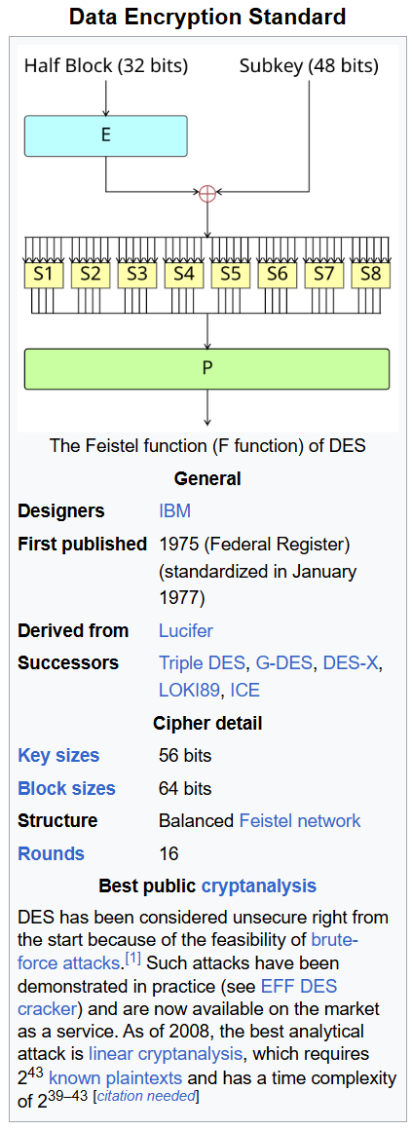
Data encryption standard (des)
DES is a very well known, and long-used encryption standard. It was developed in the 1970s and uses a 56-bit key.
Why DES was considered secure (at first)
In the 1970s computers were millions of times slower
A year of computation was astronomically expensive
Brute force felt unrealistic for large keyspaces
So DES was believed to be safe at least for the foreseeable future.
Why DES fell:
Computers got faster
Linear hardware improvements
Clock speeds, parallelism, custom chips
Parallelism became cheap
A brute-force key search is embarrassingly parallel. In other words, we can have multiple computers divvy up the keyspace and each computer searches its own section.
If 1 computer takes 1 year:
10 computers take ~36 days
1,000 computers take ~9 hours
Custom hardware can do far more

Slide 51
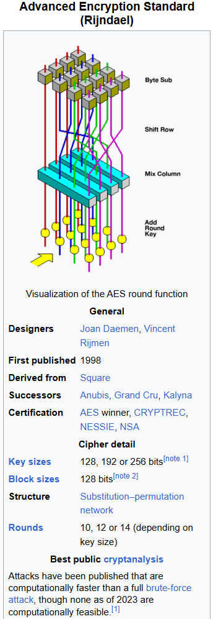

advanced encryption standard (aes)
AES was developed as the replacement for DES.
Main difference:
AES supports 128-bit, 192-bit, and 256-bit keys
Even 128 bits gives:
$2^{128}≈3.4×{10}^{38}$ possible keys
At that scale:
Brute force is completely infeasible
Even with absurd parallelism
Even for nation-states
Still considered secure today (at least from brute-force attacks)

Slide 52
What is a nanosecond? video featuring admiral grace hopper
Admiral Grace Hopper
https://youtu.be/wHdHCoeUbU4?si=D3wLjLHSFHj25qyh&t=1207
From 20 minutes to 23 minutes
Brief 60 Minutes segment about Admiral Hopper (if you’re interested in learning more about this remarkable woman).
https://www.youtube.com/watch?v=1LR6NPpFxw4

